Slide 1
LEAD Portal: a TeraGrid Gateway and Application Service Architecture
Marcus Christie and Suresh Marru
Indiana University
LEAD Project (http://lead.ou.edu)

Slide 2
Overview
Introduce LEAD
Enabling technologies
  Capability based authorization framework
  Application Service Model
  BPEL based workflow system
Current issues/Future Work

Slide 3











Slide 4
The LEAD Goal
Provide the IT necessary to allow
People (scientists, students, operational practitioners)
and
Technologies (models, sensors, data mining)
TO INTERACT WITH WEATHER

Slide 5
LEAD Empowers Users to…
Identify, locate, access, decode, mine, visualize, store and manage observational data and model output independent of their format or physical location
Create, monitor, analyze/mine and visualize simple to very sophisticated WRF (Weather Research and Forecasting model) analyses and forecasts including pre-scheduled and on-demand runs
Change the configuration of an experiment automatically, during execution, based upon specified trigger conditions
Add their own tools and observational data
By…
Operating within a web browser portal that is highly intuitive and requires nominal local resources
Using local and/or remote computing resources including those that are grid enabled

Slide 6
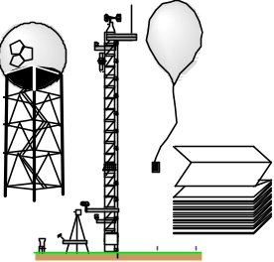
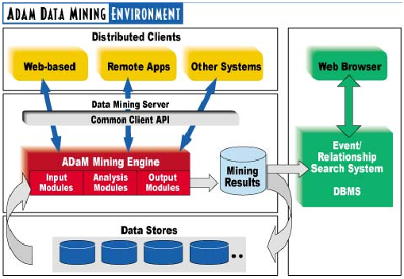


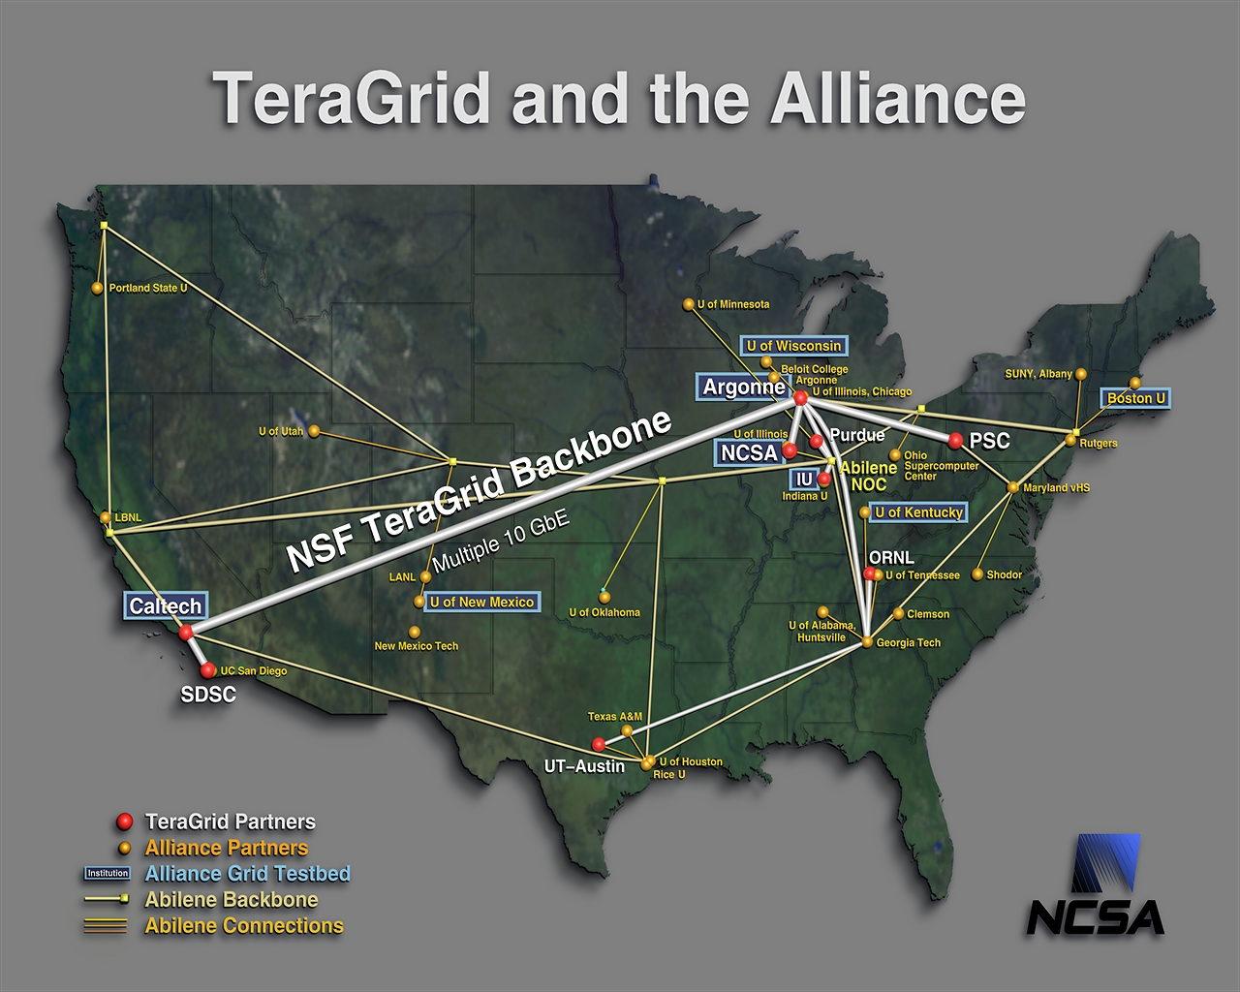
Example: “Optimal” Weather Prediction Using Dynamic Adaptivity
Storms Forming
Forecast Model
Streaming
Observations
Data Mining
On-Demand
Grid Computing

Slide 7
LEAD Architecture
User
Interface
LEAD Portal
Desktop Applications
IDV
WRF Configuration GUI
Crosscutting
Services
Visualization
Workflow
Education
Browse
Control
MyLEAD
Portlets
Ontology
Query
Monitor
Control
Client Interface
Application Resource
Broker (Scheduler)
Workflow
Monitor
Stream
Service
Control
Service
Authorization
Workflow
Services
Configuration and Execution Services
Application & Configuration Services
Workflow
Engine/Factories
Query
Service
Ontology
Service
Data Services
Authentication
Host Environment
Execution Description
Application Host
Application Description
VO Catalog
Decoder/Resolver
Service
Transcoder Service/ ESML
Catalog
Services
GPIR
Geo-Reference GUI
WRF, ADaM,
IDV, ADAS
THREDDS
Monitoring
Resource
Access
Services
Grid FTP
Scheduler
OPenDAP
Generic
Ingest Service
OGSA-
DAI
SSH
LDM
RLS
GRAM
Notification
Distributed
Resources
Observations
Streams
Static
Archived
Specialized
Applications
Steerable
Instruments
Data Bases
Computation
Storage
Notes:
This is the architecture slide that we came up with at NCSA in December and amazingly enough, it has stood the test of time – though frankly we’ve not subjected it to a ton of scrutiny until now. I can say, however, that the first step of CP#3 does indeed touch things that we had included. The only thing I had to add was the Geo-Reference GUI under the configuration and execution services layer.
Ideally, the next slides would be the wiring diagrams that all of you have produced showing the guts of the various services and how they all fit together. I don’t know if we need to do that…..perhaps something a bit more basic, like that shown above, would suffice…maybe something with arrows. The main thing is for us to capture all of the connectivity and capability that must exist in order for the steps in CP#3 to actually happen.

Slide 8
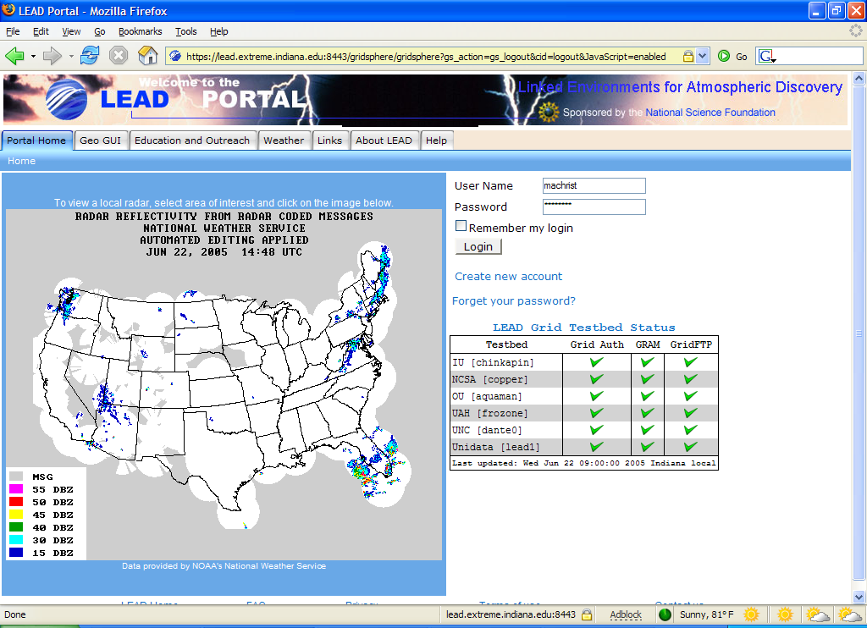
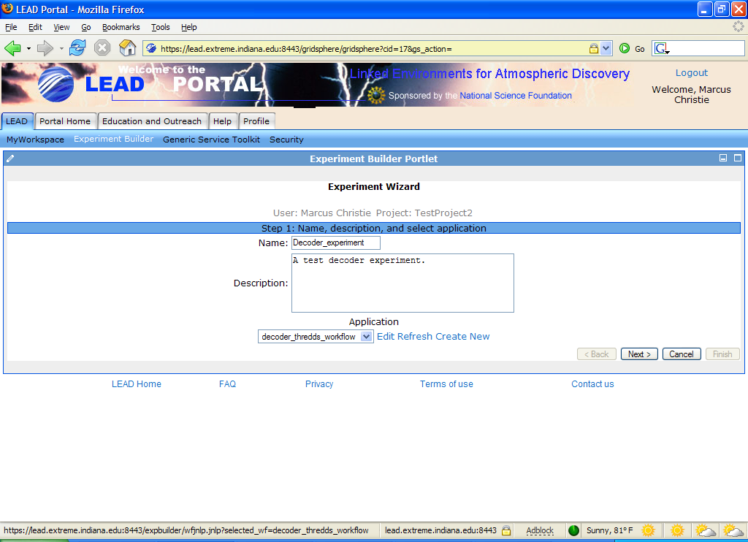
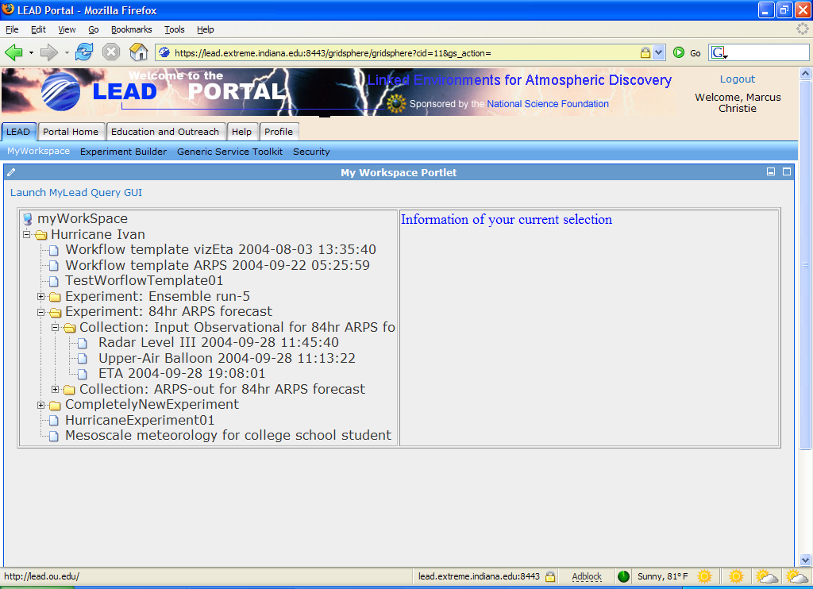
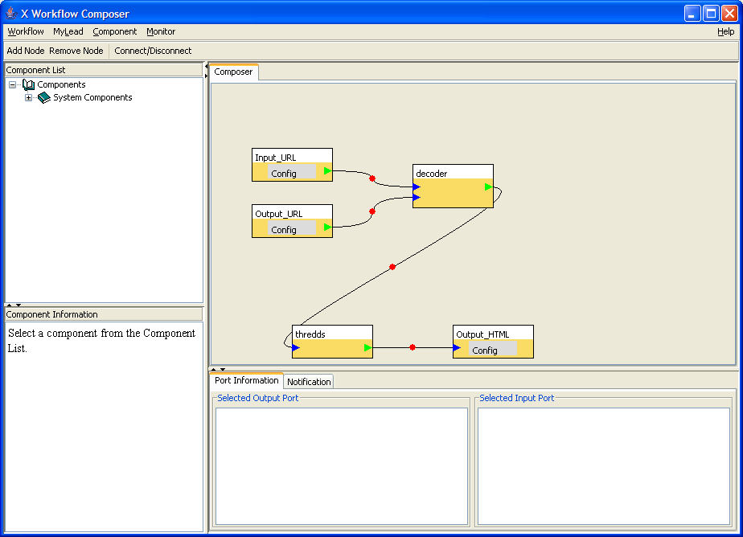
LEAD Portal

Slide 9
Enabling Technologies
Capability based authorization framework
Application Service Model
BPEL-like workflow system

Slide 10
Capabilities
A capability includes:
  Policy Document
    Bindings of the provider’s distinguished name (DN), as well as the users’ DNs.
    Identifier of the Grid resource.
      Optional: operations of a Web service instance
    Life time (notbefore, notafter)
  The provider’s signature generated with his private key.
Security Assertion Markup Language (SAML):
    Each capability is a set of SAML assertions
    AuthorizationDecisionStatement
However the policy document and protection mechanism can be extensible: XACML, symmetric keys, …

Slide 11
Capabilities: Big Picture
Provider
User
capability
token
Capability
Manager
Portlet
Proxy
Manager
Portlet
Weather
Service
Portlet
Weather
Service
capability
token
proxy
certificate
proxy
certificate
capability
token
capability
token
capability
token
Grid Portal
User Context

Slide 12
Enabling Technologies
Capability based authorization framework
Application Service Model
BPEL-like workflow system

Slide 13
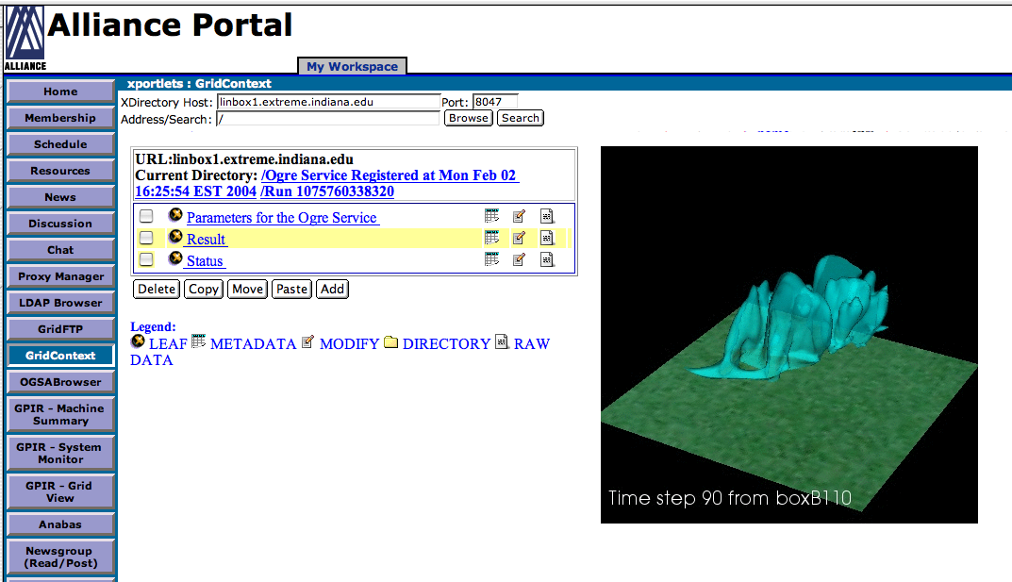

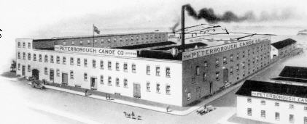
The Portal Factory Service Generator
Start with
  A Deployed Application
    A script to run it.
    A list of all needed input files
    A list of all generated output files.
Write a AppService Document
  Upload this to the portal Factory generator in the portal.
A new Factory is started for you.
  A portal client interface to the factory is also automatically generated.
Upload
AppService Doc
Browser
https
Portal
Server
Create and
Launch factory
App Factory

Slide 14
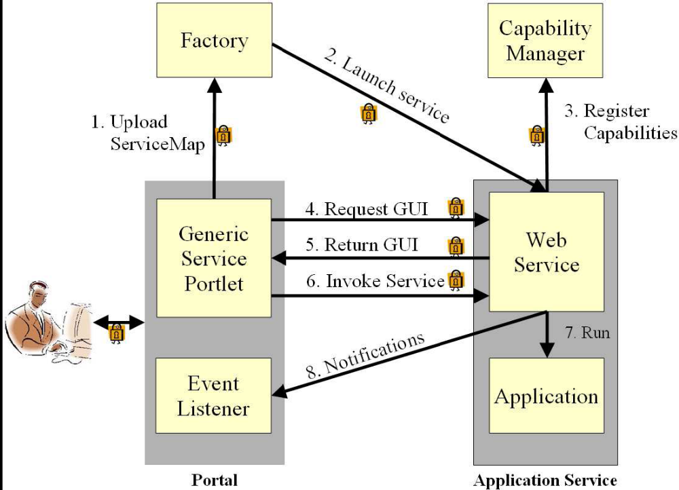
Application Services

Slide 15
Enabling Technologies
Capability based authorization framework
Application Service Model
BPEL workflow system

Slide 16
Composing Workflow In the Portal
An interactive workflow composer (WebStart)
  Component database and workflow compiler is provided by the grid service
    which also provides the interface tool.
  MVC pattern.
  Composer allows
    Component selection
    from library
    Drop and drag place-
    ment and connection
    establishment
    Save and load graph
    functions.

Slide 17
Running Workflow
Submit workflow to workflow engine
Portal supplies workflow engine with user’s capabilities
Workflow engine invokes services
Notification messages are logged to the portal
Workflow output is catalogued

Slide 18
Future Work
Accounting
Transparent certificate/capability management for users
Integrating with the BPEL engine
Community grid account usage and policy

