Slide 1
The GENIUS grid portal
Roberto Barbera
University of Catania and INFN
Science Gateways Workshop at GGF14, Chicago, 28.06.2005

Slide 2
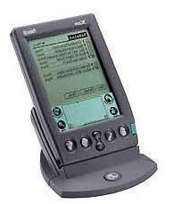
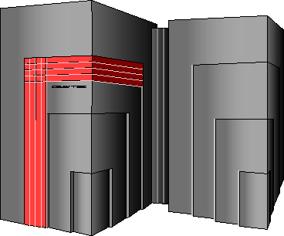
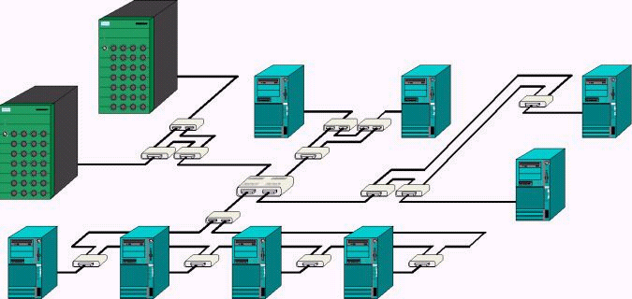
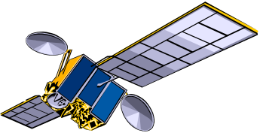
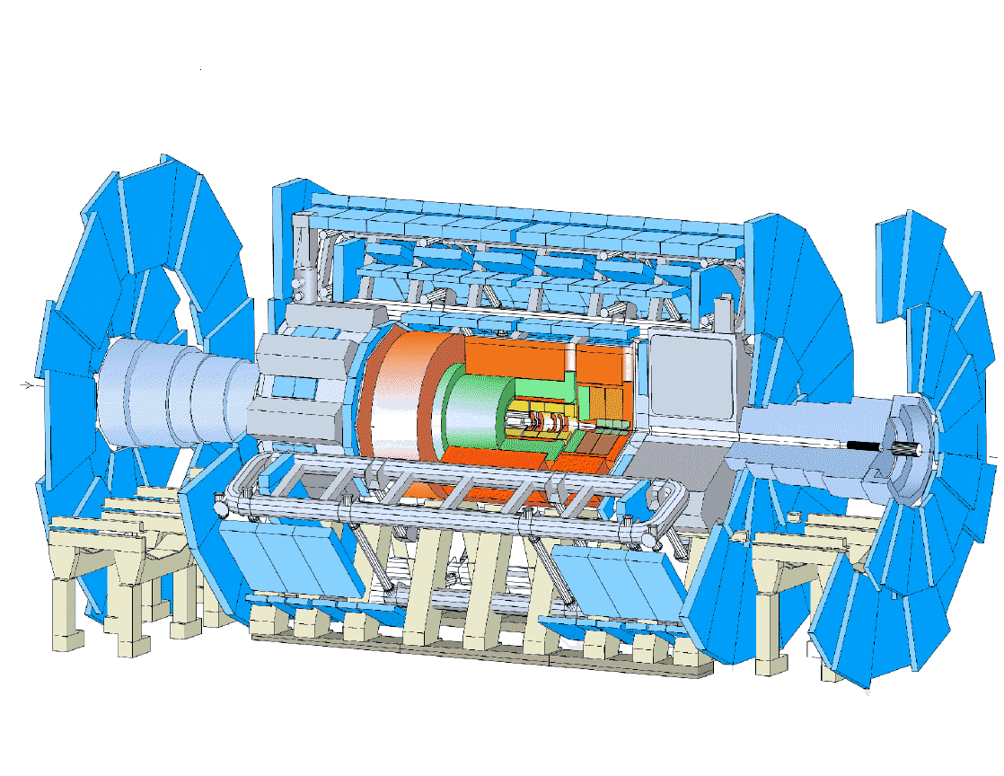
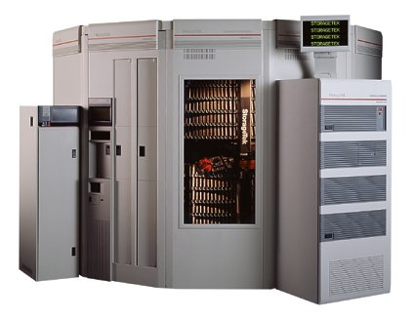
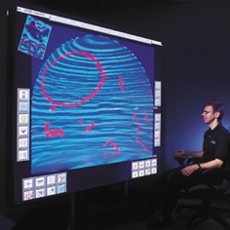

The Grid metaphor
Mobile Access
G
R
I
D
M
I
D
D
L
E
W
A
R
E
Supercomputer, PC-Cluster
Workstation
Data-storage, Sensors, Experiments
Visualising
Internet, networks

Slide 3
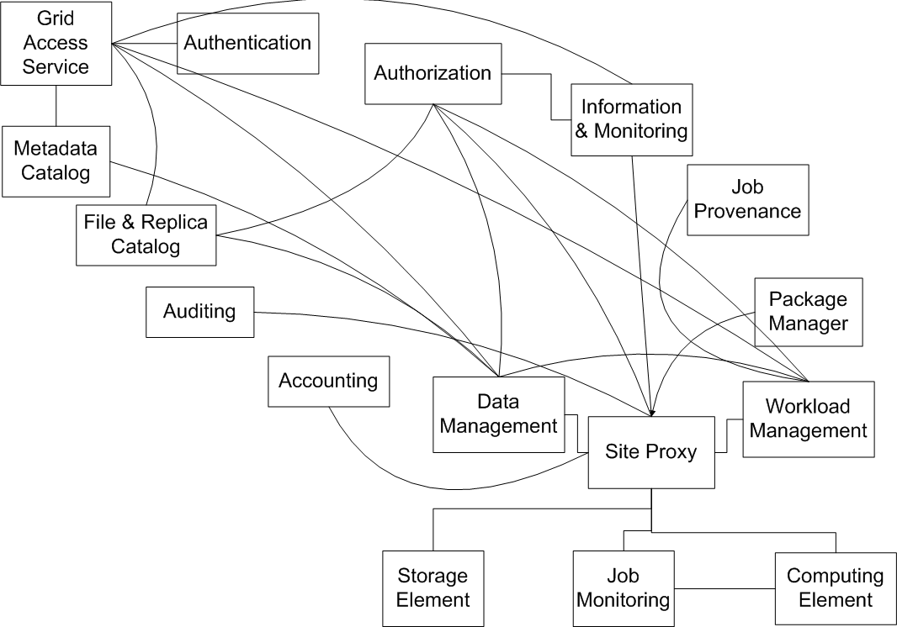







Grid services interplay
Replica
Catalogue
UI
JDL
Input “sandbox”
DataSets info
Information
Service
Output “sandbox”
grid-proxy-init
Resource
Broker
SE & CE info
Author.
&Authen.
Expanded JDL
Output “sandbox”
Job Submit Event
Job Query
Job Status
Input “sandbox” + Broker Info
Publish
Globus RSL
Storage
Element
Job Submission
Service
Job Status
Logging &
Book-keeping
Compute
Element
Job Status

Slide 4
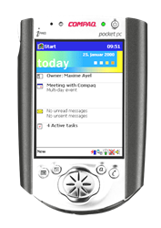


The transparent grid access
VO
colleague
VO
colleague
local
disk
Replica
Catalogue
Resource
Broker
UI
disk
Storage
Element
Storage
Element
Storage
Element
Compute
Element
Compute
Element

Slide 5
GENIUS: how it works
https+java/xml+rfb
GENIUS
WEB Browser
EnginFrame
Local
WS
3-tier model
Apache
UI
M/W+GSI
the Grid

Slide 6





EnginFrame as Grid Gateway
Portlet
Contaiers
3rd party
Apps
RSS
Clients
JSR168*
WSDL/SOAP
HTTP
End users
Skins / Themes
Portlet GW
WS GW
RSS GW
ISV 1 - XML
Application Kit
XSL Transformation engine
Single-Sign-On
Authentication – ACL management
ISV n - XML
Application Kit
GUI
Virtualization
Custom XML
Application Kits
Accounting
/ Billing
Data Management & Virtualization
Grid Middleware
(Globus, LSF, SGE, …)
File systems
(AFS, NFS, …)
WS Client
applications
Internal
HW/SW
On-demand
HW/SW
Storage
WS
Servers

Slide 7
Relevant features (upcoming in 4.1)
Security
  Flexible authentication delegation (NIS, LDAP, AD, AFS, GSI, …)
  User mapping (one to many, many to many, many to one)
  Fine grained authorization system (up to option level)
  Session-level Token management
  Support for HTTPS encryption
Connectivity
  GridML abstraction to connect to the Grid (LSF, Globus, etc.)
  Portlet Integration kit for WebSphere and Oracle Portal
  Integration with Citrix NFuse for SSO and application publishing
  Integration with VNC
  RSS2.0 Feeder
Data Management
  Working directory is virtualized via the “spooler” concept
  Select, add, remove, zip, tar actions on spooler data
  Automatic, renewable time-to-live management for spoolers
  Session variable management
Usability
  Flexible remote file/item browsing
  Multiple file upload & download (required client-side Java support)
  Context-based parameter expansion
  Xforms 1.0 support
  Correlation between job & data
Performance and scalability
  Service output caching
  Support for Web farms

Slide 8
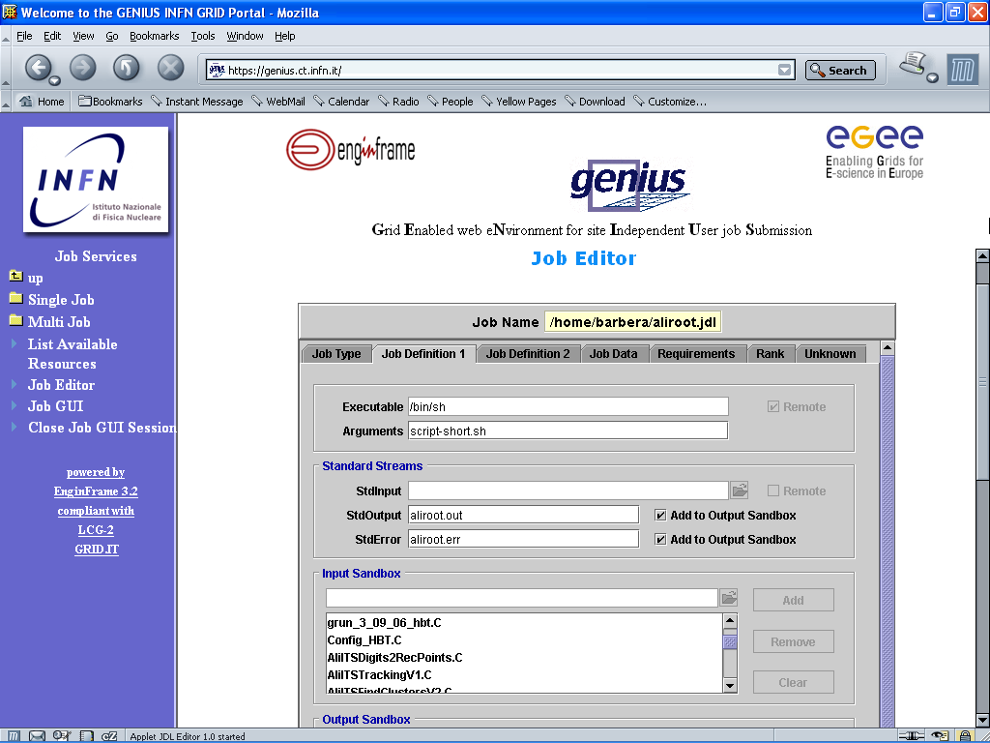
GENIUS graphic job editor
(work in collaboration with DATAMAT)

Slide 9
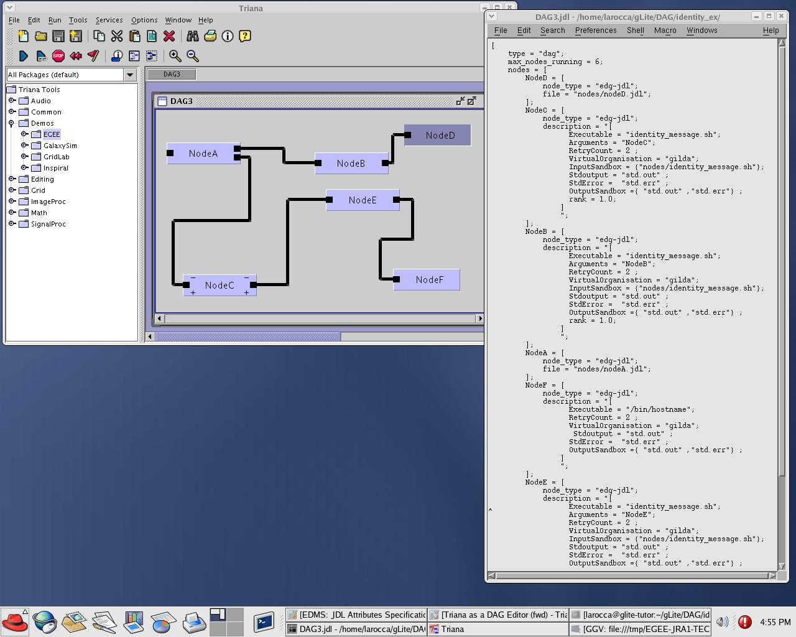
An example of integration: complex workflows (GENIUS & TRIANA)

Slide 10
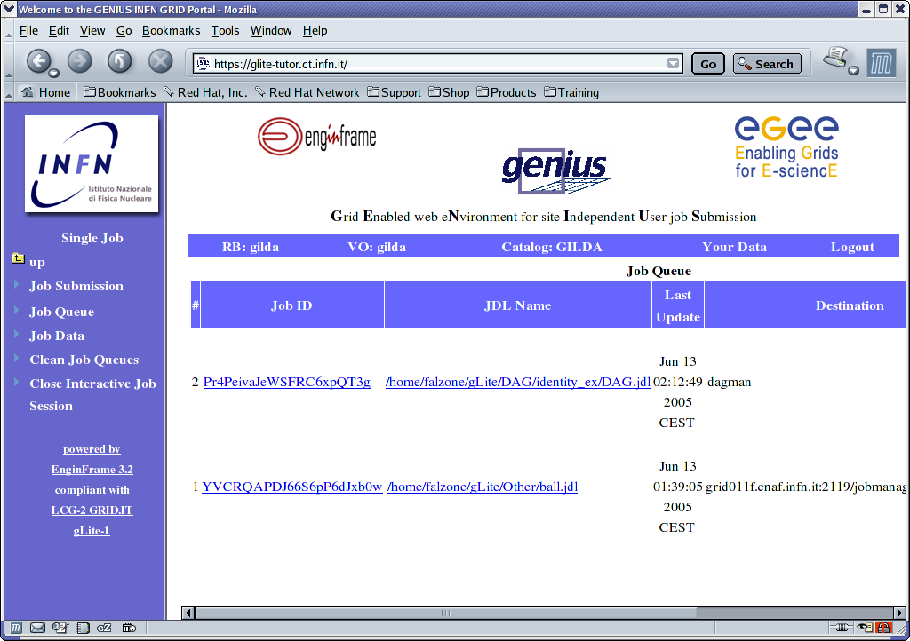
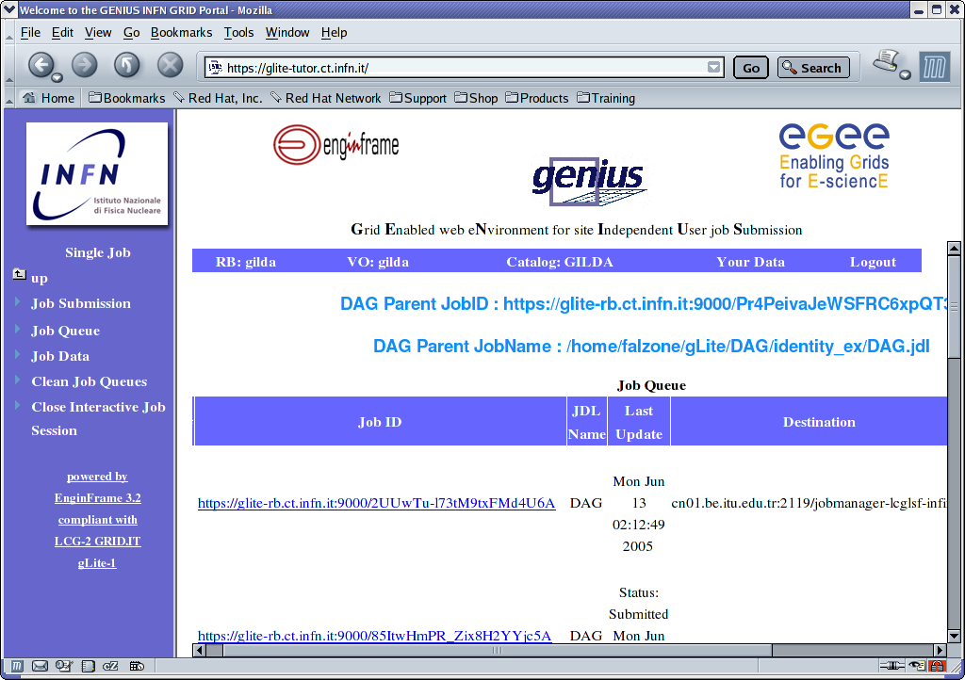
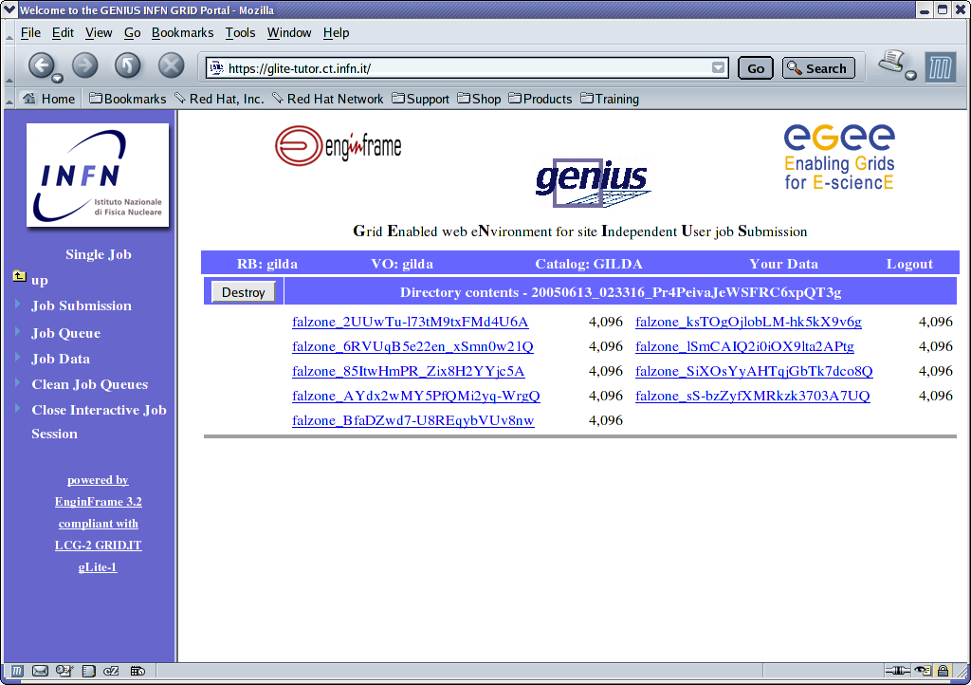
DAGs in GENIUS

Slide 11
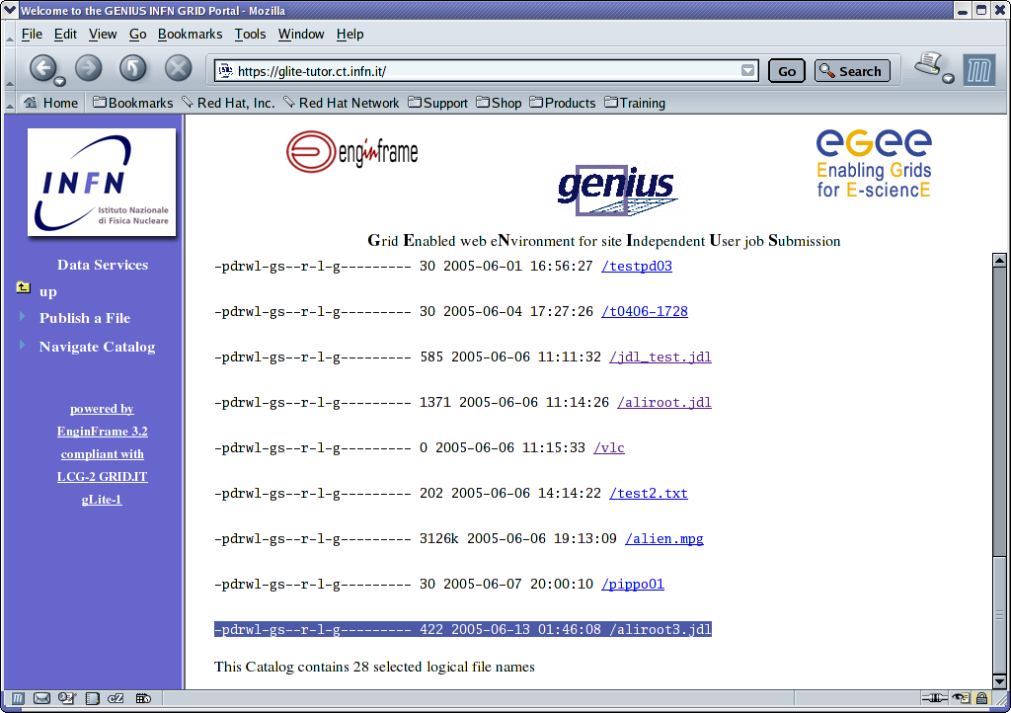
GENIUS data browsing

Slide 12
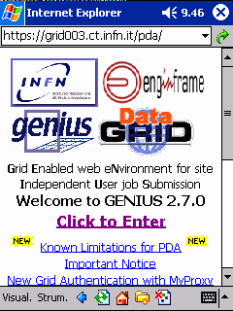
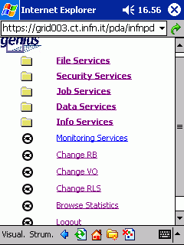
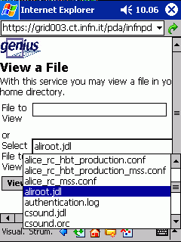
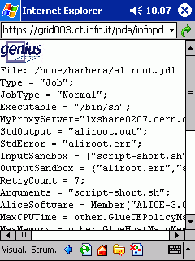
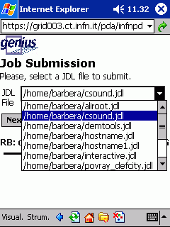
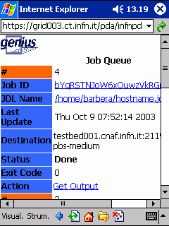
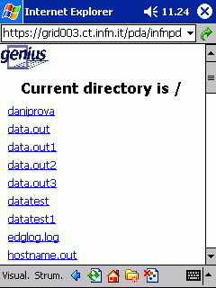
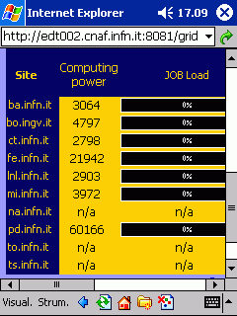
GENIUS for PDA

Slide 13
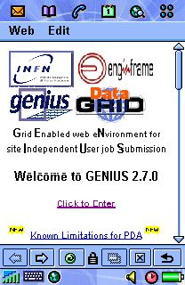
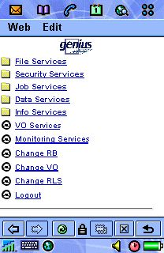
GENIUS for cell phone

Slide 14
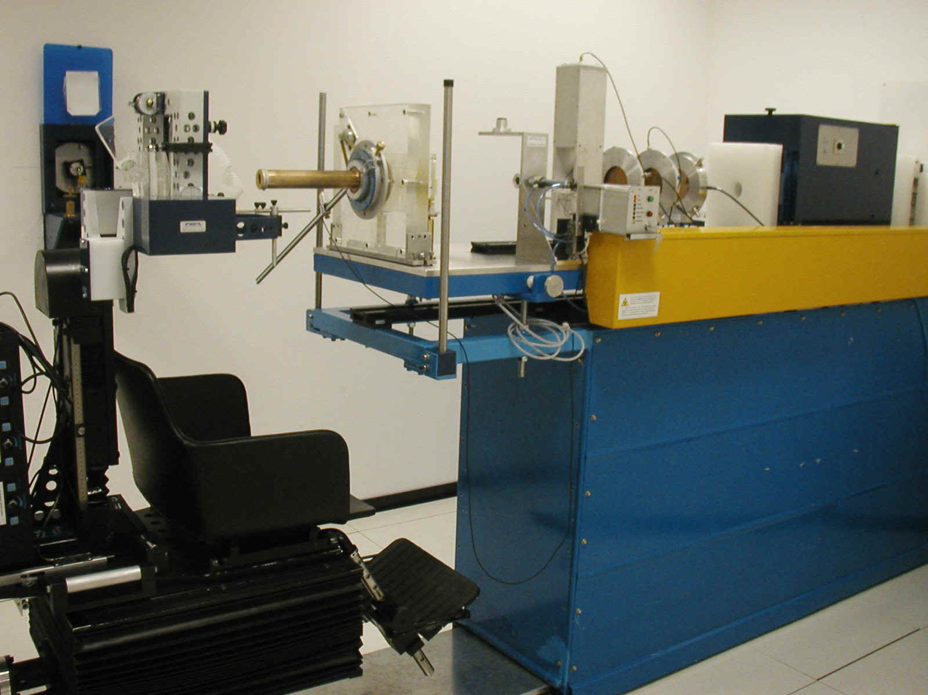
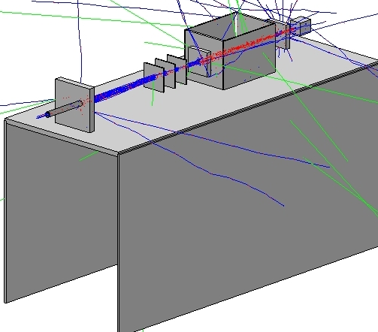
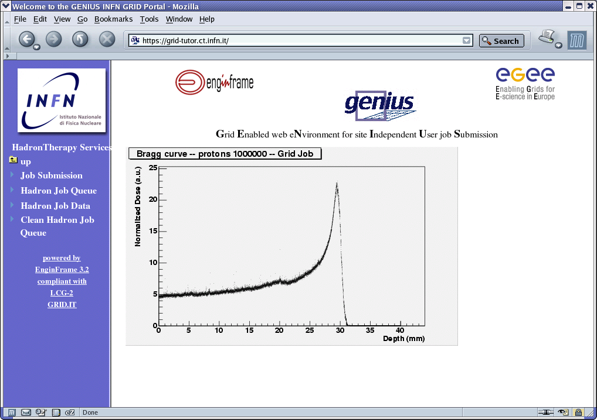
hadronTherapy example
CATANA beam line in reality
hadronTherapy in
GENIUS
CATANA beam line simulated by hadronTherapy

Slide 15
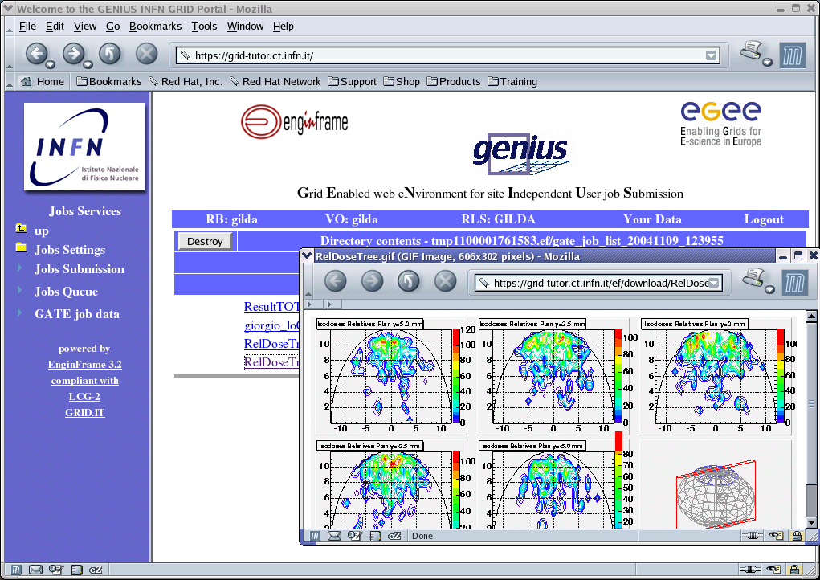
GATE example
Application-specific
services in GENIUS

Slide 16
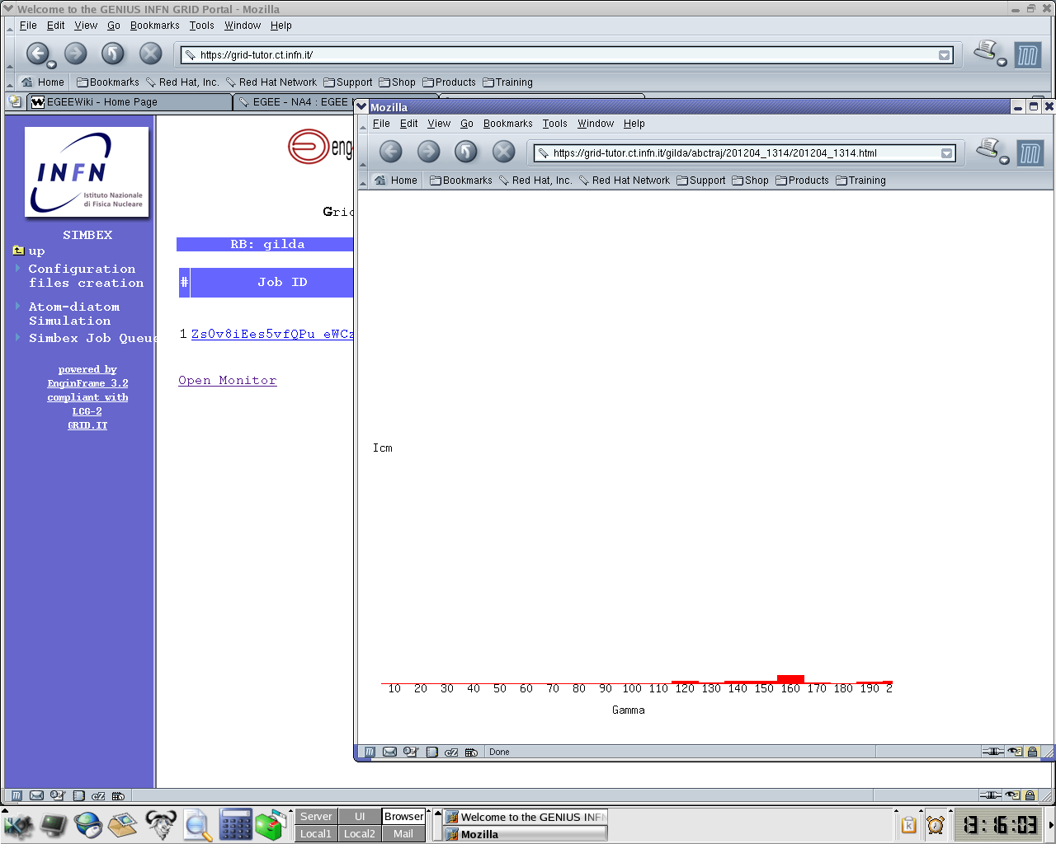
GEMS example
Interactive
MPI jobs !
Application-specific
services in GENIUS

Slide 17
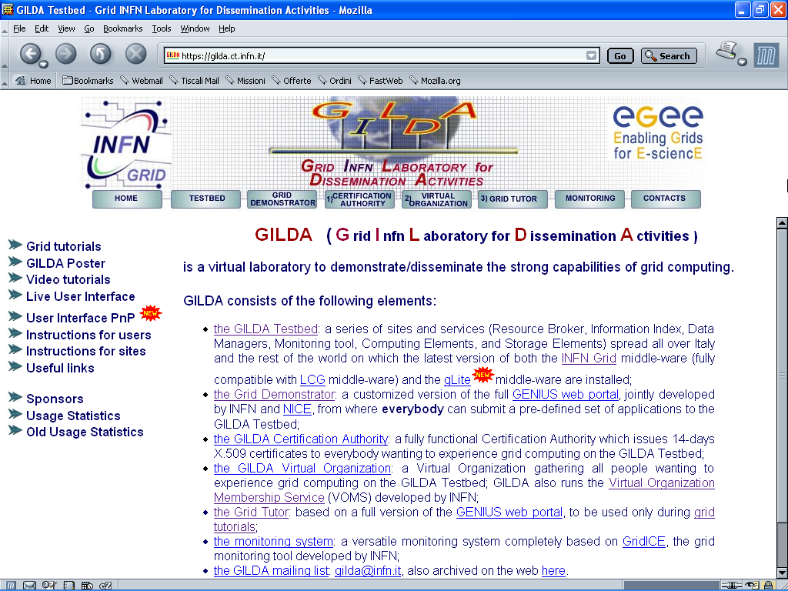
The GILDA project
(https://gilda.ct.infn.it)

Slide 18
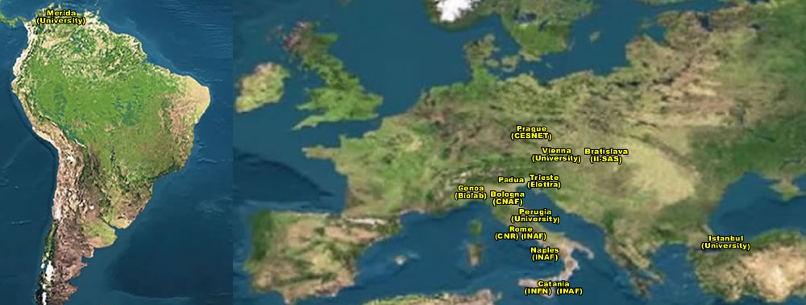
The GILDA Test-bed
(https://gilda.ct.infn.it/testbed.html)
15 sites in 3 continents !

Slide 19
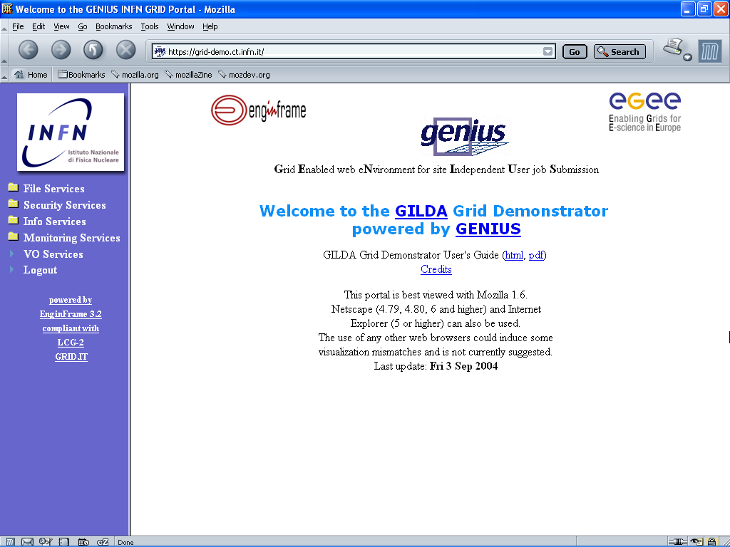
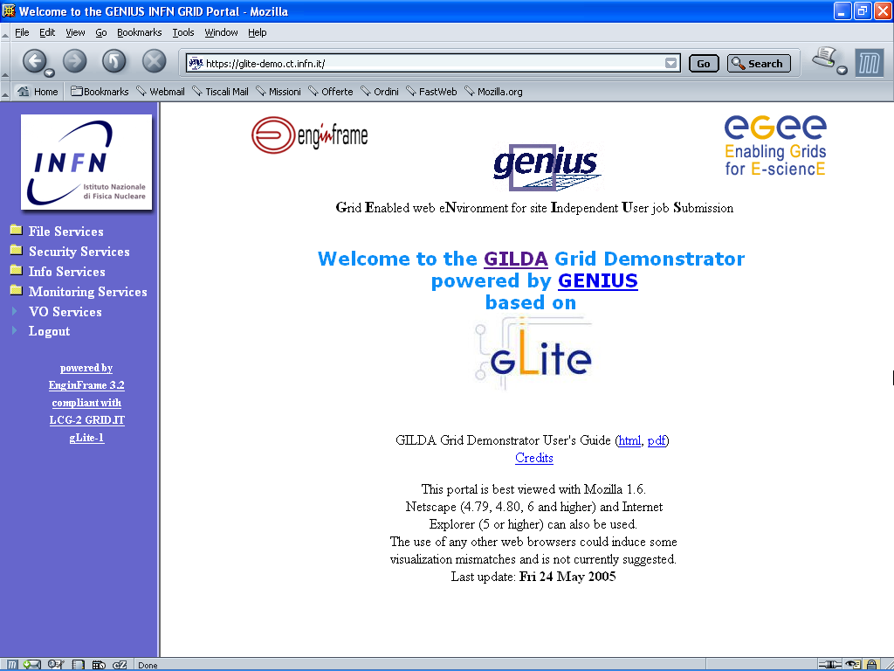
The Grid Demonstrator (1/2)
(https://grid-demo.ct.infn.it, https://glite-demo.ct.infn.it)

Slide 20
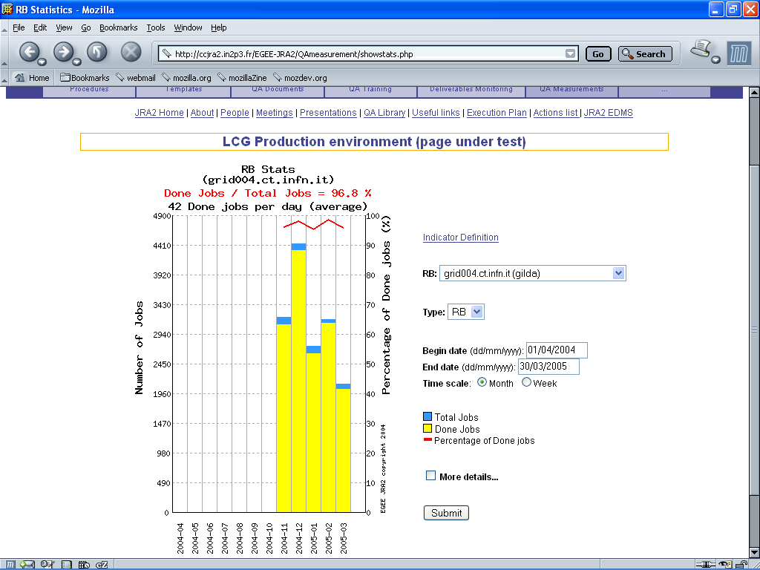
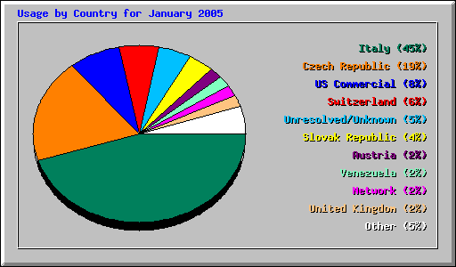
GILDA summary numbers
15 sites in 3 continents
> 1540 certificates issued, 15% renewed at least once
> 45 tutorials and demos performed in 15 months
> 40 jobs/day on the average
Job success rate above 80%
> 600,000 hits (35,000 visits) on (of) the web site from 10’s of different countries
> 385 GB of videos and UI’s
downloaded from the web site

Slide 21
EGEE-NA4 Applications and GILDA
7 Virtual Organizations supported:
  Biomedicine (Biomed)
  Earth Science Academy (ESR)
  Earth Science Industry (CGG)
  Astroparticle Physics (MAGIC)
  Computational Chemistry (GEMS)
  Grid Search Engines (GRACE)
  Astrophysics (PLANCK)
Development of complete interfaces with GENIUS for 3 Biomed Applications: GATE, hadronTherapy, and Friction/Arlecore
Development of complete interfaces with GENIUS for 4 Generic Applications: EGEODE (CGG), MAGIC, GEMS, and CODESA-3D (ESR) (successfull demos of EGEODE and GEMS at EGEE review)
Development of complete interfaces with GENIUS for 16 demonstrative applications available on the GILDA Grid Demonstrator (https://grid-demo.ct.infn.it)
Development of complete interface with CLI for NEMO

Slide 22
Who uses EnginFrame?
Mechanical
  Ferrari, Audi, BMW, FIAT Auto, Elasis, Magneti Marelli, Toyota
Manufacturing
  Bridgestone, Procter & Gamble, Galileo Avionica
Oil&Gas
  TOTAL, Slavneft
Electronics
  STMicroelectronics, Accent, SensorDynamics, Motorola
Biotech
  ENEA
Telecom
  Telecom Italia
Research
  ASSC, CCLRC, CERN, CILEA, CINECA, CNR, CNRS/IN2P3, ENEA, FzU, ICI, IFAE, INFN, ITEP, JSC G.G.M., KU Leuven, SSC-Russia, SDSC
Education
  Dresda University, Ferrara University, Messina University, Politecnico of Milan, Technische Universität Dresden, Trinity College Dublin, S-PACI

