Slide 1
Grid activities in relation to Africa
Vincent Breton, CNRS

Slide 2


Grid federation of databases for telemedecine and epidemiology
Added value:
- no central repository
- queries on federation of databases
- privacy protected
- telemedecine
Hospital
Country B
International organization
Country A
Epidemiology
Hospital
Country E
Hospital
Country C
Hospital
Country D

Slide 3
Grid federation of databases for clinical trials
Pharmaceutical laboratory /
International organization
Country A
Added value:
- no central repository
- queries on federation of databases
- privacy protected-
Hospital
Country B
Drug / Vaccine
assessment
Hospital
Country E
Hospital
Country C
Hospital
Country D

Slide 4
Projects starting on EGEE in relation to world health development
Deployment of a grid platform for in silico drug discovery
  Search for new drugs against malaria and dengue on protein targets identified by genomics research
  Partners: Swiss Bioinformatics Institute, SCAI Fraunhofer, CNRS, Swiss Biogrid initiative, Auvergne regional grid
Grid enabled telemedecine for medical development
  Development of neurosurgery in poverty regions of western China
  Ophthalmology in Burkina-Faso
    Collaboration with Schiphra dispensary (Ouagadougou, Burkina Faso)
Grid for crisis management
  Provide NPO organizations with relevant information and infrastructure to improve crisis management
    Access to information, management tools, …

Slide 5
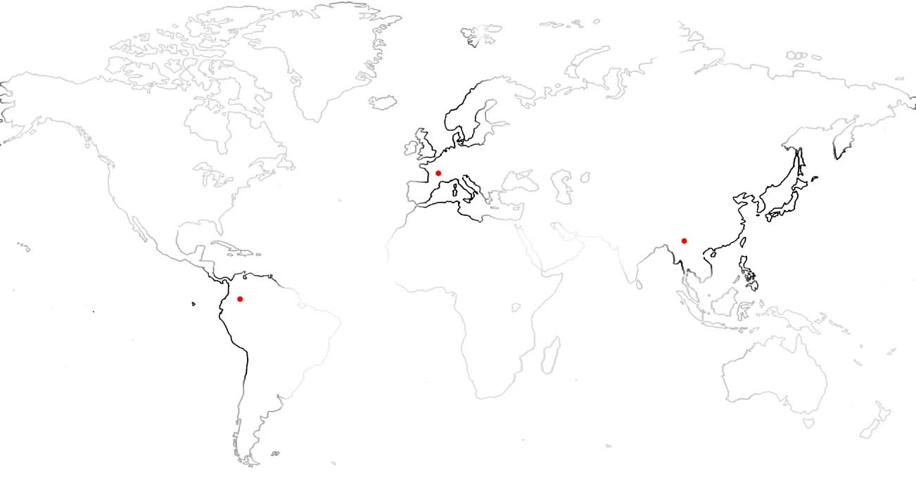
Grids for rare diseases and diseases of the developing world
An open-source shot in the arm?
June 10th 2004, The Economist print edition www.economist.com/displaystory.cfm?story_id=2724420
In silico drug discovery process
Support to local centres in plagued areas (genomics research, clinical trials and vector control)
European grid infrastructures
Local research centres
in plagued areas
The grid impact :
Computing and storage resources for genomics research and in silico drug discovery
Cross-organizational collaboration space to progress research work
Federation of patient databases for clinical trials and epidemiology in developing countries

Slide 6
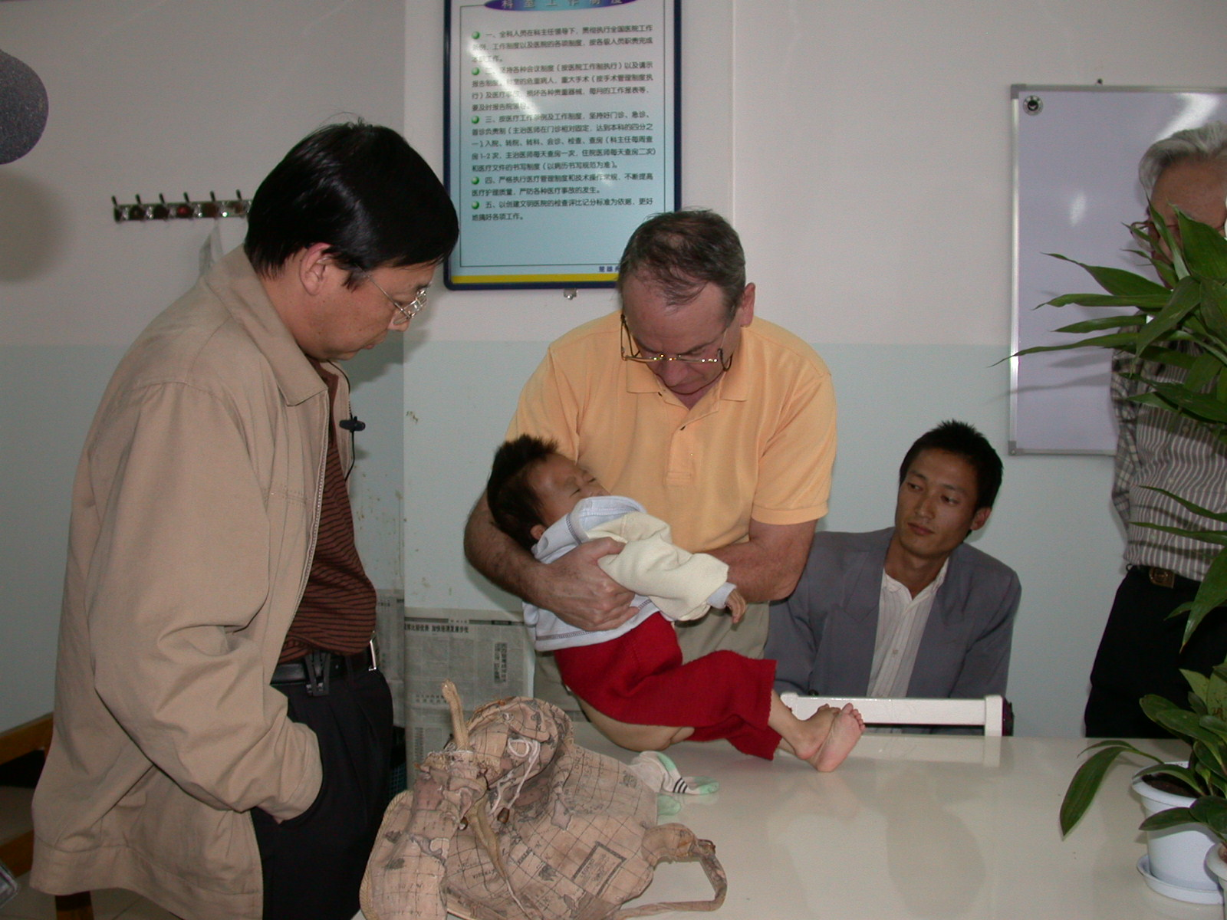
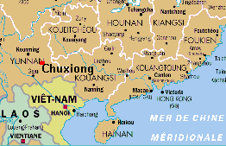
Grid-enabled telemedecine for medical development
Collaboration: NPO Chain of Hope, n°9 Hospital Shanghaï (neurosurgery unit), Chuxiong Hospital (Yunnan), CNRS-IN2P3, Clermont-Ferrand hospitals
Goal: improve patient follow-up
by french clinicians
Method: grid-enabled telemedecine web application

Slide 7
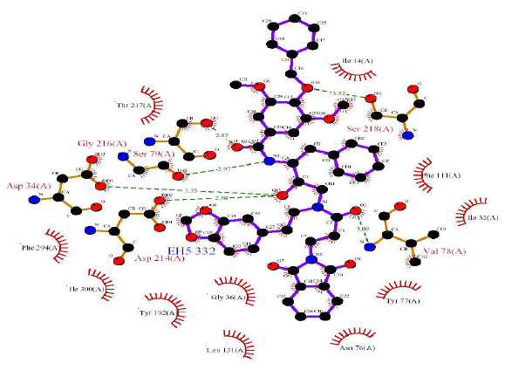
WISDOM : Wide In Silico Docking On Malaria
Scientific objectives
Demonstrate to the research communities active in the area of drug discovery the relevance of grid infrastructures
  Biological goal : Proposition of new inhibitors addressed to neglected diseases.
  Biomedical informatics goal : Deployment of in silico virtual screening on the grid
  Grid goal : Deployment of a CPU consuming application generating large data flows to test the grid infrastructure and services.
Method
  Large scale molecular docking on malaria
  to compute million of compounds with
  some software and parameters settings.
  Docking is about computing the binding
  energy of a protein target to a library of
  compounds using a scoring algorithm. It is
  a filtering step in the drug discovery process

Slide 8
Conclusion
Grid technologies promise to change the way organizations tackle complex problems by offering unprecedented opportunities for resource sharing and collaboration
Applied to world health development, grids should
  Help monitor epidemics
  Strenghthen R&D on neglected diseases
  Grant easier access to eHealth
We are looking for joint pilot projects
  Build a federation of databases to address 1 infectious disease (epidemiology, clinical trials, vector control)
  Provide computing power to R&D on a disease
  Grid enabled medical development, in conjunction with e-learning

