Slide 1
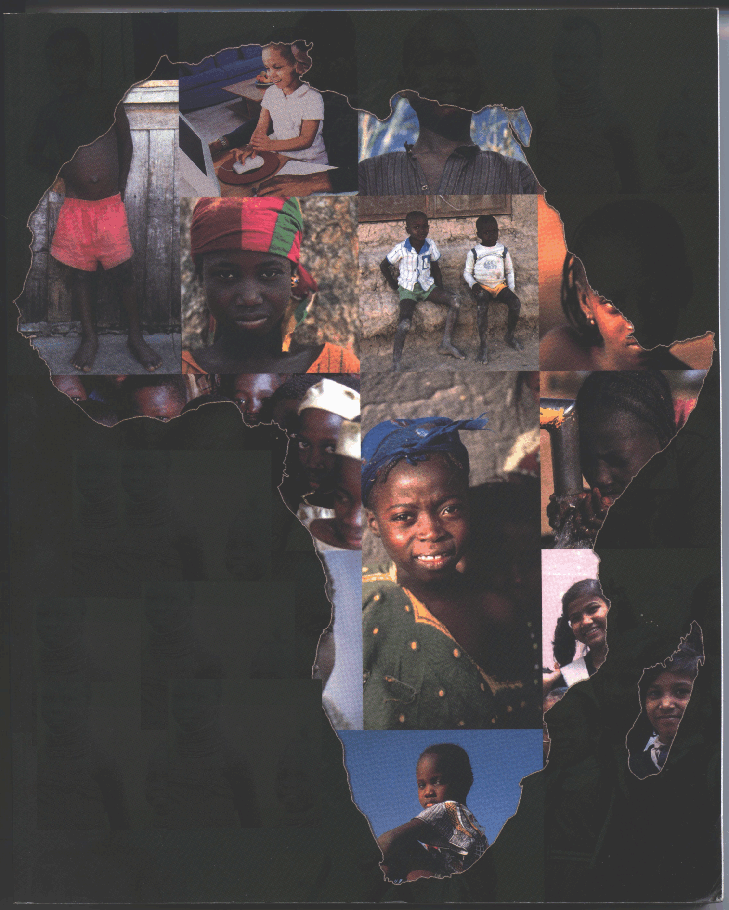
Building a Research and Education Grid in Africa
James Turner - Virginia Tech
Historically, technologically advanced communities have demonstrated the highest rates of economic development, the highest commitment to democratic values, and have created an enduring and sustainable quality of life in the communities they serve.
The World Bank

Slide 2



Current Programs & Infrastructure Development
AIMS
African Institute for the Mathematical Sciences
Khanya Project
Women Leadership Program
Maths, Science and Technology Academy
and
The In-Service Teacher Institute
Sunstep Program

Slide 3
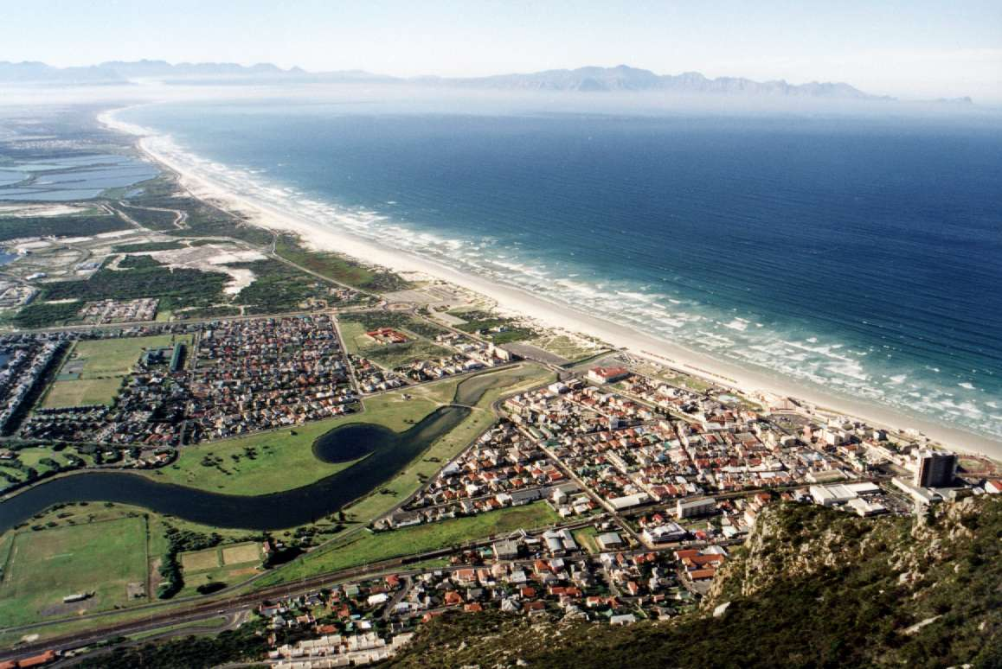
African Institute for Mathematical Sciences
AIMS
Initial Goals
  Develop indigenous innovative talent
  Develop Alumni that will become catalyst for progress in Africa
  Provide a nine month multi/inter-disciplinary diploma
  Develop problem-solving skills, using a hand-on approach, with exposure to many exciting fields

Slide 4
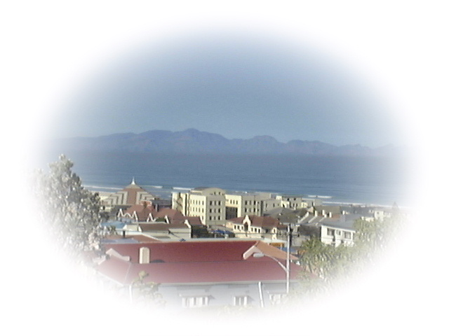
AIMS Council
AIMS
African Institute for Mathematical Sciences
Partners
Jan van Bever Donker
  University of the Western Cape
Hendrik Geyer
  University of Stellenbosch
Fritz Hahne
  AIMS Institute Director
Daya Reddy
  University of Cape Town
Graham Richards
  University of Oxford
Neil Turok
  University of Cambridge (Chair)
Vincent Rivasseau
  University of Paris-Sud-XI
James Turner
  Virginia Tech
Council for Scientific and Industrial Research
Department of Science and Technology
of South Africa
Stellenbosch Institute for Advanced Study
Sun Microsystems
The Vodacom Foundation

Slide 5
A Critical Need for African
Science & Technology
Modern society has become increasingly dependent upon
advanced technologies for
communication
information processing
medicine
agriculture
planning
finance
If Africa is to escape from the trap of poverty and dependency,
it is vital to build a critical mass of problem-solvers:
skilled people able to creatively apply modern technologies
to tackle the continent’s problems.
A strong African science community is needed as a
precondition for strong indigenous innovative capacity.

Slide 6
Some Current Numbers
Region | No. of Scientists and Engineers per Million
Industrial Countries | 1102
Asia (excluding Japan) | 783
Developing Countries | 514
North Africa | 423
Sub-Saharan Africa | 83

Slide 7

The Challenge
Africa faces three challenging problems.
Scientific Capacity - Africa in general and sub-Saharan
in particular is woefully lacking in scientific capacity.
Infrastructure at existing research and education
centers must be improved and upgraded.
For the purpose of creating a critical mass of
well-trained scientists within each country
capable of conducting 1st-class research and
training.

Slide 8

The Challenge (Continued)
ICT Infrastructure - African research and education centers
currently lack the prerequisite ICT infrastructure that is
required to support modern scientific research and training.
The centers must be given the resources to support the
development of a modern training curriculum and an open,
innovative research environment.

Slide 9
The Challenge (Continued)
Science and Economic Development - The connection
between science practice and the region’s critical economic
and social problems, must be made stronger.
Only when the public benefits directly from science and
technology will sustained public support be forthcoming.

Slide 10
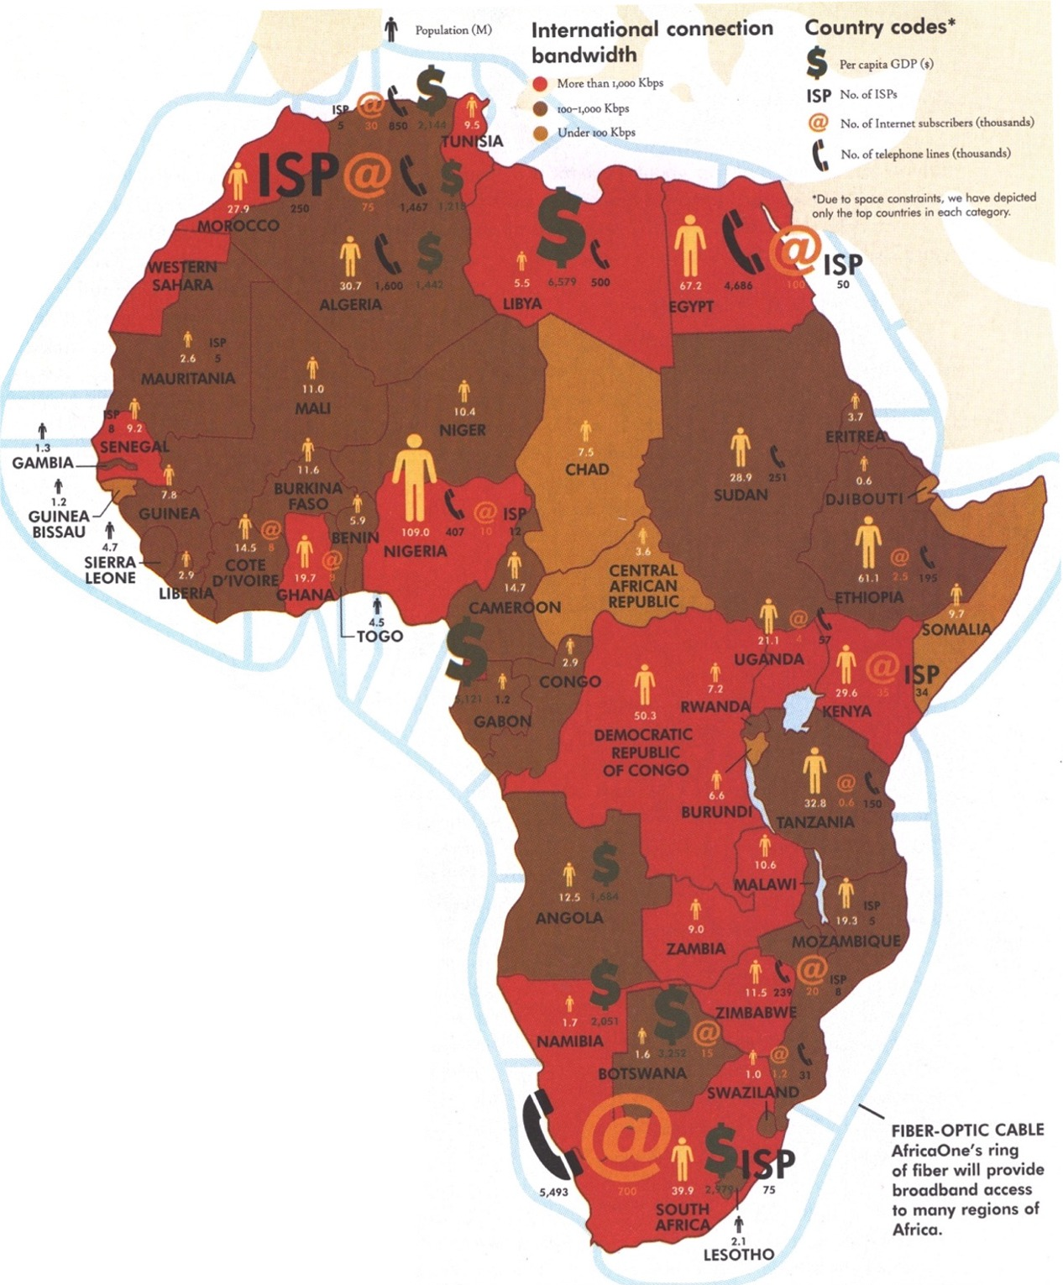
Incomes, assets, access to essential services are unequally distributed.

Slide 11
Increasing Bandwidth for African University Development - (IBAUD)
Sample Bandwidth Costs for African Universities
Nigeria
$20.00
Average
$11.03
Uganda
$9.84
Ghana
$6.77
IBAUD Target
$3.00
USA
$0.27
$0.00
$5.00
$10.00
$15.00
$20.00
$25.00
$/kbps/month
Sample size 26 universities

Slide 12
Telecommunications & Internet Infrastructure
All African countries now have Internet access.
  But degree of penetration varies substantially.
  Access largely confined to capital cities.
Some African countries have made telecommunications a priority.
  For example, some of the world’s most sophisticated national networks are in Botswana and Rwanda, where 100% of the mainlines are digital.
Mobile cellular telephony has grown rapidly in Africa.
  Only viable alternative to long waits for a standard phone.
Rapidly growing interest in kiosks, cybercafes, and other sites for public Internet access (schools, police stations, clinics, hotels, business centers).
The Greatest challenge for Africa’s Internet connectivity is not access but content.
Africa generates a meager 0.02% of global content.
A large portion of Africa’s content can be broadly categorized as business information – about institutional activities, products and services, and news.
There is a scarcity of scientific and technology information on Africa, from Africa.

Slide 13
Current ICT Initiatives
Access to Global Online Research in Agriculture
African Virtual University
Health InterNetwork
Increasing Bandwidth for African University Development
International Ocean Institute-Virtual University
NetTel@Africa
Partnership for Higher Education in Africa
The Essential Electronic Agricultural Library

Slide 14
Current ICT Initiatives
No dedicated research and education network for the African continent.
Some national inter-university connections:
  South Africa: Tertiary Education Network (TENET)
  http:www.tenet.ac.za/
  Egypt: Egyptian Universities Network (EUN) http://www.frcu.eun.eg/
  Morocco: Maroc Wide Area Network (MARWAN) http://www.marwan.ac.ma/
National Institutes of Health MIMcom project
  Satellite connectivity to malaria research sites in Ghana, Kenya, and Tanzania

Slide 15
The African Mathematical Institutes Network
(AMI-Net)
launched by AIMS
African Institutes serving as nodes, each continuously engaging in sharing, ideas, skills, and resources for research, education, and science-based economic development.
AMI-Net will connect African researchers and educators with the global science community, encouraging international exchange visits, and nourishing collaborations.
With a focus on those areas of science that are of greatest relevance to African science and development.

Slide 16
Why now?
The New Partnership for Africa’s Development (NEPAD) has made AMI-Net a priority.
The African Mathematics Millennium Science Initiative is developing African centers.
The Nelson Mandela Foundation for Knowledge Building and the Advancement of Science and Technology in Sub-Saharan Africa will build 4 regional institutes, each producing 5,000 world-class scientists and engineers every year.
NSF project for extending bandwidth Internet access for Research and education in Africa.
Satellite technology is interconnecting Africa with cheap, cost-effective bandwidth.

Slide 17
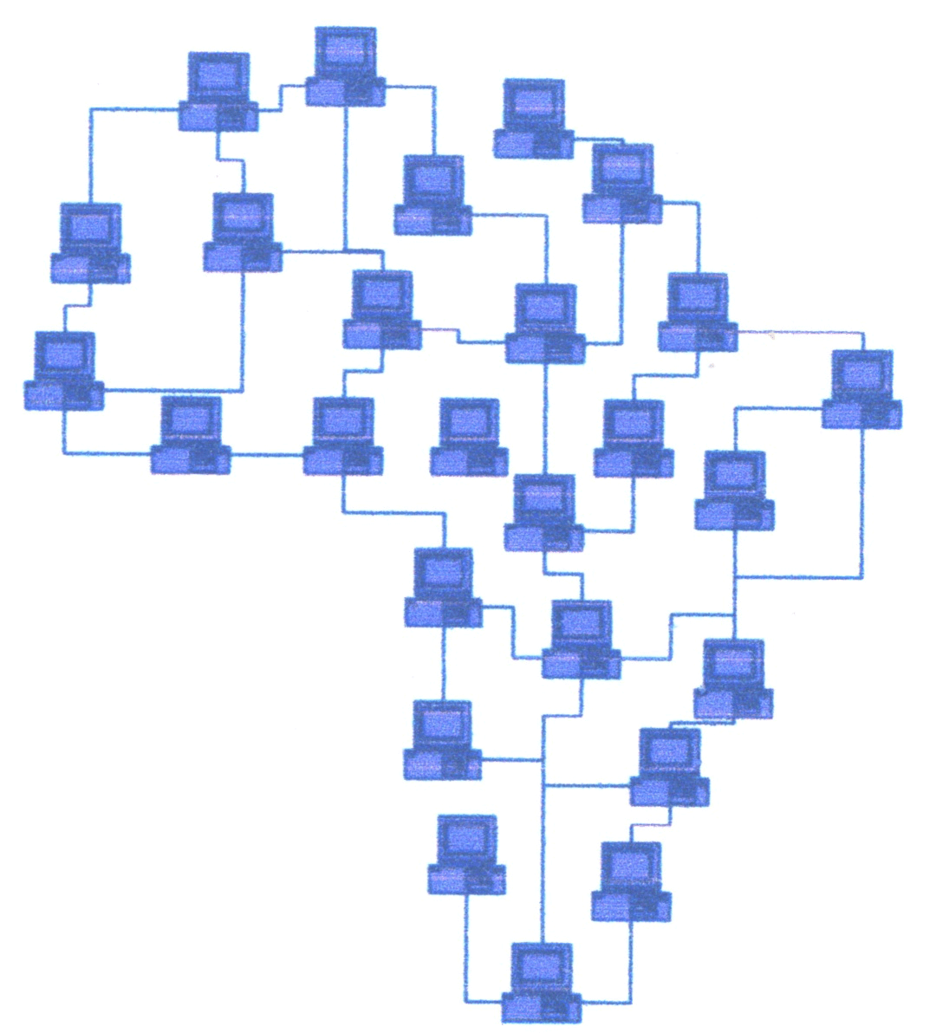
AMI-Net
African Mathematical Institutes Network
AIM-Net Vision of the Future
In the future the AMI-Net cyberinfrastructure will
be a ubiquitous, comprehensive virtual network
of research institutes that is interactive and
functionally complete for research and education
in terms of people, data, information, tools, and
instruments and that operates at high levels of
computational, storage, and data transfer capacity.

Slide 18
AMI-Net
African Mathematical Institutes Network
Goals
To establish 5 well-connected high-quality centers
within two years.
To equip each center with 40+ computers, including a full
suite of math/science software, good journal access, and
library facilities.
To increase the number of centers to 20 within 5 years.
To run annual training courses for 50 university lecturers
and system administrators in the use of software for math/science
teaching and research.
To develop and distribute documentation, upgrades, tutorials
and other teaching materials.

Slide 19
Science and Technology for
Economic Development
The creation of a cyberinfrastructure that provides AMI-Net Computational Centers with the capability of:
  Supporting high performance computing;
  Creating and maintaining comprehensive libraries of digital objects including programs and scientific literature;
  Managing and providing access to large quantities of multidisciplinary collections of scientific data;
  Providing access to online instruments and senor arrays;
  Creating and maintaining user-friendly software toolkits for resource discovery, modeling, and interactive visualization; and
  Supporting collaboration with physically distributed teams of people using these capabilities.
Encouragement of commercial spin-offs from AMI-Net, benefiting commercial science and engineering research.

Slide 20
What do we need from you?
Assist in any manner that you feel is appropriate in the development of AMI-Net.
Promote the use of Grid technologies in Africa
  Hold a Global Grid Forum Workshop in Africa.
  Consider Africa as a testbed of scientific or commercial Grid applications.
Form links with AMI-Net and other African ICT initiatives.
  Work to increase collaborations with Africa.
Goal: To have Africans join the community leading the global standardization effort for grid computing.
Thank You! James Turner
turnerj@math.vt.edu

