Slide 1
CCLRC Portal Infrastructure to Support Research Facilities
Dharmesh Chohan
e-Science Grid Technology Group

Slide 2
CCLRC Motivation
CCLRC Motivation
Portal Frameworks
Single Sign On
Portals & Web Services
Desktop Clients to Access Grid Resource
Summary
Acknowledgments
Notes:
Introduce portal frameworks, portlets and standards
Key requirement in providing AA to access facilities
Example of work we are doing in portals & webservices
Talk about destop clients and why we need it

Slide 3
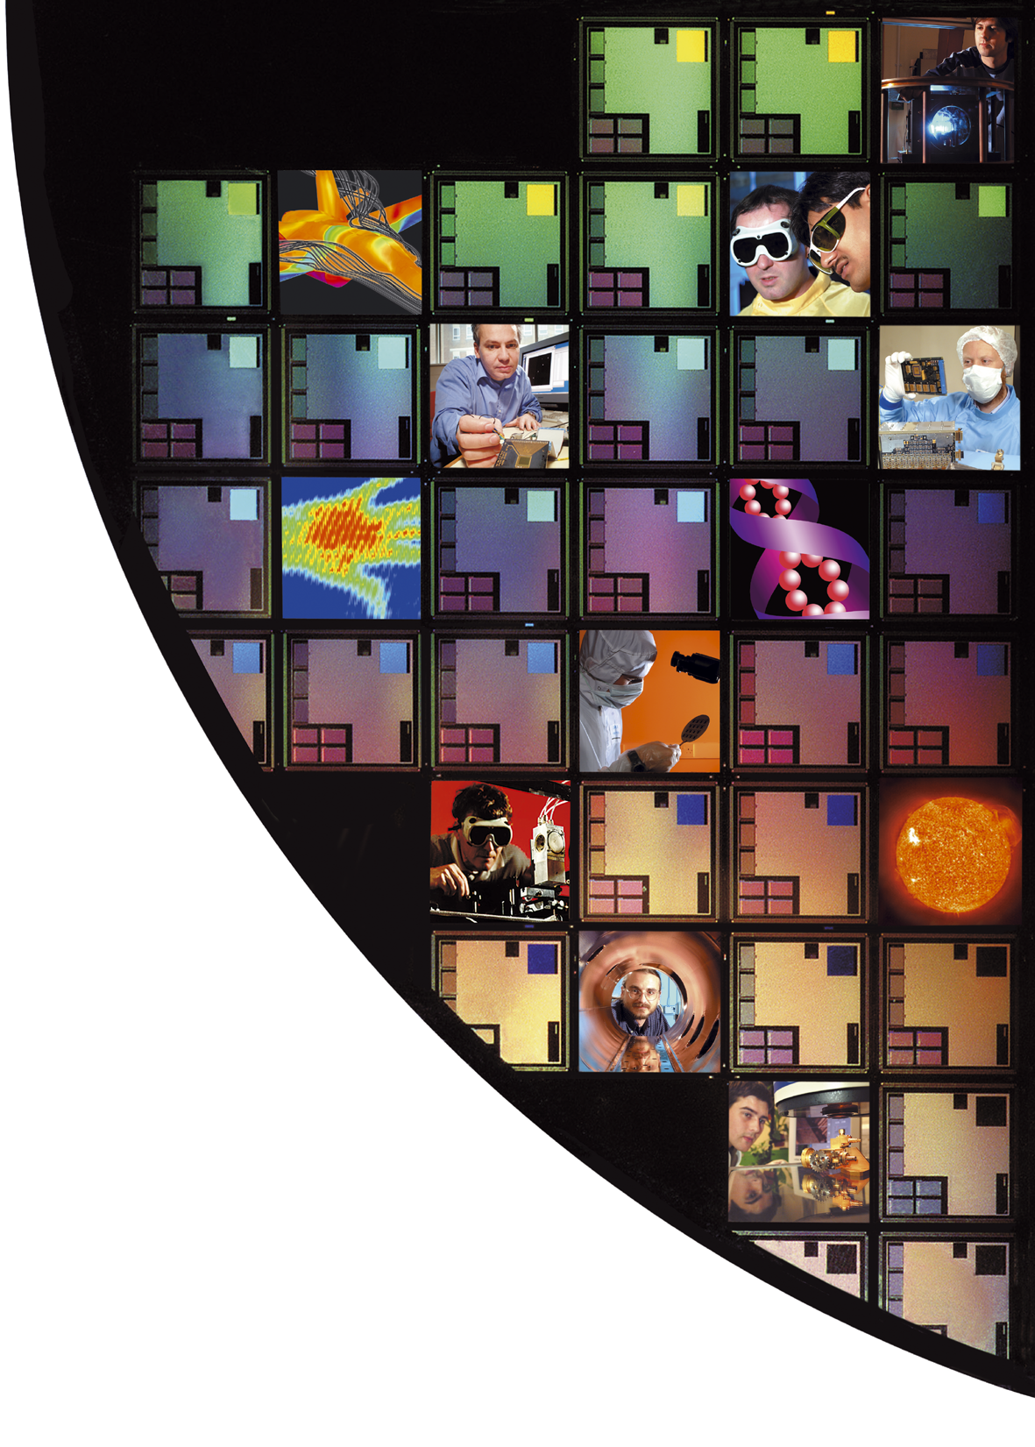
CCLRC Motivation
Who we are
  Council for the Central Laboratory of Research Councils (CCLRC)
Research Councils
  Rutherford Appleton in Oxfordshire
  Daresbury Laboratory in Cheshire
  Chilbolton Observatory in Hampshire
Together, the laboratories offer advanced facilities and expertise to support scientific research
...enabling technology for science and discovery...

Slide 4
CCLRC Motivation
Integrated e-Science Environment for CCLRC
A key requirement of facility users is to provide seamless access and integration of these resources
To achieve this goal
  Develop portal interfaces for each facility
  Project exposing their services as portlets
  Provide a Service Oriented Architecture (SOA) design to complement desktop tools
Notes:
Many types of users – visiting scientists, academics, employees etc
Aim of work to create IeSc environment for CCLRC
Benefit of portlets is for reuse between portal frameworks and CCLRC projects
Provide SOA design using portal frameworks and portlets

Slide 5



CCLRC Motivation
Some of the Research Facilities
ISIS
Synchrotron Radiation Source Central Laser Facility
Notes:
ISIS, the world's most powerful pulsed neutron and muon source - used to study the atomic structure of materials;
Synchrotron Radiation Source, the UK's brightest source of ultraviolet light and X-rays - for non-invasive research in materials and life sciences;
The Diamond synchrotron light source, the largest science facility to be built in the UK for more than 30 years, is due to start operations in 2007.
Central Laser Facility with high-power, state-of-the-art laser facilities for research in fundamental and applied science and engineering. The Central Laser Facility includes Vulcan, the world's highest intensity focused laser;

Slide 6
Portal Frameworks
What is a portal?
  An integrated and personalized web-based interface to information, applications and collaborative services.
  Portal aggregate one or more portlets into web pages
What is a portlet?
  Individual component offering a service
  Provides content for a portal
  Similar in nature to Servlet but slightly different in behaviour
Portal Standards
  Java Portlet API
    Known as JSR 168 Specification
    Provides a standard for interoperability between portlets and portals and between different vendors
Notes:
Java portlet architecture provides a framework for building systems that present users with the information they need. 2 key features; aggregation (portal can aggregate information from multiple portlets) and selectivity (the architecture allows admins and users to be selective about their sources of information by choosing with portlets will appear)
Portlets can be personalised or customised for individual users or groups of users.
Portlet container manages the life cycle of a portlet – init, render and destroy
Servlets generate complete HTML, portlets generate fragments. MIME types, No HTP header etc

Slide 7
Portal Frameworks
  Web Services for Remote Portlet (WSRP)
    Another standard created by OASIS
    Specifies the remote rendering of Portlets
    A portlet can be hosted (“produced”) locally or remotely, separate from the portal using (“consuming”) the portlet
Why work with Portals?
  Accepted specification
  Reuse of portlets
  Enhanced user experience
  Ease of maintenance
  Open source community
  Extendable framework
  Natural fit for SOA
Notes:
WSRP released in 2003. Benefit portlets hosted by different portal frameworks locally or remotely can be accessed from a single portal.

Slide 8
Portal Frameworks
Portlet Lifecycle
  Init
  Render
  Destroy
Portlet Modes
  View
    Displays the normal content
  Customise (Edit)
    Allows the user to customise the portlet
  Help
    Information on portlet

Slide 9
Portal Frameworks
Portlet Window States
  Normal
  Minimise
  Maximise
Supported Media Types
  HTML
  WML (Wireless Markup Language)
Notes:
Or Website Meta Language for Mobile devices

Slide 10
Portal Frameworks
Init Phase
  One-time initialisation of the portlet
  Init
Portlet Cache
Portlet

Slide 11
Portal Frameworks
Render Phase
  Is called per request and portlet's content is requested.
  getContent()
Portlet Cache
Portlet
Notes:
One of 3, View Edit or Help

Slide 12
Portal Frameworks
Destroy Phase
  Dependent on the life time definition of the portlet.
Portlet Cache
Portlet
Notes:
Unfortunately, your portlet is never notified when the destroy phase occurs

Slide 13
Portal & Portlet Terminology
Concepts & terms
  Content aggregation: The process of bringing together content from disjointed systems, via portlets, and controlled through the use of a portal.
  Portlet container: Controls the access, lifetime, and interaction of a single portlet. Provides the content returned from a portlet back to the portal for merging with the content of other portlets.
  Portlet: Provides content to its calling portal container for the purposes of being displayed on a portal page.
  Fragments: The content generated by a portlet is known as its fragment or fragment code. This is the HTML code generated from the portlets rendering code.

Slide 14
Single Sign On
Important requirement for CCLRC
Security framework which is easily scalable
  LDAP server
  NT Authentication
  MyProxy server (X509 certificates)
User login independent of the authentication mechanism
JAAS (Java Authentication & Authorisation Service)
  Set of API
  Part of Java 2 SDK 1.4
  Based on Java version of PAM (Pluggable Authentication Module)
  SSO support
  flexible access control policy for authorisation
Notes:
JAAS, the Java Authentication and Authorization Service API, provides flexible and scalable mechanisms for securing your client- and server-side Java applications.

Slide 15

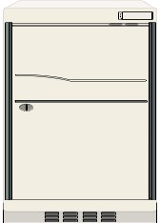
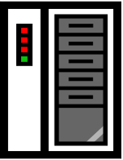
SSO NGS Portal
SSO National Grid Service (NGS) Portal
NGS User
X509 Certificate Portal Server Oracle Clustered DB
Portal User
MyProxy Server LDAP
Notes:
Uses JAAS to extend MyProxy Login. New NGSLoginModule, Modified SB PortalLoginFilter class and add new NGS_UERS table based on SB_USERS table. Proxy saved in NGS_USERS table.
Notes:
Role based access control using portal framework
JAAS authentication

Slide 16
Single Sign On
Pros and cons of using JAAS
  Authentication mechanism can be easily extended
  Authentication is tightly coupled with portal framework
Future work with SSO
  Evaluation of JOSSO framework
    Java Open Single Sign On
    Support for multiple simultaneous authentication systems
    Authentication using X509 certificate
    Security model based on open standards, JAAS, SOAP Web services, EJB and Struts
    Compatible with Java and non Java web applications

Slide 17
Portals & Web Services
Examples of portals and Web services developed at CCLRC
e-HTPX (High Throughput Protein Crystallography) Portal
  Build communication infrastructure and user interfaces to allow planning and remote executions of protein crystallography experiments
  Distributable Web application
  Single point of access to underlying e-HTPX Web services framework
  Acts as Web service client
    Service-site portal
    Client-site portal
  Portal not JSR 168 compliant
Notes:
SSO Feeds nicely into how we manage portals and web services
E-HTPX is a BBSRC (Biotechnology and Biological Sciences Research Council) funded UK e-Science project for structural biology
E-HTPX designed to allow planning and remote execution of protein crystallography experiments
NGS is the core UK grid, intended for the production use of computational and data grid resources. NGS is the core service resulting from the UK's e-Science programme
An important advantage of a service-oriented architecture is that it enables
development of loosely-coupled applications that can be distributed and are accessible
across a network

Slide 18
Portals & Web Services
Service End-points
Proxy Web Service
Internet
Clients
Repository for Authorisation
and Service Policies
Notes:
Demonstrates communication via Web services to access service end-points
Why use portal?
Interface is easy to use (hides complexity)
Session handled by portal
Service endpoints are independent (loosely coupled)
Proxy gateway handles load balancing, validates XML and does authorisation

Slide 19
Portals & Web Services
NGS Portal
  Core production use of computational and data grid resources
  Stringbeans JSR 168 compliant portal framework
  Dual login mechanisms
  Core portlets
    MyProxy Management
    MDS Resource Discovery
    GRAM Job Submission
    GridFTP
    Job Status Monitor
  Further development in progress …
Notes:
NGS portal release 2.0
Portlets tested on other frameworks, eg Integrative Biology portal
SRB, OGSA-DAI portlets and WSRP consumer portlet
Customise & personalise use of portlets

Slide 20
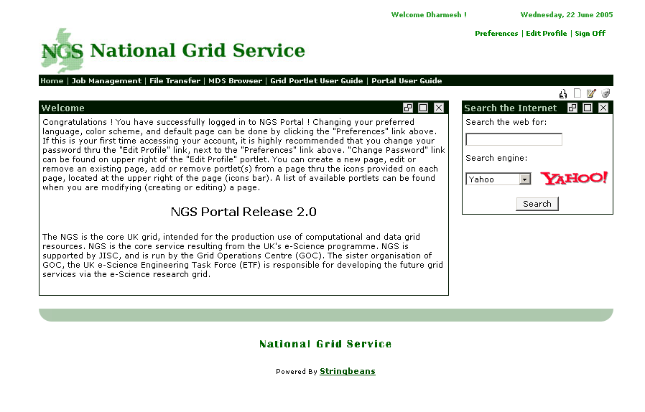
NGS Portal

Slide 21
Portals & Web Services
What is OGSA-DAI ?
  Open Grid Services Architecture - Data Access & Integration
What can OGSA-DAI do ?
  Provide an extensible grid framework for easily integrating data resources.
  Allow data access.
  Allow data discovery.
  Facilitate data integration.
  Expose data resources through services which will compliant with WS-I, WSRF and OGSI.
  Provide a uniform interface to access data.
  Bundle with a platform independent client toolkit

Slide 22
Desktop Clients to Access Grid Resources
WOSE Project (CCLRC, Imperial College and Cardiff University)
  Workflow Optimisation Service for e-Science
  Investigate optimisation strategies for workflow execution for web services using BPEL, SCUFL and BPML
  Aim is to develop workflows from users point of view with limited knowledge of workflow languages
User Portal Interface
  No configuration or installation
  Easy to develop and manage
  Provide uniform interface
  User interaction is limited
    executing existing (pre-defined) workflow
    no security and monitoring capabilities
Notes:
Issues with using portal vs desktop
Business Process Execution Language (BPEL)
Simple Conceptual Unified Flow Language (SCUFL)
Business Process Modelling Language (BPML),

Slide 23
Desktop Clients to Access Grid Resources
User Desktop Interface
  User interaction easier for complex workload
  Expert users engineering new or existing processes as workflows
  Data conversion using XSLT
  Messaging services – notification
  Maintaining a pool of compatible Web services
  Integration of local Java classes
  A rating mechanism to rank similar Web services
  GUI monitoring tool for long running jobs
  Information persistence

Slide 24
Summary
Working with portal technology will benefit CCLRC in short and long term in meeting its goal
Portlets can be reused
Deployment and maintenance of applications becomes easier to manage
Portlets can be internationalised
Different portal frameworks come with free-to-use portlets
Portals used as rich client can allow users to customise or personalise their UI and even their workflow and application access
Security and SSO can be implemented and extended easily

Slide 25
Acknowledgement
Dr Robert Allan (e-Science Centre Grid Technology Manager)
Asif Akram (WOSE Project)
Xiao Dong Wang (OGSA-DAI)
David Meredith (e-HTPX)

