Slide 1
HPC-Europa Portal: Uniform Access to European HPC Infrastructure
Ariel Oleksiak
ariel@man.poznan.pl
Poznan Supercomputing and Networking Center
Notes:
HPC-Europa portal not designed for any specific scientific community but I would not call it job submission portal like in session title but rather generic portal for scientists
the main aim: uniform interface…

Slide 2
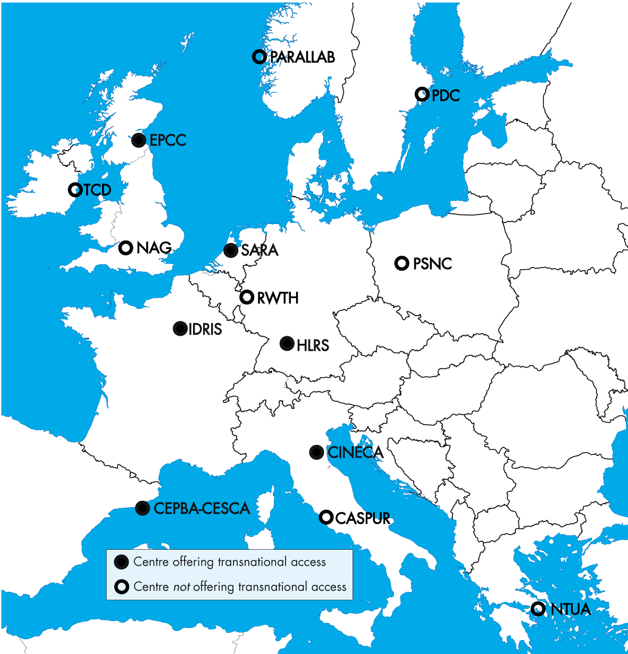
HPC-Europa
Goal: to provide advanced computational services in an integrated way to the European research community
Budget: ~13 mln euro
14 Partners across Europe
  6 Transnational Access centers
Project activities
  Transnational Access Programme
  Networking Activities
  Joint Research Activities (JRA1, JRA2)
Notes:
Work done in the framework of the h-e project which …
Goal – through a special Transnational Access programme which enables researchers to be visitors in these HPC centers
Transnational Access Programme
- Deployment and operation of a “virtual global infrastructure”
- Scientists can be visitors of particular centers…
Networking Activities
- should improve collaboration in
- e.g. data management
- …
Joint Research Activities (JRA1, JRA2)
- …

Slide 3
JRA2: Single Point of Access
Motivation
  To provide a uniform access to resources of all centers, transparently and regardless of user physical location
Main objectives
  Ease of use,
  Improvement of resources availability and utilization,
  Enabling HPC centers to use their own middleware and local policies
  Use of accounting data for charging and limiting resource usage
To achieve these goals JRA2:
  Builds the HPC-Europa portal based on the GridSphere framework
  Develops interfaces to needed tools and services
Notes:
To provide a uniform access
- which means to enable users to access computational resources of various HPC centers in the same way
to all centres resources
- so not only to the center where user is affiliated to
Transparently
- hiding the underlying complexity
and regardless of user physical location
- allowing users submitting their applications to the centers apart from the center he is a visitor in
ease of use,
- through user-firendly, intuitive interface + useful tools
improve availability,
- increase pool of resource a user has access to (to all centers)
global optimization of resources utilization
- autmatically load balancing not using statically allocated grants…

Slide 4

HPC-Europa Infrastructure
End users
GRMS
UNICORE
Pre-WS Globus 3.2
PBS
PSNC
SPA
CINECA
JOSH
Globus 3.2
GRIA
SGE
eNANOS
Globus 3.2
UNICORE
EPCC
LoadLeveler
NTUA
CEPBA
HLRS
Notes:
env very heterogenous…

Slide 5
User interfaces
Two types of interfaces (GUI)
  General and uniform interface for all users and applications
  Portlets for specific applications
Main requirements
  Uniform access to various tools & services
  Dynamic GUI adaptation to the functionality provided by diverse services (a) and applications (b)
Notes:
a)
Not as in the case of portals presented in the first 3 sessions today
Because one of the main requierments is to enable all scientists to run their own applications
Should be uniform to be easy to use (because there are many different services)

Slide 6
Single Point of Access Portal
Use & extension of the GridSphere’s GridPortlets
Definition of the common interface
  For each functionality, e.g. job submission
  Based on standards where possible (e.g. GGF JSDL)
  Taking into account both gathered requirements and available functionality
Capability check
  Description of implemented capabilities (constrained common schema)
  to disable not available options and controls in portal
Application-specific
Job Submission
Job Monitoring
Resource Inform
Portlets
JSDL
JSDL
Job Submission
Job Monitoring
Resource Inform
Services
JSDL
eNANOS
GRIA
GRMS
JOSH
UNICORE
Plugin
Plugin
XSL
GJD
Plugins
UNICORE
GRMS
JOSH
eNANOS
GRIA
Notes:
Set of portlets
Services
Interfaces
App-specific – use of services
Plugins – hidden fo users
Capability check

Slide 7
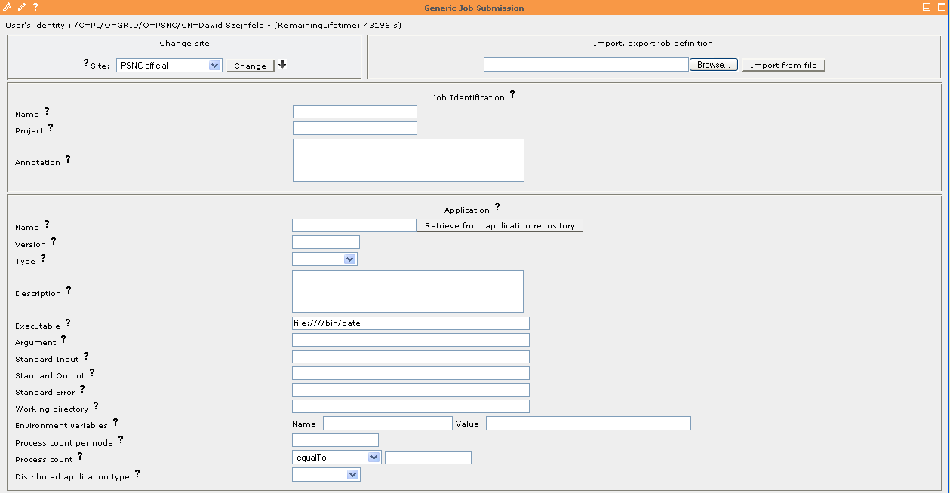
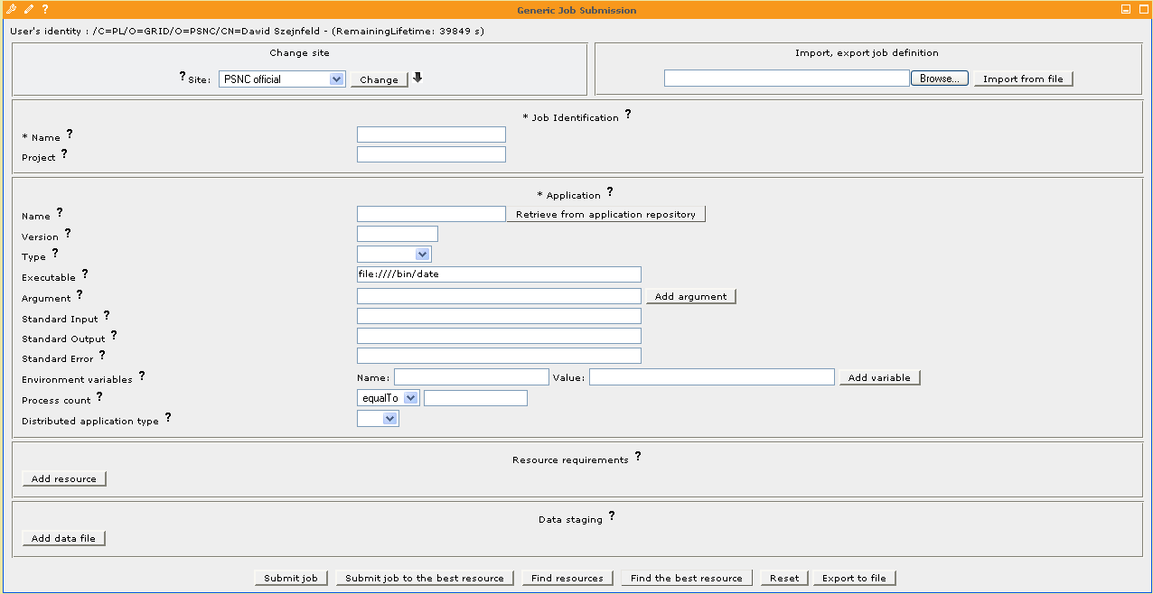
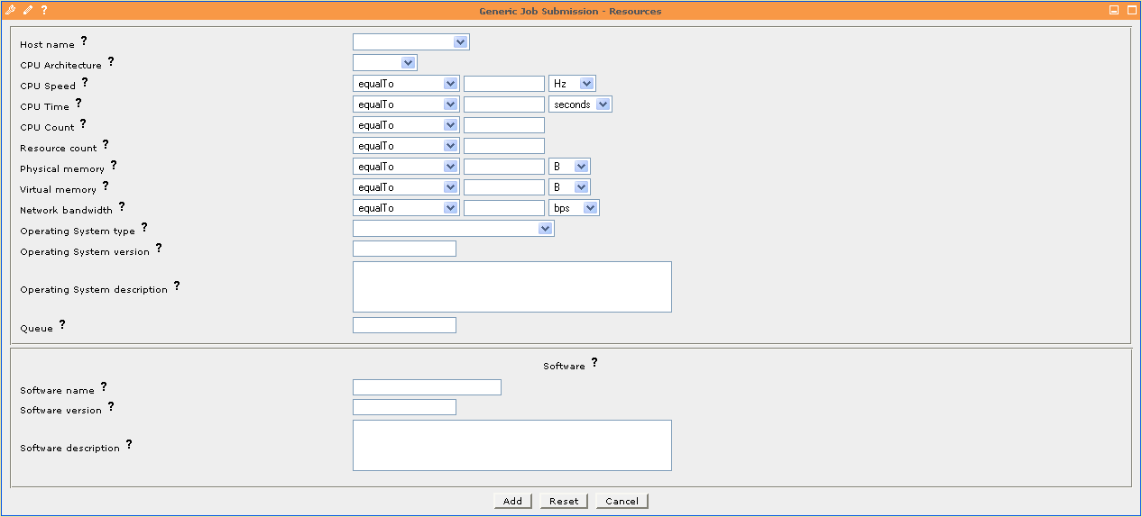
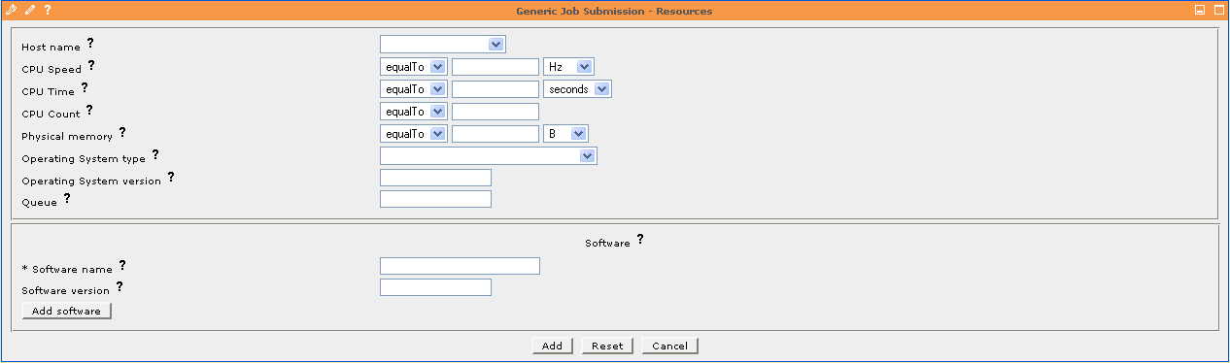
Generic Job Submission Portlet

Slide 8
Application-specific portlets
Specific portlet per application
Portlet generates JSDL output which is passed to Job Submission Service
Prototype portlets for commercial applications from the field of CFD and structure mechanics are being developed
Applications chosen among:
  Fluent
  Star-CD
  MSC.Nastran
  FENFLOSS
    (= Finite Element based Numerical FLOw Simulation System, developed at the University of Stuttgart)
Portlets
Job Submission
Resource Info
Fluent portlet
input
output
<JSDL>
2d
3d
Portlet Services
<JSDL>
Job Submission
Service
Resource
Information
Service

Slide 9
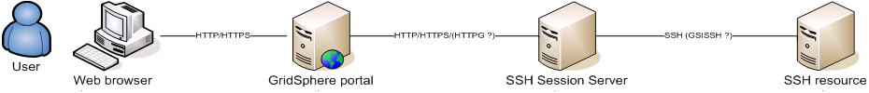
SSH Session Server Framework
Developed in the framework of the GridLab & Clusterix projects and being used and extended by HPC-Europa
Allows adding user-defined interfaces
  Both for a definition of input parameters and presentation of application output
  Can be done at portal run-time
  In the form of finite-state automata described in a XML-based format
  Supports translation of application’s output into the following formats: HTML, VRML, SVG, Charts (JPEG, PNG)
Enables users to easily adapt existing applications
Notes:
Today I got email about succesful access to resource using GSI

Slide 10
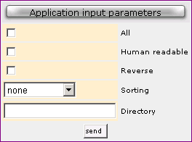
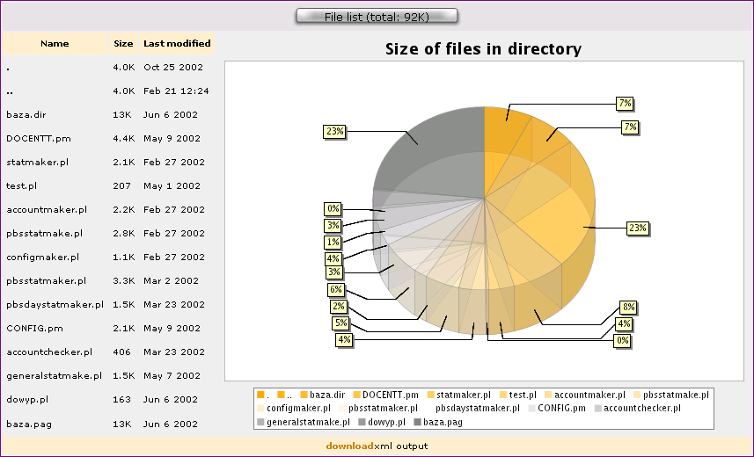
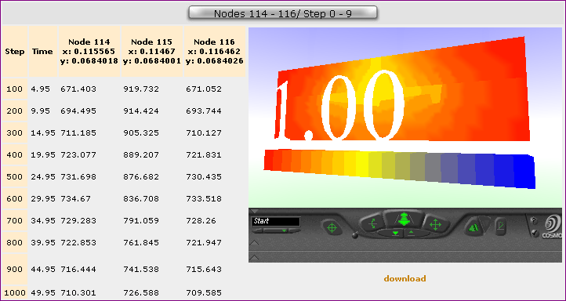
Examples
…
<Pattern>ls -l$PARAM{a}</Pattern>
…
<Param>
<ID>a</ID>
<WidgetType>
<Checkbox>
<Description>All</Description>
<TrueValue>a</TrueValue>
<FalseValue/>
</Checkbox>
</WidgetType>
<Required>false</Required>
</Param>
…
Notes:
Transformation from description to form in a portlet
Screenshots of app output

Slide 11
Security issues
Authentication problem
  Globus-based systems - use of GSI (proxy certificates)
  UNICORE & GRIA - "end to end" security model based on a standard X509 certificates (lack of delegation)
Current solution
  SPA authenticates on behalf of users using its certificate
  User's distinguish name (taken from proxy certificate) passed to the underlying system
  GridLogin used for certificate requests and storing users credentials to MyProxy
Authorization
  Grid Authorization System (GAS)
  Local authorization systems
Notes:
Various security models – despite them we are trying to provide uniform access
Current solution – use of GridLogin and portal certificate to sign requests
GridLogin
Possible final solutions: gsi gateway, etd
Authorization: GAS + local auth systems

Slide 12
Accounting & Charging Model
Allocation Unit (AU)
  1TFlop sustained for 1 hour
  TFlops measured using the Linpack benchmark
  Kept for each resource provider for every single HPC system
Used for 2 purposes
  charging the EC for the use of HPC facilities
  limiting the maximum amount of resources a user (or group of users) may utilize
Currently available in HPC centers
  Goal: to provide global accounting for all centers
Budgets
  The processing capacity of the whole machine is divided between projects
  The allocation for each project is subdivided into budgets
  Users can be granted access to one or more budgets

Slide 13
Conclusion
Two types of interfaces provided
  Uniform interface for generic users
  Application-specific portlets
Status & next steps
  Job submission interface & portlet ready
  The remaining interfaces under construction
  Work on security issues and accounting
Portlets are JSR168-compliant, portlet services based on Spring (portability!)
Can be a basis for building a specific science gateway
Finally deployed for all Transnational Access centers?
Notes:
possible to use in another container – tried in liferay

