Slide 1
GridSAT Portal: A Grid Portal for Solving Satisfiability Problems
Wahid Chrabakh
and
Rich Wolski
University of California, Santa Barbara

Slide 2
Challenging Scientific Problems
Computationally demanding
  Large compute power
  Extended Periods of time
Infrastructure:
  Desktops, Clusters, Supercomputers
Common Resource Usage:
  Most suitable for co-located nodes
  Determine number of nodes to use
  Use all nodes until termination criteria reached
Notes:
Many challenging problems: what programming models are used,
Most are synchronous MPI.
Here we present an example of highly aysnchrous application and fits very well the grid model.

Slide 3
Satisfiability
Example of dynamic resource use
Application Characteristics:
  Branch-and-bound
  Unpredictable runtime behavior
  Memory Intensive:
    Internal database grows overwhelming RAM
  CPU intensive: 100% CPU load

Slide 4
Satisfiability Problem(SAT)
Set of variables V={v_{i} | i=1,…,k}
Literal: a variable or its complement
Problems in CNF form: community standard
Clause: OR of a set of literals
Conjunctive Normal Form:
  F=C₁ C₂ C₃ … C_{k}
Standard File format:
p cnf num_vars num_clauses
c comments
+v1 –v2 … +v213 0
Notes:
-different from other CSPs.
-the cnf format from the Second DIMACS Benchmark Challenge. This
format is currently accepted by almost all of the best-performing SAT solvers and
tools, it is simple to parse and generate, reasonably concise and flexible, portable
across different platforms, and human-readable

Slide 5

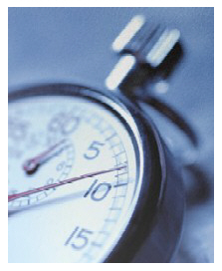
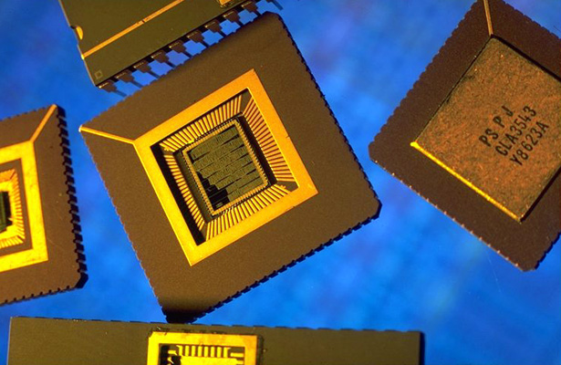

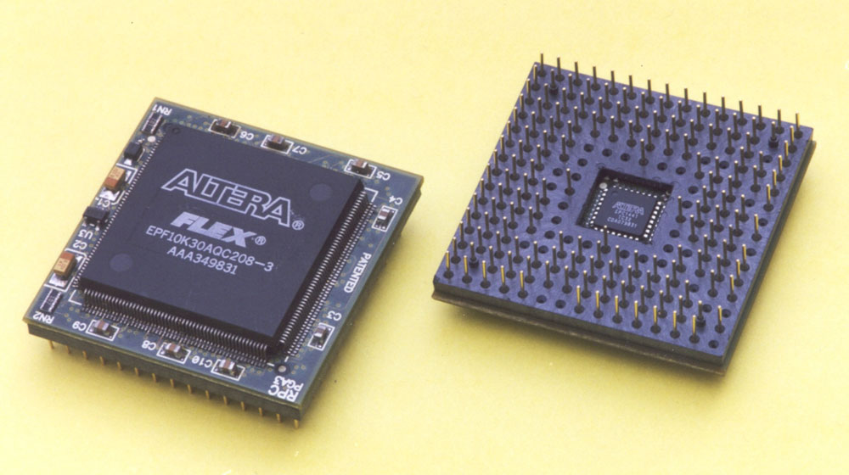
Satisfiability Applications
Circuit Design
FPGA routing
Model Checking:
  AI, software
Security
Scheduling
Theoretical:
  physics, chemistry, combinatorics
Many More…

Slide 6
SAT Community
Communities:
  SATLive: http://www.satlive.org/
    News, forums, links, documents
  SATEx: http://www.lri.fr/~simon/satex
    Experimentation and execution system
  SATLIB: http://www.satlib.org/
    Dynamic set of Benchmarks
    Freely available solvers
Notes:
-News and links about SATisfaibility, forums
-The SAT-Ex site attempts to group experimentations around the fundamental SAT problem. Its aim is to gather experiments, providing executions traces of provers on all benchmarks. It also provides some study on benchmarks and on programs performances.
-SALIB: core components, a benchmark suite of SAT instances and a collection of SAT solvers, aim to
facilitate empirical research on SAT by providing a uniform test-bed for SAT solvers along with
freely available implementations of high-performing SAT algorithms.
-Enhance comparability of the different results
-SATLIB:
1.randomly generated native SAT instances
2.SAT-encoded, randomly generated problem instances from other
domains,
3.instances from direct applications of SAT
4. SAT-encoded instances from other application domains.

Slide 7
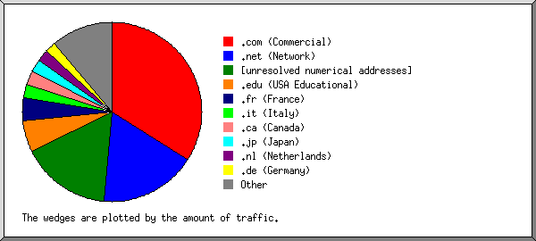
Who uses SAT Live!
Period: Sep 2000- Jan 2003
  21,766 distinct hosts
Jan 7-13 2003: 524 distinct hosts
SATLIB: 250 hits/month

Slide 8
SAT Competition
http://www.satcompetition.org/
55 Sequential Solvers: circus, circush0, cls, compsat, eqube2, forklift, funex, gasat, isat1, tts-2-0, unitwalk, walksatauto, walksatmp, walksatskc, werewolf, wllsatv1, zchaff, zchaff_rand
Execution uses SAT-Ex
Two rounds:
  First round: easy problems
  Second round: harder problems
Awards to category leaders for SAT, UNSAT and overall
Challenging set: some problems left unsolved

Slide 9
Benchmarks:
Community submitted benchmarks
Crafted Benchmark: (38 MB)
  Especially made to give a “hard time” to the solver
Random Benchmark: (11 MB)
Industrial Benchmark: (2 GB)
  REAL industrial instances from all domains

Slide 10
GridSAT: The Solver
Parallel distributed SAT solver based on GridSAT
Based on zChaff leading sequential Solver
GridSAT beats zChaff on problems that zChaff can solve
GridSAT Solves problems which were not previously solved

Slide 11
GridSAT: Grid Aware
Highly Portable Components
Uses resources simultaneously:
  Single nodes, Clusters, SuperComputers
  Resources may leave and join at any time
Fault-tolerant:
  Error detection & checkpointing
  All resources can/do fail:
  Even reliable resources: Maintenance & upgrade periods
Reactive to Resource Composition and Load: Migration

Slide 12

How to make GridSAT available to users?
Deploy GridSAT locally by interested users
  Complex
  Not enough computational resources
Feedback from SAT experts:
  Make it available through a portal
  Simple interface: minimal user input
GridSAT Portal: orca.cs.ucsb.edu/sat_portal
Test problems: orca.cs.ucsb.edu/sat_portal/test_problems.htm

Slide 13



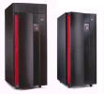

Internal Design
WebServer
GridSAT Coordinator
User
TeraGrid
DataStar
Desktop Machines
Notes:
Web server is used for accounting and not for resource oversight
-GridSAT coordinator, lightweight launched on trusted resources

Slide 14
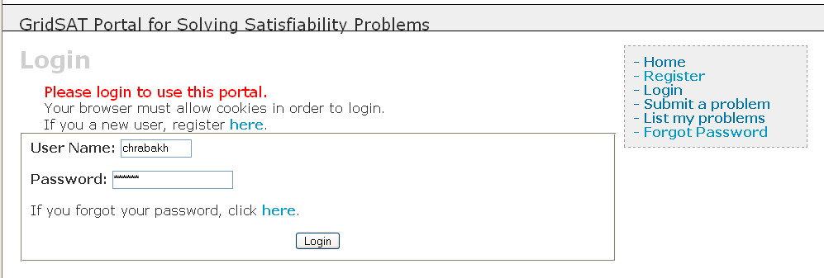
User accounts:

Slide 15
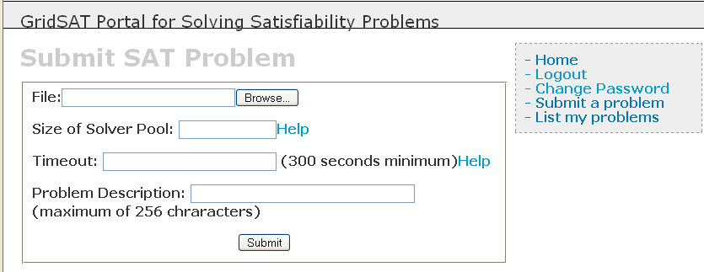
Problem Submission

Slide 16
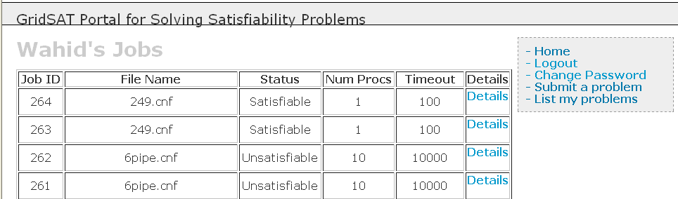
List Problems

Slide 17
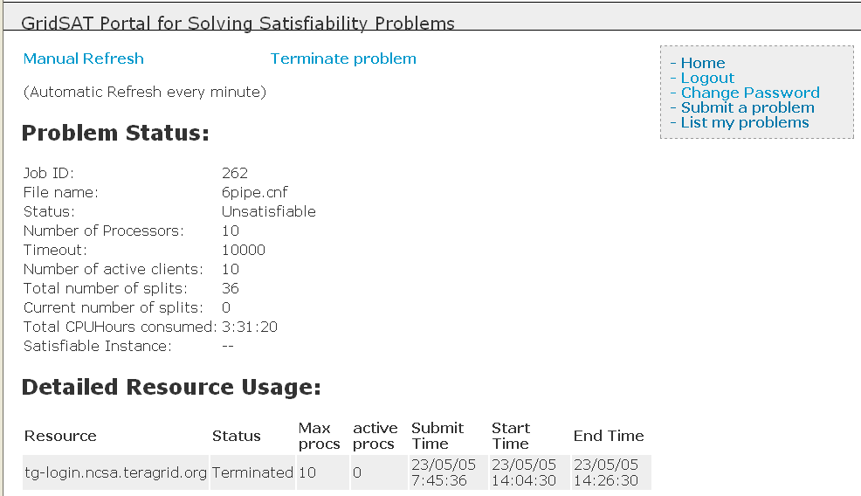
Detailed Report

Slide 18
Budget based Scheduling
CPU count or timeout may not be fulfilled
  CPU count: too large
  Time limit: too large or too small
Find closest job to user request
May need multiple jobs
Use Max CPUs * Timeout as a budget:
  Debit from budget for every job

Slide 19
Conclusion
New science and engineering portal
GridSAT: Grid enabled application manages resources
Web Portal:
  Launch coordinators
  Provide feedback and Accounting
Challenge:
  Provide compelling service to get community interested

Slide 20



Thanks
LRAC Allocation through NSF
TeraGrid:
  SDSC, NCSA, PSC, TACC
DataStar at SDSC: also BlueHorizon
Mayhem Lab at UCSB

Slide 21
User Environment
Input:
  Problem in standard CNF format
  Max number of CPUs to use
  Timeout period
Feedback:
  Jobs: resource, status, submit, start and end times
  Total number of active processors
  CPU*hours consumed
  Number of checkpoints
  Final result: UNSAT or SAT instance

Slide 22
Programming Models
Synchronous Model:
  Predictable Space: number of nodes, memory
  Predictable Time: How long per instance
  Synchronization Barrier
  Fits Cluster Model (MPI)
Asynchronous Model:
  Dynamic resource requirement,
  Variable and Unpredictable duration
  Asynchronous Events
  Fits Computational Grid environment

Slide 23
Thanks
LRAC Allocation through NSF
TeraGrid:
  SDSC, NCSA, PSC, TACC
DataStar at SDSC: also BlueHorizon
Mayhem Lab at UCSB

