Slide 1
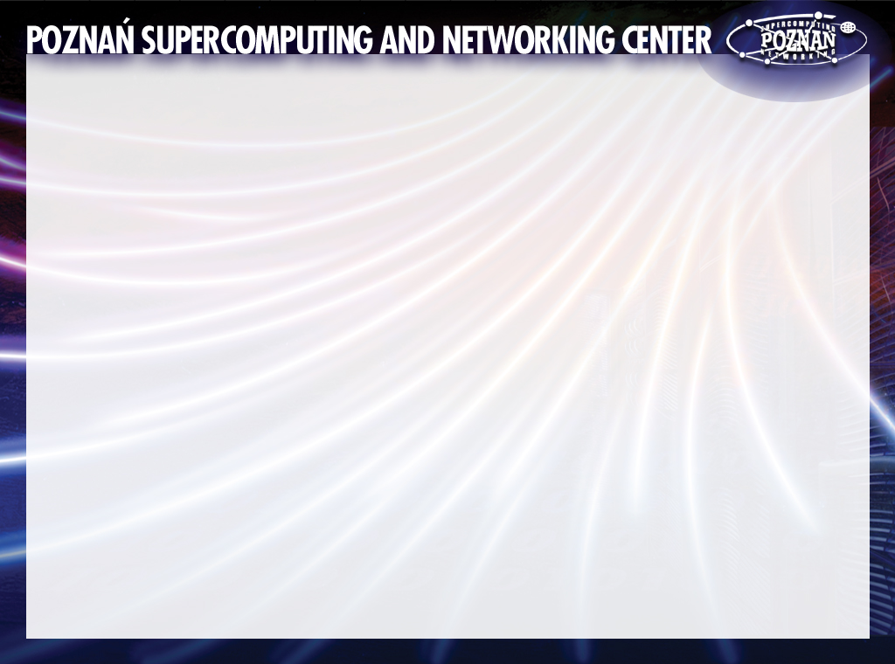

Flexibility and user-friendliness of grid portals: the PROGRESS approach
Michal Kosiedowski
kat@man.poznan.pl

Slide 2
PROGRESS: goals
Design an access environment to computational services and resources
Facilitate the construction of computing portals
Facilitate grid application enabling within computing portals

Slide 3
PROGRESS: results
New architecture for a grid-portal environment
PROGRESS HPC Portal: the reference deployment of the new architecture
PROGRESS Package: open source tools for computing portal construction and management
  Grid Service Provider
  Data Management System
  Portlet Framework
  Portlets

Slide 4
PROGRESS: architecture
Grid Portal
Grid Portal
Grid Portal
Portlets
Portlet Framework
Grid Service Provider
Data Management
System
Grid Resource Broker
Computing Grid
Management System
Grid Resources

Slide 5
PROGRESS Package
Grid Service Provider
Provides a high-level abstraction of grid resources and applications
Application Management Service
  stores descriptors of grid-enabled applications
  allows to describe any applications, with all its parameters, including workflow applications
Job Submission Service
  manages computing job descriptions
  uses application descriptors to construct a framework for a new grid job
  allows to submit a job built on top of any application to any underlying grid infrastructure
  grid resource broker plug-ins: provide users with an opportunity to submit the same grid job to a number of independent grid infrastructures

Slide 6
PROGRESS Package
Data Management System
A distributed system capable of storing large amounts of data on various types of storage resources:
  generic filesystems
  tape archivers
  relational databases
  any other
Stores application input and output data
  user data files
  external databases
Provides access to data via a unified interface: the Data Broker Service

Slide 7
PROGRESS Package
Portlet Framework
Provides an environment capable of facilitating construction of web-based user interfaces to grid services
Features a layered component architecture allowing to reuse portlet components for construction of a new portlet
Ideal for quick construction of specialized web-based user interfaces to grid-enabled applications

Slide 8
HTTP
Provider
Provider
Provider
Provider
...
Provider
Portlets
Content Generator
Content Generator
Content Generator
Content Generator
...
Content Generator
Request Handler
Request Handler
Request Handler
Request Handler
Request Handler
...
Request Handler
Web Service Proxy
Web Service Proxy
Web Service Proxy
Web Service Proxy
...
Web Service Proxy
Web Services Invocation Framework
SOAP (to GSP, DMS)

Slide 9
PROGRESS Package
Portlets
Core portlets allow to utilize the whole functionality of the Grid Service Provider
  „Applications”: allow to add and modify application descriptors
  „My computing jobs”: allows to build a grid job on top of any application based on its descriptor
  „My data”: allows to manage user’s data files stored within the Data Management System
Specialized application portlets
  utilize the capabilities of the Portlet Framework to access grid services
  provide highly specialized user interfaces to grid-enabled applications
  example application portlets („Gaussian”, „DNA Assembly”) provide a perfect pattern for quick construction of new application portlets within the Portlet Framework

Slide 10
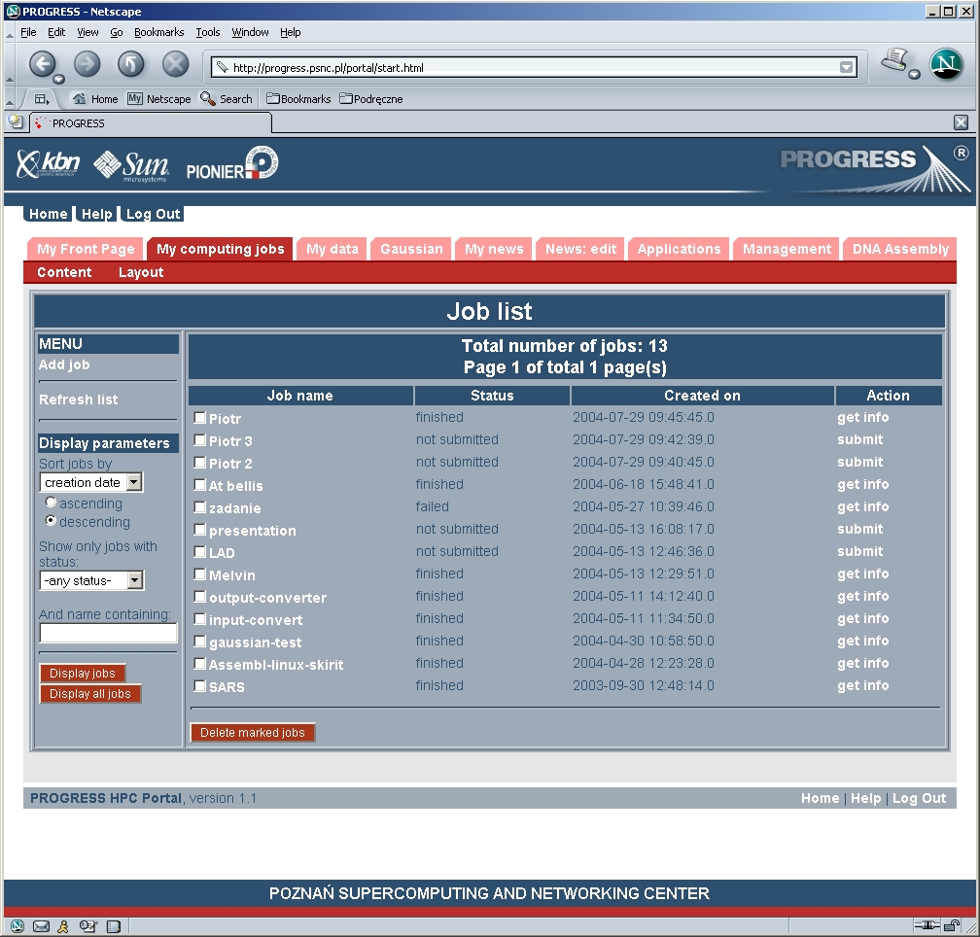
PROGRESS HPC Portal

Slide 11
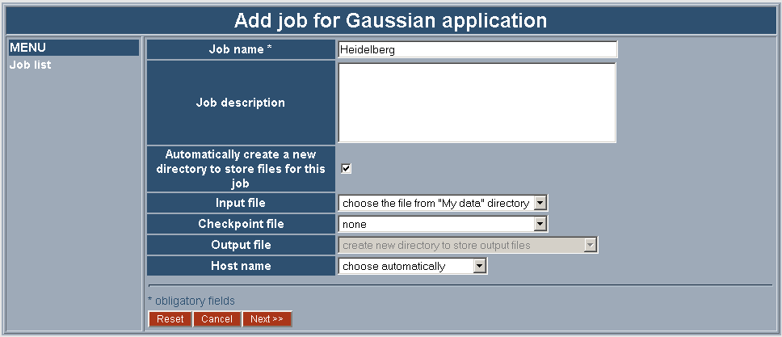
“Gaussian” portlet (1)

Slide 12
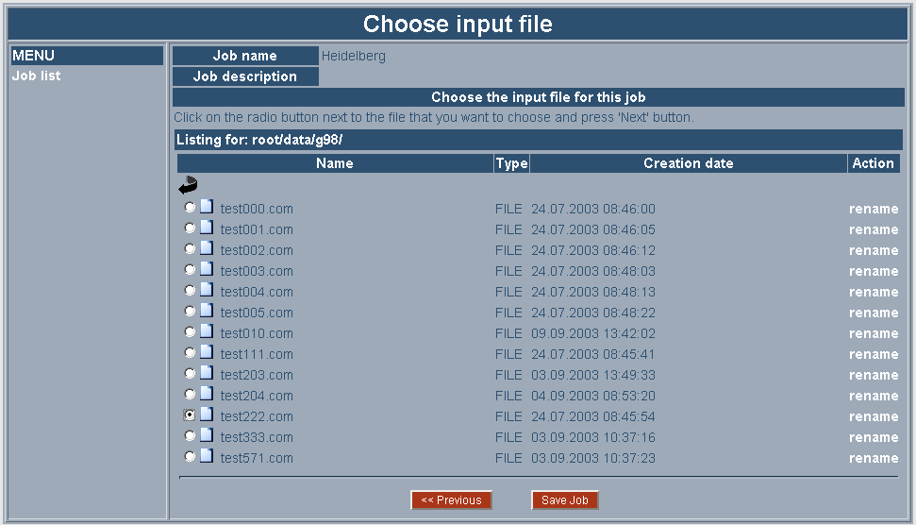
“Gaussian” portlet (2)

Slide 13
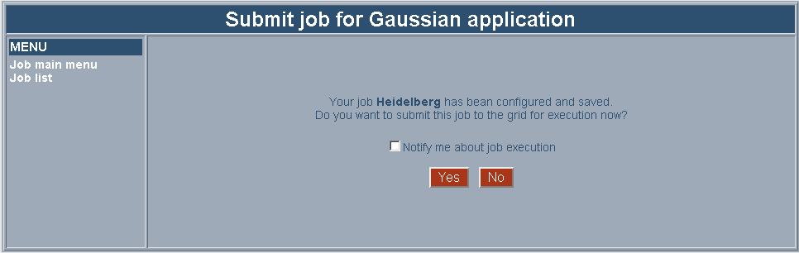
“Gaussian” portlet (3)

Slide 14
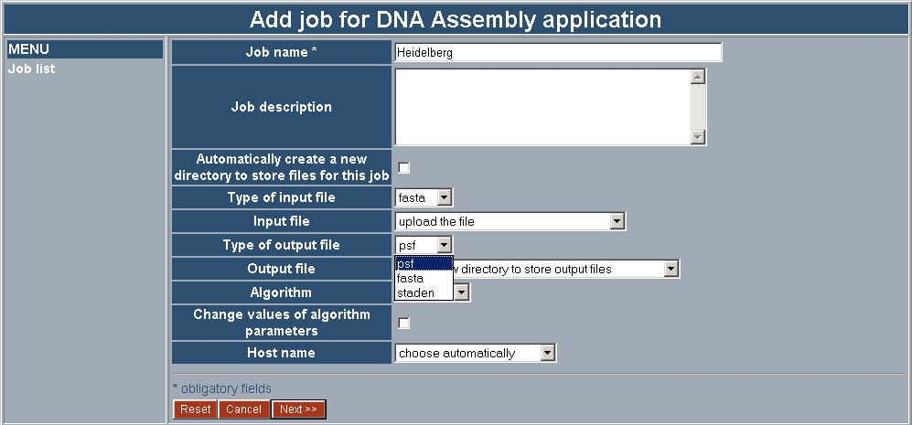
“DNA Assembly” portlet

Slide 15
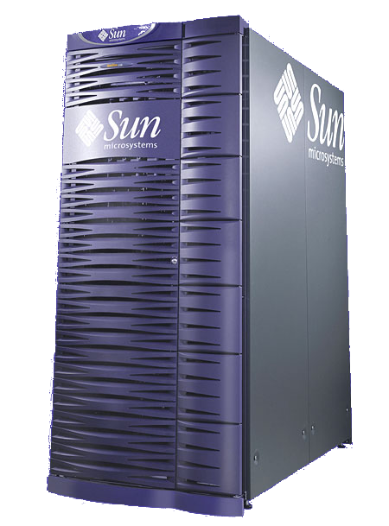
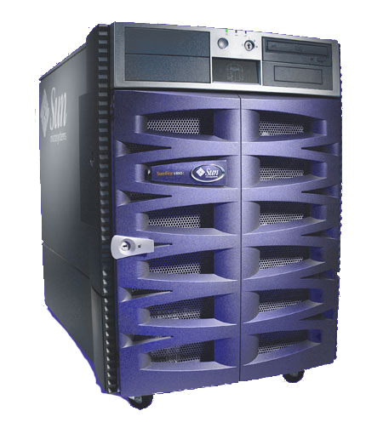
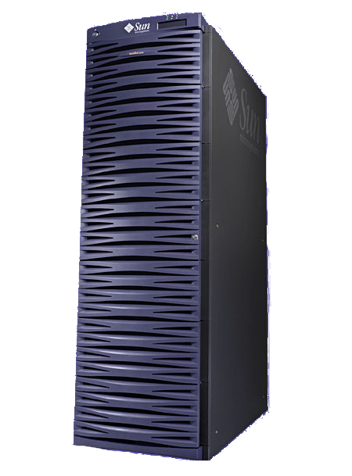
PROGRESS: How do I ...
...access my grid resources, applications, data on the web?
Scientific portal
Portlets
Portlet Framework
Grid Service Provider
Data Management
System
Applications
Grid Infrastructure
Data files
Scientific databases

Slide 16
PROGRESS Package
Enabling your grid infrastructure
„My computing jobs” can be submitted to my grid infrastructure using the core and specialized application portlets
Portlets
Portlet Framework
My grid infrastructure is automatically available within any portlets built with the use of the Portlet Framework
Grid Service Provider
Enable the grid infrastructure within the Job Submission Service with a grid resource broker plug-in
Grid Infrastructure

Slide 17
PROGRESS Package
Enabling your applications within your computing portal
Grid jobs built on top of my applications can be submitted for execution using the core and specialized application portlets
Portlets
Portlet Framework
Build specialized application portlets with the use of the Portlet Framework
Grid Service Provider
Add the application descriptors to the Application Management Service repository
Applications

Slide 18
PROGRESS Package
Enabling your data files within your computing portal
I can manage and utilize „My data” within my grid jobs with the use of the core and specialized application portlets
Portlets
Portlet Framework
My data files are automatically available within any portlets built with the use of the Portlet Framework
Data Management
System
Upload the data files to the Data Management System
Data files

Slide 19
PROGRESS Package
Enabling external scientific databases within your computing portal
I can easily utilize the data found in the databases within my grid jobs with the use of the core and specialized application portlets
Portlets
Portlet Framework
The databases are automatically available within any portlets built with the use of the Portlet Framework
Data Management
System
Enable the scientific databases within the Data Management System
Scientific databases

Slide 20
PROGRESS Package
Usage scenarios
Local
  one research team
  up to 20 team members
  a few applications
  local computing resources
Campus
  several research teams
  each team with their own set of applications
  an organization-wide high performance computing lab
Inter-campus
  a grid infrastructure shared by a few organizations
  each organization features several research team

Slide 21
PROGRESS Package
Local grid-portal environment
Scientific portal
Portlets
Portlet Framework
Grid Service Provider
Data Management
System
Local computing resources

Slide 22
PROGRESS Package
Campus grid-portal environment
Scientific
portal
Scientific
portal
Scientific
portal
Portlets
Portlets
Portlets
Portlet Framework
Grid Service Provider
Data Management
System
HPC Lab

Slide 23
PROGRESS Package
Inter-campus grid-portal environment
Campus 1
Campus 2
Scientific
portal
Scientific
portal
Scientific
portal
Scientific
portal
Scientific
portal
Scientific
portal
Portlets
Portlets
Portlets
Portlets
Portlets
Portlets
Portlet Framework
Portlet Framework
Grid Service
Provider
Data Management System
Data Broker
Data Broker
Grid Service
Provider
Shared Grid Infrastructure

Slide 24
Summary
The PROGRESS project delivers a new scalable architecture for a grid-portal environment
The PROGRESS Package features tools allowing to enable grid resources, applications and data within computing portals
The PROGRESS Package can be used for various usage scenarios in multiple configurations

Slide 25
Conclusion
The PROGRESS Package facilitates the construction of an environment which:
  allows to easily access and enable grid resources within scientific portals: GSP’s Job Submission Service and grid resource broker plug-in mechanism
  allows to easily deploy grid-enabled applications within scientific portals: GSP’s Application Management Service and Portlet Framework
  allows to easily enable scientific data within scientific portals: DMS’s proxy modules to external scientific databanks
  is flexible (Grid Service Provider) and user-friendly (specialized application portlets)

Slide 26
Contact
Email: progress@psnc.pl
WWW: http://progress.psnc.pl/
Download: http://progress.psnc.pl/

