Slide 1

XML-Aware Networking
Rich Salz,
Chief Security Architect
DataPower Technology, Inc.
One Alewife Center
Cambridge, MA 02140
http://www.datapower.com
+1 617 864 0455
Notes:
DataPower is in the XML-Aware Networking Space.

Slide 2
XML Benefits and Costs
XML Has Many Architectural & Business Benefits
  Dramatically lowering cost & time for EAI / b2b
  Flexible websites and one-source publishing
  Code reuse, easy debugging
  XML is foundation for web services
  Broadest industry support since HTTP
…But Also Some Real World Drawbacks
  Scalability: XML is bandwidth, CPU and memory intensive
  Performance: some XML apps literally grind to a halt
  Insecure: connecting systems never before connected
  Insecure: clear text over HTTP with no inherent security
  Standards are still in flux
  Financial, technical and organizational challenge

Slide 3
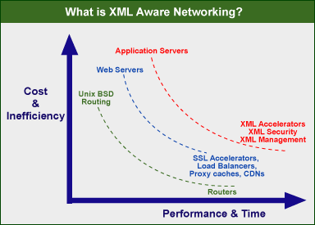
Historical Trend Favors XAN
“Commodity” Processes Migrate to Hardware

Slide 4
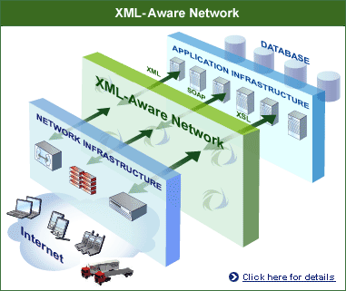
XML-aware Network Infrastructure
The
  Performance
  Security
  Manageability
that you expect from your IP network
for your XML apps

Slide 5


Security and Protocol Layers
end-to-end
WS-Security
XML DSig
XML Encryption
XML Access Control
XML/SOAP
Sender
HTTP
HTTP
Receiver
S
S
Intermediary
point-to-point
point-to-point

Slide 6
Measuring XML Performance
Broad range of XML operations – parse, validate, transform, route, encrypt
Applications operate on messages, not packets
Message size varies from 10 bytes to 1+ gigabyte
XML content complexity varies
Processing can change message size & content
PPS or TPS not very useful
DataPower XSLTMark (2000) – defined throughput as
(bytes_in + bytes_out)/ 2
  Good: gives useful rule-of-thumb
  Bad: does not account for type of XML processing

Slide 7

Anatomy of XML Security Performance
Approved, decrypted and validated SOAP/XML Transaction
Encrypted & Signed
SOAP/XML Transaction
Processing Steps
Parsing
Schema
Validation
XPath
Filtering
XML
Decryption
Signature
Verification
Parsing
Schema
Validation
XML
Transformation
XML
Signing
XML
Encryption
1 3 5 8 8 1 3 10 6 8
Performance is key to security
  Each security function requires XML processing
  Must implement all services without any compromise
  Need ability to scale as content and user base grows
-- Crypto Ops
-- XML Ops

Slide 8
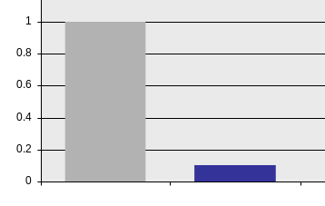
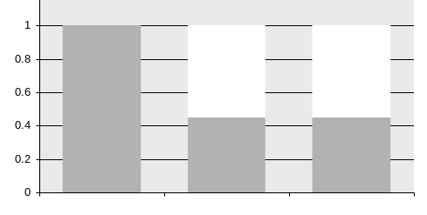
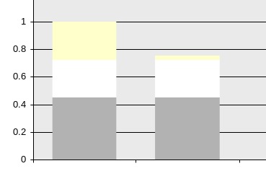
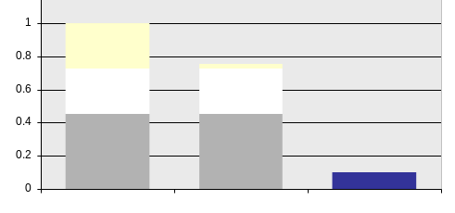
XML Security Performance Analysis
Contribution of XML Processing
to Security
Basic XML Processing
XML
Crypto
Tasks
Crypto
Proc.
Time
Time
XML
Security
Tasks
XML
Proc.
Pure
XML
Tasks
x10
Software
DataPower
Impact of Crypto Accel.
XAN Advantage
Time
Time
Software
Software w/ Crypto Acceleration
Software
Software w/ Crypto Acceleration
DataPower

Slide 9
XML Processors
XML-specific hardware for:
    XPath
    XML Schema
    XML parsing
    Text inspection
Implements Key Standards:
    XML 1.0 & 1.1
    XML Namespaces
    XML Schema
    XPath 1.0
    XSLT 1.0
PCI-X Interface
Parallel processing
Much more power efficient than systems using general purpose CPU

Slide 10

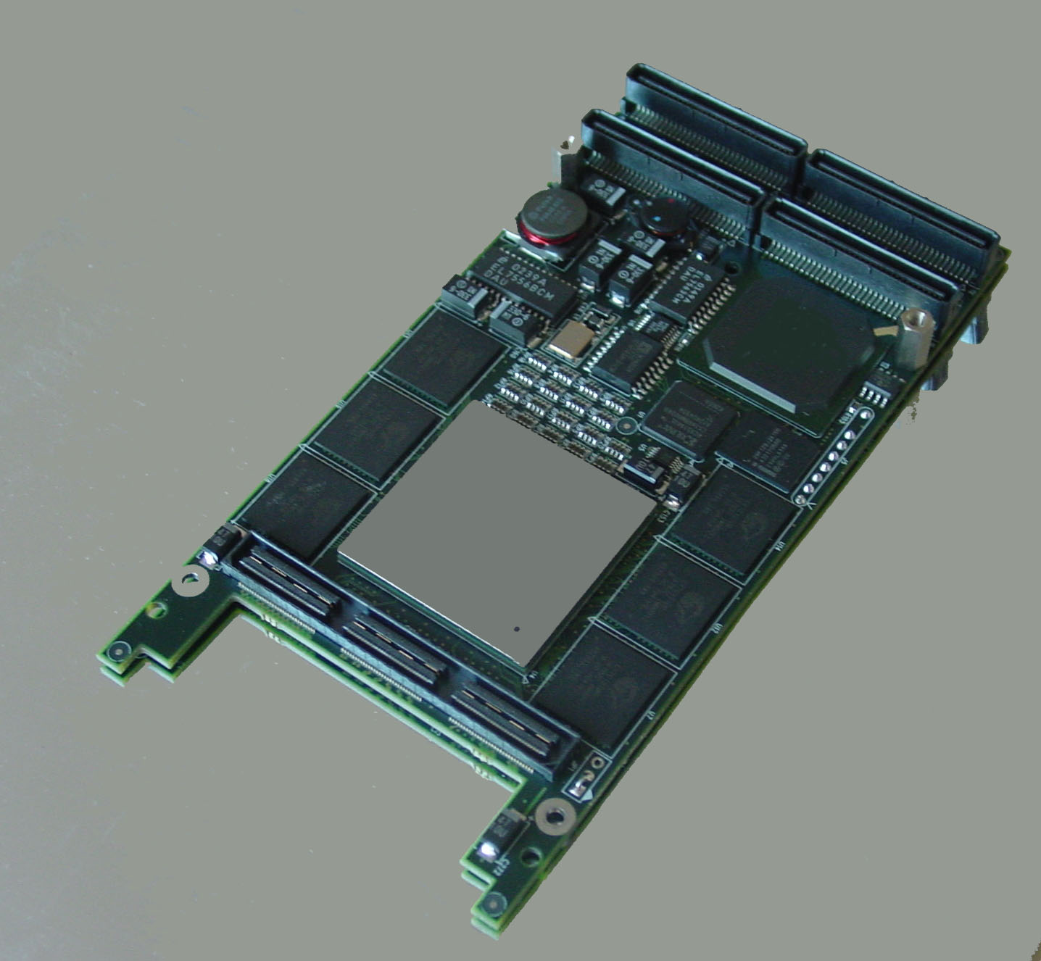

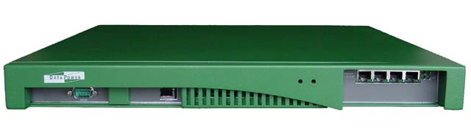
Vendor Example: DataPower
XA35 XML Accelerator
  Offload XML processing
  No more hand-optimizing XML
XG4 XML-aware subsystems
  First to break XML gigabit barrier
  Highly embeddable OEM solution
  Broad applications
XS40 XML Security Gateway
  Security
  Agility – future-proof
  True network device
XI50 Integration Appliance
  Application-oriented networking
  Groundbreaking DOP architecture
  Integrated message-level security
XI50 Integration Device

