Slide 1
Signet and Grouper for Distributed Attribute Administration
Tom Barton
University of Chicago

Slide 2
Group and Privilege Management
Groups
  Who someone is (identity)
  Populations sharing a common characteristic
  Organizational role, departmental, personal
Privileges
  What someone can do (permissions)
  Subject, action, resource, context
Exploring Grouper and Signet…
  Groups for eligibility & authorization
  Privileges, policy & permissions

Slide 3
Identity & Access Management Reality
Each person’s online activities are shaped by many Sources of Authority (SoAs)
  Institutional policy making bodies
  Resource managers
  Program/activity/project heads
  Self
Management of the information it conveys should be distributed
  Hook up all of those SoAs to the middleware
Common IAM infrastructure should be operated centrally
  To not oblige departments/programs/activities/projects to build & operate their own IAM infrastructure

Slide 4
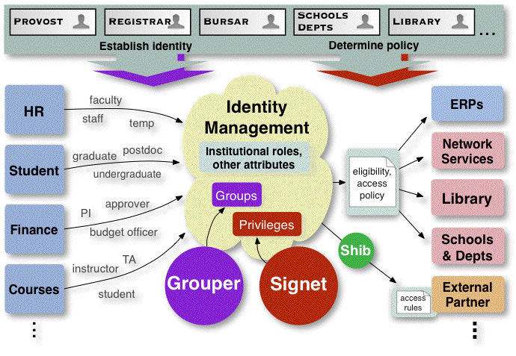
Connecting SoAs, Integrating with Existing Infrastructure

Slide 5
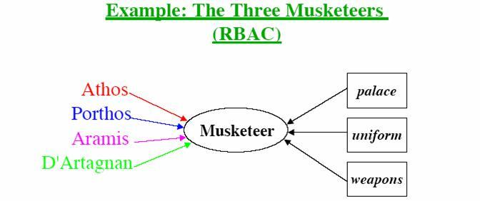
Relative Roles of Signet & Grouper
RBAC model
  Users are placed into groups (aka “roles”)
  Privileges are assigned to groups
  Groups can be arranged into hierarchies to effectively bestow privileges
  Grouper manages, well, groups
  Signet manages privileges
  Separates responsibilities for groups & privileges
Grouper
Signet

Slide 6
Grouper Overview
Mix of manual and automation processes manage a common Group Registry
  Stored in an RDBMS
  Automation processes provision info from the Group Registry to wherever the value of the info warrants spending the resources to place it there
Two types of managed objects: groups and namespaces (or “naming stems”)
  Groups are created & named within namespaces
Group management authority is delegatable
  By group or by namespace

Slide 7
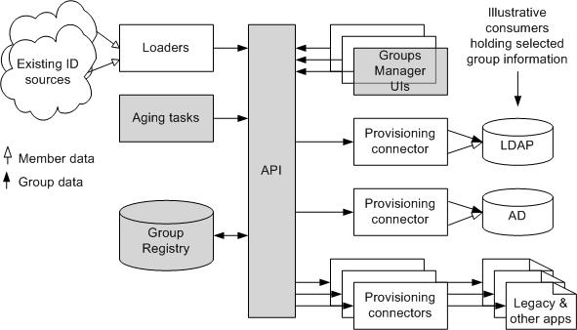
Grouper Architecture

Slide 8
Grouper Groups
Any “subject” can be a group member or privilegee
  Persons, groups, site-defined subject types
  Uses Subject API developed by Grouper+Signet teams
Subgroups (now), compound groups (v1.0), and aging (v1.1) of groups and memberships
Privileges
  ADMIN, UPDATE, READ, VIEW, OPTIN, OPTOUT
Group attribute set can be site-extended

Slide 9
Grouper Namespaces
Groups are created within namespaces
  Limits the authority to create and name groups
  Support distinct activities with own authority
Namespaces can be arranged hierarchically
Privileges
  STEM
    Create subordinate namespaces
    Assign privs for this namespace
  CREATE – create groups in this namespace

Slide 10
Five Ways to Delegate Group Management
Create a group and assign someone to manage its membership (UPDATE)
Create a group and assign someone to manage who manages the group’s membership and who can see what about the group (ADMIN)
Create a namespace and assign someone to create groups within it (CREATE)
Create a namespace and assign someone to manage who can create groups within it (STEM)
Allow Self to OPTIN or OPTOUT of membership

Slide 11

Signet Overview
Analysts define privileges in Signet in functional terms and specify associated permissions
Signet presents this view in a Web UI where users assign privileges and delegate authority across all areas in which they have authority
Signet internally maps assigned privileges into system-specific terms needed by applications
  Stored in an RDBMS, the Privilege Registry
Privileges are published as XML docs, transformed, & provisioned into applications and infrastructure services

Slide 12
Privileges Building Blocks
Functional view
Subsystems
Categories
Functions
Scope, Limits
Prerequisites & Conditions
System view
Permissions
  Subject
  Action
  Resource

Slide 13
Signet Components
Subsystems
Financial system
Student Administration
HR system
Network access management
Research administration
Clinical resources
XYZGrid
Signet (Privilege Registry)
Grouper (Group Registry)
Define domains of ownership and responsibility
Reflect real world boundaries
Can be large or small

Slide 14
Functional View
Subsystems contain…
Functions
The things a person can do; what they are getting privileges for.
Categories
Provide useful arrangement of functions within a subsystem; for reporting, ease of use.
Limits
  Qualifiers, constraints for a privilege.
Scope
  Organizational hierarchy governing distributed delegation,

Slide 15
Functional View ➔ Permissions
Student Admin
Calendar
reserve_time
view_schedules
Course Support
Add/Drop students
Course
Schedule Classes
update_course_data
Facilities
Process Applicants
reserve_room
Financial Aid
Financial
Award Scholarships
view_fund_data
Manage Accounts
update_fund_data
Student
student_records
categories
functions
applicant_data
Functional View
Resources/Permissions

Slide 16
Provisioning Permissions into Applications (connectors)
Calendar
Calendar
reserve_time
<Privileges>
<Subject>
<Permission>
<Permission>
<Permission>
view_schedules
CourseWare
Course
update_course_data
Financials
Facilities
reserve_room
Financial
or
Reporting
view_fund_data
API
update_fund_data
Space Mgmt
Student
student_records
applicant_data
Student

Slide 17
Provisioning Permissions into Infrastructure (LDAP)
Calendar
Calendar
eduPersonEntitlement
reserve_time
view_schedules
CourseWare
Course
update_course_data
Directory
Financials
Facilities
reserve_room
Financial
Reporting
view_fund_data
update_fund_data
Space Mgmt
Student
student_records
applicant_data
Student

Slide 18
Privileges Lifecycle
Conditions
Provides automatic revocation of privileges
Date controls -- from date, until date
Based on person’s status, affiliation, etc.
e.g., as long as person is at Stanford
Prerequisites
Pre-conditions that must be met to activate privileges
e.g., training

Slide 19
Privilege Elements by Example
By authority of the UPCI IRB | grantor
UPCI Researchers | grantee (group/role)
who have an approved UPCI IRB protocol | prerequisite
can access de-identified data and order tissue | function
from the network of caTIES participants | scope
for Study HD7687 | resource
up to 100 patients | limit
until January 1, 2006 as long as approved for material transfer… | conditions
Privilege
Lifecycle

Slide 20
The duck test…
Grouper
Binary info – you’re either in some list or not
Identity- or affiliation-based access control or distribution
Identification layer of an encompassing access management scheme
Locally tweak or combine other groups
Signet
Structured, qualified info – limits, conditions, scope, …
Oriented to individuals rather than roles
Human judgment and chain of authority essential for access decisions
Enable functional, not just technical, people to manage privileges
Supports policy control closer to source of authority
Audit requirements

Slide 21
Signet & Grouper Roadmaps
Now available
  Grouper v0.6. Basic group management, full GUI
  Demo release of Signet v0.5 toolkit and UI
Signet Roadmap
  v0.6, early October 2005 – designated drivers, history
  v1.0, late November 2005 – lifecycle conditions, XML
  v1.1 Toolkit / API release
Grouper Roadmap
  v0.9, mid-November 2005 - internal refactoring, some enhancement
  v1.0, mid-January 2006 – compound groups
  v1.1, mid-March 2006 – group & membership aging

Slide 22

Attribute Management & Delivery:
Affiliation, Privilege, & Privacy
SIS
Person
Registry
uid: jdoe
eduPersonAffiliation: …
isMemberOf: …
eduCourseMember: …
eduPersonEntitlement: …
Loaders
HR
Core Business Systems
Group
Registry
Grouper
LDAP
Subject API
Privilege
Registry
Distributed
Authorities
Signet
Shibboleth/
GridShib
ShARPe
Attribute
Release
Policies
Attribute
Authority
Library ERMs/
Self

Slide 23

Distributed Authorities
Session authentication credential
Attribute Authority
Authorities
Home Org
Affiliated Org
Grid user
Signet, Grouper
Virtual Org
Grid Service

Slide 24
$ ./bin/shibecho -s https://127.0.0.1:8443/wsrf/services/ShibEchoService
---------
Response:
---------
SAMLAttribute
{
name='urn:mace:dir:attribute-def:eduPersonAffiliation'
namespace='urn:mace:shibboleth:1.0:attributeNamespace:uri'
value #1 ='member'
notBefore='2005-09-28T13:47:44Z'
notOnOrAfter='2005-09-28T14:17:44Z'
}SAMLAttribute
{
name='urn:mace:uchicago.edu:attribute-def:ismemberof'
namespace='urn:mace:shibboleth:1.0:attributeNamespace:uri'
value #1 ='vo:xyzgrid:members'
notBefore='2005-09-28T13:47:44Z'
notOnOrAfter='2005-09-28T14:17:44Z'
}

