Slide 1
Use of Kerberos-Issued Certificates at Fermilab
Kerberos → PKI Translation
Dane Skow, Fermilab
Credits to Matt Crawford and Frank Nagy

Slide 2
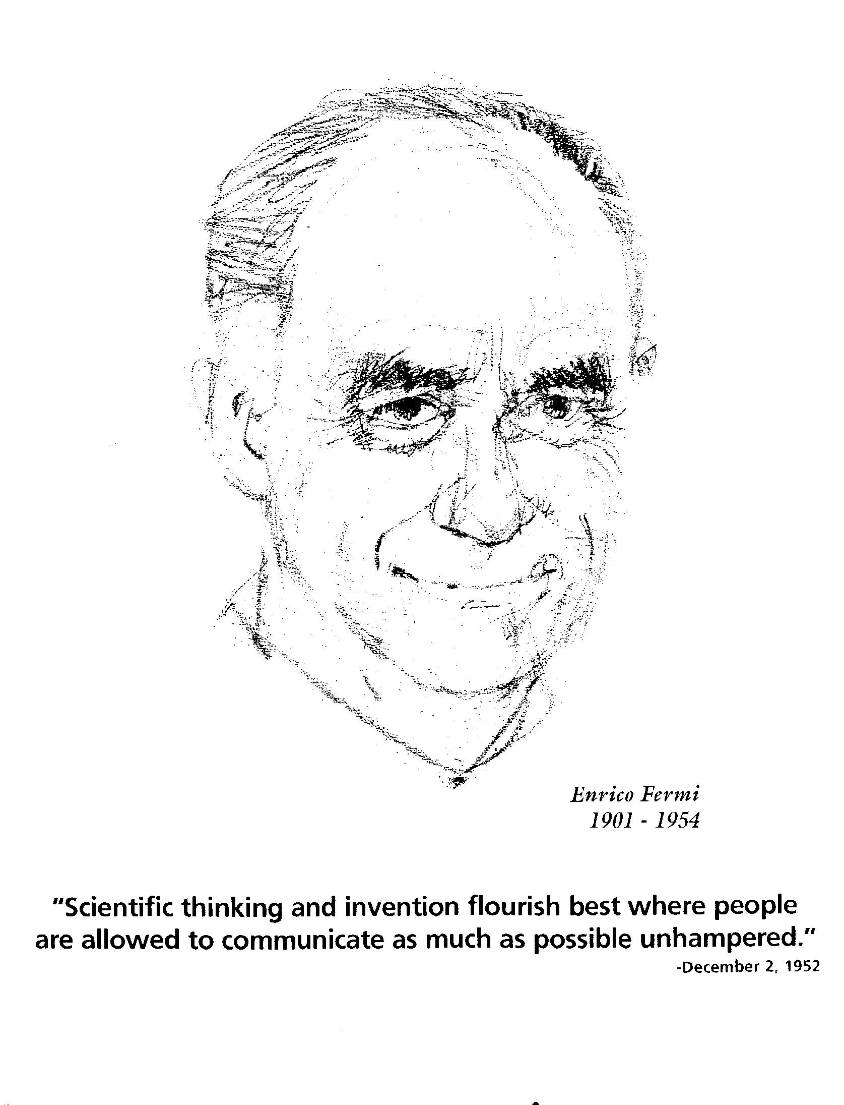
Philosophy
"Scientific thinking and invention flourish best where people are allowed to communicate as much as possible unhampered.”
Enrico Fermi

Slide 3
Kerberos Infrastructure
2 connected domains
  MIT Kerberos V5 based system (Unix + AFS)
  Windows Domain
No passwords on the wire !!
  Kerberos + OTP
Redundant, very high availability infrastructure
  O(Minutes/year) downtime (99.99+% uptime)
O(10⁴) principals, O(10⁶) service tickets/day
Different classes of principals
  (Privileged) Users
  Automata (e.g. kron, services, …)
  “Services acting on behalf of user X”

Slide 4
Why Short-Lived Certificates?
Intuition and measurement both tell us that a significant number of long-lived authentication secrets will be compromised.
The frequency of this event is reduced if the secrets:
  are not stored on computers;
  are not transmitted on the network;
  can be held in organic memory.
The impact of this event is reduced if:
  The owner of the secret can quickly and easily invalidate it and establish a new one.

Slide 5
Passwords vs. Private Keys
Passwords are small secrets (most) users can remember. Private keys are sets of large integers which must be stored - usually in one or more online file systems.
Passwords are easy to change, private keys difficult.
On the other hand, passwords can sometimes be guessed - if an offline attack is possible. Private keys are seldom guessable.

Slide 6
KCA
KCA = Kerberized Certificate Authority
  An online CA which is a Kerberos service.
Client generates an RSA key pair, sends public key to KCA with authentication and integrity protection.
KCA generates the Subject DN, other extensions, and signs a certificate.
  Valid until expiration time of Kerberos ticket.
Client receives certificate, inserts it in the browser cache or Globus proxy file.
Software originated at CITI, U of Michigan.
  Available now through NMI distribution

Slide 7
CA Considerations
The KCA host must be as well protected as any comparable part of the authentication infrastructure - KDC, Domain Controller, ...
Since the CA private key is on-line, it should be short-lived* and easy to replace.
  * Short relative to some other CAs, not to the certificates it signs!
Relying parties (Grid or SSL services) need the KCA public key on file, or another CA key which certifies the KCA.
Certificate revocation: moot.

Slide 8
KCA - LDAP Connection
The KCA accepts only the public key and Kerberos identity from a client. The Kerberos identity is algorithmically transformed into a UserID and an Email address, but the CommonName ("John Smith") is also wanted.
  The CommonName is obtained through a secure LDAP query to the Windows 2000 directory.
  All our Windows 2000 domain user accounts are synchronized with Kerberos v5 user principals.

Slide 9
KCA - DNS Connection
KCA's client, "kx509," locates the KCAs through DNS SRV records, based on the Kerberos realm name.
This obviates any client configuration and achieves failover and load-balancing among redundant servers.

Slide 10
Uses - Grid
Grid users can delegate proxy credentials from a KCA certificate in the usual way.
As long as the Globus toolkit on a grid server can trace a path from a trusted root CA to a user's certificate or proxy, that server can verify a user's identity.
  Simplest deployment: store the KCA's self-signed certificate and signing policy on each server.
  More elegant deployment: KCA fit into a hierarchy of CA's

Slide 11
Uses - Web
Windows client stores user certificate & private key in the registry for browser's use.
*n*x client includes a Netscape cryptographic module which can access the certificate and private key stored among the tickets in the Kerberos credential cache.
An SSL-enabled web server can securely determine the client's UserID, name, Email address and Kerberos principal name.
  Subject DN available to CGI, PHP, etc.
Alternative to IP-based access control

Slide 12
Uses - Other
The Nessus security scanner can act as a TLS-authenticated server.
We provide servers inside and outside the site border and generate, for each registered sysadmin, a list of IP addresses they are responsible for and allowed to scan.
On their own schedules, they authenticate through KCA/kx509, connect to the Nessus server with a GUI client, initiate scans, and receive the reports directly or return for them later.

Slide 13
Operational experience
Lack of standard translation of OID to string has caused some interop problems (eg. UserID, USERID, UID)
Import into browsers viewed as tricky/annoying. BAT integration popular on Windows.
Extremely stable operations. 1 brief outage in 3 years. Modest startup investment
Immediate gratification is appreciated
Stability of Common Name need for Grid not obvious to LDAP maintainers

Slide 14
Usage Statistics
(July and August 2005)
16000 and 140000 proxy generations respectively
  Interesting pattern. Don’t understand yet
Approximately 150 separate individuals
  Usage steady at ~1500 proxies/month
Automata were 850 and 30 respectively
  Able to distinguish both at KCA (principal) and in certificates (subject altname)

Slide 15
Summary
Deploying KCA has linked many TLS/SSL services into our site-wide authentication infrastructure.
Either W2K or KRB5 is a sufficient base to allow deployment of this technology.
  Can serve both at once
The security concerns of an online CA issuing short-lived certificates are no more severe than KDC, kaserver, W2K DC,...
Short-lived certificates require less storage protection than long-lived ones, and fulfil all the most common user requirements.

Slide 16
GGF Security Area Update
Middleware Security BOF moved from Thurs 11AM to 12:30 PM Wednesday in the St. James Room
Security Area meeting moved to Thursday 11AM in the Whittier room

