Slide 1
Differential (De)Serialization for Optimized SOAP Performance
Michael J. Lewis
Grid Computing Research Laboratory
Department of Computer Science
Binghamton University
State University of New York
(with Nayef Abu-Ghazaleh, Madhu Govindaraju)

Slide 2
Motivation
SOAP is an XML-based protocol for Web Services that (usually) runs over HTTP
Advantages
  extensible, language and platform independent, simple, robust, expressive, and interoperable
The adoption of Web Services standards for Grid computing requires high performance

Slide 3
The SOAP Bottleneck
Serialization and deserialization
  The in memory representation for data must be converted to ASCII and embedded within XML
  Serialization and deserialization conversion routines can account for 90% of end-to-end time for a SOAP RPC call [HPDC 2002, Chiu et. al.]
Our approach
  Avoid serialization and deserialization altogether, whenever possible
bSOAP: Binghamton’s SOAP implementation

Slide 4
Overview of the Optimizations
Differential Serialization (DS) (sender side)
  Save a copy of the last outgoing message
  If the next call’s message would be similar, then
    use the previous message as a template
    only serialize the differences from the last message
Differential Deserialization (DDS) (receiver side)
  Checkpoint incoming message portions
  If the next incoming message is similar, then
    use the deserialized values from the last message
    only deserialize the differences from the last message

Slide 5
DS and DDS
DS and DDS are separate, different, disjoint optimization techniques
  sender side (DS) vs. receiver side (DDS)
  data update tracking (DS) vs. parser checkpointing (DDS)
  neither depends on the other
  each takes advantage of sequences of similar messages to avoid expensive SOAP message processing
  neither changes the protocol, what goes in the SOAP message, or on the wire
  each remains interoperable with other SOAP implementations

Slide 6
DS: Update Tracking
How do we know if the data in the next message will be the same as in the previous one?
If it is different, how do we know which parts must be reserialized?
How can we ensure that reserialization of message parts does not corrupt other portions of the message?

Slide 7
Data Update Tracking (DUT) Table
struct MIO { int a; int b; double val;};
int mioArray(MIO[] mios)
Field TPointer SLength FWidth Dirty?
X 5 5 YES
Y 3 7 YES
Z 5 10 NO
POST /mioExample HTTP/1.1
.
<?xml version='1.0'?><SOAP-ENV:Envelope ...>
.
<x xsi:type='xsd:int'>12345</x>
<y xsi:type='xsd:int'>678</y>
<z xsi:type='xsd:double'>1.166</val>
.
</SOAP-ENV:Envelope>

Slide 8
Problems and Approaches
Problems
  Some fields require reserialization
  The current field width may be too small for the next value
  The current message (or chunk) size may be too small
Solving these problems enables DS, but incurs overhead
Approaches
  shifting
  chunking
  stuffing
  stealing
  chunk overlaying

Slide 9
Shifting
Shifting: Expand the message on-the-fly when the serialized form of a new value exceeds its field width
  Shift the bytes of the template message to make room
  Update DUT table entries for all shifted data
…</w><x xsi:type='xsd:int'>1.2</x><y xsi:type=….
becomes
…</w><x xsi:type='xsd:int'>1.23456</x><y xsi:type=….
  Performance penalty
    DUT table updating, memory moves, possible memory reallocation

Slide 10
Stuffing
Stuffing: Allocate more space than necessary for a data element
  explicitly when the template is first created, or after serializing a value that requires less space
  Helps avoid shifting altogether
  Doesn’t work for strings, base64 encoding
…<y xsi:type='xsd:int'>678</y><z xsi:type=…
can be represented as
…<y xsi:type='xsd:int'>678</y><z xsi:type=…

Slide 11
Stealing
Stealing: Take space from nearby stuffed fields
  Can be less costly than shifting [ISWS ‘04]
…'>678</y><z xsi:type='xsd:double'>1.166</val>
y can steal from z to yield…
…'>677.345</y><z xsi:type='xsd:double'>1.166</val>
Performance depends on several factors
  Halting Criteria: When to stop stealing?
  Direction: Left, right, or back-and-forth?

Slide 12
Performance
Performance depends on
  which techniques are invoked
  “how different” the next message is
    Message Content Matches
      identical messages, no dirty bits
    Perfect Structural Matches
      data elements and their sizes persist
    Partial Structural Matches
      some data elements change size
      requires shifting, stealing, stuffing, etc.
We study the performance of all our techniques on synthetic workloads of scientific data
summary: 17% → 10X improvement

Slide 13
Perfect Structural Matches
Perfect Structural Matches:
  Some data items must be overwritten (DUT table dirty bits)
  No shifting required
Performance study:
  vary the message size
  vary the reserialization percentage
  vary the data type
    Doubles and
    Message Interface Objects (MIO’s, <int, int, double>) (not shown)

Slide 14
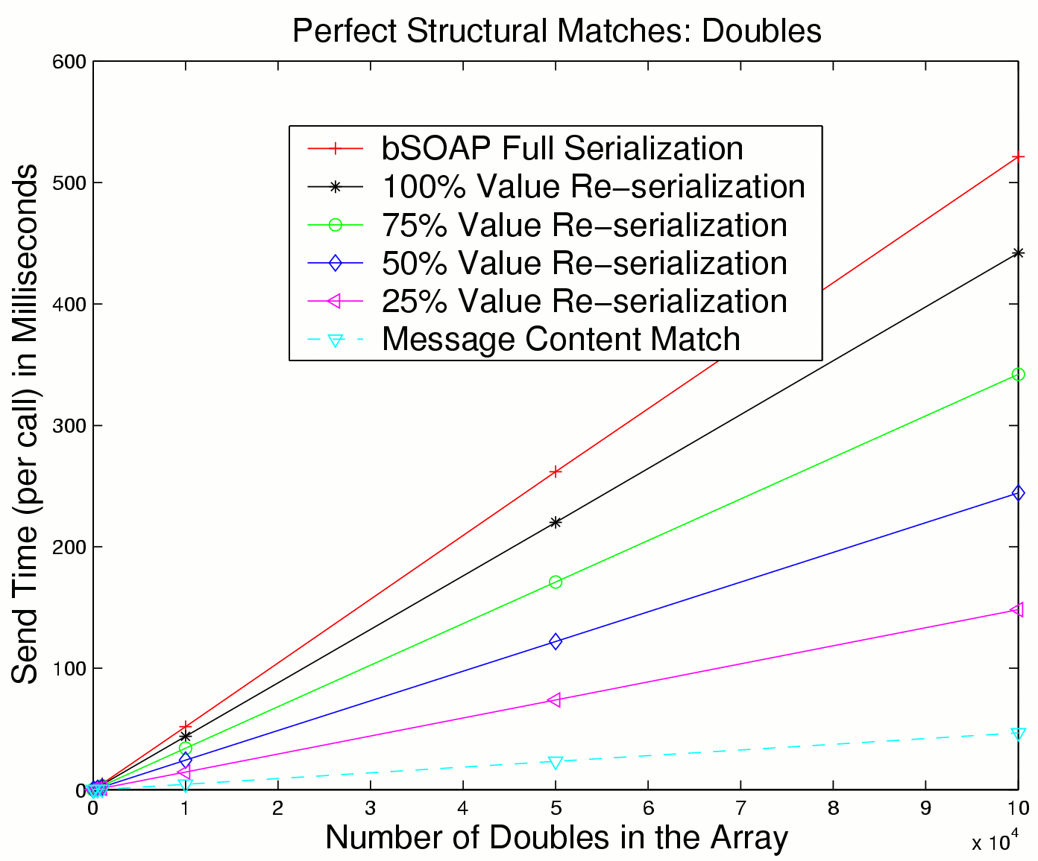
  Send Time depends directly on % serialized
  Important to avoid reserializing

Slide 15
DDS: The Approach
As an incoming message is being processed
  store parser states periodically
  compute corresponding message portion checksums
For subsequent (hopefully similar) messages
  compare incoming message checksums with stored checksums (fast mode parsing)
  if checksums match
    the parser can skip to the next parser state without actually generating it from the incoming message
  on checksum mismatch
    revert to regular mode parsing

Slide 16
Effectiveness
Depends on…
Similarity in consecutive messages
  determines how often in fast mode
How much faster fast mode is
  deserialization vs. checksum calc and compare
Efficiency in identifying mode switches
Checkpoint and checksum overhead

Slide 17
Creating Checkpoints
First one right after start tag that contains the name of the back end element
Thereafter, checkpoints are created periodically
  based on number of bytes processed
  configurable parameter of bSOAP
  Tradeoff: overhead vs. fast mode processing time
  standard implementation: full parser checkpoints
  optimization [Grid 2005]: differential checkpoints

Slide 18
Fast mode parsing
Parser reads messages and computes checksums on message portion boundaries
  a match allows the parser to “skip” to the next saved state
Switching back to fast mode
  must compare current and stored parser states
  matching stack contains necessary structural info
  namespace aliases must also be the same
    stored and checked separately

Slide 19
Performance Summary
Without DDS: comparable to gSOAP
DDS Overhead
  message portions 256 → 4K; overhead < 10%
  message portion size 32 bytes too small
DDS improvement
  large “hard to deserialize” messages, very similar → 25X speedup (upper bound)
  Dual mode performance
    depends on message portion size, where and how often mode switches take place
    can reduce by a factor of 3, or be slightly slower

Slide 20
Benchmark Suite for SOAP-Based Grid Web Services
Motivation
  Web services based applications have diverse requirements
  SOAP and XML present design and implementation challenges
  Several novel efforts exist to address key bottlenecks
    examples can be found in gSOAP, bSOAP, .NET
A benchmark suite
  can help determine the best available toolkit
  based on communication patterns and data structures in use
Benchmarks and performance evaluation framework
  Drivers, WSDL files and Java code
  helps provide insights on opportunities for optimization
Madhu Govindaraju: mgovinda at cs.binghamton.edu
http:// grid.cs.binghamton.edu / projects / soap_bench

Slide 21
Thank You
For More information
  Grid Computing Research Laboratory
  SUNY – Binghamton: Computer Science Department
  http:// grid.cs.binghamton.edu
  mlewis at binghamton.edu
  DS: [HPDC ’04], [IC ‘04]
  DDS: [SC ’05], [Grid2005]

Slide 22
Extra Slides

Slide 23
Experimental Setup
Machines
  Dual Pentium 4 Xeon 2.0 GHz, 1 GB DDR RAM, 15K RPM 18 GB Ultra-160 SCSI drive.
Network
  Gigabit Ethernet.
OS
  Debian Linux. Kernel version 2.4.24.
SOAP implementations
  bSOAP and gSOAP v2.4 compiled with gcc version 2.95.4,
  flags: -O2
  XSOAP 1.2.28-RC1 compiled with JDK 1.4.2
  bSOAP/gSOAP socket options: SO_KEEPALIVE, TCP_NODELAY,SO_SNDBUF = SO_RCVBUF = 32768
  Dummy SOAP Server (no deserialization).

Slide 24
Message Content Matches
Message Content Match:
  The entire stored message template can be reused without change
  No dirty bits in the DUT table
  Best case performance improvement
Performance Study
  compare gSOAP, XSOAP, and bSOAP, with differential serialization on and off
  vary the message size
  vary the data type: doubles and MIO’s (not shown)

Slide 25
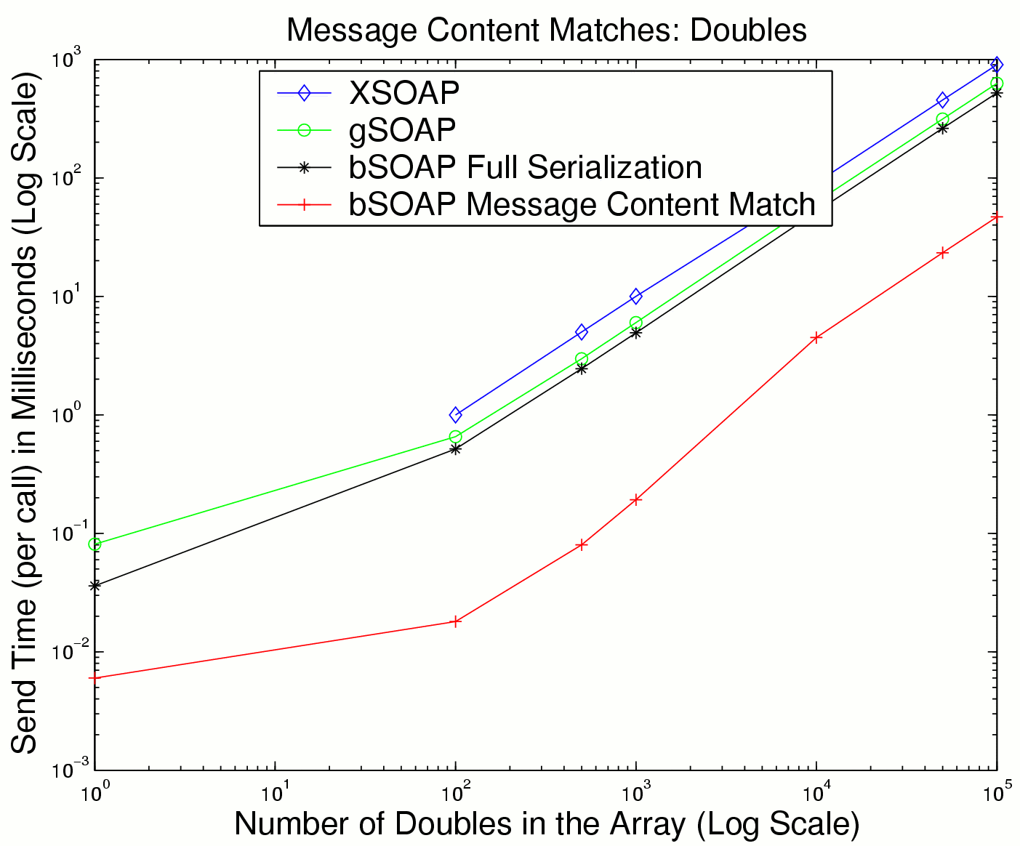
  bSOAP ~= gSOAP
  10X imprvmt in DS
    (expected result)
    Upper bound

Slide 26
Shifting
Partial Structural Match:
  Not all of array elements are reserialized
Performance Study
  Intermediate size values to maximum size values.
  Array of doubles (18 → 24)
  Array of MIO’s (36 →46) (not shown)

Slide 27
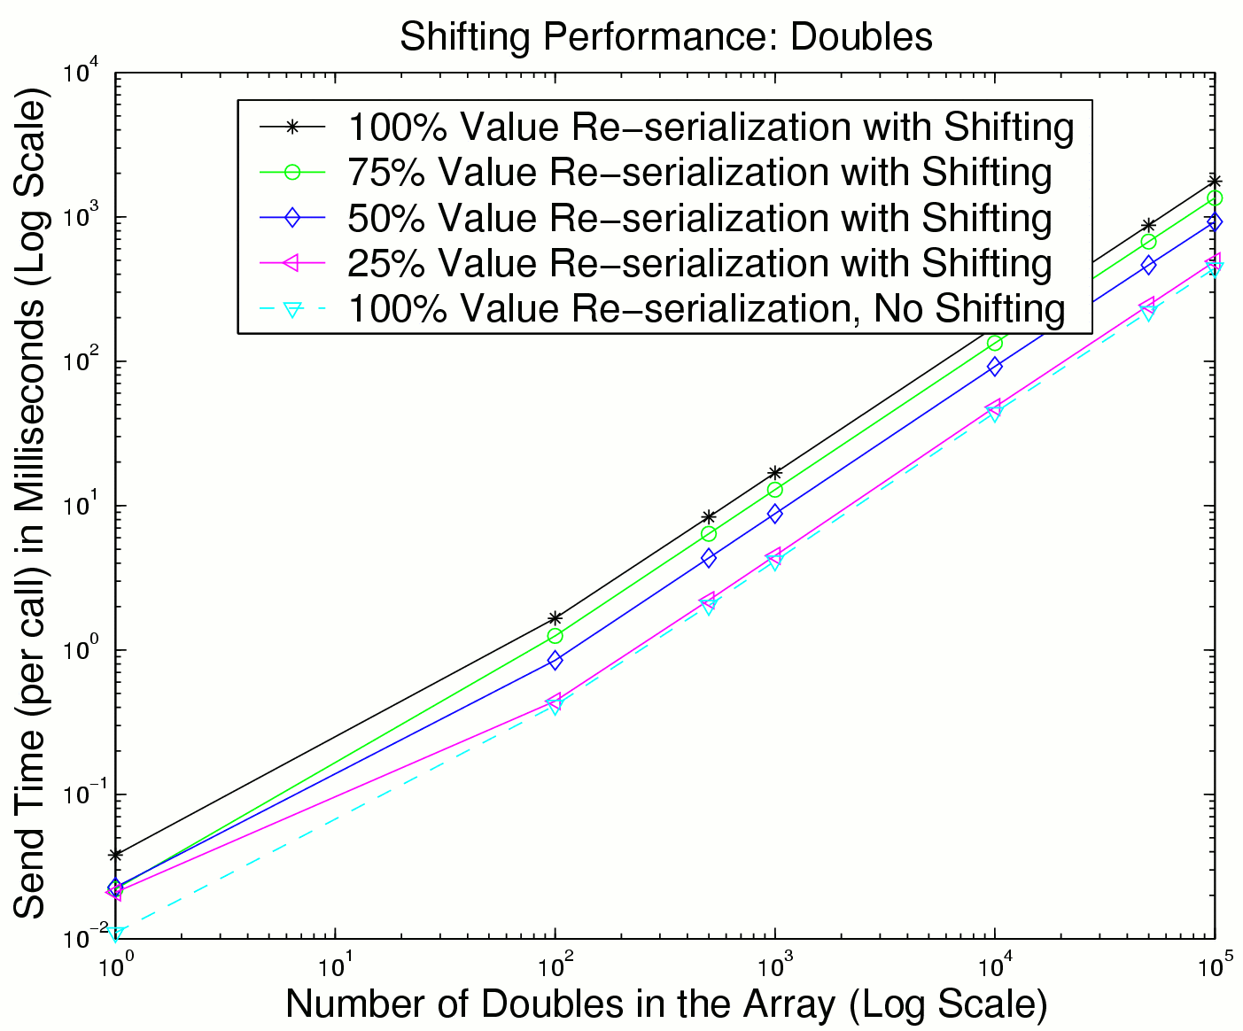
100% → 75%: Imprvt 23%
75% → 50%: Imprvt 31%
50% → 25%: Imprvt 46%

Slide 28
Stuffing
Closing Tag Shift:
  Stuffed whitespace comes after the closing tag
  Must move the tag to accommodate smaller values
Performance Study
  send smallest values (1 char)
  vary field size: smallest, intermediate, maximum
  Array of doubles (max = 24, intermediate = 18, min = 1)
  Array of MIOs
    (max = 46, intermediate = 38, min = 3) (not shown)

Slide 29
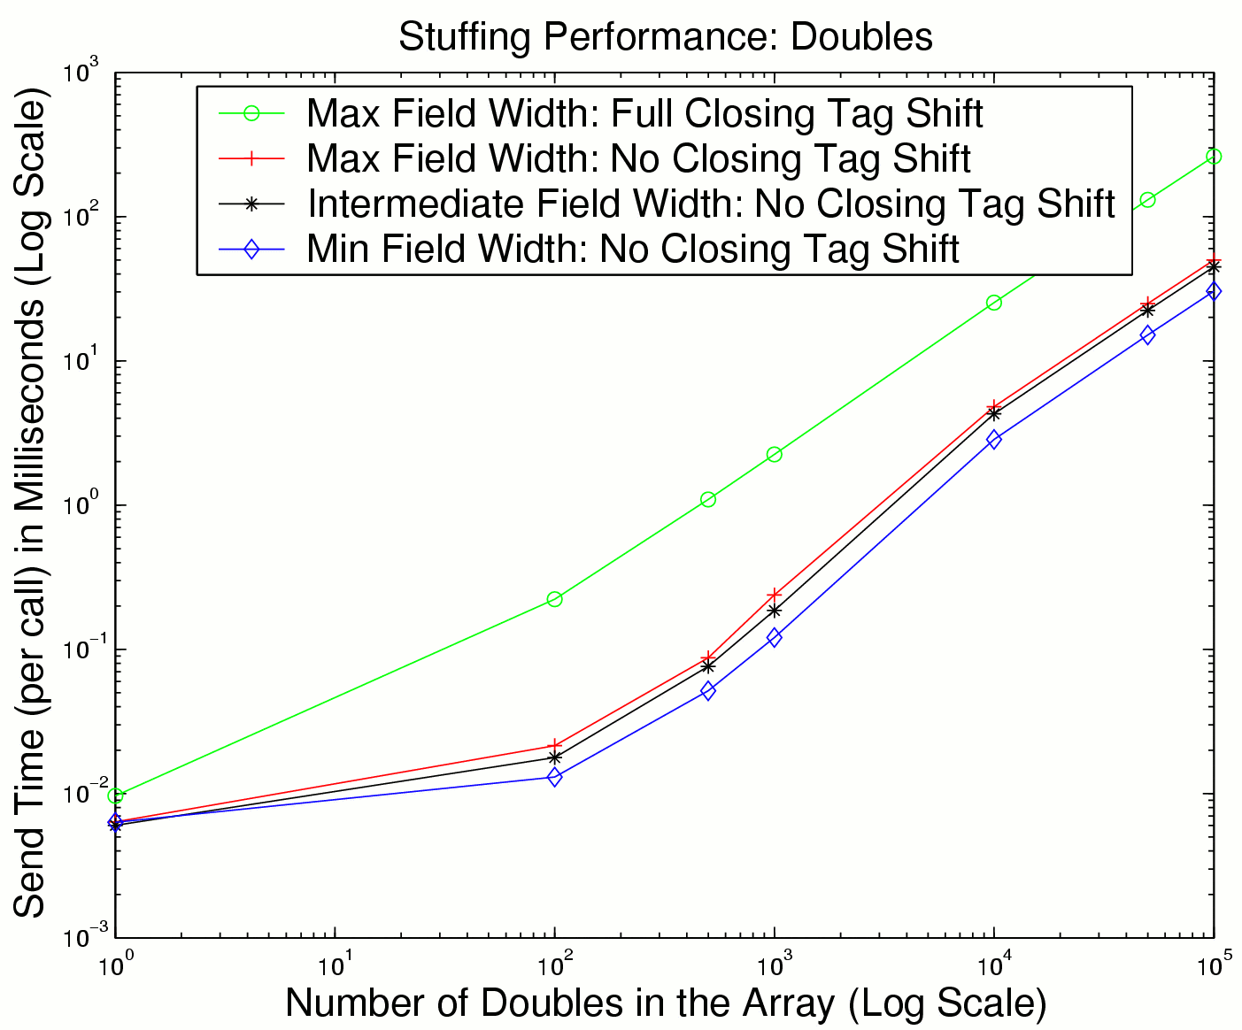
Closing tag shift, not increased message size, effects stuffing performance

Slide 30
Summary
SOAP performance is poor, due to serialization and deserialization
Differential serialization
  Save a copy of outgoing messages, and serialize changes only, to avoid the observed SOAP bottleneck
Techniques:
  Shifting, chunking, chunk padding, stuffing, stealing, chunk overlaying
Performance is promising (17% to 10X improvement), depends on similarity of messages

Slide 31
Other Approaches
SOAP performance improvements
  Compression
  Base-64 encoding
  External encoding: Attachments (SwA), DIME
These approaches may be necessary and can be effective. However
  they undermine SOAP’s beneficial characteristics
  interoperability suffers
The goal
  improve performance, retain SOAP’s benefits

Slide 32
Applications that can Benefit
Differential Serialization is only beneficial for applications that repeatedly resend similar messages
Such applications do exist:
  Linear system analyzers
  Resource information dissemination systems
  Google & Amazon query responses
  etc.

Slide 33
Data Update Tracking (DUT) Table
Each saved message has its own DUT table
Each data element in the message has its own DUT table entry, which contains:
  Location: A pointer to the data item’s current location in the template message
  Type: A pointer to a data structure that contains information about the data item's type.
  Serialized Length: The number of characters needed to store the last written value
  Field Width: The number of allocated characters in the template
  A Dirty Bit indicates whether the data item has been changed since the template value was written

Slide 34
Updating the DUT Table
DUT table dirty bits must be updated whenever in-memory data changes
  Current implementation
    explicit programmer calls whenever data changes
  Eventual intended implementation
    more automatic
    variables are registered with our bSOAP library
    data will have accessor functions through which changes must be made
    when data is written, the DUT table dirty bits can be updated accordingly
      disallows “back door” pointer-based updates
      requires calling the client stub with the same input param variables

Slide 35
Worst Case Shifting
“Worst case shifting”:
  All values are reserialized from smallest size values to largest size values.
Performance Study
  vary the chunk size (8K and 32K)
  Array of doubles (1 → 24).
  Array of MIOs (3 → 46) (not shown)

Slide 36
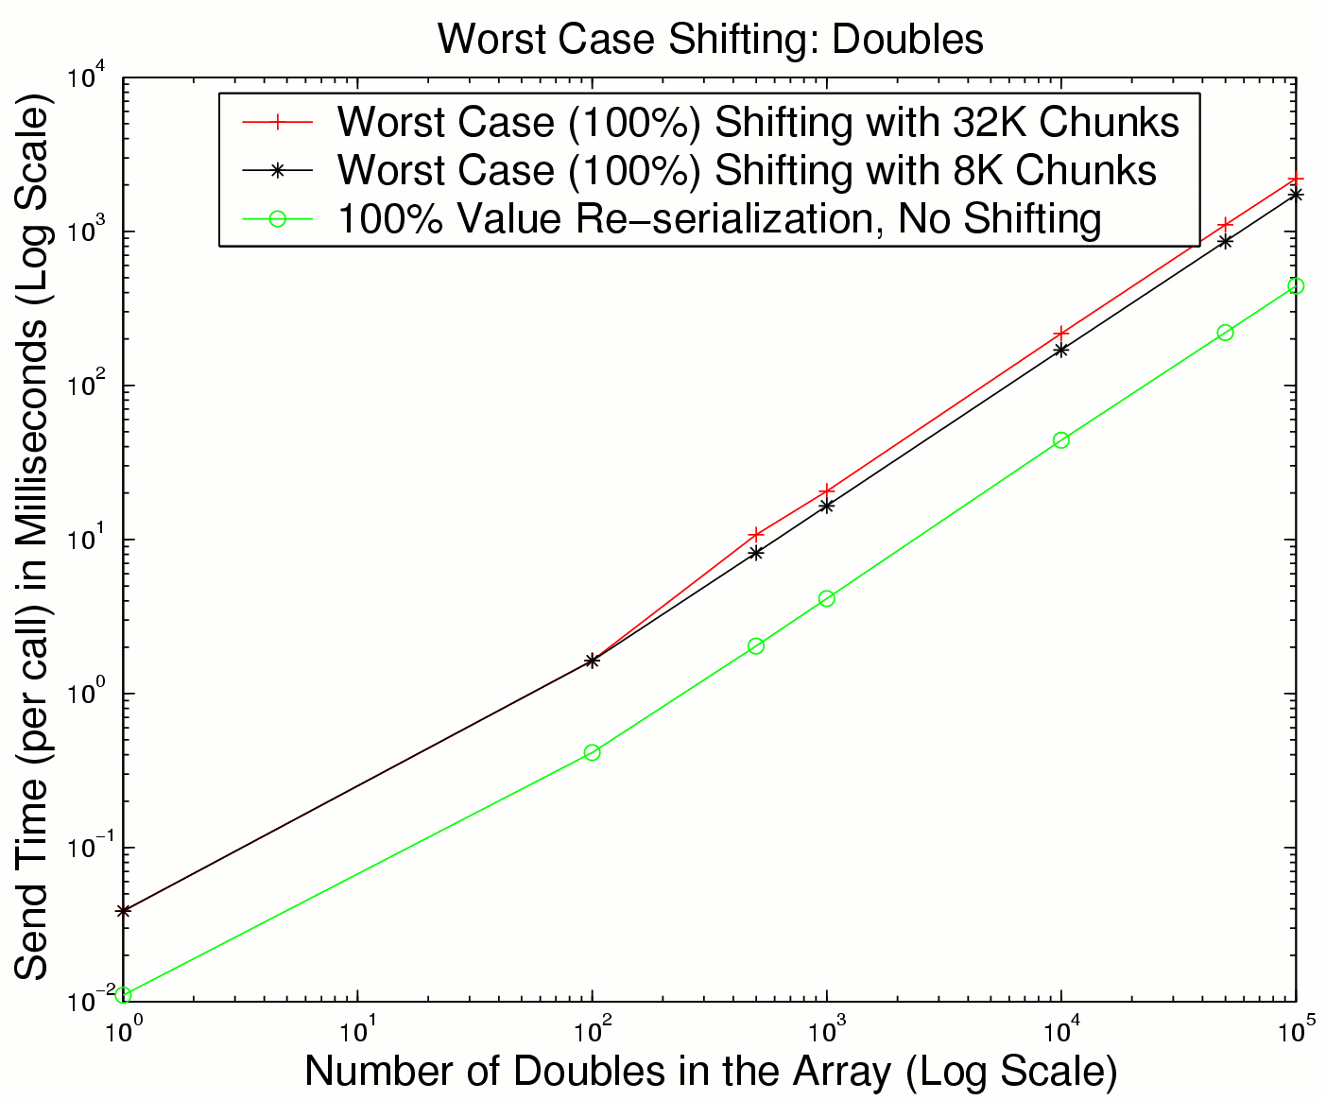
Worst case shifting is 4X slower
Reducing chunk size doesn’t help

