Slide 1
Integrating MyProxy with
Site Authentication
Jim Basney
Senior Research Scientist
National Center for Supercomputing Applications
University of Illinois at Urbana-Champaign
jbasney@ncsa.uiuc.edu
http://myproxy.ncsa.uiuc.edu/

Slide 2
MyProxy
A service for obtaining X.509 PKI credentials
  A combined credential repository and certificate authority
An Online Credential Repository
  Issues short-lived X.509 Proxy Certificates
  Long-lived private keys never leave the MyProxy server
An Online Certificate Authority
  Issues short-lived X.509 End Entity Certificates
Supporting multiple authentication methods
  Passphrase, Certificate, PAM, SASL, Kerberos
Open Source Software
  Included in Globus Toolkit 4.0

Slide 3
MyProxy Logon
Authenticate to retrieve PKI credentials
  End Entity or Proxy Certificate
  Trusted CA Certificates
  Certificate Revocation Lists
MyProxy maintains the user’s PKI context
  Users don’t need to manage long-lived credentials
  Enables server-side monitoring and policy enforcement
    For example: passphrase quality checks
  CA certificates and CRLs updated automatically at login

Slide 4
MyProxy Online Credential Repository
Stores X.509 End Entity and Proxy credentials
  Private keys encrypted with user-chosen passphrases
  Credentials may be stored directly by user/administrator or via proxy delegation protocol
  Users can store multiple credentials from different CAs
Access to credentials controlled by user and administrator policies
  Set authentication requirements
  Control whether credentials can be retrieved directly or
  if only proxy delegation is allowed
  Restrict lifetime of retrieved proxy credentials

Slide 5
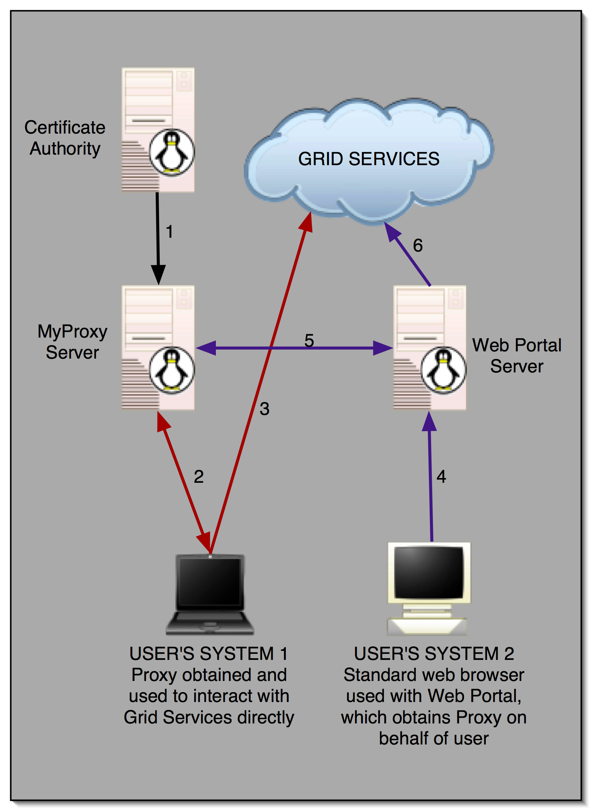


MyProxy and Grid Portals

Slide 6
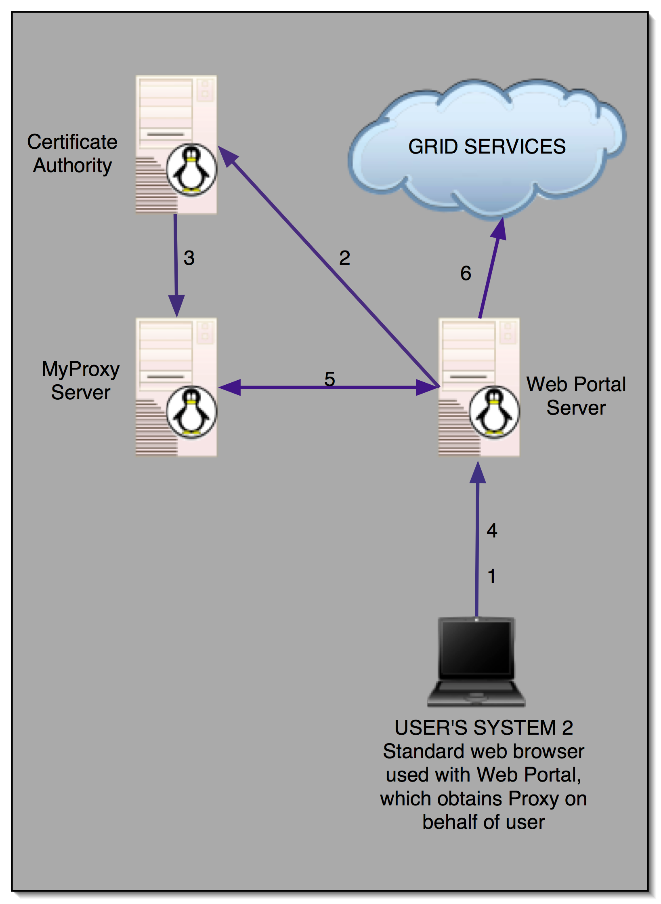

User Registration Portals
PURSE:
Portal-based User Registration Service
GAMA:
Grid Account Management Architecture
ESG

Slide 7

MyProxy Online Certificate Authority
Issues short-lived X.509 End Entity Certificates
  Leverages MyProxy authentication mechanisms
  Compatible with existing MyProxy clients
Ties in to site authentication and accounting
  Using PAM and/or Kerberos authentication
  “Gridmap” file maps usernames to certificate subjects
Avoid need for long-lived user keys
Server can function as both CA and repository
  Issues certificate if no credentials for user are stored

Slide 8
Pluggable Authentication Modules
Flexible, standard authentication mechanism
  Specified by DCE RFC 86.0
  Supported by Unix/Linux vendors
Many available modules:
  Authentication: Unix Password, One Time Password, Radius, Kerberos, AFS, LDAP, SQL, SMB, Netware
  Access Control: Access, Deny, Filter, Tally, Time
MyProxy server PAM support
  Configure PAM authentication as sufficient or required
  Create standard PAM configuration file for MyProxy
  Compatible with existing MyProxy clients

Slide 9
Simple Authentication and Security Layer
Authentication protocol framework
  Specified by IETF RFC 2222
  Used by LDAP, POP, and IMAP
Supports multiple mechanisms:
  PLAIN, DIGEST-MD5, GSSAPI, NTLM
MyProxy support:
  Configure available mechanisms for client and server
  Tested with GSSAPI (Kerberos) and PLAIN
Use Kerberos ticket to obtain PKI credentials from MyProxy

Slide 10
Conclusion
MyProxy leverages site authentication
  Using PAM and SASL to obtain PKI session credentials
MyProxy eases credential distribution
  User Registration Portals provide an interface for loading credentials into MyProxy
  Online CA distributes credentials using existing MyProxy clients and authentication methods
For more information:
  http://myproxy.ncsa.uiuc.edu/
  jbasney@ncsa.uiuc.edu

