Slide 1
MyProxy Integration with PubCookie
Marty Humphrey*, Jim Jokl*, and Jim Basney**
*Department of Computer Science, University of Virginia, Charlottesville, VA
**NCSA/University of Illinois, Urbana-Champaign, IL
Supported by: NSF Next Generation Software (NSF NGS), NSF Middleware Initiative (NMI), San Diego Supercomputing Center

Slide 2
The Challenge
I have a dream…
  Opportunistically expand campus researchers’ local resources to “The Grid”
[Security] Problem:
  Relatively little of campus is PKI-enabled
  Grid is (largely) PKI (GSI)
Goal: Leverage existing site (campus) authentication infrastructure
  Approach: integrate PubCookie and MyProxy

Slide 3
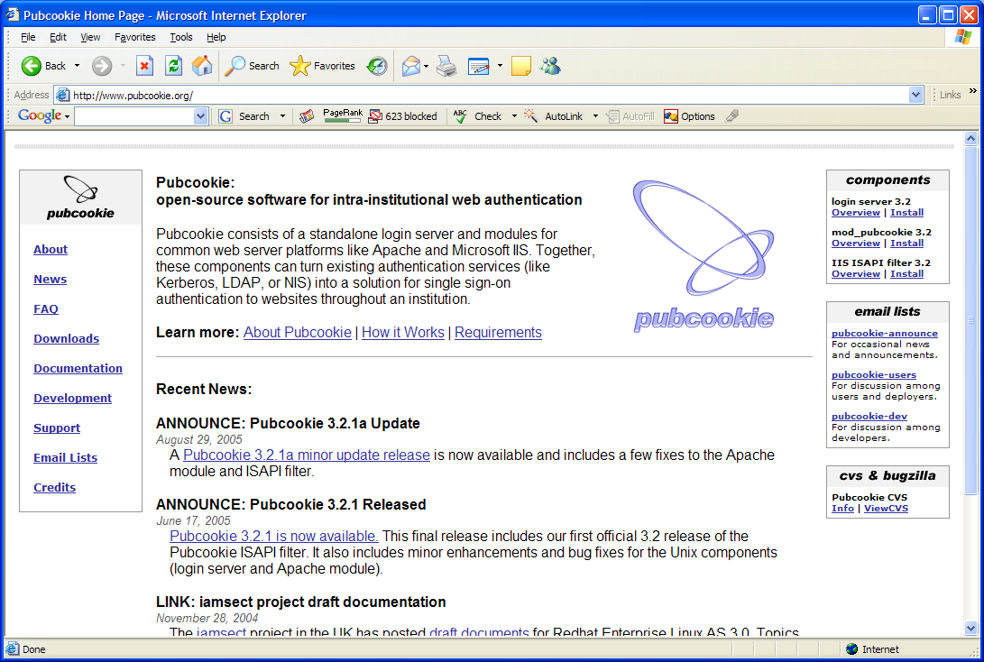
PubCookie

Slide 4
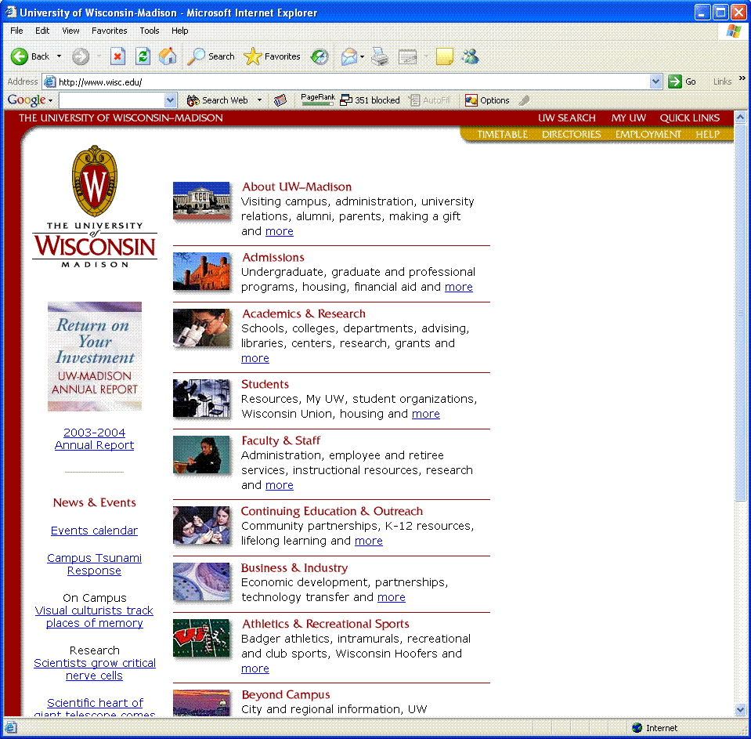
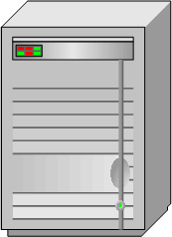
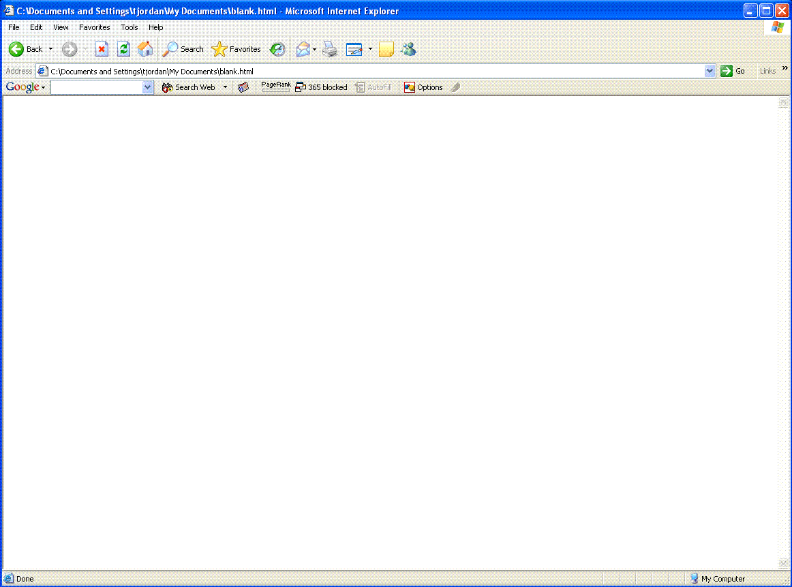
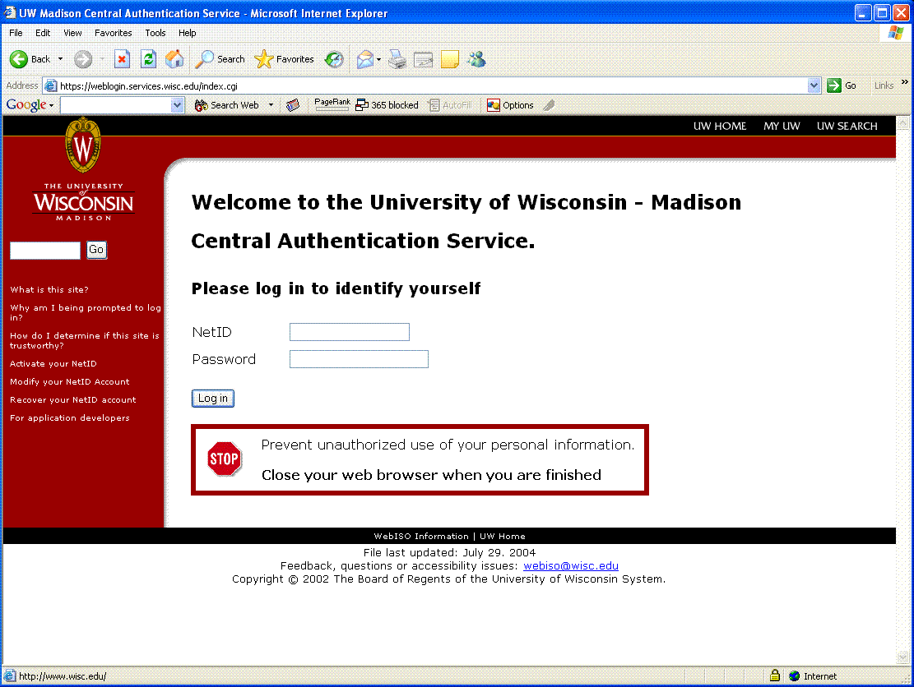
PubCookie in Action (1)
PC
Pubcookie Apache Module or ISAPI Filter
Your IIS or Apache Web Server
End-User
Campus Login Server
From Tom Jordon, UW-Madison

Slide 5
PubCookie in Action (2)
PC
Pubcookie Apache Module or ISAPI Filter
Authenticated to Central Login Server?
Your IIS or Apache Web Server
-- Nope
End-User
Campus Login Server
From Tom Jordon, UW-Madison

Slide 6
PubCookie in Action (3)
PC
Pubcookie Apache Module or ISAPI Filter
Your IIS or Apache Web Server
End-User
Login
Redirect
Logged In
Campus Login Server
From Tom Jordon, UW-Madison

Slide 7
PubCookie in Action (4)
PC
Pubcookie Apache Module or ISAPI Filter
Authenticated to Central Login Server?
Your IIS or Apache Web Server
-- Yep
Access Allowed
End-User
Redirect
Logged In
Campus Login Server
From Tom Jordon, UW-Madison

Slide 8
PubCookie in Action (5)
PC
Pubcookie Apache Module or ISAPI Filter
Your IIS or Apache Web Server
Authenticated to Central Login Server?
-- Yep
Access Allowed
PC
Pubcookie Apache Module or ISAPI Filter
End-User
Another IIS or Apache Web Server
Logged In
Campus Login Server
From Tom Jordon, UW-Madison

Slide 9
PubCookie/MyProxy Integration
Campus Authentication Server
5
Pubcookie Login Server
4
MyProxy Server
9 (SSL)
3
Pubcookie-enabled Application Server
6
2
8 (SSL)
1
10
Grid request
7
11
Browser
12

Slide 10
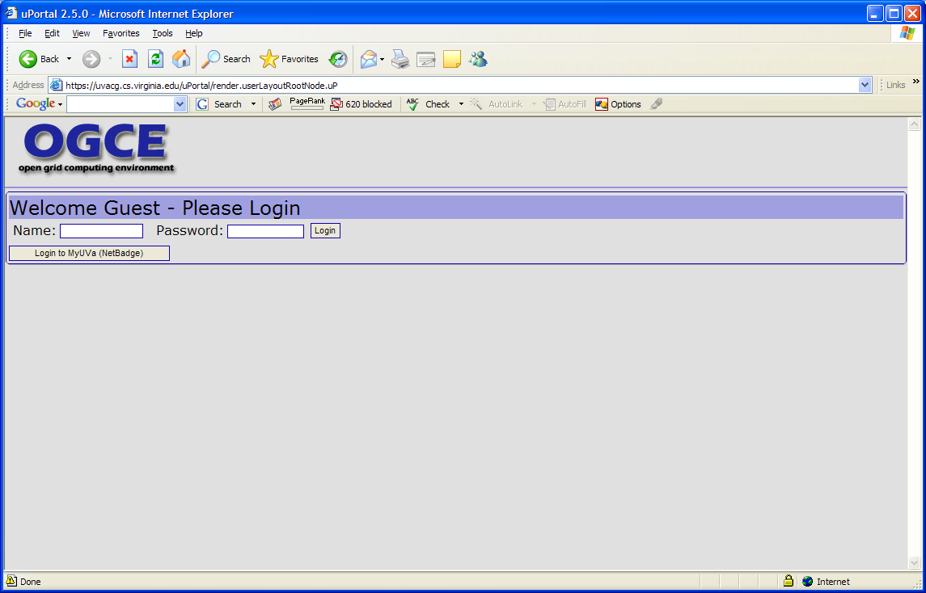

Slide 11
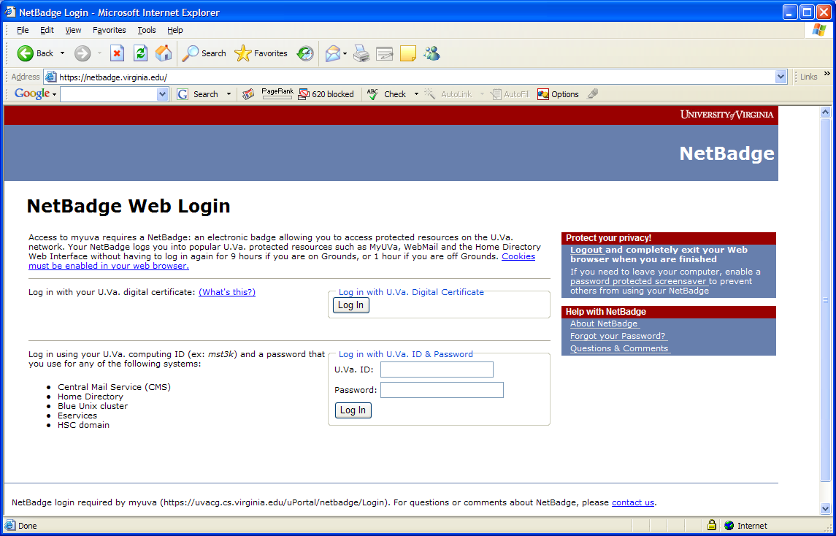

Slide 12
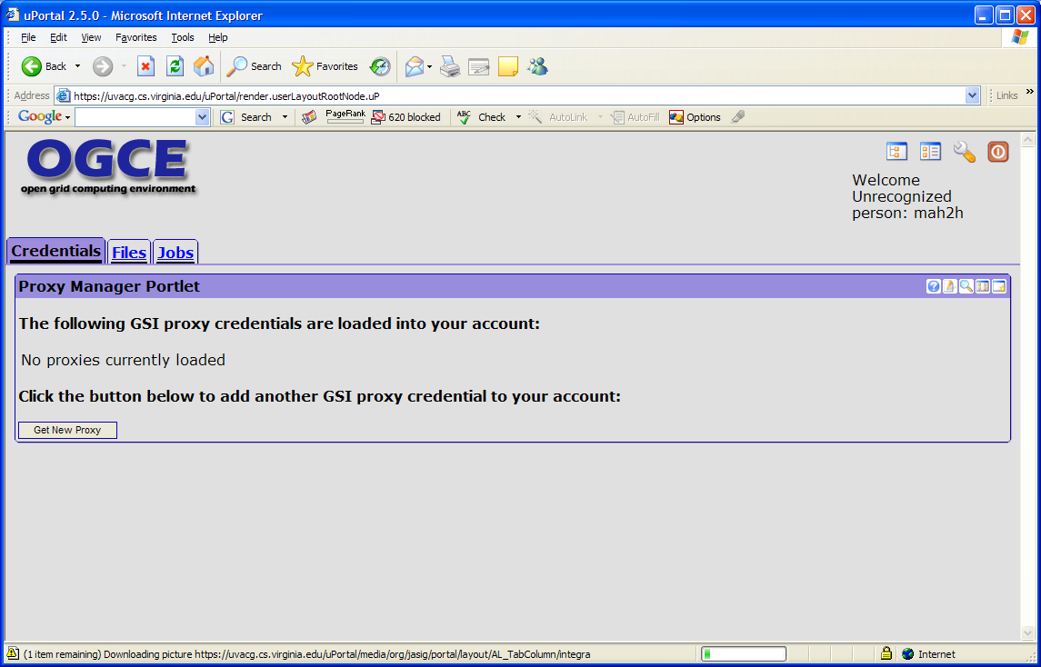

Slide 13
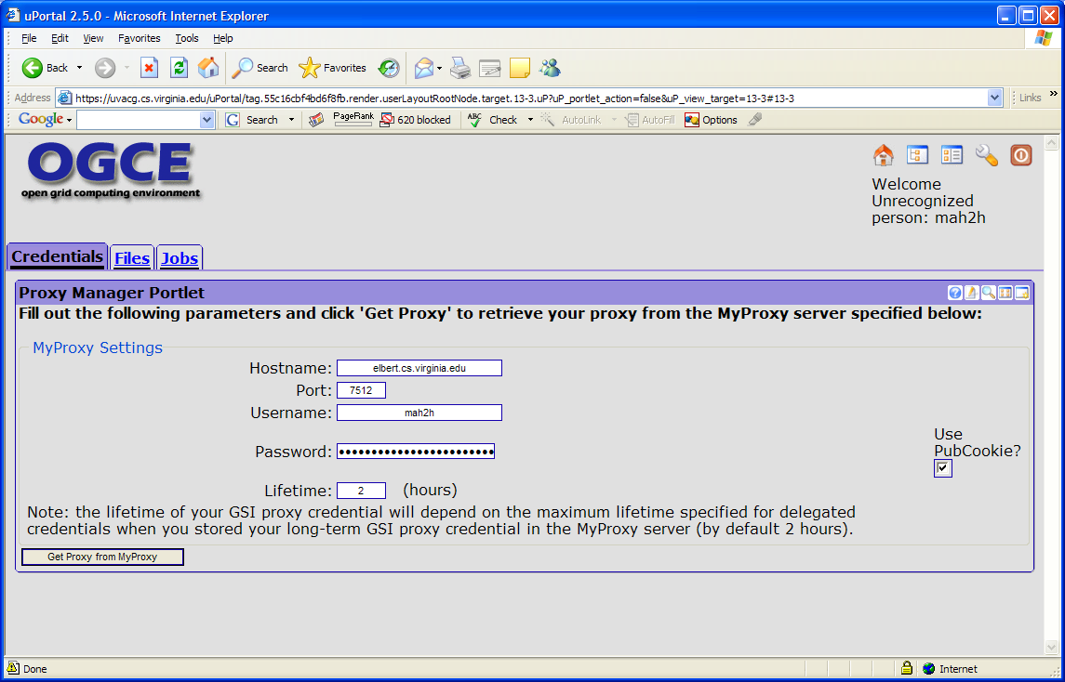

Slide 14
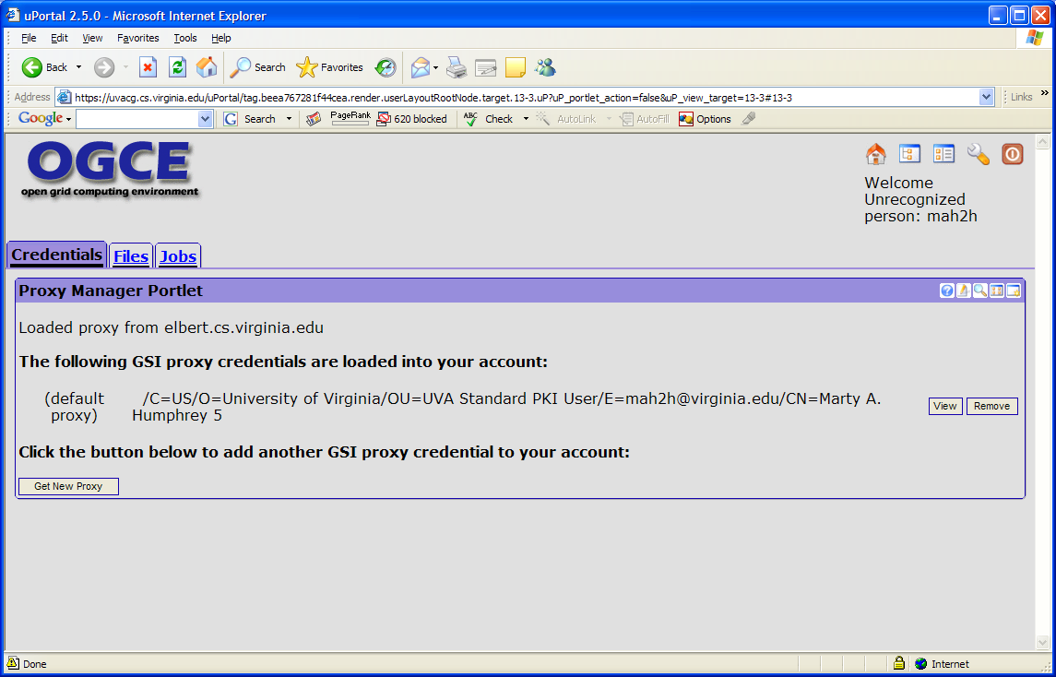

Slide 15
Technical Details
3 main cookies involved in PubCookie (http://www.pubcookie.org/docs/how-pubcookie-works.html)
  Granting cookie: “contains the authenticated username and some other items”
    Granting cookie is signed by PubCookie login server and encrypted in symmetric key shared between app server and PubCookie login server
  Login cookie: “scoped to the login server and will be used on any subsequent visits by the user to the login server”
    Opaque to the client – only login server can decrypt
  Session cookie: scoped to app server
Problem: granting cookie does not persist

Slide 16
Software Development
No mods to the MyProxy Client
  Upload creds via normal mechanism
  Presents the granting cookie in the “password” field
Mods to MyProxy server to be able to decrypt and verify signature on pubcookie
Mods to portal (uPortal) to keep the granting cookie
  Issue: JSR 168 does not deal well with cookies
Note: we cannot use the granting cookie as the password directly

Slide 17
Cleartext in MyProxy Server?
Yes, in this instantiation
  We are not unique in this regard
Alternative:
  Use the granting cookie as the basis to generate/retrieve user-specific [large] passphrase, like so….

Slide 18
PubCookie/MyProxy Integration
Campus Authentication Server
Password server
5
Pubcookie Login Server
4
9
8
MyProxy Server
11 (SSL)
3
Pubcookie-enabled Application Server
6
2
10 (SSL)
1
12
Grid request
7
13
Browser
12

Slide 19
Summary
Integration of PubCookie with MyProxy reduces the number of passphrases
Currently pushing mods to OGCE2 and MyProxy CVS
Future
  What about Shibboleth?

