Slide 1
The rise, slowly, of a middleware infrastructure
Ken Klingenstein
Director, Internet2 Middleware and Security

Slide 2
Topics
The model and the plan
  Enterprises
  Federations
  Virtual organizations
What’s happening
  Federated Identity and other Trust Fabrics
  Federating Software
  Federations
  Virtual organizations
What you’ll see today
  Different leverages of the emerging infrastructure

Slide 3
Federated model
Enterprises and organizations provide local LOA, namespace, credentials, etc.
Uses a variety of end-entity local authentication – PKI, username/password, Kerberos, two-factor, etc.
Enterprises within a vertical sector federate to coordinate LOA’s, namespaces, metadate, etc.
Internal federations within large complex corporations have been “discovered”.
Privacy/security defined in the context of an enterprise or identity service provider

Slide 4
Virtual organization model
Components
  User
  Enterprise
  Virtual Organization
  Virtual Organization Service Center
Issues
  How integrated should VOs be with the campus?
  Requires shared collective interests

Slide 5
Why enterprises are important
Primary context for the Grid user
  Logical – application contexts, auth n/z
  Physical – firewalls, diagnostics, external c
  Policy - including auditability
Key use cases are enterprise centric
As potential deployers of enterprise Grids
A large part of the users collaborations are based on enterprise tools – vc, calendaring, web access, listprocs, wikis, webdavs, etc…

Slide 6
The grand plan –circa 2000
Build campus middleware infrastructure in a consistent manner
Approach higher ed collaborative requirements through a federated model, preserving privacy but enabling security
Agreement on the attributes to be exchanged
  eduPerson and eduOrg
Development of packaging and privacy preserving software to transport the attributes
  SAML
  Shibboleth
Development of policies to support the federated exchanges
  InCommon

Slide 7
What’s happening in the enterprise
Identity management as core infrastructure
  Technologies and infrastructure
  Organization and process
  Policy – privacy and security
Growing use of common open source software
Microsoft
Growing desire for inter-institutional collaboration
Move towards consistent management of enterprise applications (CMS, legacy, calendaring, etc.)

Slide 8
eduPerson and eduOrg
UML data models, with LDAP schema and SAML bindings
eduPerson captures core attributes about users, including identity, principalAffiliation, entitlements, etc.
eduOrg captures official information and contacts for the enterprises
Formed in 2002 and evolved since
Widely deployed and well-maintained in the sector
Primary use currently is access controls on digital content, with federated wireless access on horizon

Slide 9
Shibboleth
An architecture, consisting of both a payload definition (using SAML) of attributes and a set of privacy-preserving methods of exchanging such payloads.
A project that has managed the development of the architecture and code
A code package, running on a variety of systems, that implements the architecture; other code sets exist
(Note that major new functionalities “on top of” Shibboleth are due out shortly, including the privacy managers)
Note that original project – which was web centric – has extended to other architectures

Slide 10
Unified field theory of Trust
Bridged, global hierarchies of identification-oriented, often government based trust – laws, identity tokens, etc.
  Passports, drivers licenses (breeder documents)
  Future is typically PKI oriented
Federated enterprise-based; leverages one’s security domain; often role-based
  Enterprise does authentication and attributes
  Federations of enterprises exchange assertions (identity and attributes)
Peer to peer trust; ad hoc, small locus personal trust
  A large part of our non-networked lives
  New technology approaches to bring this into the electronic world.
  Distinguishing P2P apps arch from P2P trust
Hybrids and virtual organizations layer on top

Slide 11
Enterprises and Federations
Enterprises and organizations provide local LOA, namespace, credentials, etc.
Enterprises use a variety of end-entity local authentication – PKI, username/password, Kerberos, two-factor, etc.
Enterprises within a vertical sector federate to coordinate LOA’s, namespaces, metadata, etc.
Privacy/security defined in the context of an enterprise or identity service provider

Slide 12
Federations
Persistent enterprise-centric trust facilitators
Sector-based, nationally-oriented
Federated operator handles enterprise I/A, management of centralized metadata operations
Members of federation exchange SAML assertions bi-laterally using a federated set of attributes
Members of federation determine what to trust and for what purposes on an application level basis
Steering group sets policy and operational direction
Note the “discovery” of widespread internal federations

Slide 13
Federations and PKI
The rough differences are payload format (SAML vs X.509) and typical length of validity of assertion (real-time vs long-term)
Federations use enterprise-oriented PKI heavily and make end-user PKI both more attractive and more tractable – adding privacy (secrecy), ease of verification, addition of role, etc.
The analytic framework (evaluation methodologies for risk in applications and strength of credentials) and infrastructure developed for PKI is useful for federations.
The same entity can offer both federation and PKI services
The additional degrees of freedom within the federated model is very helpful for bootstrapping and may grow towards PKI rigor to scale.

Slide 14
Federating Software
SAML and Shibboleth
Liberty Alliance crowd…Netegrity, Oblix, Nokia, Chase, etc.
WS-*

Slide 15
SAML
Security Access Markup Language – an OASIS standard
SAML 1.0 current eAuth standard; SAML 1.1 widely embedded
SAML 2.0 ratified by OASIS earlier this year
  Combines much of the intellectual contributions of the Liberty Alliance with materials from the Shibboleth community – a fusion product
  Scott Cantor of Ohio State was the technical editor
  Adds some interesting new capabilities, eg. privacy-preservation, actively linked identities
  Possibly a plateau product

Slide 16
Shibboleth
An architecture, consisting of both a payload definition (using SAML) of attributes and a set of privacy-preserving methods of exchanging such payloads.
A project that has managed the development of the architecture and code
A code package, running on a variety of systems, that implements the architecture.
(Note that other code sets are under development)

Slide 17
Shib Timeline
Project formation - Feb 2000
Inception of SAML effort in OASIS – December 2000
OpenSAML release – July 2002
Shib v1.0 April 2003
Shib v1.2 April 2004
Shib v1.3 July 2005 – non web services, new fed metadata
Shib v1.3.a Sept 2005 – Federally certified
Shib v 1.3 b - WS-Fed compatible
OpenSAML 2.0 – relatively soon, we hope
Privacy and resource managers – in the next year
Refactored Shib 2.0 – 2Q06?

Slide 18

Shibboleth v1.3
Released -- July, 2005
  Certified by GSA for governmental use
Major New Functionality
  Full SAML v1.1 support -- BrowserArtifact Profile and AttributePush
  Support for SAML-2 metadata schema
  Improved Multi-Federation Support
  Support for the Federal Gov’t’s E-authn Profile
  Native Java SP Implementation
  Improved build process

Slide 19
WS-*
A collective of nine or so protocols and architectures to manage interrealm services
Owned by Microsoft, with subordinate status of IBM and BEA
Complex interactions among a different mapping of the problem space
Some published; some still in the white binder…

Slide 20
WS* - Shib Interop
Agreements to build WS-Fed interoperability into Shib
  Contracts signed; work to begin after Shib v1.3
  WS-Federation + Passive Requestor Profile + Passive Requestor Interoperability Profile
Discussions broached, by Microsoft, in building Shib interoperabilty into WS-Fed; no further discussions
Devils in the details
  Can WS-Fed-based SPs work in InCommon without having to muck up federation metadata with WS-Fed-specifics?
  All the stuff besides WS-Fed in the WS-* stack

Slide 21
Requirements
Domain-specific software
  Code-sharing
  Data-sharing
  Distributed computing
  Instrumentation management and data acquiring
Collaboration tools
Integration and management

Slide 22
Operational Issues
Enterprise-level
  Staffing time and expertise
  Policy framework and negotiation
  Business model and case
VO-level
  Users from schools with limited resources
  Tool set
  Disconnect between those who support and those who use the services
  Policy framework

Slide 23
Virtual Organizations
Geographically distributed, enterprise distributed community that shares real resources as an organization.
Examples include team science (NEESGrid, HEP, BIRN, NEON), digital content managers (library cataloguers, curators, etc), a state-based life-long learning consortia, a group of researchers coordinating a launch vehicle payload, etc.
On a continuum from interrealm groups (no real resource management, few defined roles) to real organizations (primary identity/authentication providers)
Want to leverage enterprise middleware and external trust fabrics, as well as support centers

Slide 24
Virtual Organizations have…
Real resources that they share and manage
  May be computational resources
  May be scientific instruments
  May be bandwidth
  May be shared data and content
    Economic data
    Museum materials
    Cultural and artistic works
A relatively small set of users who tend to travel in common circles
Often the need to have some accounting and regulatory compliance

Slide 25
Virtual organizations vary…
By lifetime of VO
  Some are relatively short-term, perhaps 1-2 years
  Some may persist for extended periods
By size
By cluster – at any one time, 15-20 experiments (virtual orgs) are active at Fermi Lab, CERN. A shuttle launch may need coordination among several vo’s that have equipment aboard.
By type of domain-specific tools
  A number are using Grids
  A number subscribe to major scientific data streams
  Some have no domain-specific tools

Slide 26
Being a VO is hard…
  There are new requirements for security
  There is the need for development of operational models that integrate requirements from sites with requirements from science
  Simplified end-user tools that are consistent with the rest of a user’s experience would be very helpful.
  Diagnostics across so many systems is difficult and getting significantly worse

Slide 27
Being a VO is hard…
  Many resources use geographically-oriented access controls
  Regulatory requirements might span countries
  The local IT infrastructure of members of a VO may vary widely
  Tools are not designed to work together, present a common management infrastructure, etc.

Slide 28
The Common Requirements
Communications support
  Multiple options for real-time and asynchronous intraVO work
  Integrated into the rest of one’s “presence”
Collaboration support
  Transparent web content access control
  Workflow
  Diagnostics
Plumbing the control plane into the domain science systems and virtual organization software
Plumbing the vo technologies into the local environment

Slide 29
Communication support
Add this address book to my desktop video client as a vo setup
Shared calendar access: Grant the following roles in my vo permission to read my calendar at a campus-equivalent level
A “transparently manageable” mail list for the vo.
Provide and maintain an IM buddy list for the vo
Diagnostics

Slide 30
Collaboration support
A transparent and managed wiki
A transparent and managed set of web access controls
Role based authorization
Workflow
A p2p trust fabric for vo use
Data models
  Of the data
  Of the meta-data – what are the privileges, rights. Etc
Management of international issues in privacy, copyright, etc.

Slide 31
Federations happening
i.e., SAML-based (or similar) federations
in Europe, natural extension of HE NREN services
  Switzerland, Finland, Netherlands, UK, Spain, France, Australia. etc
in US
  InCommon Federation in higher ed
  also state-level planning, vertical apps such as student loan management
  US government E-Authentication Program
  also much non-fed or pre-fed Shibboleth deployment among fed members (InQueue, the no-trust staging federation, has hundreds of institutions and businesses)
  Ad hoc federations, as in the Katrina evacuee database

Slide 32
Federation Components
Members
  A mix of Identity Provider and Service Provider interests
Federation operator
  Metadata, enterprise-proofing, etc.
Policy Contexts
  Among members
  Between members and federation operator
Attribute and authentication coordination among members

Slide 33
InCommon federation
Federation operations – Internet2
Federating software – Shibboleth 1.2 and above
Federation data schema - eduPerson200210 or later and eduOrg200210 or later
Federated approach to security and privacy, with policies posted by members in common formats
Became fully operational 9/04
http://www.incommonfederation.org

Slide 34
InCommon Members 7/1/05
Cornell University
Dartmouth
Georgetown University
Ohio University
Penn State
University of California, Irvine
University of California, San Diego
The University of Chicago
University of Rochester
University of Southern California
University of Washington
University of California, Office of the President
The Ohio State University
University of California, Los Angeles
Internet2
SUNY Buffalo
Elsevier ScienceDirect
OCLC
WebAssign
OhioLink - The Ohio Library & Information Network

Slide 35
InCommon Uses
Institutional users acquiring content from popular providers (Napster, etc.) and academic providers (Elsevier, JSTOR, EBSCO, Pro-Quest, etc.)
Institutions working with outsourced service providers, e.g. grading services, scheduling systems, software sales
Inter-institutional collaborations, including shared courses and students, research computing sharing, etc.
(Shared network security monitoring, federal research trust peering, interactions between students and federal applications, wireless network access, peering with international activities, etc.)

Slide 36
InCommon Management
Operational services by I2
  Member services
  Backroom (CA, WAYF service, etc.)
Governance
  Steering Committee – drawn from CIO level leadership in the community - sets policies, priorities, etc.
  Project manager – Internet2
Contractual and policy issues were not easy and will evolve
Initially a LLC; likely to take 501(c)3 status in the long term

Slide 37
Trust in InCommon - initial
Members trust the federated operators to perform its activities well
  The operator (Internet2) posts its procedures
  Enterprises read the procedures and decide if they want to become members
  Contracts address operational and legal issues
Origins and targets establish trust bilaterally in out-of-band or no-band arrangements (using shared posting of practices)
  Origins must trust targets dispose of attributes properly
  Targets must trust origins to provide attributes accurately
  Risks and liabilities managed by end enterprises, in separate ways
    Collaborative apps are generally approved within the federation
    Higher risk apps address issues through contractual and legal means

Slide 38
Members Trusting Each Other:
Participant Operational Practice Statement
Basic Campus identity management practices in a short, structured presentation
  Identity proofing, credential delivery and repeated authn
  Provisioning of enterprise-wide attributes, including entitlements and privileges
Basic privacy management policies
  Standard privacy plus
  Received attribute management and disposal
No audit yet; self-audits by independent staff possible
Similar, and different from the CAF

Slide 39
InCommon Progress
Relatively straightforward
  Syntax and semantics of exchanged attributes (Eduperson)
  Set up and operation of federation
  Selling the concept and value
More challenging
  Having applications make intelligent use of federated identity
  Handling indemnification
  Finding scalable paths for LOA components

Slide 40
Interfederation
an immediate consequence of federation
  brand-new federations don't have well-defined boundaries or service scopes
  it's the Internet, we're all connected
  many interesting SPs are global, e.g. Elsevier
Interfederation workshop, Oct 2004
  Upper Slaughter, UK
  many countries, including CERN
  many agreements on direction, future work
  Uneven follow-up, due to some minor politics and work loads

Slide 41
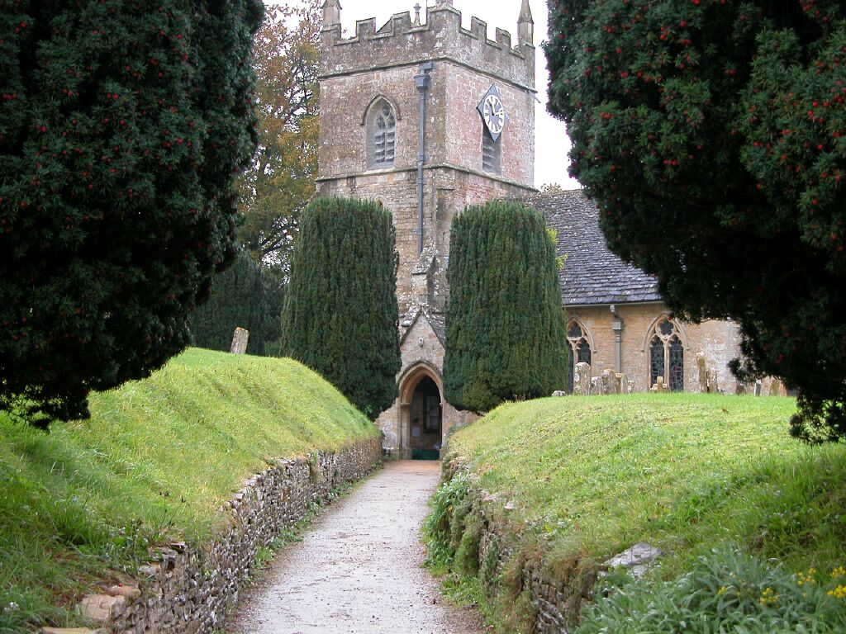
Leading trust to Slaughter

Slide 42
Aspects of interfederation peering
Technologies
User presentation issues
Business issues – the multi-federation service provider
LOA
Attribute mappings and identifier correlation
Legal – indemnity, liability, audit, etc.
Lots of issues, lots of opportunities

Slide 43
InCommon E-Auth alignment
promote interop for widespread higher-ed access to USG applications
  grants process, research support, student loans ...
process
  project started Oct 2004, thru July 2006
  compare federation models
  propose alignment steps
  validate with federation members, via concrete application trials
  implement via next e-auth, InCommon phases
good exchanges among GSA, NIST, and InCommon, with progress and improvements for all…

Slide 44
US person
motivated by InCommon desire for attribute-based authorization
modeled on Internet2 eduPerson spec
framework on which agency/app definitions can be built
Draft initial attributes and a proposed ongoing process
  Parsimonious at the start: perhaps higher classes plus citizenship, DOB
  Proof of process: US information presentation subclass
ambitious? yes ...

Slide 45
Federated Security Services
Federated networks
  Share a common network substrate
  Share a common trust fabric
  Together they could permit…
Collaborative incident analysis and response
Security-aware capabilities

Slide 46
Federated Security-aware Capabilities
Federated user network authentication for on-the-road science – www.eduroam.nl
Control spam through federated verification of sending enterprises
Permit end-end videoconferencing through firewalls and NATs
Allow enterprise-specific patching paradigms to coexist
Create end-end transparency for use of Grids
Personal firewall configuration based on authorization

Slide 47
What you will see today…
A variety of innovative couplings of enterprise infrastructure to Grid components
  Plumbed into lots of different points of the infrastructure
  Differences reflect needs, timeframes, flavor of Grid, assumptions about campus infrastructure, etc.
Which raises interesting issues for the panel at the end of the day…

