Slide 1

WS Resource Framework &
WS Notification: Update
Dr. David Snelling
Fujitsu Laboratories of Europe
GGF11 - Hawaii
June 8, 2004

Slide 2



Outline
Technical Overview
  Implied Resource Pattern
  Summary of Specifications
WS-RF in Action
  Three examples of possible usage patterns
WS-RF/WS-N Issues
  Some “dirty laundry” from the WSRF-TC
Status and Plans

Slide 3



Motivation
State Exists
  Your bank account
  A temporary database resulting from data mining.
  Statelessness in human terms equates to no short-term memory.
No Standards for Access or Discovery
  Reinvented by every implementation of a “state wrapper”
  Either too coarse grained or too fine grained
    GetSystemConfigurationDocument vs. GetIPAddress
Aims of WSRF
  Formalize the representation of “state” in Web services
  Facilitate Grid computing and systems management in the Web services

Slide 4
WS Interaction Pattern
The message exchange patterns, defined in
WSDL, describe the service’s semantics.
Any state associated with the
exchange pattern is implicit.
Implied
State
Implied
State
address
Implied
State
Interface
Web
Service
message
message

Slide 5
Implied Resource Pattern
EPR
Reference
properties
Implied
State
Reference
properties
address
Interface
Web
Service
message
message
id
WS-Resource

Slide 6
WS-RF Factory Pattern
address
Interface
Factory Enabled
Web
Service
message
message
Implied
State
EPR
id
EPR
address
Reference
properties
The factory pattern does not require that the
resource (or even the EPR) be created dynamically.

Slide 7
WS Resource Framework
Resource Addressing
  Reference and “Identification” of stateful resources in a Web services context.
Resource Properties
  Modeling of state as an XML document.
  Accessing state WSDL defined interfaces.
Resource Lifetime
  Management of leases on resource access.
  Create, destroy, exipre.
Service Groups
  Creating and managing aggregations of Web services.
Base Faults
  Baseline for extensible fault framework.
  Ability to reproduce exception hierarchies, as in Java.
Identity
Lifetime
State
Type

Slide 8
WS Notification
Publish Subscribe Pattern
WS Base Notification
  Notification producer and consumer
  Notification subscription
WS Brokered Notification
  Addition of publisher mechanisms
  Broker role
WS Topics
  Framework for Topics and Topic spaces in XML.

Slide 9
Context Refresh: Outline
Technical Overview
  Implied Resource Pattern
  Summary of Specifications
WS-RF in Action
  Three examples of possible usage patterns
WS-RF/WS-N Issues
  Some “dirty laundry” from the WSRF-TC
Status and Plans

Slide 10
Modeling Context in WSRF
The Problem
  A umber of interactions between a client and a service are linked in some way.
  The interactions may involve multiple services.
These interactions are linked by a context.
  Information and/or operations are associated with this context.
  The context needs to be created and then managed over time.
  It may need to be passed to additional services.
  It should not interfere with the semantics of the interactions.
Examples:
  User id, message logging level, locking level, session id, coordination id,

Slide 11
Contextual Interactions
Implied
State
id1
Special
Client
Good
Service
Implied
State
id2
id1
Lid
id2
Lid
Log:
lots of
details
about the
service of
details
about the
service
Very Fine Detail

Slide 12
Context Management
Implied
State
id1
Special
Client
Good
Service
Implied
State
id2
id1
Lid
id2
Lid
Log:
lots of
details
about the
service of
details
about the
Operations for:
Reading and setting detail
Turning logging on and off
Extending context lifetime
Creating new logging contexts
Notification of logger status
Very Fine Detail
Lid
Implied
State
Lid
Logging Service Manager

Slide 13
Resource Collections
Setting:
  Computer Centre
  Requirements for system start, stop, configuration, management, ...
  A massing cluster system
  Web Services interface for interoperability.
Variable Operational Granularity:
  Start/stop all.
  Create sub-nets
  Take individual nodes off line for replacement
  ....

Slide 14
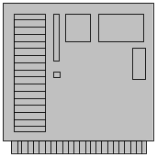
Service Groups
Each Resource Modeled as a WS-Resource
  Identifier and individual management service
Each cluster as a Service Group
  Extended to support collective operations (WSDM)
  Add and remove functions to reconfigure clusters
  WS-Lifetime can provide a reservation service
Whole System
Cluster Management
Service
Cluster A
id
id
id
id
id
id
id
id
Cluster B
id
id
id
id
id
id
id
id

Slide 15
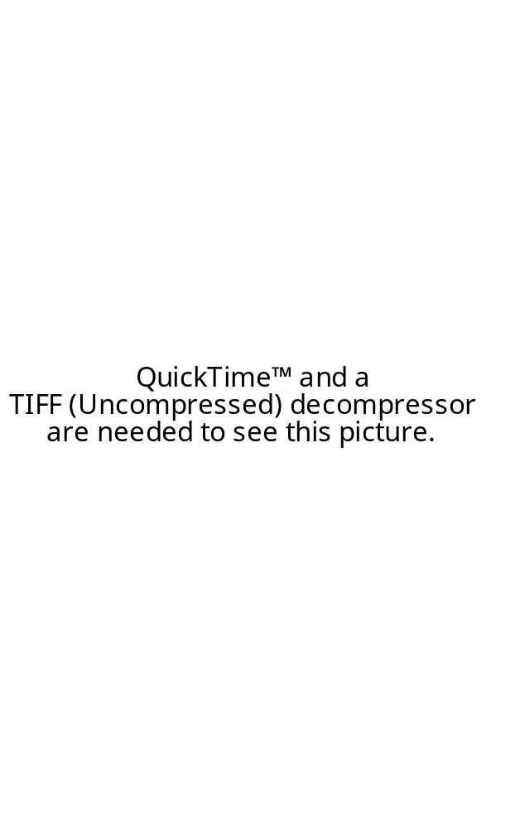

An Enigma Machine
Enigma Machine
  WWII Cryptography Device
As a Stateful Resource
  En-/De-crypt operation
  Long and short term state
    Key of the Day
      Steckers, Rotors, Rings
    Message Setting

Slide 16
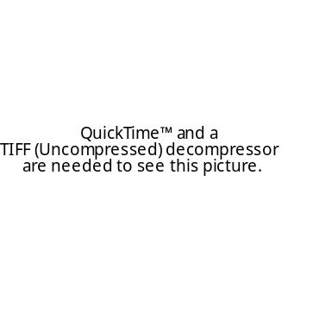
Operational Process
Encrypr Message
Send Secret Message
Set RP
Key-of-the-Day
Set RP
Message Setting
Decrypt Message
Create Enigma Machine
Set RP
Key-of-the-Day
y
y
y
x
Set RP
Message Setting
y
x
x
x
Create Enigma Machine
Your Enigma Machine
My Enigma Machine

Slide 17
Context Refresh: Outline
Technical Overview
  Implied Resource Pattern
  Summary of Specifications
WS-RF in Action
  Three examples of possible usage patterns
WS-RF/WS-N Issues
  Some “dirty laundry” from the WSRF-TC
Status and Plans

Slide 18
Issue: Discovery
Web Services Discovery
  Addressing a WS only requires endpoint and port
    Available in WSDL service definition
  UDDI Registries support look up for WSDL
WS Resource Discovery
  Addressed using a WS-Addressing Endpoint Reference (EPR)
    No standardized or ubiquitous directories of EPRs
  EPRs, for WS Resources, cannot be constructed from WSDL
    Need resource id in the reference properties
Solutions
  Fully functional registries are the long term solution
  Singleton pattern, might help for early adopters
  ....

Slide 19
Issue: Resource Property Metadata
Rich Support for Metadata in OGSI
  Mutability: Defines when the service data expected to change
  Modifiability: Advertised whether or not modifiable by clients
  Service Data Lifetime Model: GoodFrom, GoodUntil, ...
In WS-RF
  Nothing defined yet in the submissions
  Attributes are permitted, but no standard is planned yet.
Solutions
  Not part of WSRF.
  If part of WSRF, probably simpler than OGSI.

Slide 20
Issue: Multiple vs Single Accessors
In Resource Properties
  There are three “get” operations: Get single, Get multiple, and Query.
  There is one “set” operation, with a three sub-type argument.
Issues on the list:
  We should have only one getter.
  We should have three separate setter.
Solutions:
  ....

Slide 21
Context Refresh: Outline
Technical Overview
  Implied Resource Pattern
  Summary of Specifications
WS-RF in Action
  Three examples of possible usage patterns
WS-RF/WS-N Issues
  Some “dirty laundry” from the WSRF-TC
Status and Plans

Slide 22
WS-RF/WS-N: Status
Document Refresh
  To be posted: June 2004
  Schemas included
  Recommended for early adopters
  Not a “Committee Draft”, only a starting point
Next Steps
  Sequence: WS-RP, WS-LT, WS-BF, WS-SG
  Still waiting for a submission on Renewable References.
Next Face to Face Meetings
  WSRF: July 27-28 at Fujitsu Laboratories of Europe
  WSN: July 29-30 at Fujitsu Laboratories of Europe

Slide 23
Interoperability Fest
Pre-TC Formation Interoperability Fest
  Great success, mostly full interoperability achieved
  Many lessons learned and issues generated.
GGF11: Mini Interop
  1:30 - 2:00 Today, Here
Plans:
  Not formalized yet.
  Reasonable support the idea.
  Similar participants to the pre TC fest.
  Probably late 4Q04/1Q05

Slide 24
Links and Questions
OASIS Links
  http://www.oasis-open.org/apps/org/workgroup/wsrf/
  http://www.oasis-open.org/apps/org/workgroup/wsn/
  http://www.oasis-open.org/apps/org/workgroup/wsdm/
Contacts:
  WSRF: Dave Snelling, Ian Robinson
  WSN: Peter Niblett, William Vambenepe
Questions
  ????

