Slide 1
Global Grid Forum, Standards Panel
David Snelling
Fujitsu Laboratories of Europe
June 8, 2004

Slide 2
What is GGF?
An Open Process for Development of Agreements and Specifications
  Grid “Recommendations” process
  Persistent, Reviewed Document Series
  Intellectual Property policies (RAND moving toward RF)
A Forum for Information Exchange and Collaboration
  Activity Cross Section:
    Grid Research, Designing and Building Grid Software, Deploying Grids, Using Grids
  Technology Cross Section:
    Infrastructure; Middleware; Science, Industry
  Mechanisms:
    Working Groups, Research Groups, Workshops, Online Communities, Marketing and Outreach

Slide 3
The Pyramid Diagram
OASIS
Specifications and Best Practices
GGF Collaborates
with standards organizations and
other community
groups working on
all aspects of Grid
technology.
DMTF
Partnerships
Education
W3C
IETF
Identify where / what specs are critical
EGA
Frameworks / Architectures
(how specs fit together)
WS/I
Research and Technology Directions
Application Requirements

Slide 4

The Perfect World
The Real World

Slide 5
Formal Established Liaisons (as of June 2004)
Internet Engineering Task Force (IETF)
  IETF: Brian Carpenter (IBM)
  GGF: Cees de Laat (Univ Amsterdam), David Martin (IBM)
Distributed Management Task Force (DMTF)
  DMTF: Winston Bumpus (Dell, DMTF President)
  GGF: John Tolefsrud (Sun), Jeff Nick (IBM)
OASIS
  OASIS: Karl Best (OASIS VP), James Bryce Clark (Mgr, Tech Stds)
  GGF: Dave Snelling (Fujitsu), John Tolefsrud (Sun)
WS/I
  WS/I: Michael Weiner (IBM, WS/I President)
  GGF: Dane Skow (FNAL)
WC3
  WC3: Steve Bratt (COO)
  GGF: Charlie Catlett (UC/ANL, GGF Chair), Steve Crumb (GGF)
EGA (new)
  Liaison details in discussion

Slide 6
Other Approaches to Collaboration
Grass Roots
  OASIS/WSDM-TC and GGF/CMM-WG
Venue Sharing
  DMTF and OASIS are working here today.
Persistent Document Service
  Possible WSRF/WSN Primer
Whatever ...

Slide 7
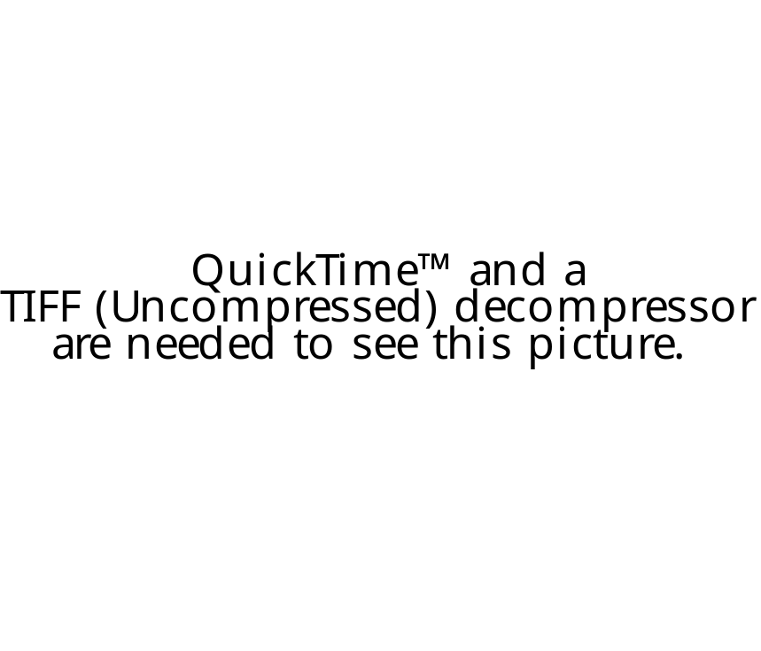
Answer to John’s Question
We are falling down with style!

Slide 8
Question Time

