Slide 1
The GRIDs @ Pharma
The Novartis Example
Prof. Manuel C. Peitsch
Global Head of Information and Knowledge Management at NIBR

Slide 2
Agenda
The Vision and the challenges in Drug Discovery
Information Integration and the Knowledge Space (a Data GRID?)
How can in silico science contribute to the Drug Discovery process and in pharma?
The NIBR/IK@N HPC concept and status update.
E-Collaboration environment
Concluding remarks

Slide 3
The Challenges of Drug Discovery
Mechanism-based Drug Discovery
  Understanding Disease
  Pathways elucidation and association
  Target validation
  Clinical PoC
Exploit X-nomics
Reduce project life cycle
Increase PoS after D3 (Lead optimisation)

Slide 4
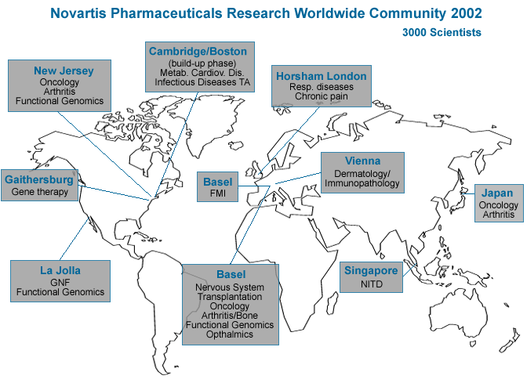
Geographical complexity.

Slide 5
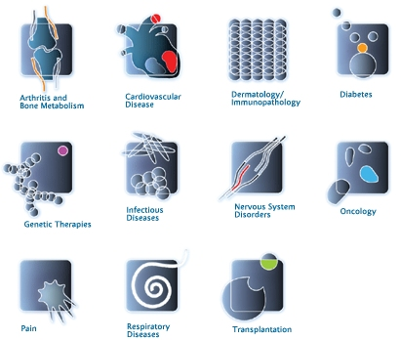
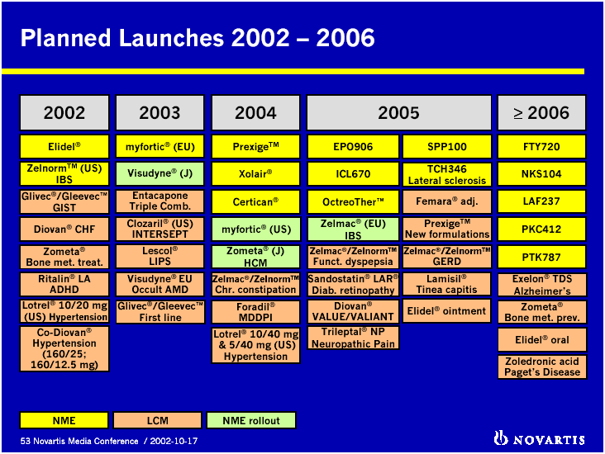
Organisational complexity.

Slide 6
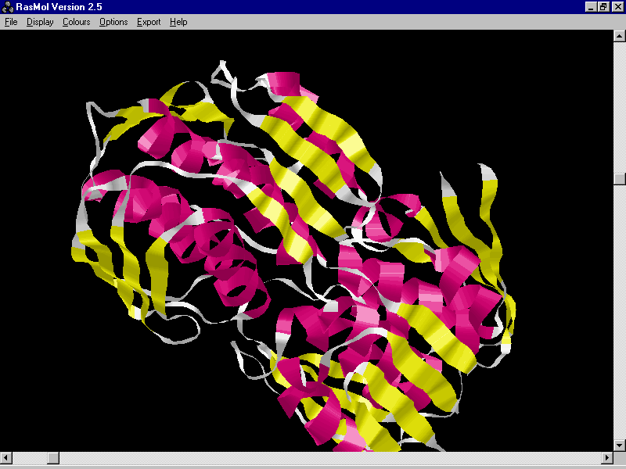
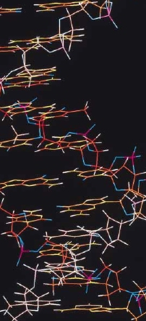
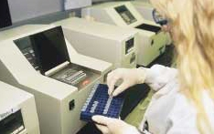
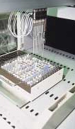
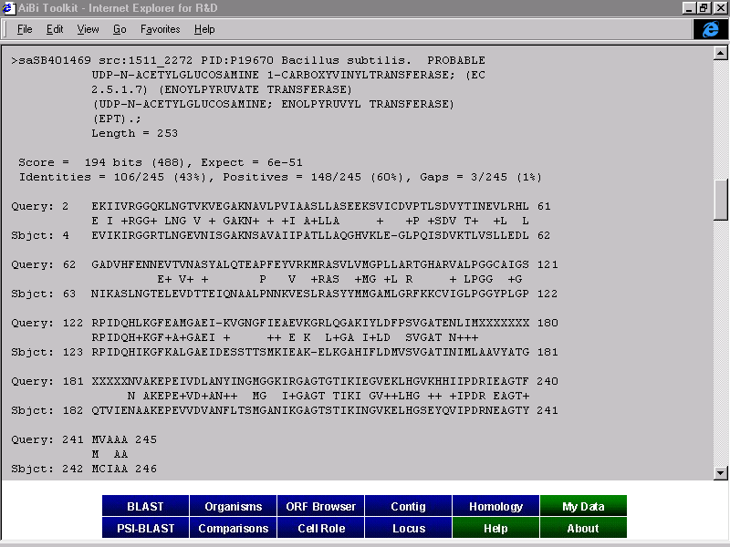
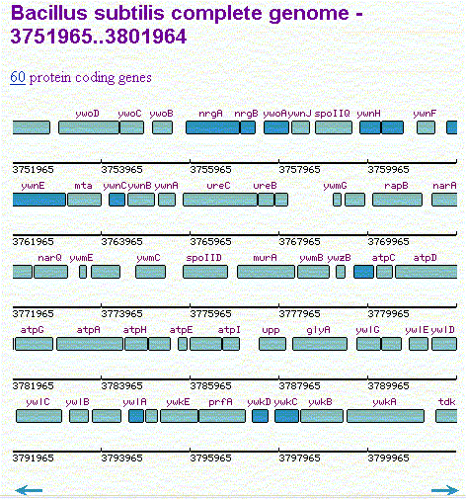
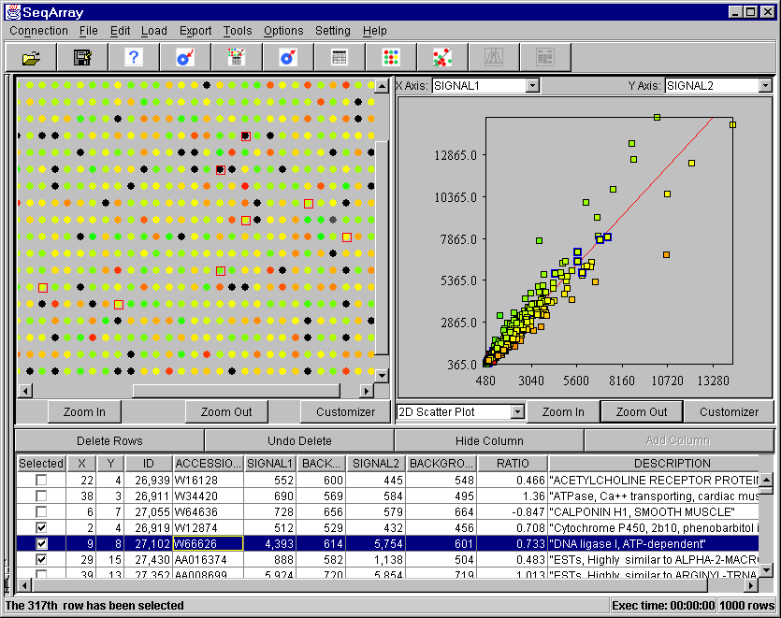
Data and Information complexity.
Raw data from instruments.
Analysed data.

Slide 7
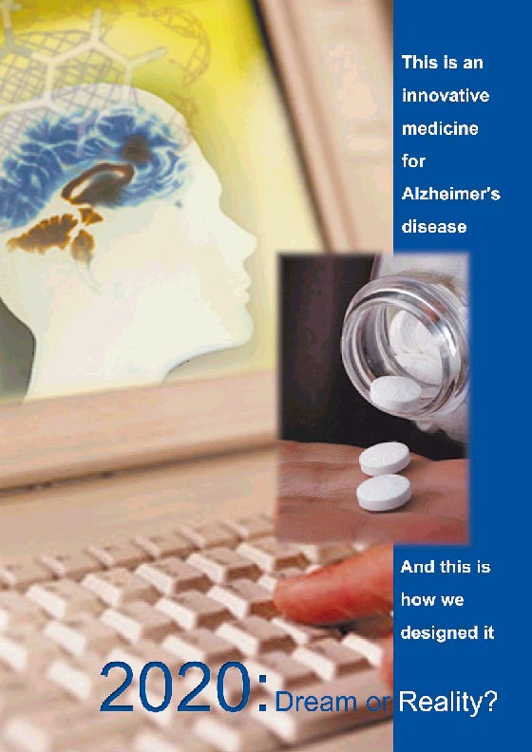
The Vision
Enable and transform the Drug
Discovery process through:
  - Comprehensive and reliable Data and Information
  - Seamless information integration for easy navigation
  Turning Data into Knowledge
  using in silico science
  Simulate biomolecular processes using in silico science
  E-Collaboration and v-communities
Data Information and Knowledge GRID → Knowledge Space
Knowledge Space Portal
Computational life science
People Networks

Slide 8
Agenda
The Vision and the challenges in Drug Discovery
Information Integration and the Knowledge Space (a Data GRID?)
How can in silico science contribute to the Drug Discovery process and in pharma?
The NIBR/IK@N HPC concept and status update.
E-Collaboration environment
Concluding remarks

Slide 9
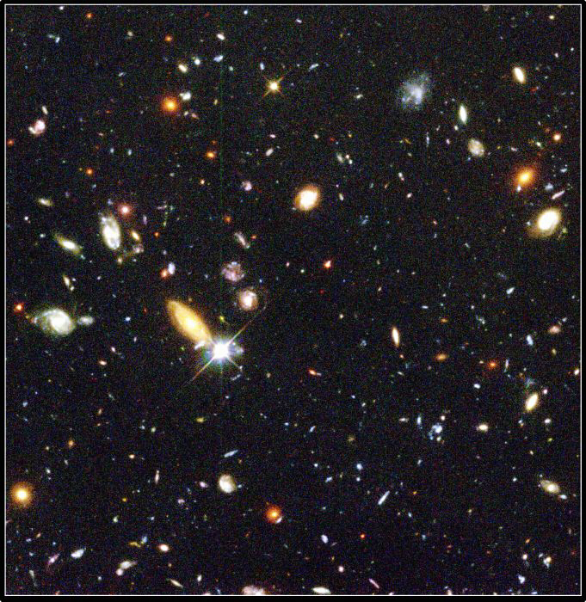
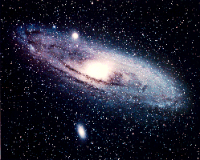
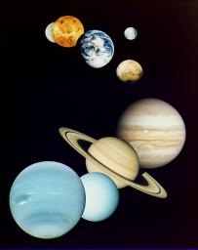

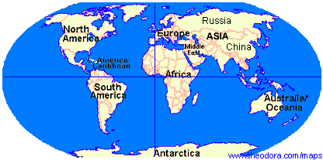
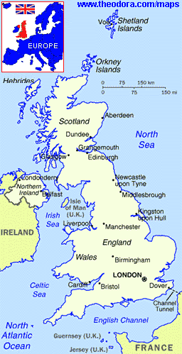
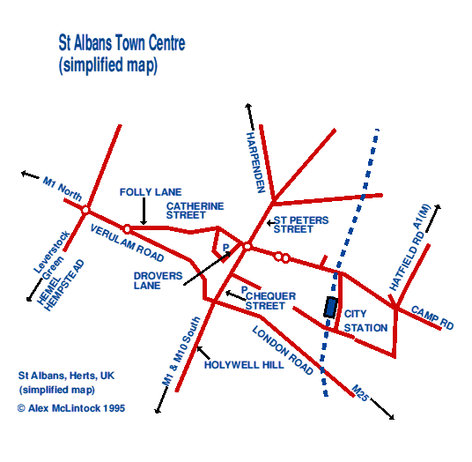
The Space metaphor
Map and navigation metaphor
Connectivity map between discrete objects.
The maps are published and updated to reflect changes in the space.
All towns must be connected by the system of roadways. If not there will be isolated pockets of people (ideas, knowledge, and wasted resources).
Reasonable number of “roads” between any two points
Travel service help travelers scope out new adventures.
Metaphorical mapping
Universe: All Data / Information / Knowledge
relevant to Novartis.
Galaxies: Exploratory / Development /
Regulatory / Manufacturing / Commercial.
Solar sys: Disease / Targets / Hits&Leads / Patients
Planets: Bioinformatics / Chemoinformatics / Clin Pharm IS / etc …
Continents: Genetics / Genomics / Proteomics / Libraries / etc …
Countries: SNP / Sequence databases / compound databases / etc …
Cities: Genebank / SWISS-PROT / Beilstein / etc …

Slide 10
The Knowledge Space
The Knowledge Space consists of:
The collection of all types of data and information within the scope of interest defined by a particular business.
  Thus, the Knowledge Space is composed of:
    Databases, information sources, document/knowledge bases, etc… with relevance to us.
    There is no conceptual difference between internal and external data/information. This is only a matter of tagging it as either.
The Meta Data and the Knowledge Map which describe the collection in terms of content and location of content.

Slide 11
The Knowledge Space Portal
The "Knowledge Space Portal" will, via a single customizable interface
  Federate heterogeneous data resources and provide precise organization of the content
  Provide quick and intuitive access to information
  Provide data extraction, analysis and exploration tools
  Allow data integration, data exchange and interoperability of applications
  Provide mechanisms for data capture and annotation
  Provide knowledge sharing and collaborative tools

Slide 12
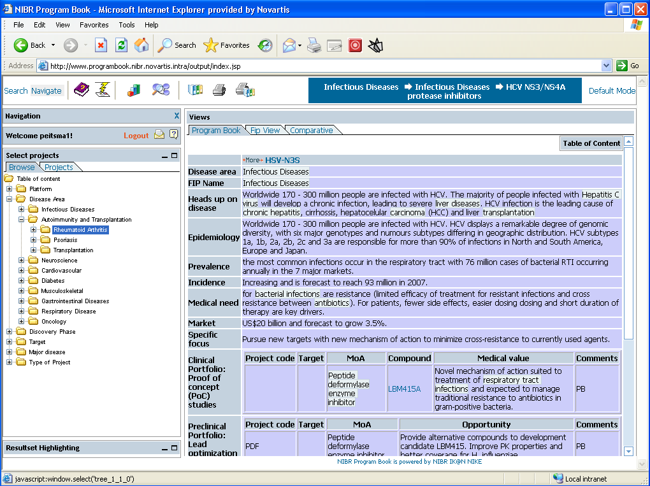
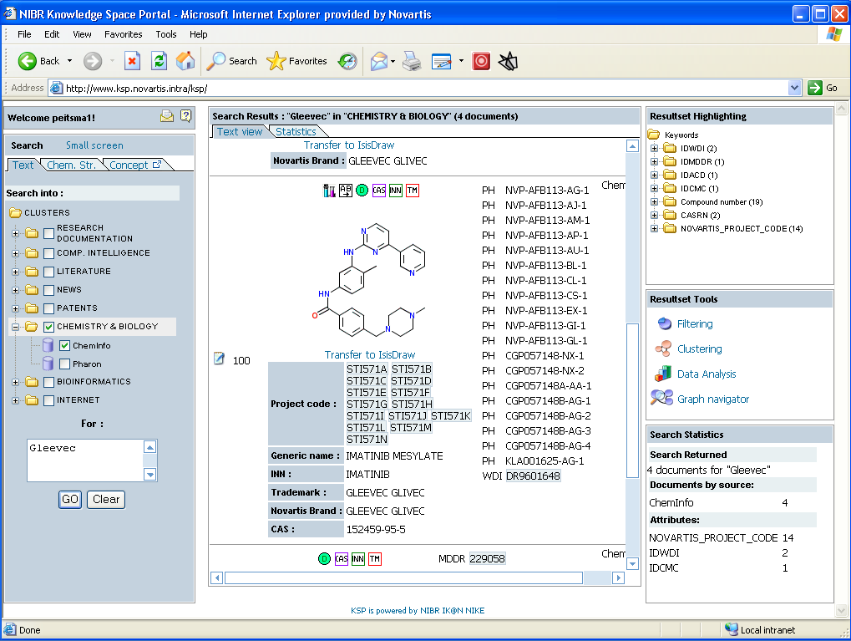
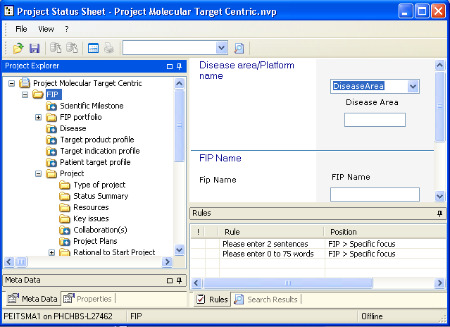
Our Knowledge Space
Literature
Comp. Inf.
Navigators
Meta D/I
Ontologies
Thesaurii
Expert
Systems
Bioinformatics
Analytics
K maps
Retrieval
Mining
Chemistry
Program Book
Biology
Internet
RDS
Research
Documentation
Other

Slide 13
About the Ultralink/Ultraaction and the Ultralinker
The Ultralink is an “intelligent” context-sensitive Hyperlink (the classical link provided by standard Web Browsers)
This “intelligence” is created by the Ultralinker
In the Portal, the Ultralink looks like a Hyperlink on a shaded background.
By clicking on an Ultralink you will go to another page, but get a menu.
This menu will offer a number of actions/options which can be taken, some will in fact be a chain of logical consecutive actions, normally done manually one after the other.
  The Ultralink allows direct interaction between any type of entity (gene name, compound name, disease name, company name, etc… with the appropriate tools and components of the Business Logic layer.
  The Ultralink allows to select any portion of text and use it as input to a text mining-assisted search “à la Ulix”, using a single mouse click.
  And more to come….
The Ultralink allows easy navigation in a coherent region of the Knowledge Space.

Slide 14
How the Ultralinker works
The Ultralinker is a Web service.
The Ultralinker analyses any information (such as a complete web page) it receives for items it recognises using text mining and pattern recognition tools.
Each recognised item is mapped onto the Knowledge Map.
The Knowledge Map (meta Knowledge) will tell what can be done with that item e.g.
  If a gene name is recognised then you can: search for its sequence in databases; do sequence similarity searches; search for it in target databases; search for it in genetic disorder databases; translate its codons into amino acids, map it onto the transcriptome; produce a 3D structure by comparative modelling; look for hits from HTS; etc… any thing you can do with this gene name which is coherent and scientifically valid…It can be chained/automated in a single click (Ultraaction or work-flow) or provided as separate items.
The Ultralinker will create a menu that will be sent to the User interface.
Easy to configure
Recognises “zoned” documents.

Slide 15
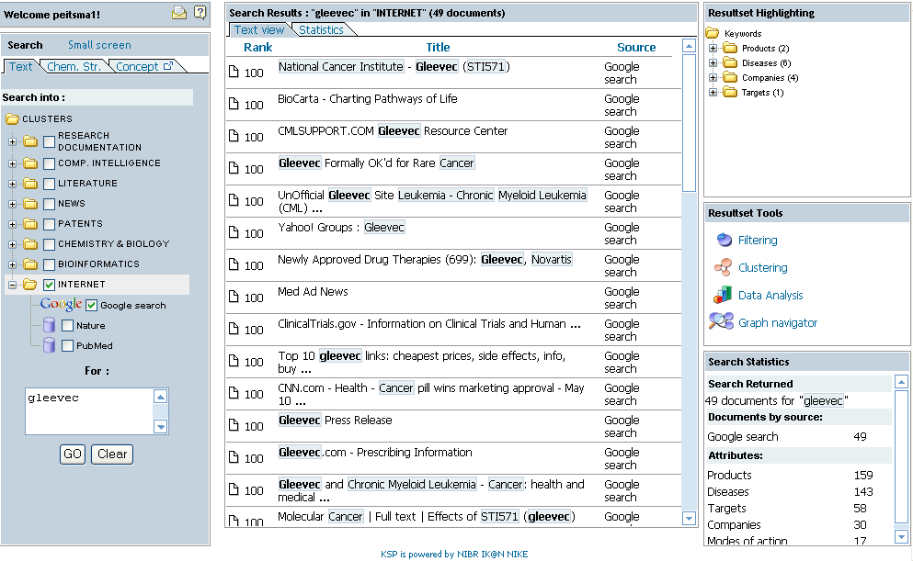
Search sequence: e.g. on the Internet 1

Slide 16
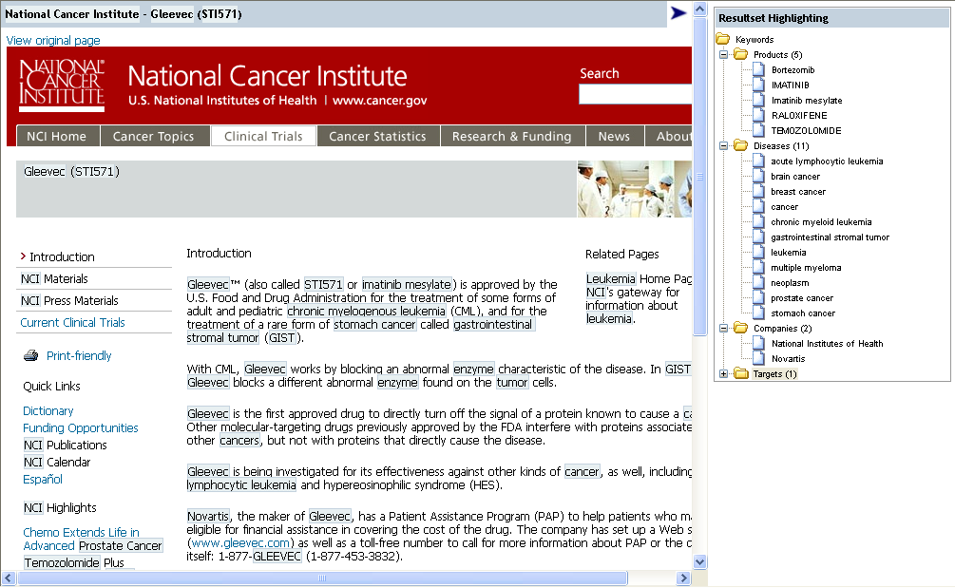
Search sequence: e.g. on the Internet 2

Slide 17
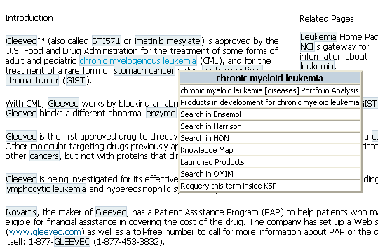
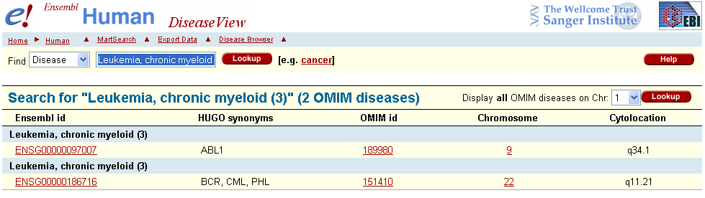
Search sequence: e.g. on the Internet 3

Slide 18
Agenda
The Vision and the challenges in Drug Discovery
Information Integration and the Knowledge Space (a Data GRID?)
How can in silico science contribute to the Drug Discovery process and in pharma?
The NIBR/IK@N HPC concept and status update.
E-Collaboration environment
Concluding remarks

Slide 19
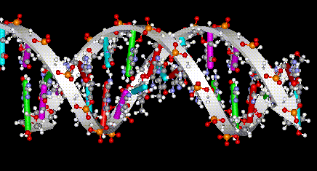
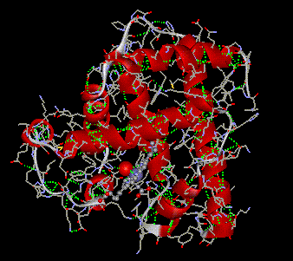
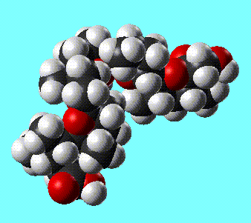
Computational aspects of Drug Discovery
Macromolecular
Structure & Function Lab
Computational
Chemistry Lab
Bioinformatics Lab
Target
finding
Target
validation
Lead
finding
Lead
optim.
Notes:
We strive to cover the whole discovery pipeline.

Slide 20
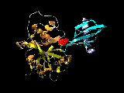
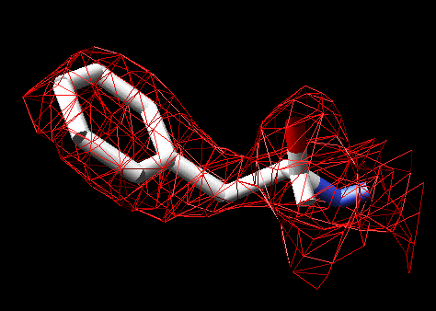
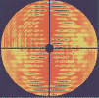
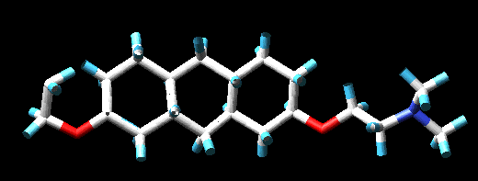
In Silico Drug Discovery: areas of application
DNA Sample
Sequencing
SNP
Translate &
Map/Align
SAP
Model &
Map
Human data
Structures &
Modelling templates
Kinases
NR
Proteases
DB
DB
DB
DB
DB
Disease association
Validated Targets
Functional and
Structural insights
Virtual Drug Discovery
In Silico Docking
In Silico “Chemogenomics”
Virtual Library Design
Predictive MedChem
Tox PK/PK ADME modelling
Compounds
QSAR
Proteins

Slide 21
In silico drug discovery pipeline: major aims
Ensure that we have a flexible software architecture which can accommodate any algorithm any time.
Ensure low cost software infrastructure and freedom to operate.
Ensure “GRID-ability” and full exploitation of HPC architecture despite hungry software providers.
Promote internal algorithm development, new science and new ideas should be testable in known environment.
Allow D0/D1/D2 scientists to run low cost “validations” in silico experiment.
Break down the boundary between “biologists” and “chemists” and “screeners”.

Slide 22
In Silico Drug Discovery: goals
Long Term Goal
  Develop a semi-automated, human-supervised In Silico Drug Discovery pipeline.
What for?
  Enable scientists to quickly and easily find compounds binding to a particular target protein
    Use the compound as a tool to do pre-clinical target validation.
    Use the compounds as hits for hits to leads programs.
    Accelerate target selection and improve probability of success.
Specific plans for 2004
  Grow GRID computing beyond NIBR.
  Various key components available at Novartis.
    Protein modelling
    Docking
    Chemoinformatics
  Create draft pipeline by chaining existing tools and methods; Explore adequate workflow.

Slide 23
In Silico Drug Discovery: the time axis
1990
1995
2000
2005
GeneCrunch
First PC-GRID
at Novartis
Productive
In Silico Drug
Discovery and
Chemogenomics
pipeline
Productive
Automated Protein
modelling email server
SETI@Home
Docking
in production
at Novartis
Productive
Automated Protein
modelling Web server
3D-Crunch
Genome scale Automated
Protein modelling
Full Transcriptome
Modelling at Novartis
Protein Model
Structure database
PC-GRID using public resources
First automated Modelling and
Docking pipeline at Novartis
Large-scale automazed bioinformatics analysis of genome sequence/information
SETI@Home recognised as a leading new concept (ComputerWorld Award)
Various automated ToxCheck and other CIx services
Large-scale automated prediction of protein structures
GeneCrunch recognised as a leading new concept (ComputerWorld Award)
SWISS-MODEL and 3D-Crunch recognised as a leading new concept (ComputerWorld Award)
UD recognised as a leading implementation (ComputerWorld Award)

Slide 24
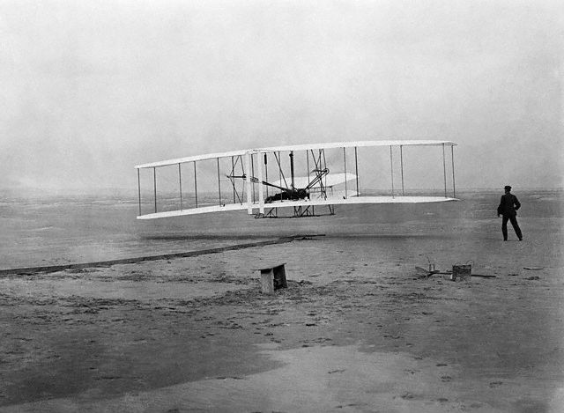
The „Kitty Hawk Project“: will it fly?
Pave the way towards achieving new functionality by combining available components
17th December, 1903
12 seconds, 36 meters

Slide 25


Let‘s make it fly!
December 17, 1903
Fly in 2005?
Grow
applicability
Optimize
components
Grow
reliability
New concepts
100 years of optimization and improvements

Slide 26
Agenda
The Vision and the challenges in Drug Discovery
Information Integration and the Knowledge Space (a Data GRID?)
How can in silico science contribute to the Drug Discovery process and in pharma?
The NIBR/IK@N HPC concept and status update.
E-Collaboration environment
Concluding remarks

Slide 27
The NIBR/IK@N HPC concept and status update
Key enabler of in silico science
Please see Pascal Afflard’s presentation in the Pharma panel after noon today.

Slide 28
Agenda
The Vision and the challenges in Drug Discovery
Information Integration and the Knowledge Space (a Data GRID?)
How can in silico science contribute to the Drug Discovery process and in pharma?
The NIBR/IK@N HPC concept and status update.
E-Collaboration environment
Concluding remarks

Slide 29

E-Collaboration environment
Objectives
  Bring people together across sites, time zones and functional areas.
  Enable collaborations with external partners, both in academia and business.
  Foster collaboration and virtual projects → the right person on the right project → Availability and location are not skills!
  Status
  Toolbox state. Each situation has a recommended tool.
Future
  Fully integrated into our work environment across all of Novartis.

Slide 30
Agenda
The Vision and the challenges in Drug Discovery
Information Integration and the Knowledge Space (a Data GRID?)
How can in silico science contribute to the Drug Discovery process and in pharma?
The NIBR/IK@N HPC concept and status update.
E-Collaboration environment
Concluding remarks

Slide 31
General comments on GRIDs
To create credibility and support from Senior Mgmt, it is crucial to avoid confusion between Crunch-GRIDs, Data-GRIDs, Information/Knowledge-GRIDs and People-Networks/GRIDs.
  Clarity in concepts will help focus projects and concrete deliverables.
  They can all be part of a single multi-tiered and coherent strategic framework.
  Whichever you talk about, it will not be perfect for quite some time. Manage expectations!
    Think “Kitty-Hawk”. The conceptual layers are there, prototype are emerging, improvements and optimization is essential, maturity will follow
Leadership, transcendence, entrepreneurship and tenacity are the essence of transformation!
  Concepts are easy to draw on a napkin over beer!
  But new and great things are hard to achieve! --> Think about OPERATIONAL Excellence

Slide 32
General comments on GRIDs
Optimization of resources utilization:
  HPC platforms usage is maximized.
Thinking out of the box:
  Enables our scientists to think differently about in silico sciences and their applications to Drug Discovery. --> Fertile Ground.
  New ways to tackle information integration and Knowledge Management.
  Far more efficiency in the area of distributed teams.
Issues and risks:
  Current SW licensing models are a barrier to the advancement of GRIDs in general. --> Create your freedom to compute, OpenSource, in house algorithm and software development capabilities to be considered seriously.
  Security is still a generally open question.

Slide 33
Comments on Crunch-GRIDs
A component of an integrated HPC strategy
Address unmet computational needs
Create a fertile ground for new in silico science approaches
Most current software licensing models must change and will change.
  CREATE your Freedom to Compute!
  A new opportunity for “freeware”
  New algorithms and sw implementations are needed
    Build more, buy less: Commercial software as an impediment to in silico science and its applications.
  Stop believing that there is a successful business model for specialty scientific software.

Slide 34
Comments on Data-GRIDs
A component of an integrated storage strategy
Dissociate from Information/Knowledge GRIDs
It is about:
  Replication, distribution vs centralization
  Optimal access for Crunch and Knowledge GRIDs
  “Federation” schemes for input and retrieval
They require:
  Standards and shared Data as well as Meta-Data models
  QA&QC: curation requires data officers and discipline
  Undivided adherence to all shared standards, schemas, principles and data quality.
  Security

Slide 35
Comments on Information/Knowledge-GRIDs
Layer above Data-GRIDs
Expert systems, Semantic-Web/GRID
It is about:
  Ontologies, Semantic Networks, Thesauri and Vocabularies
  Categorization, Text Mining, Correspondence Tables, MetaStores, analytics.
  Context-based UltraLinking and UltraAction (workflows)
They require:
  Standards
  Maintenance of Ontologies, Semantic Networks, Thesauri and Vocabularies
  Undivided adherence to all shared standards, schemas, principles and data quality.
  Security

Slide 36
Comments on People-Networks/GRIDs
Knowledge Management: explicit vs tacit
eCollaboration and distributed teams (a team cannot be virtual!)
It is about:
  Easy to use and well integrated eCollaboration services.
  Capability and not technology.
They require:
  Standards
  Integrated into people’s workspace
  Mobility and the Martini Principle
  Security

