Slide 1
Grid Computing at The Hartford
OGF22 February 27, 2008
Robert Nordlund
robert.nordlund@hartfordlife.com

Slide 2
About The Hartford…
Headquartered in Hartford, CT
Founded in 1810
Fortune 100
31,000 Employees Worldwide
$26.5 Billion Revenues
$2.9 Billion Core Earnings
$377.6 Billion Assets Under Management

Slide 3
The Hartford’s Businesses
Property & Casualty
  Auto, home, marine, workers compensation, etc.
Retail Investment Products
  Variable and fixed annuities, mutual funds, 529 college savings plans
Retirement Plans
  401(k), 403(b), 457
Institutional Financial Solutions
Individual Life Insurance
Group Benefits
International

Slide 4
A Brief History…
Exponential growth in risk modeling activity exceeded our existing computing capabilities.
Grid technology was identified as a possible solution.
Condor was selected over other commercial solutions.
  Mature
  Windows Support
  Simple, Scalable, and Flexible
  Active Community
  Free

Slide 5
Our Grid Environment…
In Production Since 2004
Two Pools (Production, Test)
Dedicated and Non-dedicated Execute Nodes
  ~1000 Two-socket, multi-core x86 servers
  ~1000 desktops, notebooks
Linux Central Managers
Linux and Windows Job Schedulers
Windows Execute Nodes
Web-based Administration and User Console

Slide 6
Our Workload…
Hedging
Risk Management
Portfolio Pricing
Product Development
Off-the-shelf Software
In-house Software
Embarrassingly Parallel

Slide 7
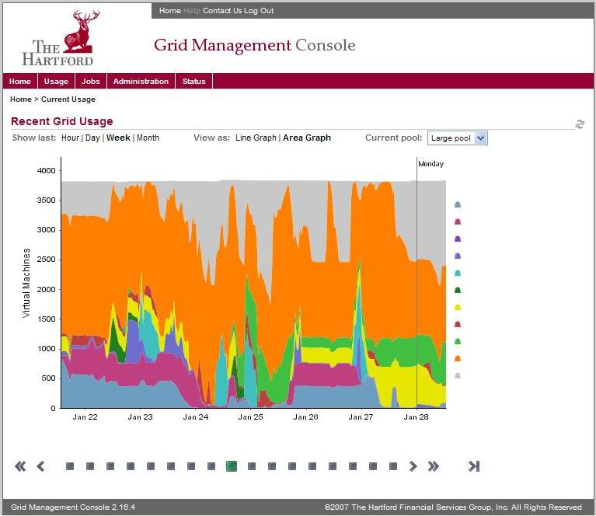
Typical Utilization

Slide 8
Technical Challenges
Scaling – Rapid expansion of grid computing puts tremendous strain on operations (power, cooling, networking, floor space, etc.).
DR/BCP – A “cold spare” is not an option when the system is over 1000 servers.
Testing – An isolated, equivalent test environment is not an option (see above). Predictive modeling is necessary to simulate the environment at scale.
Storage – Traditional storage options are limited in both capacity and throughput.
Application Development – Developers need to be educated on writing “grid-friendly”, high-performance applications.

Slide 9
Non-Technical Challenges
Policies – Effective and fair resource management policies need to be developed in cooperation with the users. Transparency is key in maintaining good relationships between user groups and between the users and IT.
Expectation Management – Users need to know what to expect in a shared grid environment.
  Variable Capacity
  Allocations vs. Named Servers
Procurement – Vendors and internal purchasing departments aren’t typically accustomed to ordering 100’s of servers at a time.
Finance – Traditional charge-back mechanisms ($/Server) don’t translate well to a grid environment.

Slide 10
Growth Opportunities
Non HTC (High Throughput Computing) Workloads – Use grid resources to dynamically provision capacity for web services or other transactional business applications.
Virtualization – Leverage grid resource management capabilities to orchestrate virtualized resources.
More Scavenging – Continue to exploit underutilized resources throughout the enterprise to increase compute capacity.
Incorporate external resources, e.g. cloud computing, utility computing, etc., to handle planned/unplanned peaks.

Slide 11
Conclusion
Grid has been a transformational technology giving users access to capabilities they wouldn’t have envisioned, or can now live without.
Grid computing is an integral part of our business and gives the company a stable, scalable platform to model uncertainty.
Condor has proven to be an invaluable asset and has time and again handled whatever challenge we’ve thrown at it.

