Slide 1
Next Generation Grid:
Emerging technologies poised to revolutionize financial markets
Kevin Pleiter
Director – Global Financial Services Sector

Slide 2


Financial Market Analytics
Companies need
to grow
aggressively
by leveraging
differentiating technology
Notes:
Begin with Data center chanllenge

Slide 3
Financial Services Sector Trends, 2007-2015
FSS Industry Trends
Challenges
Speed & Transparency
Informed clients are increasing demands
Data Explosion
Global integration is reshaping industries
Managing Complexity
Regulatory burdens are growing
Managing Business Integrity
Innovation is becoming imperative
Collaboration & Partnering
Notes:
technology is creating an opportunity for innovation. We see this along two fronts:
(1) data gathering and analytics (e.g., risk models, mathematical analytics and algorithms, client needs analysis, etc.)
(2) the more infrastructural side (increased agility, responsiveness and speed to market through such technologies as service-oriented architecture and grid computing)

Slide 4
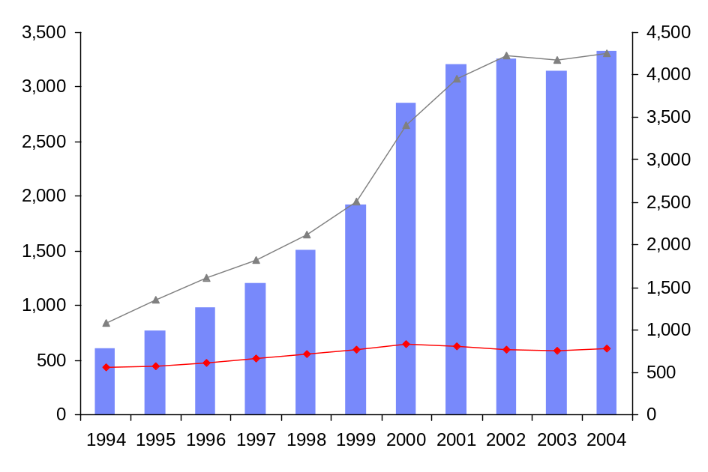
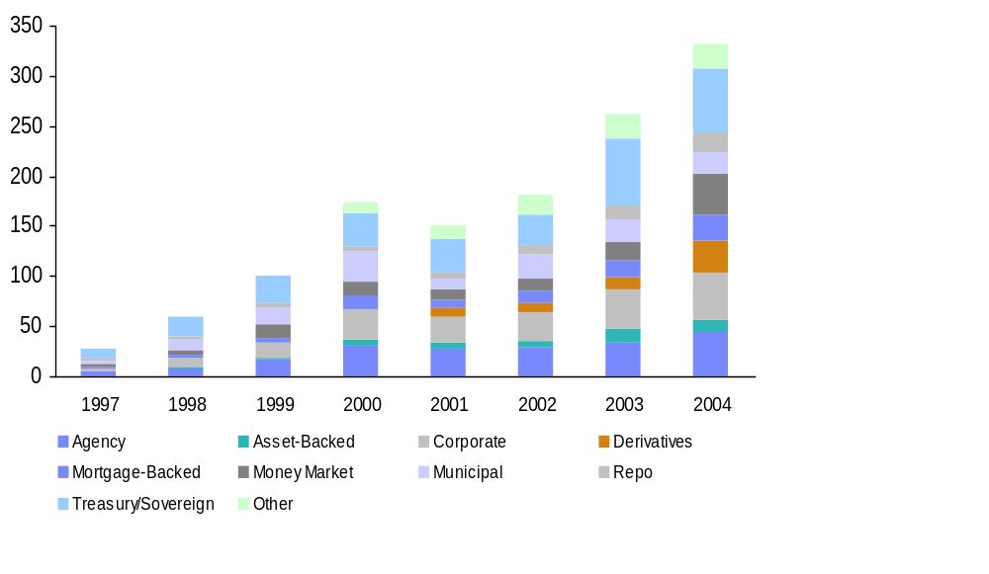
Electronification will target all asset classes…
1
Number of US and European
Electronic Trading Systems¹, 1997-2004
(Number of Electronic Trading Systems
by Type of Market Supported)
Average Daily Trade Volumes vs. Headcount, 1994-2004
(Millions of Shares; Number of Employees (‘000), Volume per Employee)
Average Daily Trade Volume (millions)
(10 year CAGR 19%)
Volume of daily shares traded per employee
(10 year CAGR 15%)
Security brokers and services personnel ('000)
(10 year CAGR 3%)
Note: ¹Totals may exceed the actual number of systems listed since some systems cover multiple product lines
Source: The Bond Market Association; Reuters; SIA; IBM Institute for Business Value analysis

Slide 5
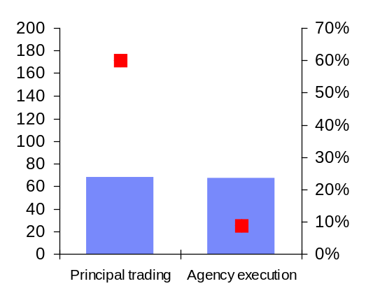
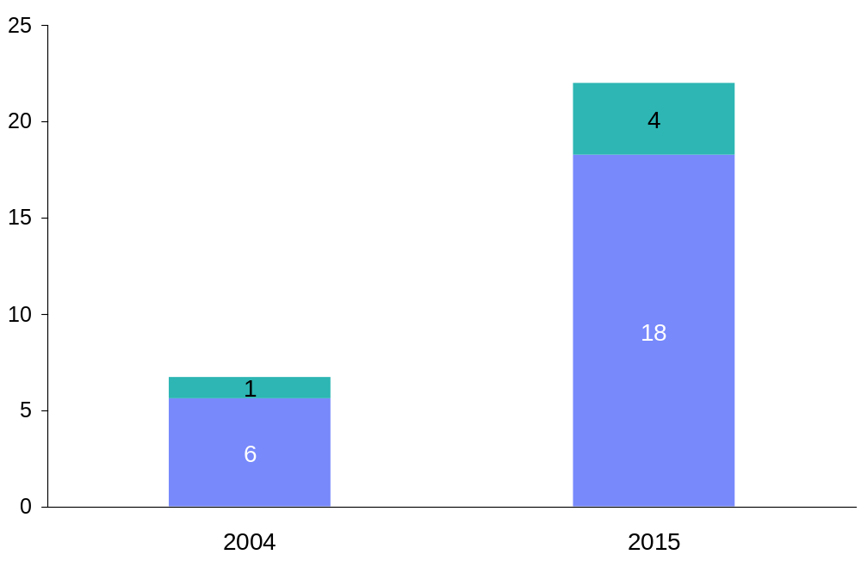
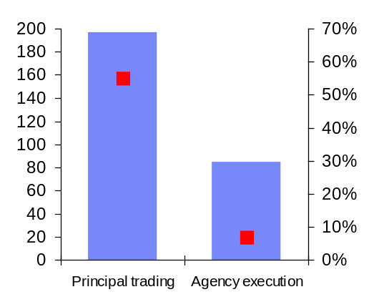
…causing agency margins to die and value to shift toward riskier activities
1
Agency vs. Principal¹, 2004 and 2015
(US $ Billions, Margin Percentage)
Financing and Structured Products Revenue,
2004 and 2015
(US $ Billions)
2004
Revenue
Share
50%
Revenue
Share
50%
Revenue
Share
50%
Revenue
Share
50%
CAGR 11%
Revenue
Margins
2015
Revenue
Share
70%
Revenue
Share
30%
Structured products
Financing
Firms unanimously agreed that proprietary trading will be an increasingly important source of profit over the next ten years; regulators indicated they will not prevent it.
Note: ¹Agency is risk free intermediation of a trade and principal is risk assuming intermediation of a trade
Source: IBV profit map model (see slide 18 in this study)

Slide 6










The data center energy, power and cooling challenge is a major hurdle for the ongoing success of Financial Services Grids
35
30
25
20
15
10
5
0
Cooling systems
Electrical and building systems
% of total data center electricity use
Chiller/
Cooling
Tower
Humidifier
Computer
Room Air
Conditioner
Information
Technology
Power
Distribution
Unit
Uninterruptible
Power
Supply
Switch/
Gen
Lighting
Power Use

Slide 7
These Business and Technology imperatives result in the following Technology trends in financial markets globally
  Aggressive adoption of Model and Algo driven trading
  +
  Demand for real time portfolio and risk management
  +
  Massive build out of computing infrastructure
Next Generation Grid
Powered by Hybrid Computing and Stream computing
enabling the use of Data and Analytics as a Weapon
Notes:
Electronically routed buy-side orders will increase from 1.2 billion shares a day in 2004 to more than 3.1 billion shares per day in 2007²
In 2006, 53% of institutional equities trades in the US were executed through direct market access, algorithms, programs and crossing networks – by 2008 that will be 64%¹
Overall market data volumes rose by 1750% from 2003-2006
Aggressive adoption of model driven trading and algorithmic execution
Demand for real time portfolio and risk management
- Data explosion + globalisation mean it is increasingly difficult to understand where your positions lie locally, let alone in other markets at the end of the month let alone, weekly, daily or realtime !!
Emergence of Hybrid Computing and Stream Processing
- Many small vendors have put product into the market which is having significant impact on trading -> Give you a window into a generation step change in stream computing from IBM research

Slide 8




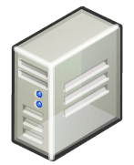

Specifically Financial firms analytic infrastructures are challenged to support ongoing business growth in five dimensions
  Application Management
Inconsistent and unrepeatable
Inability to quickly deploy new apps
  Workload Management
High cost model
Lack of scalability and Performance
  Data
  Management
I/O bottle necks and geographic data dispersion issues not addressed
  Hardware Management
Data center Crisis
Cost, utilization, power and space
  Systems Management
High cost, manual and reactive
No automated / integrated feedback

Slide 9

The need for speed
Exploit advanced technology
to accelerate performance

Slide 10
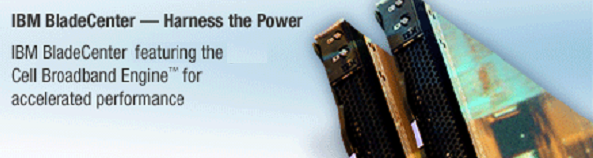
Hybrid computing powered Grids incorporating the Cell Broadband Engine™ (Cell/B.E.)
Ten year collaboration with Sony®, Toshiba®
  Extended through 2012
IBM BladeCenter® QS20 system introduced
September 2006, QS21 in 2007 and QS22 2008
  “Just another Blade”
  Operates in standard BladeCenter® chassis
  Infiniband, Gig-E and 10GigE support
  Runs Redhat Linux and a host of other standard industry applications
Cell/B.E. Highlights
  Significant performance advantages over traditional systems
  64-bit Power™
  Streaming Processors
  Low power consumption
  Real-Time
  Security Enabled

Slide 11
Cell use cases in the Financial Service Sector
Various domains
  Fixed Income and FI Derivatives, Equities and Equity Derivatives, Risk Management, Portfolio Trading, Algorithmic Trading and Analytics
Functional areas
  Pricing of Options, Swaps, and Futures
  Interest Rate Modeling, CDO, MBS
  Path Dependent Calculations
  Risk evaluations – VaR, EPE, PCE, etc
  Stream Processing - market and analytic data

Slide 12
Typical Algorithms being deployed in Cell grids
Algorithms typically used include
  Analytical and approximate (crude) solutions through to Black-Scholes
  PDE solvers (e.g.,Crank-Nicolson)
  Householder transformation, Cholesky decomposition, SVD, PCA
  Monte Carlo Simulations
  Statistical Analysis
Standard Library routines being called
  BLAS, LAPACK, FFT
  Random Number Generation (Sobol, MT, Box-Muller, Moro’s Inversion)
  Math Library’s (R, NAG)

Slide 13
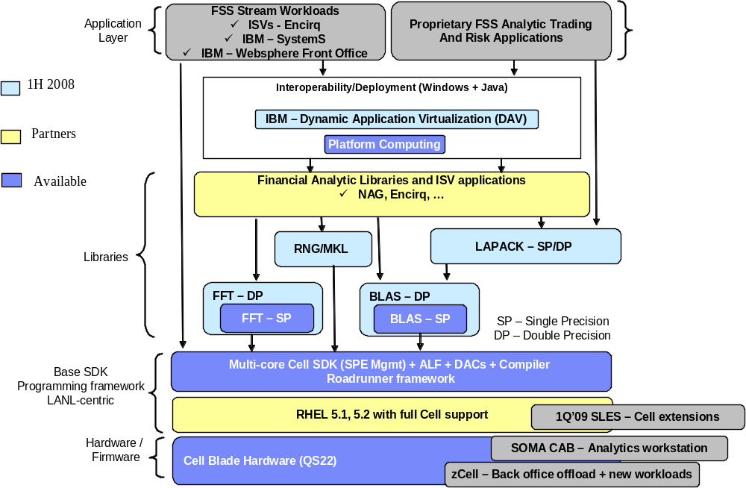
Rapidly growing Application Development, Math library and Grid ecosystem for Financial Services

Slide 14


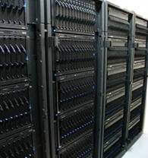




Hybrid Supercomputing Reference
x86 Linux
master cluster
Cell/B.E.
accelerator
cluster
Targeting 1.4 petaflop peak, 1.0 petaflop sustained performance
Notes:
TD: Make this chart into two charts:
1st chart: Title: Cell BE – multi-core acceleration; replace bottom half of this chart with the theoretical performance chart (p26..DC excerpt deck)
2nd chart: Make this a customer success chart and title Revolutionary Hybrid Supercomputing i.e. use the de-clutered Roadrunner chart (p31..DC excerpt deck…which is) or the current bottom half of the chart. Add in partner logos from p31… here is an excerpt from the press release on this for ideas on more content:
IBM to Build World's First Cell Broadband Engine Based Supercomputer
Revolutionary Hybrid Supercomputer at Los Alamos National Laboratory Will Harness Cell Game Chips and AMD Opteron(TM) Technology
WASHINGTON, DC - 06 Sep 2006: The U.S. Department of Energy's National Nuclear Security Administration (NNSA) has selected IBM to design and build the world's first supercomputer to harness the immense power of the Cell Broadband Engine™ (Cell B.E.) processor aiming to produce a machine capable of a sustained speed of up to 1,000 trillion calculations per second, or one petaflop.
The 'hybrid' supercomputer, codenamed Roadrunner, will be installed at DOE's Los Alamos National Laboratory. In a first-of-a-kind design, Cell B.E. chips -- originally designed for video game platforms -- will work in conjunction with systems based on x86 processors from Advanced Micro Devices, Inc. (AMD).
Designed specifically to handle a broad spectrum of scientific and commercial applications, the supercomputer design will include new, highly sophisticated software to orchestrate over 16,000 AMD Opteron™ processor cores and over 16,000 Cell B.E. processors in tackling some of the most challenging problems in computing today. The revolutionary supercomputer will be capable of a peak performance of over 1.6 petaflops (or 1.6 thousand trillion calculations per second).
The machine is to be built entirely from commercially available hardware and based on the Linux® operating system. IBM® System x™ 3755 servers based on AMD Opteron technology will be deployed in conjunction with IBM BladeCenter® H systems with Cell B.E. technology. Each system used is designed specifically for high performance implementations

Slide 15
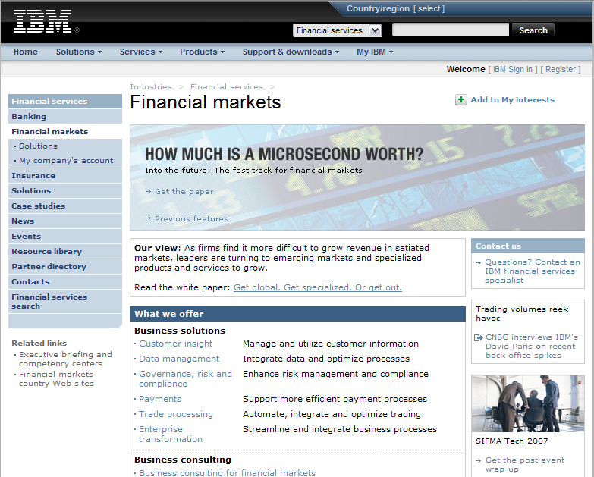
For more information download “How much is a microsecond worth?” at www.ibm.com/financialmarkets

