Slide 1

Enterprise Grid in Financial Services
Nick Werstiuk
werstiuk@platform.com

Slide 2
Contents
Evolution of the Market
Key Areas of Focus – Platform Symphony
  Achieving Enterprise Grid
  Speed – Grid for Low Latency Applications
  Openness – Expand Application Adoption

Slide 3
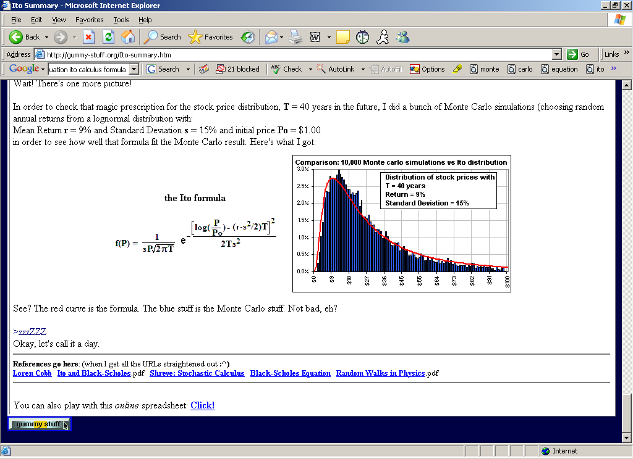
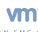
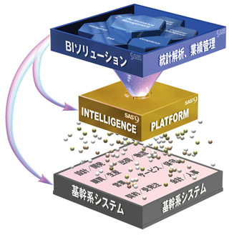

Evolution of the Market - Four Phases of Grid Adoption
Phase 1
Phase 2
Phase 3
Phase 4
LOB
LOB
LOB
LOB
LOB
LOB
LOB
LOB
A
A
A
A
A
A
A
A
A
A
A
A
A
A
A
A
A
A
A
A
A
A
A
A
A
Phase 1: Application Grid – Grid enable application running on a commodity cluster
Phase 2: LOB Grid – Resource sharing among multiple applications
Phase 3: Enterprise Analytics Grid – Utility computing; enterprise scale and management
Phase 4: Enterprise Grid – Beyond analytics: commercial applications on grid

Slide 4

FS Demanding One Solution for Applications across the Enterprise
Application Grid:
Improve performance and decrease response time, by distributing complex compute applications to the grid
  Increase product profitability
  Reduce exposure to risk – risk calculations can be performed in real-time, with greater accuracy
Enterprise Grid:
By enabling sharing of computational power across Lines of Business, IT departments will dramatically lower Total Cost of Ownership by increasing utilization of expensive idling CPU’s
  1% of increased utilization saves millions of dollars
  Enable access to more and differential resources (ie x86, Cell)

Slide 5








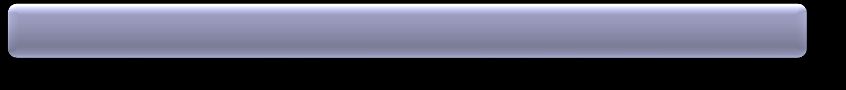
Platform Symphony - Overview
Platform
Management
Console
Application
Library
Workload
Management
Workload
Execution
Client
API
Service Session
Manager (SSM)
Service
Instance
Manager
(SIM)
Platform SOAM
Workload Scheduling
Service
API
Resource Conductor
Plug-in
Platform EGO
Resource
Usage Management
To make it easy for developers to interact with their peers and share their expertise, Platform Symphony 4 has launched an online community at my.platform.com

Slide 6
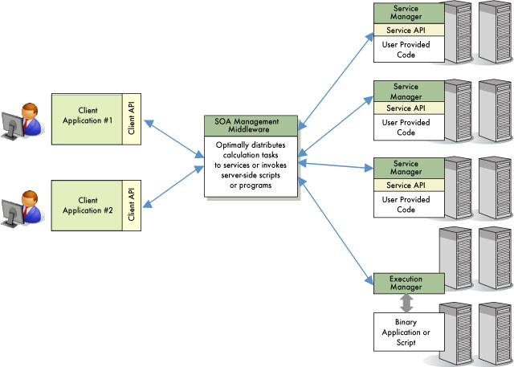
Platform Symphony – How IT Works

Slide 7

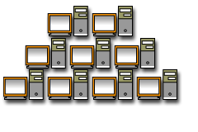

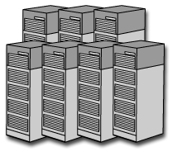

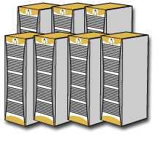
Achieving Enterprise Grid - Silo Grid: Utilization Still Too Low
Unpredictable
Demand
Desktops/Workstations
Un-scalable!
Untapped
Potential
X
DR Sites and Spares
Un-shareable
Resources
(“Silos”)
Linux/UNIX Clusters
_{Windows Clusters}
UAT Servers
Underutilized Resources

Slide 8
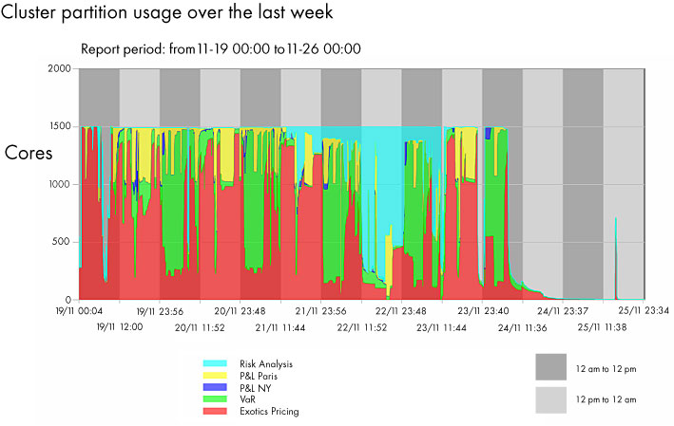
Achieving Enterprise Grid

Slide 9
Grid for Low Latency Applications
 | Symphony Performance
Scalability 1,000 concurrent clients, 100 applications | 20,000+ CPU’s simulated on 1,000 physical CPUs in one cluster
CPU Utilization 1-100 clients, 1 sec task, 1KB message, 2,000 CPU | 98%
Task Throughput 1KB Message | 2,700 messages/sec
Single Task Round Trip | 2.4 ms
Single Session Round Trip 100KB common data, 10 second 1KB Task | 11.8 ms

Slide 10
Making Cost Reduction and Reality
Costs (1 Year) | Data Center | Silo Grids | Utility Grid
 | Environment (CPU’s) | 4,000 | 2,500 | Server Consolidation – resource sharing
CAPEX | Hardware + Chassis | $20,000,000 | $12,500,000 | Movement to more commodity hardware
 | OS support | $400,000 | $250,000 | Reduced OS Subscriptions
 | Storage | $86,400 | $86,400
OPEX | Data Center (power, cooling) | $1,822,080 | $1,138,800 | Utility Grid = true Green Computing
 | Data Center (rental) | $600,000 | $600,000 | not going to reduce the size of the DC
 | System Administrator | $2,500,000 | $1,750,000 | More CPU’s managed per Admin
 | Application Dev/Support team | $4,000,000 | $4,000,000
 | Total | $29,408,480 | $20,325,200
Year 1 Savings of $9M!

Slide 11
Benefits for Financial Services
Speed
  The lowest-latency HPC service-oriented middleware
  5 x 10 times faster than alternative environments
Cost Savings
  Cut your silo server farms in half OR better yet -leverage resources that you all ready have
  The only true utility computing model
Openness
  Easy for developers to build and deploy their HPC service-oriented applications
  Download, install and run an application in under an hour
  Free to download with no time or node-count restrictions

