Slide 1

Grid Usage and
Productivity in HPC
Addison Snell, VP/GM, addison@TaborResearch.com
Actionable Market Intelligence for High Productivity Computing
February 2008

Slide 2
Tabor: “High Productivity Computing”
Tabor Research is studying how HPC transcends price/performance and server sales.
Productivity analysis studies: How do users define and measure productivity?
Site census studies: How do users configure their systems over time?
Budget maps: What are the components of TCO?
New online Productivity Analysis Tool

Slide 3
What is “Productivity”?
Users asked to give top three metrics. Most common:
Better utilization of resources
Reduction of IT costs
Improved collaboration
(tie) Increased revenue (most common top metric among commercial users)
(tie) Advancing state of scientific discovery (most common top metric among academic users)
How does grid computing relate to HPC productivity?

Slide 4
Grid Computing Adoption Rates
Tabor Research study on HPC buyer preferences
“What software do you prefer to have pre-loaded on a new system?”
  Grid / utility computing software: 23% of respondents
  Eliminating the respondents who checked every category brings it down to 16%
  Roughly one in five users prefers to have grid software preinstalled on a new system

Slide 5
Grid Computing Adoption Rates
Tabor Research user site census
16% of users that indicated their middleware packages listed some grid computing package (Globus, Sun Grid Engine, etc.)
  This does not include “data grids” that could be formed with parallel clustered file systems
  This also does not include schedulers such as Platform LSF
  Clearly there is some overlap between a “scheduler” like LSF and “grid software” like SGE

Slide 6
Grid Taxonomy for HPC
Enterprise grids: Transaction-oriented jobs fit into a single node. Grid middleware virtualizes the nodes, such that the job is assigned to a node, which reports back the results.
Distributed computing grids: Scalable jobs are distributed across multiple nodes in the grid.
HPC resource grids: HPC jobs are submitted, which the middleware assigns to an appropriate HPC resource somewhere in the organization. The individual resource may be any time of scalable system, but the job says within that resource once assigned.
Data grids: Computational jobs are not necessarily distributed or virtualized, but the data storage is virtualized across the organization.
Visualization grids: Visual images are calculated and rendered on a remote graphics server and viewed and controlled locally.

Slide 7
Grid Computing Adoption Rates
Online productivity analysis tool
Types of grid computing in use:
  Computational grids: 33%
  HPC resource grids: 22%
  Visualization grids: 14%
  Data grids: 24%
39% of respondents doing some form of grid computing

Slide 8
Online Productivity Analysis Tool
Interactive tool to help gauge impact of HPC investment on organizational productivity
Peer comparisons
Recommendations for improving productivity
Includes analysis of time spent by end users, system administrators, and application programmers
Survey (front-end) prototype site live now at http://www.goodapps.biz/taborresearch
Full tool with recommendations available in March

Slide 9
Conclusions
Grid computing technologies can have a major impact on productivity, according to the ways organizations measure it
Grid computing adoption is underway and growing
Tabor Research is playing a role in furthering the productivity message

Slide 10
Grid Usage and
Productivity in HPC
Addison Snell, VP/GM, addison@TaborResearch.com
Actionable Market Intelligence for High Productivity Computing
February 2008

Slide 11
Backup Slides
Addison Snell, VP/GM, addison@TaborResearch.com
Actionable Market Intelligence for High Productivity Computing
February 2008

Slide 12
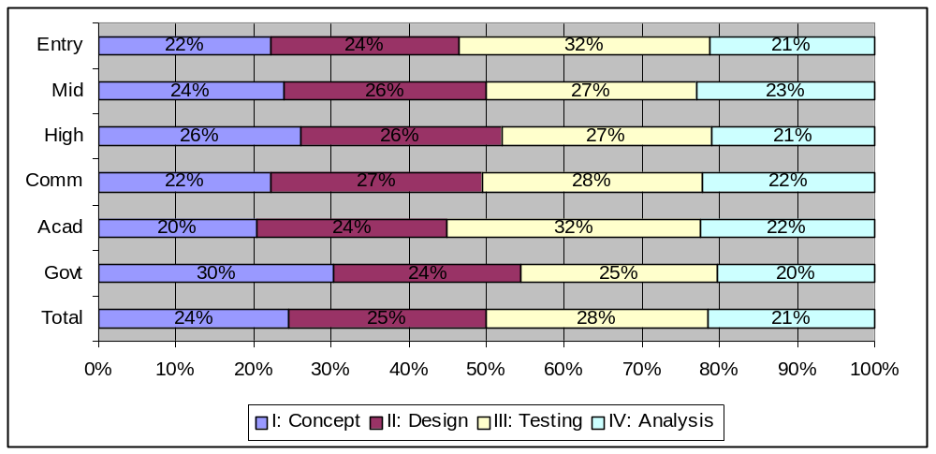
End User Time Distribution

Slide 13
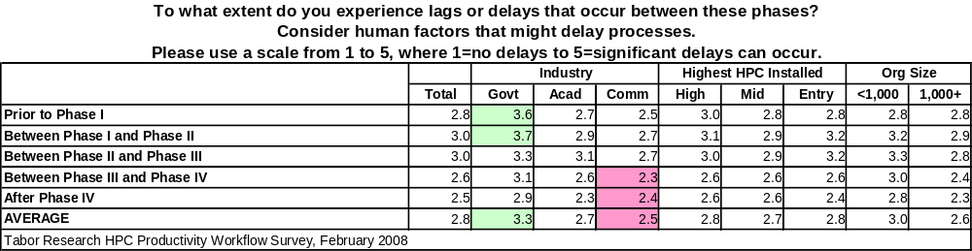
End User Delays Between Phases

Slide 14
End User Time Distribution With Delays
2.8
3.2
3.2
2.6
2.4
2.8
2.9
2.9
2.6
2.6
3.0
3.1
3.0
2.6
2.6
2.5
2.7
2.7
2.3
2.4
2.7
2.9
3.1
2.6
2.3
3.6
3.7
3.3
3.1
2.9
2.8
3.0
3.0
2.6
2.5

Slide 15
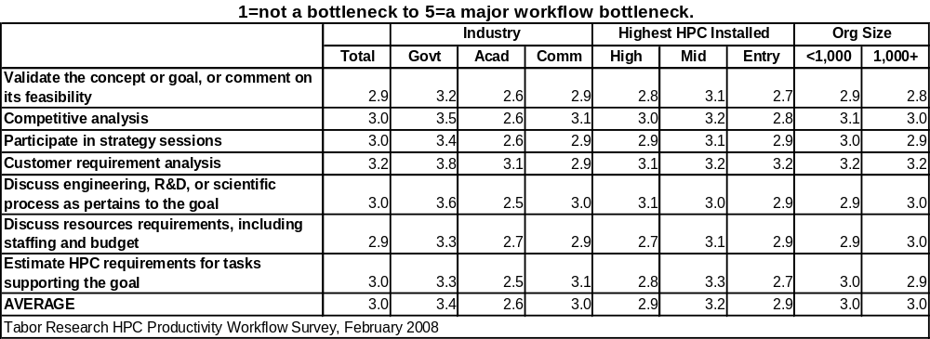
Sample: End User Phase I Bottlenecks

Slide 16
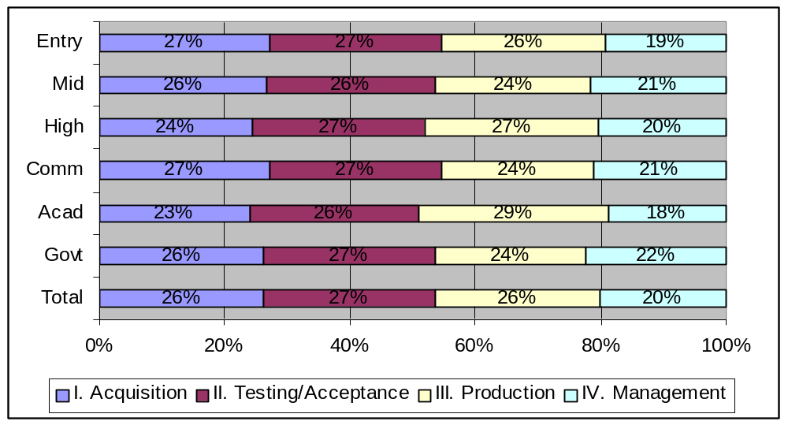
Sys Admin Time Distribution

Slide 17
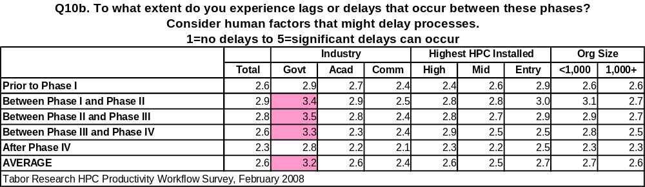
Sys Admin Delays Between Phases

Slide 18
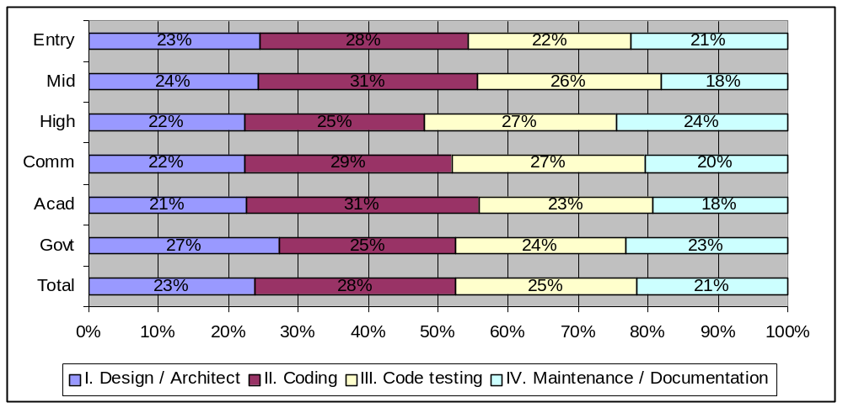
Application Programmer Time Distribution

Slide 19
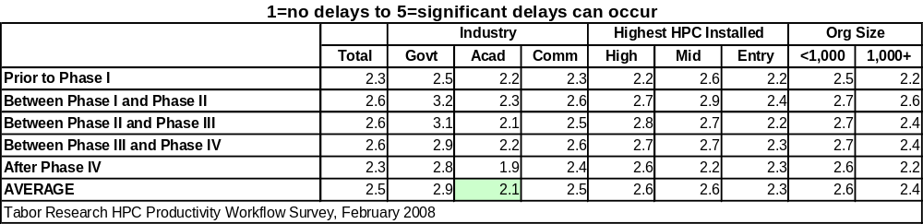
Application Programmer Time Delays

Slide 20
Grid Usage and
Productivity in HPC
Addison Snell, VP/GM, addison@TaborResearch.com
Actionable Market Intelligence for High Productivity Computing
February 2008

