Slide 1
Implementing Federated Security with ConSec
Jens Jensen, STFC
OGF40, Oxford, 16 Jan 2014

Slide 2








Federation
abstraction of providers
selection and deployment by description, providing unified approach
single authentication/authorisation framework covering all resources
Federation
contrail-project.eu
Notes:
Here comes the Federation. Federation is our answer to current diversity and division of cloud solutions. What exactly is federation?
Federation is an abstraction of providers. The abstraction gives us interoperability, where we have a unified approach to description of the applications as well as unified way of deploying it to different providers, automatically, if requested. The user experience remains the same regardless of the provider.

Slide 3
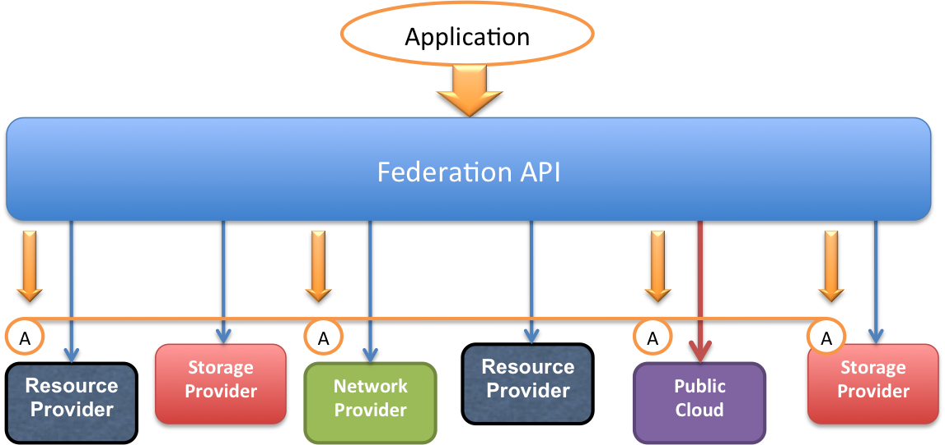
Contrail Objectives: Elastic PaaS Services over a Federation of IaaS Clouds
Cloud Federation
ConPaaS Elastic Services
Web applications
Bag of Tasks
MapReduce
SQL & NoSQL
Interoperability
Advanced SLA
Security
Scalability

Slide 4


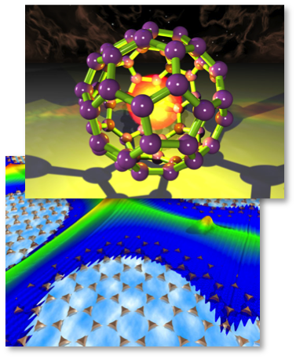



Contrail Use Cases
Distributed provision of geo-referenced data
Multimedia processing service market place
Clouds for high-performance real-time scientific data analysis
High throughput electronic drug discovery
Notes:
Large-scale scientific facilities (accelerators, high-power laser, synchrotrons) producing large data sets to be analyzed in real-time to provide support of in situ experimental decision
ISIS accelerator involving small angle scattering experiments on biological molecules
Central laser facility for chemical, metal and biological samples (microscopic scale)

Slide 5
Several Security Technologies being used…
OAuth
X.509
OpenID
SAML
XACML3
Why?

Slide 6
Use of SAML and OpenID
Identity Providers
External SAML IdPs (eg. National Shib fed.)
External OpenID IdPs (e.g. ESGF, or Google)
External IdPs have an internal LoA associated with them
Consistency of attribute publishing …
Internally, SAML used to authenticate to OAuth authorisation server
SAML used as authorisation attribute statement

Slide 7
Credential Translation
Google
Yahoo
IdP
Bridge
Auz Svr
Umbrella
Account creation
LoA set
Attribute update (eg email)
WAYF
DB
IdP

Slide 8
Authentication workflow
CA
WEB
FAPI
Core
Contrail
IdP
AS
External
IdP

Slide 9
X.509 certificates – Non-Elastic Services
Essential to establish trust in the infrastructure
Required to use IGTF or commercial
Can industry always get IGTF (nearest RA?, community)
Commercial for browser-facing services
Testing and integration
Generator creates a fake PKI for testing, then start servers and tests!

Slide 10
Use of X.509 Personal Certificates
Internal – generated at login
Usually hidden from users (can be downloaded though)
Non-Web stuff – SSL sockets
Carries identity information (Distinguished Name)
Carries authorisation information (like VOMS, only it’s SAML instead of RFC 3281 ACs) – used with XACML

Slide 11
OAuth2
Interoperating python and Java implementations
Used for services which need delegated user certs
E.g. contextualising virtual machine, needs delegated user certificate
Authorisation server tracks use of authorisations

Slide 12

Authorisation and Access Control
PEP
Resource
Federated Id
OK
X reject
+ suspend
PIP
PDP
DB
Subscr.
Federation core
Policies
PAP
=attributes (SAML)

Slide 13
Reuse and Sustainability
Everybody wants Fed Id Mgmt…
So let’s reuse some stuff
Components-based reuse, rather than all or nothing

Slide 14
Component | Origin | Needed for | Used by | Maturity of component | Integration of component
OAuth2 | python collab. between Contrail and NDG | Delegation of User credentials; Plan A authentication | CEDA CLARIN. | Production | Completeed
OAuth2 | Java code from the Apache Amber project | Supporting Java components in AAI | Widely used | Production | Done by XLAB (user CA with OAuth2 Client)
User CA | Developed by STFC as part of Contrail | Obtaining fed X.509 credentials | Contrail; EUDAT. | Medium: hasn’t changed recently except for the OAuth ∫ | OAuth resource server integration done recently by XLAB.
User database | Schema developed by INRIA as part of Contrail; actual database is MySQL | Maintaining user attributes (external and internal), account management, accounting. | Contrail; EUDAT. | MySQL is clearly extremely mature. SAML formatting of attributes also using existing libraries. | A web services API was developed to obtain assertions in SAML format.
Authorisation components | Based on XACML: Various implementers | Authorisation (XACML) supporting community and fed attributes and roles | Many external users | Standards-compliant XACML libraries | Federation roles fully integrated. Resource authorisation not started
Accounting | Developed in Contrail based on RabbitMQ and usage records | Accounting | RabbitMQ widely used. | RabbitMQ widely used. | EUDAT required work is not started.
IdP selectors | DiscoJuice (for Shib); built in for OpenID. | Selecting federations and IdPs | FEIDE (Norwegian fed.) | Being used by other projects in production. | In progress (STFC, with XLAB)
SImpleSAMLPhp | Managing authentication and IdP selector | Supporting actual OpenID and SAML authentication | Several projects | Used by “real” projects in production | Integrated with portals (Django) and with authorisation server

Slide 15
General Component Sustainability
Do without component – don’t need the feature
Replace component with other component
Use of standards
Support component ourselves (open source)
Build support community (open source)
Live with the risk (non-security-critical components)

Slide 16
Implementation Options
Portal integration:
Full integration: portal is an OAuth2 client
Partial integration: portal calls out to CA, bypassing OAuth
Side-by-side: frame EUDAT portal with community portal
Command line access

Slide 17
File access
MyProxy
Globus
Online
GridFTP(?)
GridFTP
iRODS
Portal
GridFTP(?)
HTTP(S)
GridFTP
PRACE
Browser

Slide 18
Integrate with Everything™: EUDAT
Federated Services
Invenio…
“SimpleStore”
REMS…
GridFTP (for data transfers), GO (via MyProxy?)
iRODS
Communities
CLARIN
ENES
EPOS
VPH
LifeWatch
…

Slide 19
Conclusion
Tools for supporting federations
Federated identities – and other external IdPs
Typically supporting diverse user communities
Going for standards components
… but pragmatic approach to getting things working

Slide 20



http://contrail-project.eu
contrail is co-funded by the
EC 7th Framework Programme
Funded under: FP7 (Seventh Framework Programme)
Area: Internet of Services, Software & Virtualization (ICT-2009.1.2)
Project reference: FP7-IST-257438
Total cost: 11,29 million euro
EU contribution: 8,3 million euro
Execution: From 2010-10-01 till 2013-09-30
Duration: 36 months
Contract type: Collaborative project (generic)
contrail-project.eu

