Slide 1
Updates from the
EUGridPMA
David Groep, May 9st, 2007

Slide 2
Outline
EUGridPMA constituency
New CAs and profiles
Technicalities update

Slide 3
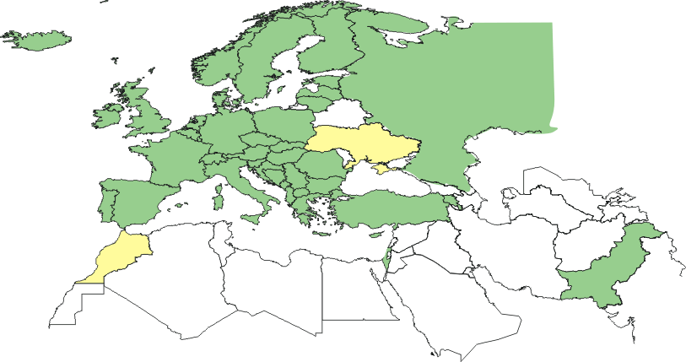
EUGridPMA members and applicants
Green: EMEA countries with an Accredited Authority
24 of 27 EU member states (all except LU, MT, RO)
+ AM, CH, HR, IL, IS, NO, PK, RU, TR
Other Accredited Authorities:
DoEGrids (.us), GridCanada (.ca), CERN, SEE catch-all

Slide 4
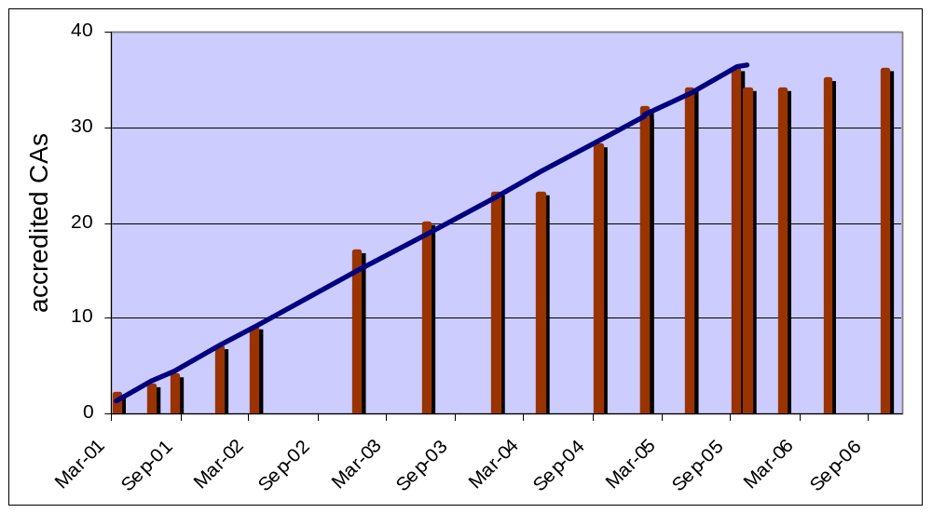
The story so far …
Foundation of the IGTF
allows migration of CAs to Regional PMA

Slide 5
Membership by type
Under “Classic X.509 secured infrastructure” authorities
  accredited: 39 (recent additions: Bulgaria)
  active applicants: 5 (Serbia, Romania, Morocco, Ukraine, FYROM)
Under “SLCS”
  accredited: 1 (SWITCHaai)
Major relying parties
  EGEE, DEISA, SEE-GRID, LCG, TERENA

Slide 6
Developments in Europe
Automated clients
  have been proposed in 2002 by Mike Helm et al.
  Introduced in the UK in 2006, in NL in 2007
  see http://ca.dutchgrid.nl/info/etokens for examples for tokens
Why?
  monitoring use case (classic one) for functional tests
  portals and web sites with ‘canned’ jobs,
  just like the cgi-bin use case
  use of automated clients needs quite some policy changes,
  but having secure hardware tokens is a good ingredient

Slide 7
Some dates for you to remember and schedule
May 30-31 and June 1, 2007
10th EUGridPMA meeting, Istanbul, TR (hosted by ULAKBIM)
June 11-12, 2007
5th TERENA NREN-Grids Workshop, Paris
mid or end September, 2007
11th EUGridPMA meeting, Athens or Tessaloniki, Greece

