Slide 1
Data Access
OGSA Data WG F2F

Slide 2
Status
Have a first draft
  General Introduction
    Based on generalised DAIS
  DAIS section
  ByteIO section
    Stolen from document by Mark Morgan/Andrew Grimshaw
Several outstanding issues
Needs to be reviewed

Slide 3
Peeling the onion
Provide different levels of abstraction
  Hide the underlying data model
  Intrinsic data resource access methods

Slide 4
Patterns for accessing data
Conduit
Standard
Not so good for large data
Query
Data Service
Data
Derived Data
Avoids unnecessary data movement
Need policies
Not quite symmetrical
Query
Data Service
Data Service
Data
Third Party Delivery
Query
Data Service
Versatile (out of band delivery)
Requires framework
Data

Slide 5
Properties
Idea from DAIS
Describe characteristics of:
  Data resource
  Relationship between DS & DR
Represented as XML elements
More added if necessary
Changing property can change behavior
Data Service
Data Description:
Abstract name (xsd:any)
Description (xsd:any)
Data Factory:
none
Data Access:
Readable (boolean)
Writeable (boolean)
ConcurrentAccess (boolean)
TransactionInitiation (enumeration)
TransactionIsolation (enumeration)
Sensitivity (enumeration)
RequestMessageResponseTypeList
Data Management:
none
Notes:
<xsd:element name="TransactionInitiation">
TransactionInitiation
NotSupported Does not support Transactions.
Automatic Transaction initiated for each message.
Manual Transaction context under control of the consumer. DAIS does not define interfaces for controlling transactions manually. It is expected that other specifications such as WS-Transaction [WS-Transaction].
TransactionIsolation:
NotSupported Does not support transactions.
ReadUncommitted Access uncommitted changes made by other
transactions.
ReadCommitted Access only committed changes made by other
transactions.
RepeatableRead Access only committed changes made by other
transactions and ensure that no records read during
the transaction are changed by other transactions.
Serialisable Access only committed changes made by other
transactions, ensure that no records read during
the transaction are changed by other transactions and
ensure that result sets read during the transaction are
not extended by other transactions.
Sensitivity:
NoSensitivity There is no data resource to which this data resource
can be considered to be sensitive.
Insensitive Changes to the parent data resource do not affect the data presented by this data service/data resource.
Sensitive Changes to the parent data resource are reflected in this data service/data resource.

Slide 6
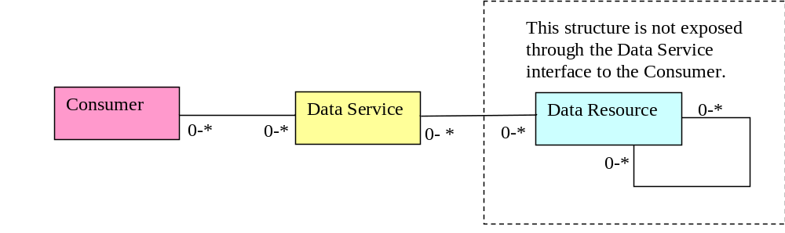
Data service multiplicities

