Slide 1
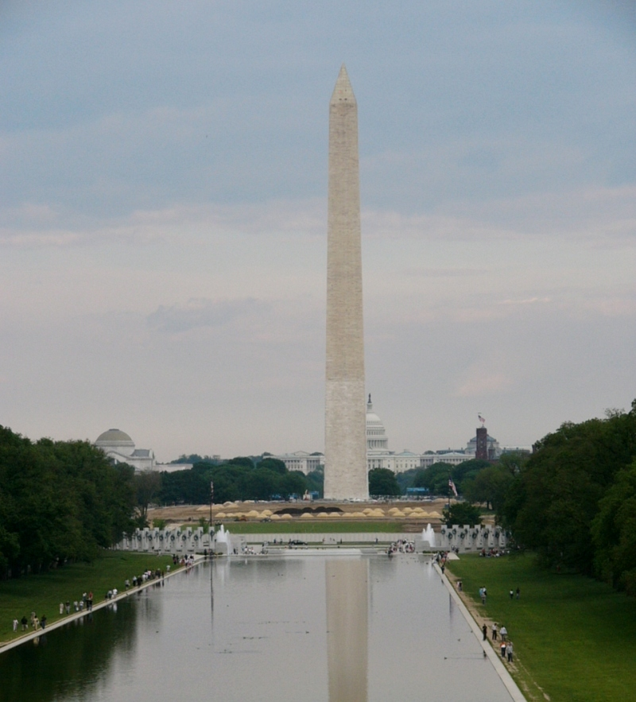

Welcome!
R2AD, LLC.
P.O. Box 10872
McLean, VA 22012
(703) 714-0442
http://www.r2ad.com
info@r2ad.com
ACS-WG
Face-to-face meeting
23-24 May 2005
Northrop Colshire
Washington DC

Slide 2
*** DAY 1 (May 23) ***
10:00 Agenda bashing, role call, note taker & time keeper. (KF; 30 min)
10:40 ACS Overview (10 minutes)
11:00 Security (Mike; 60 min)
  General understanding on the range of the security topics in ACS.
  Minimum requirements on ACS spec.
12:10 OASIS SDD TC updates (Tom; 45 min)
  history
  plan and milestones
  relationship to GGF CDDLM-WG
  collaboration with ACS-WG; scope, participation …
LUNCH

Slide 3
Day 1 Continued
13:50 ACS requirements and issues list overview (KF; 1 hour)
  Review the requirements description to be merged into the WG draft spec.
  Itemize, prioritize and the issues in a list
  Use of the tracker in gridforge.
16:00 Review of the NAREGI PSE information. (KF; 30 min)
  Review presentation
  Material will be posted on the acs-wg by noon EDT.
  Review the information if there are questions or issues.
  Return comments or questions to PSE team to prepare the call in the next morning.
17:20 OGSA roadmap report (20 min)
17:40 ACS requirements (30 min)
18:10 Wrap up day 1 and planning for next day (KF; 30 min)
Dinner : 19>>

Slide 4
*** DAY 2 (May 24) ***
8:00 NAREGI integration (KF; 1 hour)
  Use case description in the WG draft.
  ACS interface example to NAREGI type of deployment engine.
  Requirements 1: multiple compiled binaries in ACS.
  Requirements 2: data caching in ACS.
9:30 Interface between ACS & CDDLM. (KF & Sachiko; 1 hour)
  Summary report on CDDLM component model.
  "addFile" in CDDLM deployment API. There are two possible mapping
  (relationship) between them and ACS/ARI.
10:55 Break

Slide 5
Day 2 continued
11:10 GGF14 session plan (KF; 1 hour)
  Avoid conflicting with CDDLM/WSDM joint session
  Deadlines
    Draft document deadline: May 27, 2005
    Session request deadline: June 3, 2005
  Chairs update –
    critical updates and training: Monday, 27 June 2005
12:50 Other items in issues list (Mike; 30 min)
  WSDM management interface in ACS.
  Updates on OGSA naming activity.
  Specification on the data transport to be used with ACS.

Slide 6
Day 2 continued
12:50 Lunch
13:50 New use cases (Mike; 1 hour)
  SDD (Tom)
  Shipping (Mike)
  Federation (Pete)

Slide 7
Day 2 continued.
14:50 WG draft writing plan. (KF; 1 hour)
  Review of the table of contents.
  Editorial work.
  Drafting additional contents, for example,
    Requirements from new use cases(all),
    authZ/authentication(Mike),
    signature/integrity(Pete),
    ARI interface detail including WSDL(all),
    AAF in detail (Tom).
15:50 Management and/or strategy in the ACS activity. (KF; 1 hour)
  Regular teleconference Wed 8pm EDT/Thu 9am JST
  Recruiting in the European Grid community.
16:40 Break

Slide 8
Day 2 continued
16:50 Interoperability Goal (KF; 30 minutes)
  Other activities which may have relationship with ACS e.g. EGA, EGEE, OMII, etc.
  Define target systems and scope. Research
17:20 Wrap up F2F meeting and review of action items. (KF; 30 min)
17:50 End of meeting
Postponed
  SCRM collaboration

Slide 9
SDD + WSDM + CDDLM + ACS
ACS ARI
AAF
SDD
Deploy Engine
(CDDLM, NAREGI)
ACS
DMTF CIM
Mgmt Intf (WSDM)
describes
Server
Server
other

Slide 10
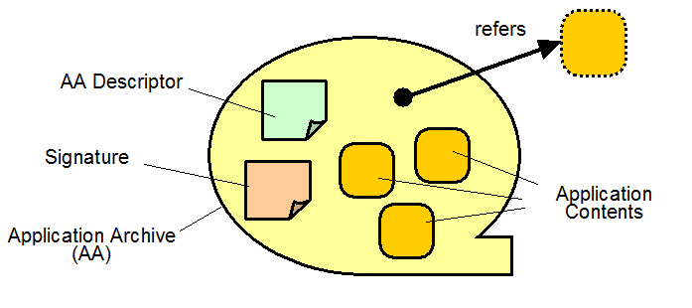
ACS
AAF
ACS assumes that there is overall grid management which ensures that ACS and other resources are available. For example, an archive should not be deleted when it is in use. ACS is not responsible for this.
(WSDM)
AD
Signature

Slide 11
CDDLM Discussion
BAM
Register()
GetAA()
ACS
JM
CDDLM
CDDLM
AP
BAM
ACS
JM
Portal
System
Register()
AA EPR
Submit (AA epr)
New()
getCDL()
Initialize()
AA EPR
Initialize()
getAA()

