Slide 1
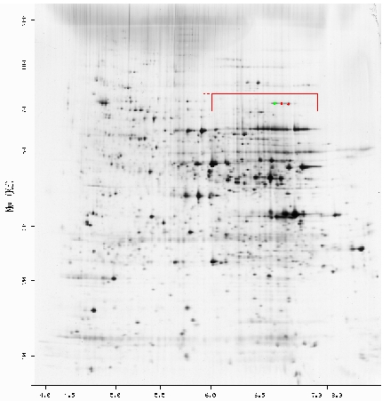
Life Sciences Grid
Research Group
Dave Angulo
DePaul University
Abbas Farazdel
IBM Healthcare and Life Sciences

Slide 2
GGF Intellectual Property Notice
Attending this GGF14 session means that:
You have read and understood the GGF Intellectual Property (IP) Policy and
You acknowledge that participation in GGF is subject to the GGF IP Policy.
You have already signed for the above
when you registered for GGF14

Slide 3
Secretaries
Need 2 secretaries present and taking notes

Slide 4

Leaders
Research Group Chairs:
  Dave Angulo, DePaul University
  Abbas Farazdel, IBM Healthcare and Life
Special Recognition to:
  Peter Arzberger, SDSC
Secretraries:
  Larry Ang, BioInformatic Institute
  Piotr Bala, N. Copernicus University
LSG Advisory Council (TBD)
LSG Community

Slide 5
Example Project (Updates at Gridforge.org)
Worldwide LS grids Survey Subcommittee Leaders:
  Mark Miller, SDSC Integrative Biology Program
  Karpjoo Jeong, Kookmin University, Seoul
  Vincent Breton, PCSV Group
Open LSG Architecture Subcommittee Leader:
  Rick Stevens (interim), Argonne
Workflows Subcommittee Leaders:
  Carole Goble, University of Manchester
  Virinder Batra, IBM
LS Solutions (Medical Informatics) Subcommittee Leaders:
  Vincent Breton, PCSV Group
Requirements Document
  Vincent Breton, PCSV Group
Workshop GGF Deliverables:
  John Ibbotson, IBM UK

Slide 6
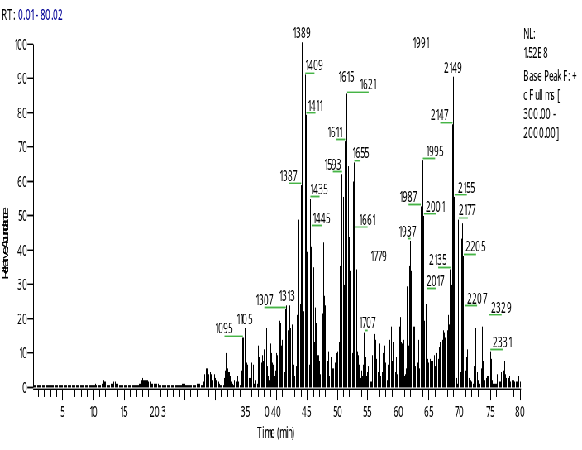
Open Positions
Requirements Document Subcommittee Leader:
Open
LS Solutions (Discovery) Subcommittee Leader:
Open
LS Solutions (Medical Imaging) Subcommittee Leader:
Open
Best/Common Practices in Healthcare and LS Subcommittee Leader:
Open

Slide 7
Life Science Grid – Research Group
Explores issues related to the integration of Information Technology with the Life Sciences on a grid infrastructure.
Works at the interface of two revolutionary areas: biology and information technology.
Throughout 2005, LSG will be exploring privacy and security needs of the health care industry.
  Focus question:
    Whether GGF is developing enough middleware tools so that users of grid technology in this industry are able to comply with many required security and privacy guidelines and policies.
Deliverable of the workshop:
  An Informational Document addressing the issues of security and privacy in healthcare industry and how it relates or challenges GGF.

Slide 8
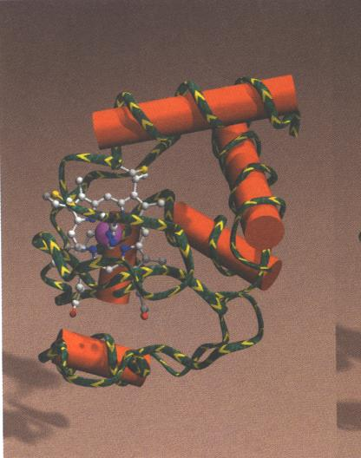
Security Groups Interaction/Coordination
Allen Luniewski & Dave Berry
  Co-Chairs OGSA Data WG
Andrew Simpson
  Oxford
  Developing secure, interoperable frameworks
  to facilitate aggregation of clinical data from
  disparate sources.
Peter Kunszt
  European EGEE Project
  Grid Storage Resource Management WG
  Already have a good set of requirements and detailed design
  Have discussed
    How EGEE may profit from the grid
    What EGEE would need in terms of security to be acceptable
    How EGEE deals with biomed requirements
    See
    https://edms.cern.ch/file/594698/0.1/architecture.pdf
    chapters 5 and 9.5

Slide 9
Special Issue
Konagaya Akihiko, Riken, Japan.

Slide 10
GGF 15
Partnering with IDG to form GridWorld
  Once per year
Boston, Massachusets
October 3-6

Slide 11
Mission: Healthcare & Life Sciences (HC&LS)
Identify different solution areas and classify them
Explore possible reference architectures for each solution area
Identify clear examples and the diverse use of the grid within HC&LS
Discuss issues of access to data within HC&LS
Discuss state of standards, within subdisciplines and between subdisciplines
Identify how the grid is being challenged by HC&LS, and where there is need for activity
Identify linkages to other research and working groups
HC&LS Apps
Current
WGs, RGs,
WSs, BOFs
New
WGs, RGs,
WSs, BOFs
Map to
Generate

Slide 12
Complex ecosystem associated with GGF
GGF Ecosystem
Academia
Researchers
Government
Commercial Vendor
Industry
Users
Media
Other Consortia
Other Standards Orgs
Grid Installs
Computer Science
Research Labs
Government
Labs
Software /Hardware Vendors
HPC Users
e.g.: Pharma
Grid Publications
Globus
SNIA
Japan Grid
Applied Science
Economic Development Programs
Industry Solution Providers
SOA Apps
e.g. Transactions
Industry / Technology Publications
Internet2
IETF
Korean Grid
Academic
Labs
Communications Vendors
Analyst Publications
Other Consortia
OASIS
European Grid
Government
Funding Programs
Service Providers
National Publications
W3C
TeraGrid
Partners
Online Publications / Bloggers
DMTF
Other Grid
Efforts
Researchers
Present / Future Users
KEY
HPC = High Performance Computing
SOA = Services Oriented Architecture

Slide 13
Please interrupt!!
Participate
Let’s make the talks interactive and lively

Slide 14
Agenda
9:00 AM – 9:15 Introduction (Angulo/Farazdel)
9:15 – 9:30 Healthgrid Conference Conclusions. Vincent Breton
Health Grids Workshop Presentations
  9:30 AM – 10:00 Tyrone W A Grandison, IBM Almaden Research “Data Disclosure Technology for the Grid”
  10:00 AM – 10:20 Todd Hart, Illinois Health Network. “Illinois Health Network”
  10:20 AM – 10:40 Barrett Myers, Talisen Technologies “Illinois Health Network”
  10:40 AM – 11:00 Break
  11:00 AM – 11:30 Stephen A. Langella Ohio State University , Department of Biomedical Informatics “caGrid Security Architecture”
  11:30 AM – 12:00 Stuart Johnstone Precident/CEO CompassCase “HIPAA- Where Atomic Data Collides With Distributed DNA”
  Roundtable, Q&A, Discussion

