Slide 1
Life Sciences Grid (LSG)
Research Group
LSG Working Sessions at
GGF11 – The Eleventh Global Grid Forum
8 June 2003
Honolulu, HI, USA
Life Sciences Grids – Health Grids
Dave Angulo
Peter Arzberger, Abbas Farazdel

Slide 2
Acknowledgements
Many slides based on slides from previous LSG-RG meetings
  Dave Angulo - DePaul University
  Abbas Farazdel – IBM Life Sciences

Slide 3
LSG Working Sessions at GGF11
Tuesday, June 8, 2003
8:30 a.m. - 11:30 a.m. Hawaii Time (GMT10:00)
  Note GGF schedule says 8:00, so we’ll wait half an hour
Sea Pearl 1-2 Room – PHONE CONFERENCE
Tuesday, June 8, 2003
2 p.m. - 3:30 p.m. Hawaii Time (GMT-10:00)
Sea Pearl 1-2 Room - PHONE CONFERENCE

Slide 4
Why
Life Sciences Grids?
Why
Health Grids?

Slide 5
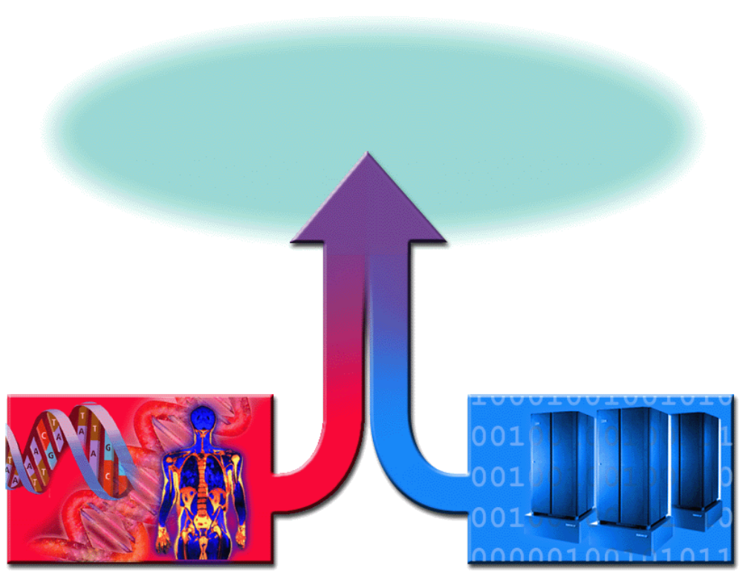
The Challenge
Scientific discovery
New drugs and treatments
Revolution in Healthcare
Bioinformatics, Cheminformatics
& Medical Informatics
Life Sciences & Medical Sciences
Information Technology

Slide 6
LSG Charter Fulfillment
Progress

Slide 7
LSG is an RG not a WG!
Working Group:
  A WG is generally focused on a very specific technology or issue with the intention to develop one or more specific documents aimed generally at providing specifications, guidelines or recommendations.
Research Group:
  An RG is often longer-term focused, intending to explore an area where it may be premature to develop specifications.
“The Life Sciences Grid Research Group (LSG-RG) provides a
Forum for the above [listed in the charter] topics until
sufficient maturity is reached that result in the formation of
separate Working Groups or Research Groups for further
exploration.”
LSG Charter, Oct 2002
Notes:
To promote and support the development, deployment, and implementation of Grid technologies and applications via the creation and documentation of "best practices" – technical specifications,
user experiences, and implementation guidelines.

Slide 8
Goals / Milestones from LSG Charter
GGF6 (Oct 02): Created the Research Group charter
Actively engage the community of life scientists in this activity
  Oct 02 – Mar 04
Plan and host an active session of the Research Group at GGF7
  Mar 03
Prepare a survey of grid activity in Life Sciences
  Oct 03
Prepare a survey of Life Sciences specific requirements for grids
  Prerequisite: current/best practices

Slide 9
LSG-RG is in Second Phase
The LSG-RG has completed the first phase
  Determine medium term objectives for the research group
Now has moved into second phase
  Looking at Life Sciences Applications and Medical Applications
    Brussels workshop Oct 200
    Chicago workshop Oct 2003
    Seattle workshop June 2003
    Tokyo workshop Jan 2003
    Brussels workshop Oct 2004
    Mapping applications to current and new GGF activity
  Creating best practices document (Moore, Bala)
  Continuing with development of a Life Science Grid platform (Stevens)
    Open Life Science Grid platform, or SEED
  Creating requirements for biomedical applications on Grids (Breton)

Slide 10
GGF11 LSG Objectives
Identify different solution areas and classify them
Explore possible reference architectures for each solution area
Identify clear examples and the diverse use of the grid within the life sciences
Discuss issues of access to data within life sciences
Discuss state of standards, within subdisciplines and between subdisciplines
Identify how the grid is being challenged by the life sciences, and where there is need for activity
Identify linkages to other research and working groups
LS Apps
Current and new
GGF
WGs and RGs
Map to

Slide 11
Some Linkages to other GGF Groups
APME
  Grid Checkpoint Recovery (GridCPR-WG)
    On demand computing in Telescience
  Grid Remote Procedure Call (GridRPC-WG)
  Advanced Collaborative Environments (ACE-RG)
    PRAGMA, GBIF, Telescience
  Advanced Programming Models (APM-RG)
  Applications and Test Beds (APPS-RG)
  Grid Computing Environments (GCE-RG)
  Grid User Services (GUS-RG)
  Life Sciences Grid (LSG-RG)
  Production Grid Management (PGM-RG)
  User Program Development Tools for the Grid (UPDT-RG)
ARCH
Data
  Database Access and Integration Services (DAIS-WG)
    GBIF, BIRN
  GridFTP-WG
  Data Replication (REP-RG)
  Data Transport
  Grid High-Performance Networking (GHPN-RG)
  Persistent Archives (PA-RG)
ISP
P2P
SEC (numerous apps)
  Authorization Frameworks and Mechanisms (AuthZ-WG)
  CAOPs (CAOPs-WG)
  Grid Certificate Policy (GCP-WG)
  Grid Security Infrastructure (GSI-WG)
  Open Grid Services Architecture (OGSA) Security (OGSA-SEC-WG)
  Site Authentication, Authorization, and Accounting Requirements (SAAA-RG)
SRM
  Distributed Resource Management Application API (DRMAA-WG)
  Grid Economic Services Architecture (GESA-WG)
  Grid Resource Allocation Agreement Protocol (GRAAP-WG)
  OGSA Resource Usage Service (RUS-WG)
  Scheduling Dictionary (SD-WG)
  Usage Record (UR-WG)

Slide 12
Diverse Uses of Grid
Telescience: Access to high-end resources to gain better understanding (neurobiology, BioGrid))
BIRN: Linking data to leverage: Relation of shape to clinical condition
Biodiversity: Heterogeneous data
Systems Biology: Understanding cells and organisms (cardiac physiology)
Structural Biology: Workflow (EOL, iGAP, myGRID), tool by Karp Joo Jeong), launching many jobs, others (BioGrid)
Quantum to continuum Mechanics: Highly compute intensive
Immunology: Compute and data intensive
Health Grids
Genetic sequence data source discovery (OBIEnv )
…

Slide 13
Agenda for Tuesday, June 8
8:30 AM – 11:30 AM and 2:00 PM -3:30 PM
Hawaii Time (GMT – 10:00)
Open Bio Grid Reference Architecture (SEED): Rick Stevens
Overview and progress report: Dave Angulo, Abbas Farazdel
  IP Rights, Attendance sheets
  Report on Life Sciences Grid activities at GGF10 and in its aftermath
  Progress on the activities since GGF10:
    LSG Advisory Council: Dave Angulo
    International Life Science Workshop report: Fumikazu Konishi (for Konagaya Akihiko)
    Special issue of International Journal of New Generation Computing – progress on getting GGF document number Fumikazu Konishi (for Konagaya Akihiko)
    Framework for Life Science Grids: (Stephan Frank absent, perhaps presented by Josh Moore)

Slide 14
Agenda for Tuesday, June 8
8:30 AM – 11:30 AM and 2:00 PM -3:30 PM
  Subcommittee reports
    Open Life Science Grid (skipped – presentation earlier by Rick Stevens)
    Worldwide LS grids Activity: Karpjoo Jeong, Vincent Breton
    Workflows: Carole Goble, Dennis Ganon
    LS Solutions (Medical Imaging): (Jun Ni absent, no report submitted)
    Best/Common Practices in Healthcare and Life Sciences: (Summary – presentation later) Joshua Moore
  Planning for GGF12 Workshop in Brussels: Workshop Focus Topic: Health Grids
    Call for presentations and nominations for invitations.
    Call or Workshop leader volunteers
  Demonstration: accessing LSG documents in Grid Forge: Dave Angulo

Slide 15
Agenda for Tuesday, June 8
8:30 AM – 11:30 AM and 2:00 PM -3:30 PM
Requirements for biomedical applications of grids; followed by a discussion: Vincent Breton
Report on the First International Workshop for Life Science GRID2004: Fumikazu Konishi (for Konagaya Akihiko)
Development of a Grid Infrastructure for Functional Genomics; the Bridges project: Richard Sinnott
Current Best Practices in the Life Sciences Grid: Josh Moore
Closing Discussion

Slide 16
How is Grid is being challenged by life sciences
Diversity and Heterogeneity of Data
  Storage
  Query
  Finding (intelligent linkage)
  Integration (e.g. Toolpath, Toolbus, OBIGrid)
Computing
Control of instruments
Workflows / Portals
  Standard interfaces (for portals/workflows)
Collaborative Tools and Environments (e.g. REALISTE)
Security Issues
  Giving access
Impulse (on-demand) Computing
Policy Issues: Privacy, IPR, National Security

Slide 17


Upcoming GGF Meetings
GGF11 (June 2004) - Honolulu, Hawaii, USA
GGF12 (Sept 20-23, 2004) – Brussels, Belgium
GGF13 (March 2004) -
.
LSG
Tasks
LSG
Tasks

Slide 18
Sub-Committees
Varied LS Solutions Leader
  Medical Imaging Jun Ni – inactive?
  Requirements Document Open
  Discovery Open
  Medical Informatics Open
  Others???
LS Grid Reference Architecture Rick Stevens
Requirements Documents TBD
Workflows Carole Goble & Dennis Gannon
Worldwide LS Grids Activity Karpoo Jeong & Vincent Breton & Mark Miller
Best/Common Practices Josh Moore
Others ???

