Slide 1


Applying Grid Computing Research to Commercial IR Applications
Presented by
Carl Sylvia, SBIR Project Manager
Deep Web Technologies, LLC
GGF-14 – June 28, 2005

Slide 2
Deep Web Technologies…
Founded in 2002 by Abe Lederman an expert in the field of information retrieval
Specialize in federated search and ranking of “deep web” content
Build custom solutions based on proprietary Distributed ExploritTM software
Develop and maintain highly visible innovative applications for DOE OSTI
  science.gov
  e-prints network
Developing next generation search technologies for DOE OSTI.

Slide 3
The Deep Web
Generally consists of high quality managed content
scientific, technical, and business documents and data
Much larger than the “surface web”
Often requires interaction with cgi/web service
May require authentication and authorization for access
Unreachable by standard web crawling / indexing approach

Slide 4
Who's Interested in the DW?
The Federal government spends over $127B a year on R&D
CENDI is an interagency working group of Scientific and Technical Information Managers from 12 federal agencies
CENDI members represent over 96% of the total federal R&D funding

Slide 5
Who's Interested Cont'
Members of CENDI include
  DOE, DOD, EPA, DOI, DOC
Currently have 10s of millions of technical documents stored in the deep web
Mandate for making results of publicly funded research available to citizens

Slide 6
OSTI (www.osti.gov)
DOE Office of Scientific and Technical Information
Tasked with making the vast quantities of quality R&D output available across organizations and to the “science attentive citizen”
Funds the development and maintenance of e-prints and science.gov search portals
Currently funding our next generation grid solution for deep web searching

Slide 7
Science.gov
Flagship search engine
High quality managed content
Scientific, technical, and business information
Science.gov alliance
Members
  DOE, DOD, USGS, USFS, NASA

Slide 8
DWT’s DOE SBIR Project
Distributed Relevance Ranking in Heterogeneous Document Collections
Phase I – August 2003 to April 2004
Phase II – July 2004 to July 2006
  Science.gov 3.0 - Fall '04
  Science.gov 4.0 – Fall '05
Phase II consultant - Professor Geoffrey Fox

Slide 9
Project Goals
Perform precision searching across hundreds of heterogeneous sources
Return higher percentage of the most relevant documents (recall and precision)
  Analyze richer set of meta data
  Selectively download and index full-text documents
  Customize ranking algorithms to improve precision and recall
Support mining and analysis of search results
  Multi-level filtering

Slide 10
Problem Description
Distributed content
  We do not own the content being searched
  Resides at content owners' facilities
Heterogeneous content
  Service level
  Access methods
  Content quality
Large quantities of streaming data
  10's of millions of documents (over 47 million currently searched by science.gov)

Slide 11
Our Grid-Based Solution
Uses open standards (Web Services, WSDL, SOAP, XML)
Runs on distributed nodes
Is platform independent (Java based)
Enables scalability
Very flexible, providing a framework for integration of various filtering and analysis tools
Powered by “hierarchical filter grids”

Slide 12
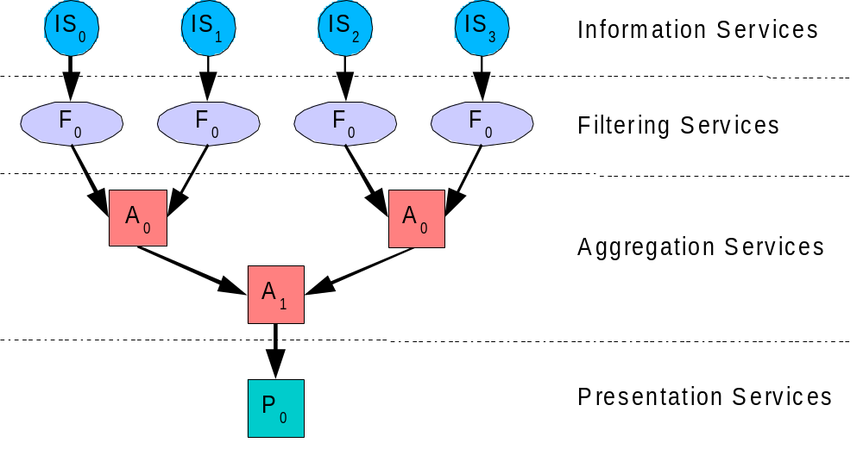
Distributing the Workload
as Grid Services

Slide 13
Filter Services
BFS
BFS
FS
=
BFS
BFS
BFS
BFS
Multiple filters may exist at each level of processing to define composite filters, provide service replication, maximize throughput and eliminate bottlenecks through each filtering layer

Slide 14
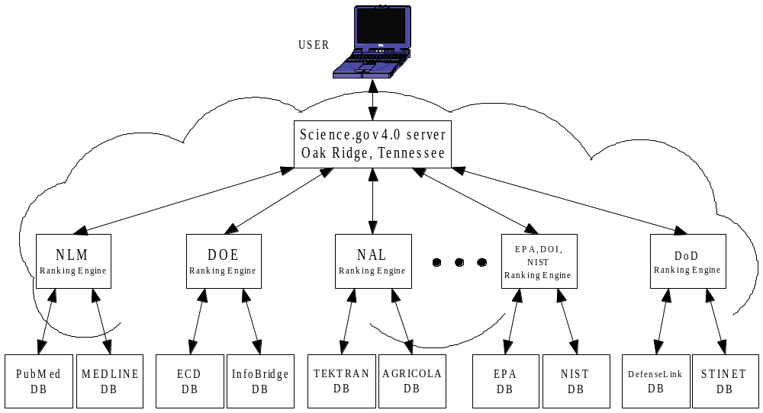
Science.gov 4.0 Vision
User

Slide 15

Three-Pronged Approach
QuickRank – Ranks results based on occurrence of search terms in title and snippet (Science.gov 2.0 – May ’04)
MetaRank – Ranks results utilizing custom algorithms applied to meta-data (Science.gov 3.0 – Fall ’05)
Deep Rank – Downloads and indexes full-text documents (Science.gov 4.0 – Fall ’06)
HEAVY LIFTING REQUIRED!

Slide 16

Science.gov Feature Timeline
Version
1.0
Dec ’02
2.0
May ’04
2.1
Feb ‘05
3.0
Fall ’05
4.0
Fall ’06
Feature
Federated Search
QuickRank
Alerts
Fielded & Boolean Searching
MetaRank
Deep Rank
Clustering, Summarization

Slide 17
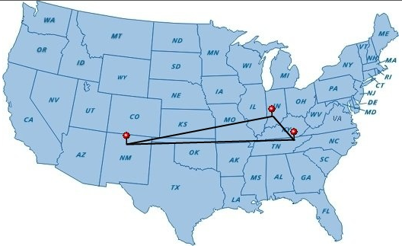
Science.gov v3.0 Alpha 1.1
Powered by 4-node Grid distributed across three locations
http://research.deepwebtech.com

Slide 18
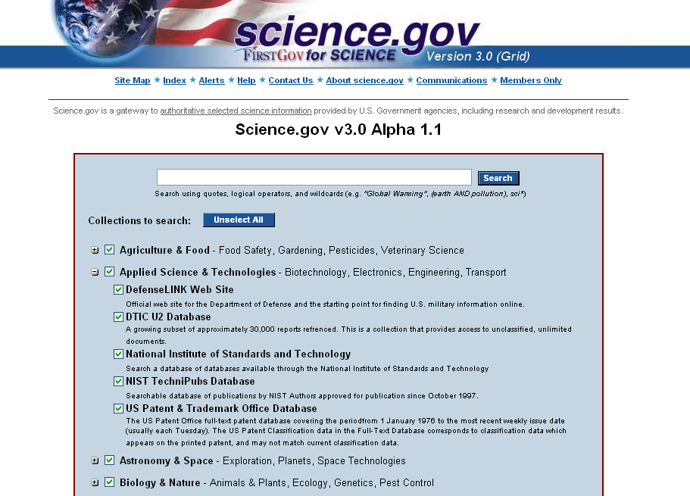

Slide 19
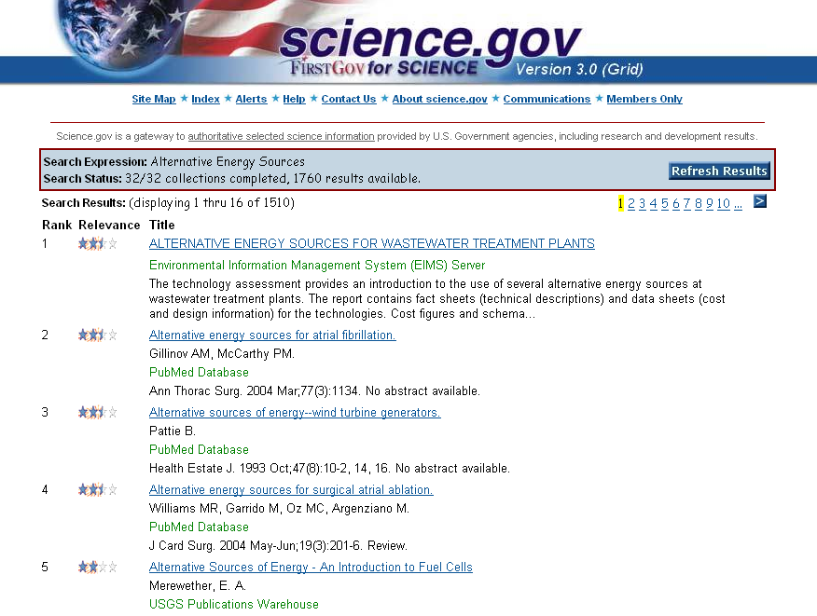

Slide 20
General Use Case
Science.gov is an instance of a solution with much broad applicability
Large numbers of distributed streaming data sources with significant variation in service levels
Application of one or more filters (computation) to these data streams
Aggregation of filtered results
Clear concise presentation of filtered output

Slide 21
Use Case Cont'
Property F(F(a)+F(b)) == F(a + b)
Many streaming data analysis applications have this property
  Digital archives / libraries
  Bioinformatics
  Particle physics
  Sensor nets

Slide 22
Necessity of Standards
Interoperable search
Workflow / scheduling
Security
Stateful resources
Notification
Addressing
Registry / Resource Discovery
Data Access
Monitoring

Slide 23
Beyond science.gov
DWT would be interested in formalizing this use case for the ggf community
GGF Working group to address this problem domain?
Development of standards to facilitate interoperability for both search and results analysis
Actively searching for applications of this technology within both government and corporate organizations

Slide 24
Conclusions
Current R&D efforts at DWT provide a real-world application for grid computing that will be available to the general public
The architecture on which the next generation science.gov portal is based may have broad applicability
This application may be formalized as a use case for related grid applications
Thank both DOE and OSTI for their investment in this project
Keep an eye on science.gov

Slide 25
For More Information, Contact
Carl Sylvia
Senior Software Engineer
carl@deepwebtech.com
(505) 672-0007
http://www.deepwebtech.com

