Slide 1
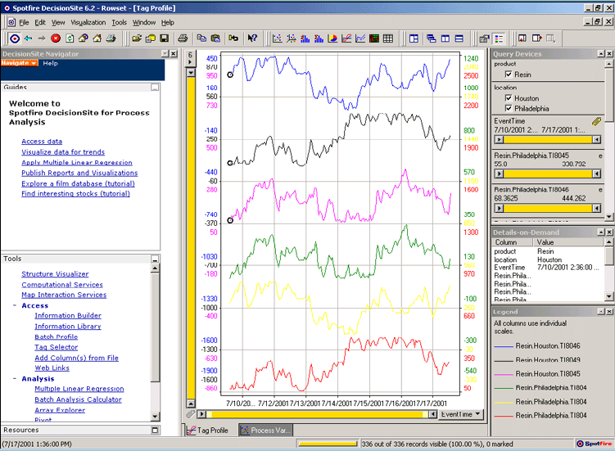
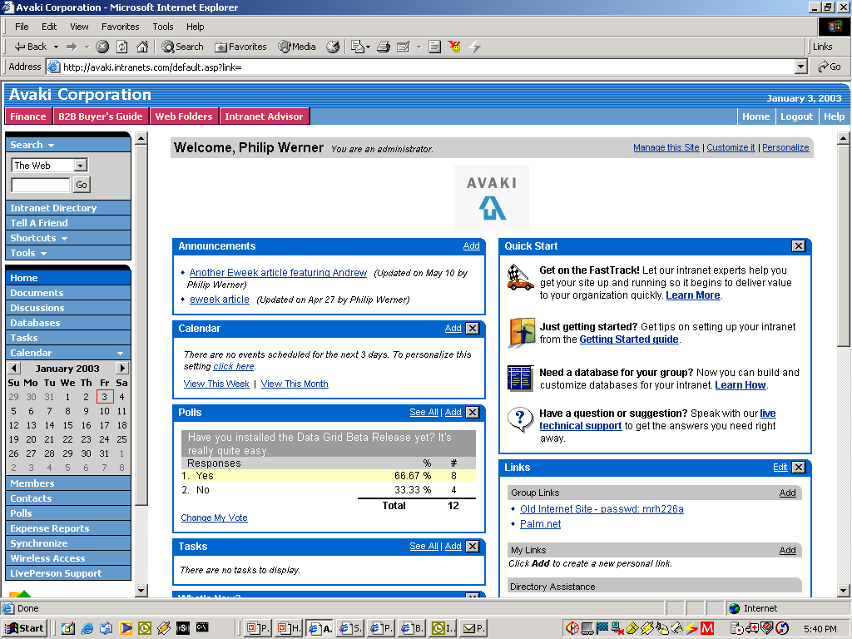

Case Study: Business Intelligence &
Customer Data
Customer Data
Customer Order Information
Oracle
SAP
DB2
Siebel
SQL
Stored
Procedure
XSLT
Results
XML
XSLT
XML
Results
XML
Data Grid
Company wants real-time integrated view of customer buying behavior
Data resides in various distributed CRM & ERP systems
Grid allows developers and apps to access and integrate customer data sources together in real time--across many distributed databases
Customer
Support
Web-based
Dashboard
(Identifies Likely
Buyers of New Product)
VP Marketing
Notes:
Here’s an example of how a company can use Avaki Data Grid to integrate data from multiple systems. In this case, a large, distributed insurance company has customer, policy, and claims data in a number of individual systems that support different product lines. Marketing specialists and other business managers need integrated views of this information that will help them enhance the company’s marketing strategy, such as: all the different policies held by a single customer, all the different customers from a single geographic location, and so on.
This diagram shows two systems that have customer data. In this case, Avaki is used as a netural integration layer that can take data out of both the Oracle and DB2 databases that are supporting two different applications, and also some data out of a file server, and combine all this data for use by a marketing dashboard and a business intelligence application. XSL transformations are used to provide the data in a particular XML format that is used by the application.
In the data grid, an architect can specify the sequence of transformations and updates that ultimately create the views of the data required by the business analysts. In this case, no intermediate data mart or data warehouse is needed.
By deploying a data grid, the company has eliminated the need for users to access remote databases directly. Instead, users sign onto their local systems and are automatically able to access data via the data grid. This saves significant time for the DBAs who manage each database; they no longer have to manage remote user access, and need only specify who should have access to the data objects that represent their data. Data is not moved and does not leave their control.
The IT organization, which thought it might have to create a data warehouse, now has a low-overhead infrastructure for making data available to users and applications for analysis. With this infrastructure in place, data owners and developers can meet requests for additional data more quickly.
Through the data flow definitions and cache configurations, architects can “dial” the freshness of the data to meet business requirements. Static reference data does not need to be updated at all, while customer data is updated frequently enough to show recent selling trends. As a result, the organization has fresher, more accurate data from which to make important business decisions.

Slide 2

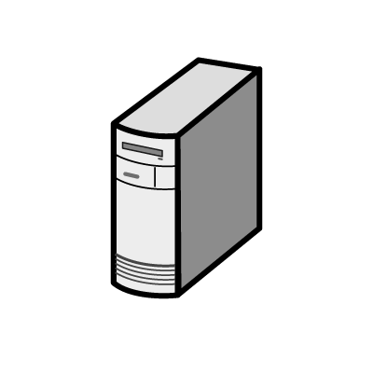
Case Study: Data Grid Provisioning Data to
Cluster-Based Analytical Application
R&D
West Coast
Engineering
East Coast
QA/Testing Outsourcer India
Data Grid
Data Grid
Data Grid
Company has centralized HPC cluster running compute-intensive applications
Source data for analyses distributed among 3 global sites, one of them an external partner
Highly manual data-sharing processes increase costs/errors, and hinder time-to-results
Grid enables secure, automatic provisioning of remote data to HPC cluster—feeding CPUs more data faster
Headquarters
Illinois
Forward Proxy Data Caches of Remote Data
Data Grid
Analytical
Applications
Centralized
Compute Cluster

Slide 3
Data Architecture Strawman - Grimshaw
Important points
Everything is a service (object)
  All have a name (EPR) and an interface (type)
One or more base types
  stream, byte_vector, directory, cache, file container, authorization_server, stored_procedure, RDBMS, etc.
  Derived types such as parallel file, replicated file, read_only file possible
Multiple levels of abstraction to users
  High-level standard interfaces for low activation energy
  Direct access for performance
Management control and site autonomy are REQUIREMENTS

Slide 4
Avaki Data Grid 4.0
A single, integrated system to provision, access and integrate distributed data
A data service layer for connecting multiple, federated data sources to applications
  Single service
  Abstracts underlying data sources
  Framework for executing actions on data
Access
Integration
Provision
DATA GRID

Slide 5
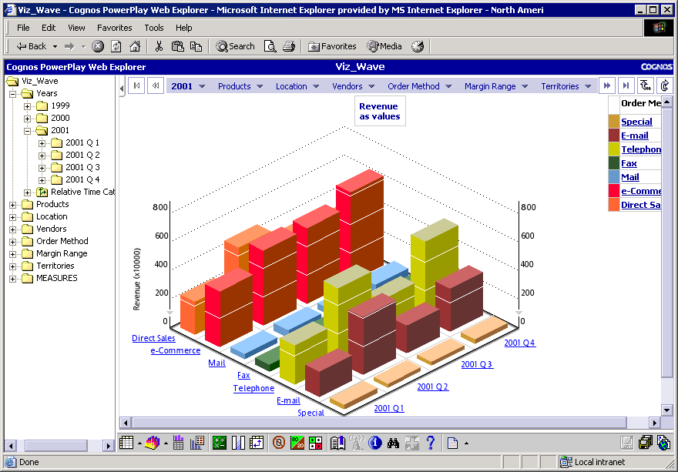
Data Services Framework – Three Layer Architecture
ETL
Data
Catalog
Access
Profiling & Quality
XML Mapping
Integration
Development Tools
Metadata Registry
Provision
Distributed Query
DATA GRID
Additional & 3rd Party Data Integration Capabilities
Core “Data Service Layer”

Slide 6
Data Services
Core Data Services
  Single data service – hides interfaces & security of many data sources
  Caching – speed data access – protect source
  Data Catalog – find, invoke, and track data
  Security – single sign-on
Additional Data Services
  Data execution “framework”
    Data as Web services or Java objects
    Data flows
    Data aggregation & transformation through XML/XSL
  Data “entities” – coarse grain abstraction of multiple data elements
    Customer, order, entities, etc.
  Third-party data tools – ETL, profiling, cleansing XML schema

Slide 7
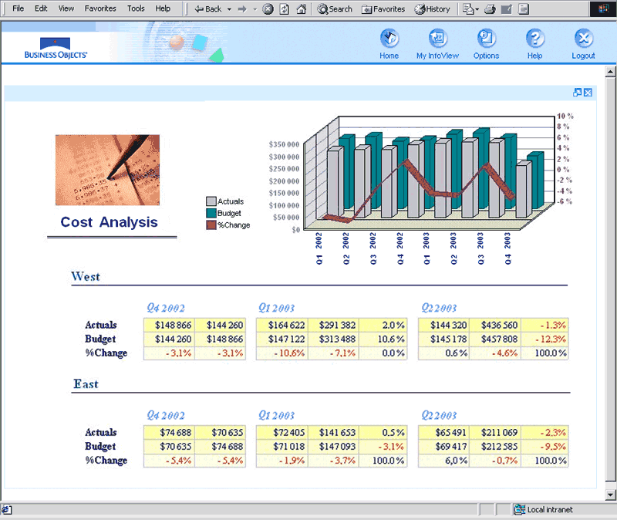
Data Provisioning
  “Publish” any relational data, files, XML, and application data sources
    Federated data service across heterogeneous, distributed sources
    Unified data catalog
    Data remains local & local ownership
    Files shared from source location
    SQL statements, stored procedures
    Application data via HTTP or Java classes
  Control access with one unified system
    Data owners control access rights at data object level
    Integration with multiple, heterogeneous authentication services (LDAP, Microsoft Active Directory, NIS)
Access
Integration
Provision
DATA GRID
Data Sources

Slide 8
Data Access
  Simplified access to federated data
    Unified view of all available data provides a single service for retrieving all data objects
    SQL result sets, XML views, files, application data sources
    Access data anywhere as if it were local
    Read and write
    Caching speeds performance
  Standard Access
    ODBC
    JDBC
    File read/write – NFS, WinFS
    Web Services/SOAP
    JSP/Tag library
  “Drill Down”
    For performance
UNIX
App
Win32
App
BI App
Portal/
Dash-
board
NFS
WinFS
ODBC/
JDBC
JSP
Access
Integration
Provision
AVAKI DATA GRID
Data Sources

Slide 9
Data Integration
  Data manipulation
    Transformers
  Multiple data sources into a single view
  Transform data formats
    Technical and semantics
  Schedule and trigger transformations
  Link and trigger transformations for automated data flows
UNIX
App
Win32
App
BI App
Portal/
Dash-
board
NFS
WinFS
ODBC/
JDBC
JSP
Access
Integration
Provision
AVAKI DATA GRID
Data Sources

