Slide 1
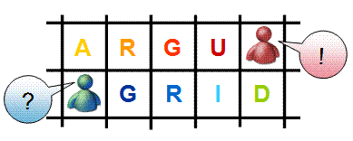
ARGUGRID
Use Case using Instrumentation
Mary Grammatikou
National Technical University of Athens
OGF 2009, Catania

Slide 2
Outline
ARGUGRID
  Platform
  Components
  Scenarios
ARGUGRID Use Case
The Instruments in ARGUGRID

Slide 3







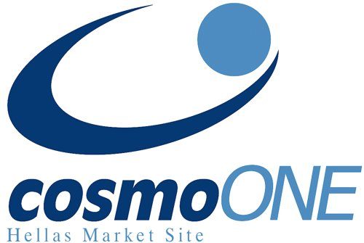
General overview
Goals
  Develop argumentation-based foundations for the GRID, populated by rational decision-making agents within virtual organisations
  Incorporate argumentation models into service-oriented architecture
  Develop underlying platform using P2P computing
  Validate ArguGRID by application scenarios
Notes:
Following Grid standards, we enable interoperability of services across different organisations
(grid not just about computation)
Gria because is it business2business, it is fully decentralised…and we have collaborations and exploitation of EU projects
Scalability because of gria –decentralised – and p2p
Where is the grid in scenarios: interoperability….

Slide 4
ARGUGRID vision
Develop a semantic grid/service-oriented architecture to support applications
Users (requesting
services/resources)
Argumentation-based Agents
Services/
resources/
Instruments
Communication
Negotiation/VOs/contracts/disputes
Notes:
Resources can include actual products (e.g. cars, computers etc as in e-procurement)

Slide 5
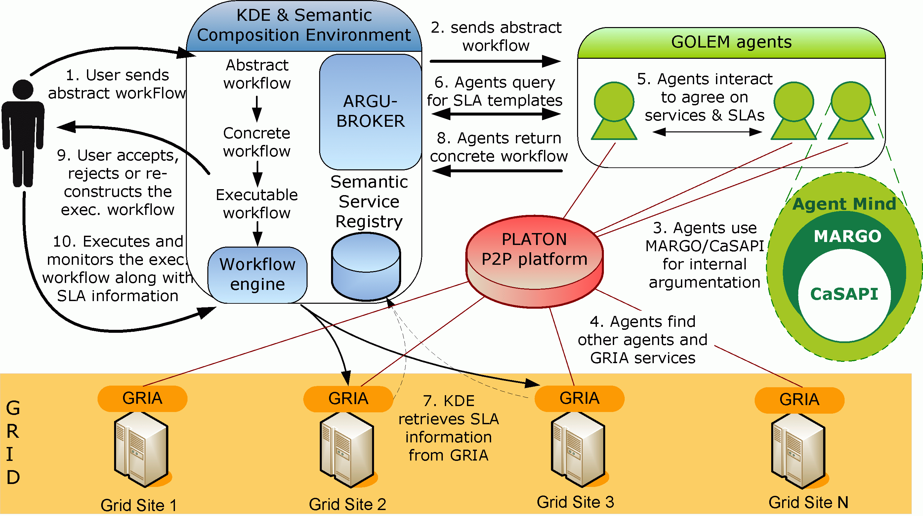
ARGUGRID platform
1‘. Users send
their goals
to Agents

Slide 6
Platform: components
SCE (Semantic Composition Environment)
  KDE
GOLEM (multi-agent platform)
MARGO agents:
  Hosted on GOLEM
  Use CaSAPI argumentation engine
ARGUGRID middleware:
  PLATON (P2P Platform)
  GRIA Grid platform

Slide 7
Semantic Service Composition - KDE
Supports
  a service-oriented computing framework
  semantic service composition
  agent-based semantic service composition
  multi-agent interaction on the Grid
Notes:
http://www.wsmo.org/:
WSMO (Web Service Modeling Ontology) is an ontology currently developed to support the deployment and interoperability of Semantic Web Services.
WSML (Web Service Modeling Language) formalizes the Web Service Modeling Ontology (WSMO).
http://www.w3.org/Submission/WSMO/:
WSMO provides a conceptual framework and a formal language for semantically describing all relevant aspects of Web services in order to facilitate the automation of discovering, combining and invoking electronic services over the Web.
http://www.w3.org/Submission/WSML/:
WSML is a language providing a formal syntax and semantics for the Web Service Modeling Ontology WSMO
It is based on different logical formalisms, namely, Description Logics, First-Order Logic and Logic Programming, which are useful for the modeling of Semantic Web services.
DPML: data processing modelling language

Slide 8
GOLEM
GOLEM - Generalized OntoLogical Environments for Multi-agent systems
  An agent environment that can be used to create multi-agent system applications
  Agents in several container environment communicate and take decisions

Slide 9
MARGO & CASAPI
MARGO - Multiattribute ARGumentation framework for Opinion explanation
  It is written in Prolog
  Implements the ArguGRID argumentation framework about service selection and composition
  MARGO is built on top of CASAPI
CASAPI - Credulous and Sceptical Argumentation : Prolog Implementation
  It is a general-purpose tool for assumption-based argumentation

Slide 10
Peer to Peer technology in ARGUGRID
PLATON++ - P2P Load Adjusting Tree Overlay Networks
  A new load-balancing framework, to support a distributed K-Dimensional tree system used for multi-attribute queries

Slide 11
GRID Platform
GRIA is the GRID middleware that ArguGRID uses to support the service – oriented infrastructure
  Supports Business to Business collaborations
  Provides an SLA module for ArguGRID needs

Slide 12
Use Case
Earth observation (GMV – Spain)
  Select appropriate (instruments) sensors/satellites e.g. for dealing with oil spill
  Combine (instruments) sensors/satellites + other services (weather) e.g. for fire monitoring
Notes:
procurement: procuring any complex service from a supplier, or from a consortium of suppliers
Request for Proposals (RFP) case (only this here)
Optimizing eAuctions parameters case (as a special case)
Business migration (AIT – academic)
Select appropriate location
Combine several services (constructors, suppliers etc)

Slide 13
Fire Monitoring Scenario
Earth Observation satellite designed to observe earth from orbit
Each Satellite brings on-board a series of instruments
  Each instrument carries on different sensors i.e. radar and optical sensors
Currently not automatic way exists for accessing earth observation services i.e. images

Slide 14
Fire Monitoring Scenario
Customers – Actors
  Service Providers (Image providers, image transformation providers, fire detection providers)
  Agents (user agent, provider agent)
  Users (wildland fire community, civil protection services, forestry departments, concerned Ministries and Departments of Interior and Agriculture, researchers)

Slide 15
Preconditions
Different GRIA host machines that store the offered services along with their SLAs. Each service has to be wrapped as a GRIA service
Different machines containing GOLEM containers. Each GOLEM agent is equipped with the CASAPI argumentation engine and is assumed to have basic knowledge as defined by each use case scenario
A peer-to-peer platform, PLATON, runs as underlying middleware with each GOLEM container constituting a PLATON node
Set up of distributed Semantic Registries holding semantic information about the services, upon which the GOLEM agents query
KDE authoring tool interface, where the users enter to set their goals forming abstract workflows

Slide 16
Involved Resources
Earth Observation Instruments i.e. Radar and Optical Sensors
A Grid infrastructure consisting of different GRIA nodes
A peer-to-peer infrastructure
GOLEM containers of agents
Semantic Registries
KDE workflow authoring Tool and Semantic Composition Environment

Slide 17
Fire Monitoring Scenario
Description
User asks for fire monitoring service in a specific area and with specific constraints (timely delivery and quality of image)
Submit user request to KDE authoring tool (abstract workflow)
The KDE delegates the abstract workflow to the GOLEM agents
GOLEM agents using MARGO argumentation engine, translate it to specific services (image acquisition, image clipping, fire detection)

Slide 18
Fire Monitoring Scenario Description
GOLEM agents use PLATON++ P2P platform to discover GRIA GRID services to perform the user request
The agents negotiate upon the service constraints in order to satisfy user goals
  SLA negotiation about the delivery time, the image quality and the price
A concrete workflow is now formed and returned to KDE

Slide 19
Fire Monitoring Scenario Description
The concrete workflow is executed
  First a satellite image from the desired area is returned (the appropriate instruments are called)
  The image is given as input to the clipping service → a transformed image is returned
  The new image is given as input to the fire detection service, which uses the radar/optical instruments to detect the fire
  An image with the fire sources marked on it, is returned back to the user

Slide 20
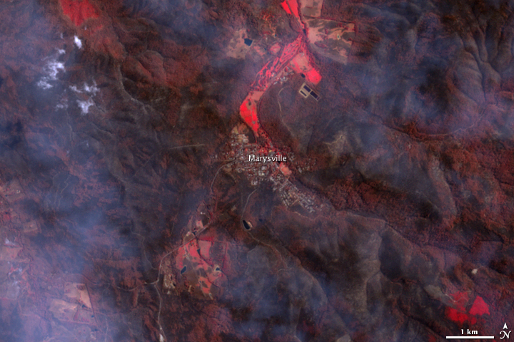
Fire Detection Scenario Image

Slide 21
Conclusions
Growing need for Earth Observation products
Easier and timely access to large quantities of primary data is a condition for delivering effective services
Users do not need knowledge about services and instruments utilized
ARGUGRID provides an automatic way to derive information from the Earth Observation Instruments

