Slide 1
Authority Recognition
GGF9
Monday Oct 6/2003

Slide 2
IPR Statement

Slide 3
Definition
Authority Recognition: the act by which a relying party accepts the assertions of a particular authority as valid for a specific application.
Notes:
Just to be clear, this is what I mean by “governance model”.

Slide 4
Agenda
Trust & Expectations
Authorities
Authority Advertisement
QIK Model
ARRG

Slide 5
Trust
‘Generally, an entity can be said to trust a second entity when it (the first entity) makes the assumption that the second entity will behave exactly as the first entity expects’ (X.509)
Essence of trust lies in the probability for disappointment of a trusting party’s reasonable expectation of another’s behaviour (Hurt factor)
Trust then is dependent on each actor being confident that the other actors will behave in a defined manner for specific circumstances.

Slide 6
Trust/Expectations
Examples of expectations in a simple PKI
Issuer
Notification of revocation
Conduct quality processes
Notification of issuance
Notification of revocation
Publish the certificate and CRLs
Query for revocation
Rely within limits
Protect private key
Use appropriately
Trust this is from me
Subscriber
Relying
Party
Use within limits
Notification of revocation

Slide 7
Expectations/Obligations/Liabilities
An obligation is a legally binding commitment to an enforceable duty.
An expectation can become an obligation if the actor concerned makes a legally binding commitment to perform (or not) the relevant operation
If an obligation is breached, then it may be decided that a liability is assumed by the negligent party.
The conversion of an obligation into a liability requires a dispute-resolution system; the output of this system will be a judgment or reward

Slide 8
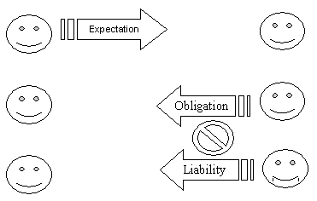
Expectations/Obligations/Liabilities ☹
☹
Failed expectation

Slide 9
Agenda
Trust & Expectations
Authorities
Authority Advertisement
ARRG

Slide 10
Authorities
Trust between entities in many transactions is enabled by a separate authority issuing assertions (e.g. X.509 certificates, SAML assertions, Kerberos tickets, etc) regarding the identity and/or other characteristics of the actors involved
The assertions issued by an authority must be recognized as valid and appropriate to its requirements before a party will rely on them

Slide 11
Examples
SAML SSO
  Authority is SAML Authority
  Assertion is SAML Authentication Assertion
WS-Trust Introduction
  Authority is Security Token Service (STS)
  Assertion is Security Token
X.509 certificate
  Authority is CA
  Assertion is certificate

Slide 12
Recognition
Whether or not an assertion from a particular authority will be recognized by a relying party as valid will depend on a number of factors, including
  The processes followed by the authority in issuing the assertion.
  the commitments the authority makes with respect to the assertion.
  the liabilities the authority is willing to assume.
  the obligations assumed by the relying party if they use the assertion.

Slide 13
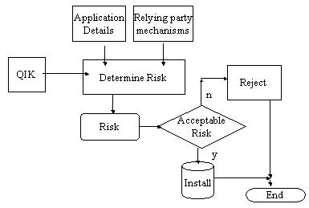
Recognition Decision
Authority
Information

Slide 14
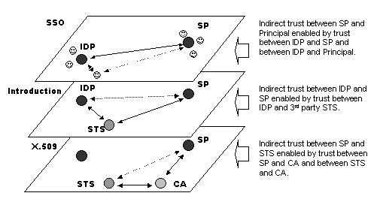
Authority Layers
Trust in an authority (e.g. SAML Authority) may be enabled by ‘lower-level’ trust (e.g. in an X.509 CA)
Question: are the recognition decisions separate?

Slide 15
Agenda
Trust & Expectations
Authorities
Authority Advertisement
ARRG

Slide 16
Authority ‘advertisement’
The authority must provide to a potential relying party sufficient information to facilitate the ‘recognition’ decision
It is from the information that the STS makes available that an entity will, at least partially, base its expectations - and consequently its trust.

Slide 17
Objectives
To achieve a proper understanding and equitable allocation of risk among the actors
Make the risks commensurate with the benefits for all participants
  Expose risk
  Apportion liability
  Identify obligations

Slide 18
Authority information
Ultimately, the question a relying party must answer is:
  “Knowing what I know about the other participants, is such an assertion appropriate for the application for which I intend to use it”
What the relying party “knows” about the authority can take two general forms, differing in the nature of the commitment that the authority makes

Slide 19
Process vs. Business
Process-oriented
  The authority declares that their processes and practices under which this assertion was issued are as follows…
Business-oriented
  The authority declares that their commitments with respect to the assertion along with the obligations assumed by any entity who uses the assertion are as follows ….
Which is most appropriate will depend on the nature of the application and the relationships between the actors involved

Slide 20
Application Info
Application
Info
If the authority is ignorant of the potential applications of its assertions it will be unable to claim that its assertions are appropriate for any specific application.
The relying party will provide the application information as input to the recognition decision.
Authorities can be ‘remote’ or ‘local’ wrt application knowledge.
‘Remote’ authority
Authority
Assertion
Info
Relying
Party
Application
Info
‘Local’ authority
Authority
Assertion
Info
Relying
Party

Slide 21
Agenda
Trust & Expectations
Authorities
Authority Advertisement
QIK Model
ARRG

Slide 22
QIK Process Flow
QIK
2 Publishes
5. Downloads
1. Creates
Validation
String
Key Owner
Relying
Party
3.Creates
And Publishes
4.Obtains
Signed
Assertions
7. Validates using public
Key and trust
6. Sends

Slide 23
Agenda
Trust & Expectations
Authorities
Authority Advertisement
QIK Model
ARRG

Slide 24
ARRG Ongoing
Continue to explore QIK (Qualified Input of Keys) as ‘business-oriented’ mechanism
Examine Liberty Authentication Context for ‘process-oriented’ mechanism
Explore 3rd party rating systems (as in PingID) for relevance
Determine mapping to Grid Federation work
  BOF Tuesday Oct 7 at 12

Slide 25
ARRG
GridForge
  https://forge.gridforum.org/projects/arrg-rg
Email
  arrg-rg@gridforum.org
Please join and contribute!

