Slide 1
Workflow Products
October 7,2003
Craig Bennett
cbennett@us.ibm.com
IBM Corporation

Slide 2
Workflow
Differentiation of workflow technologies
  Microflow
  Process Choreography
  Standards
Products
  IBM WS MQ Workflow
  IBM WAS Enterprise
  SciTegic Pipeline Pilot
  INCOGEN Vibe
  KooPrime LiveBase
  TurboWorx Enterprise
  Pallas UNICOREpro
  Platform Computing
Product table
References

Slide 3
Differentiation of
Workflow Technology

Slide 4
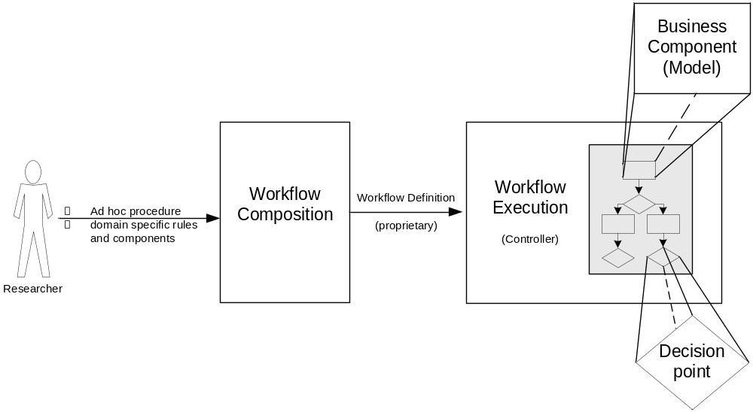
Microflow
Ad hoc workflow
Environment may be contained on a single workstation
User builds and executes workflow
Domain specific business components may be part of the package
Generally, proprietary interfaces
Notes:
Domain specific, not a generalized workflow tool. Does not imply small tasks or lightweight processes.

Slide 5
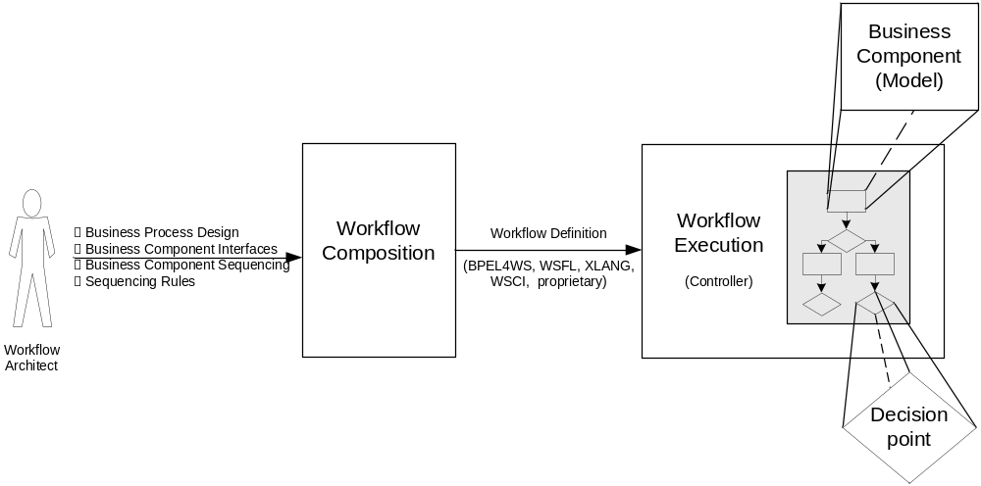
Process Choreography
Enterprise level process integration
Workflow creator is probably a programmer/developer and not the end-user of the workflow
Business components may be legacy applications/processes
Generally, built on open standards and specifications
Notes:
Generalized automation of complex tasks using conditional logic, parallelization and coordination of sub processes
Two parts to the solution:
Composition – the tool humans use to create and manage workflows
Execution – the run-time that takes the workflow created by the composition tool and executes the macroflow
Note the differences between this slide and the previous…composition tool user (actor) is technologist. Formal methodologies may be employed due to the overhead in workflow implementation and test. Typically based on open standards.

Slide 6
Workflow Standards and Specifications
Web Services Flow Language (WSFL)
  Introduced by IBM
XLANG
  Introduced by Microsoft
Web Services Choreography Interface (WSCI)
  Introduced by Sun/BEA to W3C
Business Process Execution Language (BPEL4WS)
  OASIS specification
WS-I Basic Profile
  Guidelines and best practices for defining Web Services interfaces
Open Grid Services Infrastructure (OGSI)
  Interface and behavior conventions for client to web service interaction
Notes:
First four are workflow definition specifications, last two are interface and integration specifications; OGSI adds statefulness to interface and integration standardization

Slide 7
Commercial
Workflow
Products

Slide 8
Microflow
General Information
  Interactive build and execute
  Easy to use
Scitegic Pipeline Pilot
  Life Sciences domain
  Windows client composition tool; Execution engine can run on client (single-user) or server to share “protocols”
  Extensible through COM-like component model
INCOGEN Vibe
  Life Sciences domain
  Java client composition tool; Java servlet execution engine
  Extensible through iAPI in Vibe SDK

Slide 9
Process Choreography
General information
  Scalable solutions
  Most middleware vendors are entering this space
  Workflow definition specifications are outpacing integration standards
IBM WebSphere MQ Workflow
  Proprietary workflow definition
  Transactional
IBM WAS Enterprise Process Choreographer
  BPEL4WS workflow definition
  WS-I Basic Profile for process interoperability

Slide 10
Process Choreography w/ Grid Enablement in LS domain
General Information
  Includes resource management
  Original focus on Life Sciences, but grown into more generalized solutions
  Proprietary
TurboWorx
  Java GUI workflow composition tool
  Administrative tools for distributed environment management
KOOPrime
  Java GUI workflow composition tool
  Administrative tools for distributed environment management

Slide 11
Process Choreography w/ Grid Enablement
General Information
  More than a batch-queuing system
  Includes pre-emption, load balancing, priority assignments and SLAs
  Built on open standards
Platform Computing
  Built on Globus
Pallas UNICOREpro
  Built on open source UNICORE project

Slide 12
Workflow Products
Technology | Grid Optimized | Type | Differentiator | Integration Standards* | Workflow Standards*
INCOGEN Vibe | No | Microflow (LS domain) | Easy to use. Scalable. Integrates well-known web accessible LS data sources and algorithms. | Proprietary iAPI available w/ SDK | Proprietary
SciTegic Pipeline Pilot | No | Microflow (LS domain) | Easy to use. Can be run completely on the client. | COM today. Can create a custom wrapper | Proprietary
IBM WS MQ Workflow | No | Process Choreography | Robust, established technology. Transaction oriented | Proprietary wrappers | Proprietary
IBM WAS Enterprise | No | Process Choreography | Highly scalable; standards based; flexible | Web Services;WS-I Basic Profile | BPEL4WS
TurboWorx Enterprise | Yes | Process Choreography characteristics | Distributed computing and process management; some LS domain specificity | Proprietary wrappers | Proprietary
KooPrime LiveBase | Yes | Process Choreography characteristics | Distributed computing and process management; some LS domain specificity | Proprietary – SDK available | Proprietary
Pallas UNICOREpro | Yes | Process Choreography characteristics | Based on open source UNICORE work | Globus | Proprietary
Platform Computing | Yes | Process Choreography characteristics | Based on Globus toolkit | Globus | Proprietary
* Statement of direction - not necessarily compliant in the current product version

Slide 13
What current specifications do not address
Data integration
  Consistent definition of data elements
  Semantics of data elements
Process definition
  Resource needs
  Cost estimation
  QoS provided
Workflow
  Pre-emption
  QoS specification in shared environment
  Dynamic binding of service providers
Notes:
Rules to govern naming and type conventions
Specifications to define terminology, data elements and the relationships among them (ontology)
Processes should be able to

Slide 14
References
Standards
  BPEL4WS - http://www.oasis-open.org/committees/tc_home.php?wg_abbrev=wsbpel
  WS-I Basic Profile - http://ws-i.org/Profiles/Basic/2003-08/BasicProfile-1.0a.htm
Products
  Pallas UNICOREpro – http://www.pallas.com
  Platform Computing – http://www.platform.com
  TurboWorx Enterprise – http://www.turboworx.com
  KOOPrime LiveBASE – http://www.kooprime.com
  IBM WebSphere MQ Workflow – http://www.ibm.com/software/integration/wmqwf
  IBM WAS Enterprise Process Choreographer – http://www.ibm.com/software/webservers/appserv/enterprise
  Scitegic Pipeline Pilot - http://www.scitegic.com
  INCOGEN Vibe - http://www.incogen.com

