Slide 1

g-Eclipse
Interactive grid framework
(standardization) with Eclipse environment
Harald Kornmayer
(Forschungszentrum Karlsruhe)
On behalf of the g-Eclipse consortium

Slide 2
Vision
Grid will be a fundamental tool for scientists in the future
  including
    Computers, Storage, Applications
    and scientific instruments
lower the threshold
between computing and instruments/experiments
Remote instruments must be included in the Grid
  but instruments need interactive steering
→ look for tools to integrate (remote) instruments

Slide 3
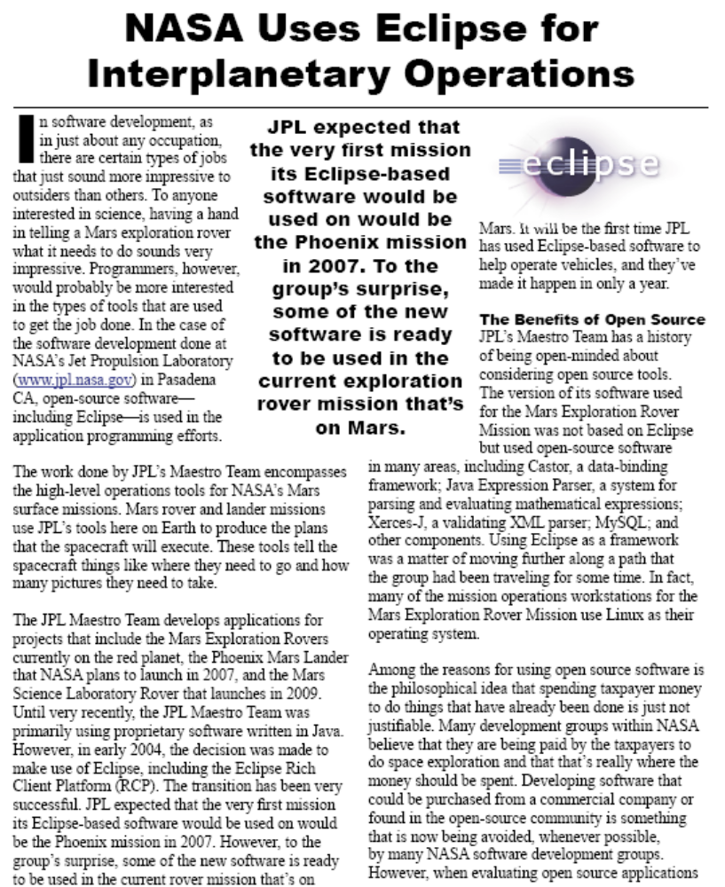
Eclipse and Instruments
but…
  isn’t Eclipse just an IDE for JAVA??
Yes, but it is …
  more than just an IDE
  general, solid eco system build for extension
  many products rely on this system
The RCP (Rich Client platform) is already used for the current MARS rover mission!
  what is good for MARS, should be good for a worldwide Grid!!
http://www.eclipse.org/community/casestudies/NASAfinal.pdf

Slide 4
g-Eclipse – The idea
Grid infrastructure are complex systems
  Provide tools to hide the complexity
Users want easy access to the system
Users act within different roles
  Grid applications users
  Grid resources providers and operators
  Grid application developers
Aim for a framework that overcome limitations of the HTTP protocol
  to enable interactivity!!
Provide a general UI framework/eco system for the different Grid actors based on a reliable platform
  (re-)use Eclipse and contribute!
  gain OS independence (by using JAVA!)

Slide 5
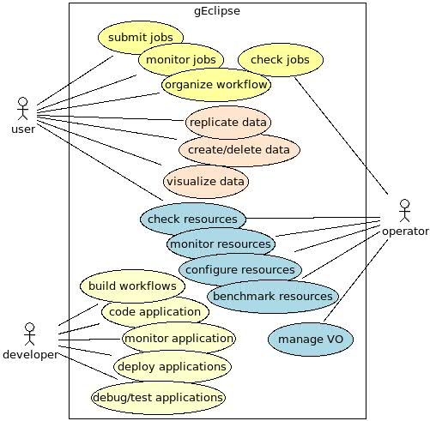
Grid user roles & use cases
3 different roles
  user
  operator
  developer
in general...
  job management
  resource management
    files
    Applications
    hardware
    ...
Extent this use case set with
  control instruments
  monitor instruments
  …

Slide 6





g-Eclipse – the project (I)
Funded by European Union
  24 months, approx. 2 M€ funding
STREP
6 Partners
  Coordinator: Forschungszentrum Karlsruhe
More Information: http://www.geclipse.eu
Objectives
Integration of existing Grid tools
Exemplary support for the widely deployed gLite middleware during the first project year
  selection of a second middleware in year 2
  Provision of the g-Eclipse framework for other EC Grid projects
Integration support for third party developments
Fostering an open source project within the Eclipse community
University of Cyprus

Slide 7
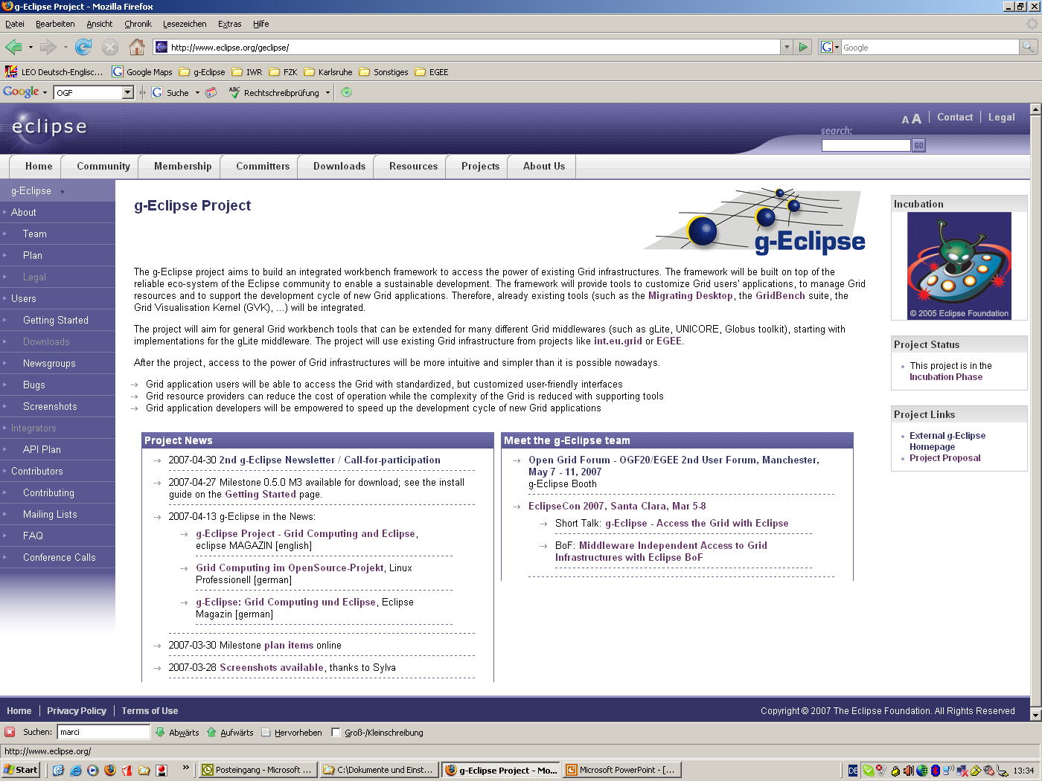
g-Eclipse – the project (II)
g-Eclipse is already a technology project supported by the Eclipse Foundation
The project will follow the open rules of the Eclipse Foundation

Slide 8
Sustainability
g-Eclipse is accepted as a project of the Eclipse foundation
  Following the Eclipse procedures and rules
    to ensure quality, openness and transparency
    based on meritocracy
      the more one contributes to Eclipse, the more responsibility one earns
      Meritocracy gives companies/partners who bring more developers to a project more say in the direction of that project.
  Including licensing issues
g-Eclipse is gathering community
  in the Grid and Eclipse community
Contribute!
  By using g-Eclipse (http://www.eclipse.org/geclipse/gettingstarted.php)
  Reading open mailing lists (geclipse-dev@eclipse.org)
  submitting bugs (http://bugs.eclipse.org)
  By sending patches
  By getting a g-Eclipse committer

Slide 9
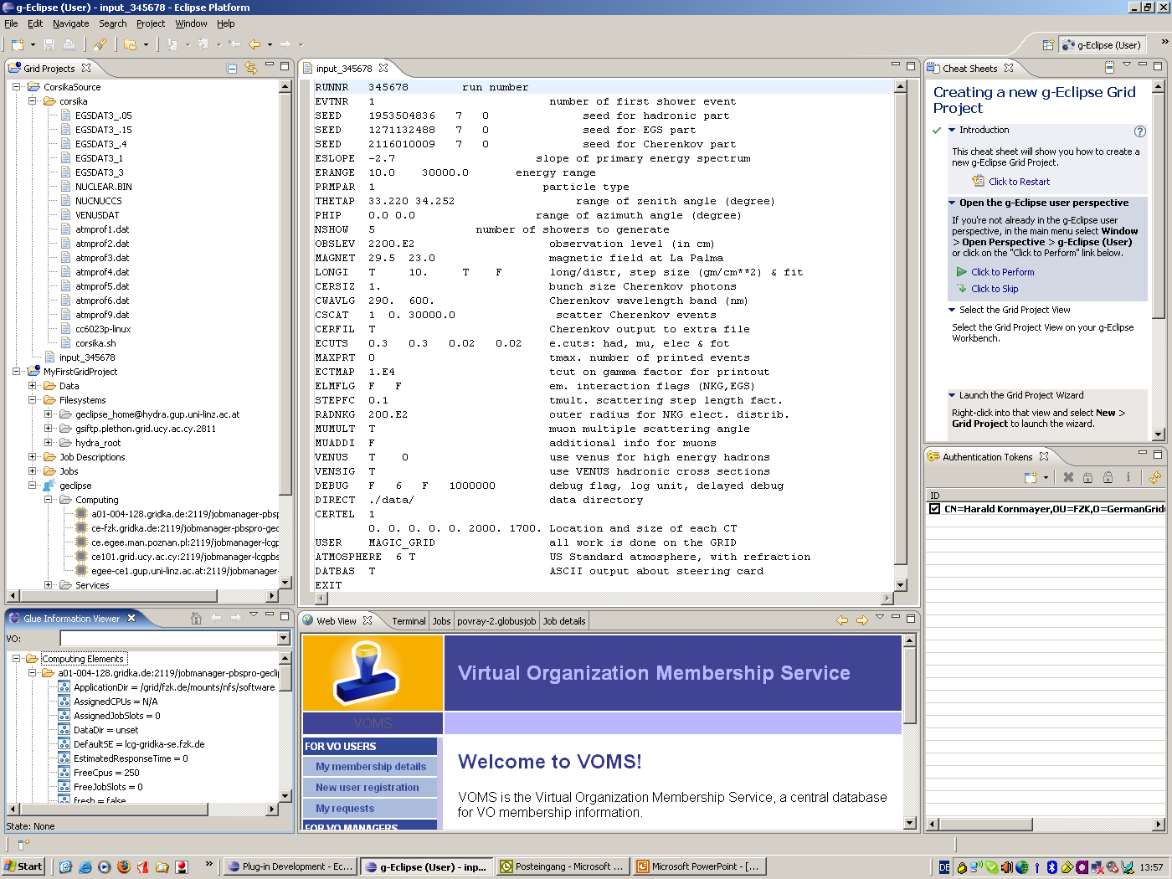
Screenshots I
Grid project view
Cheat Sheets
Editor
Auth Token View
Glue Info view
VOMS Web view

Slide 10
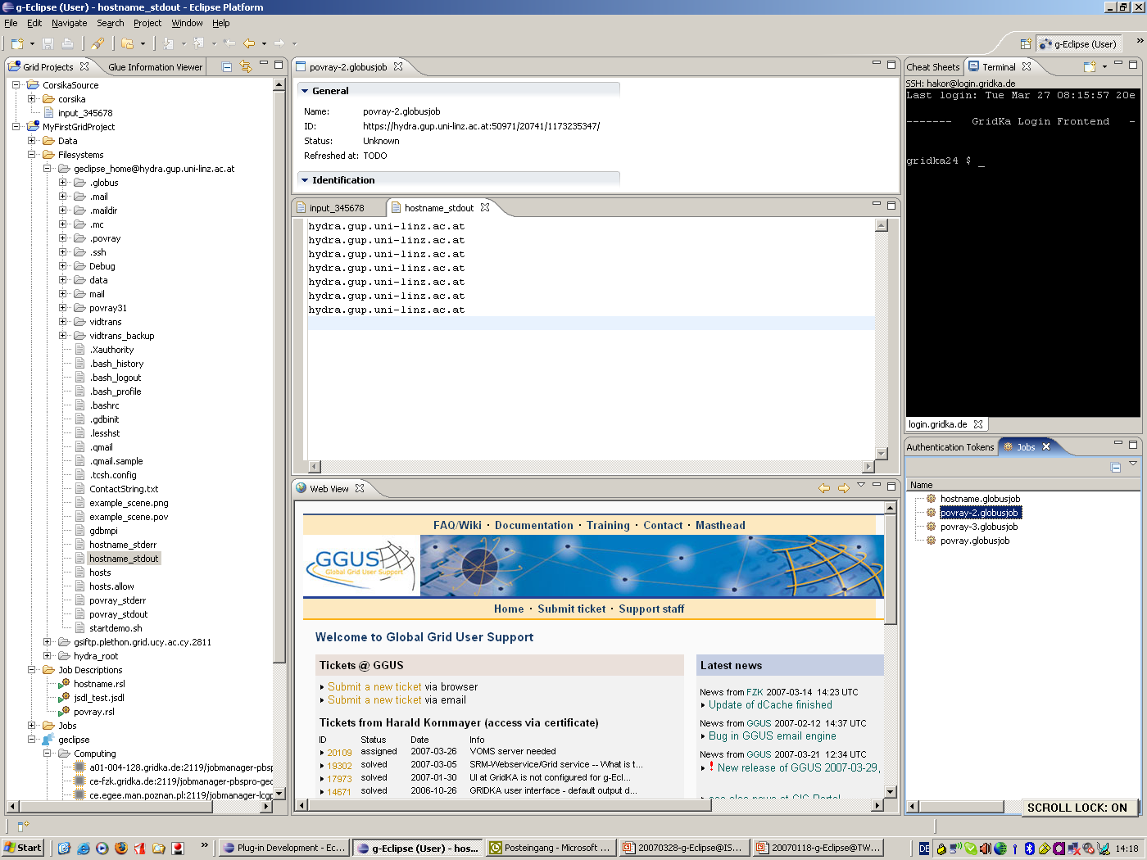
Screenshots II
Grid project view
Terminal view
Project with Legacy code
Grid project
Remote Grid File system
Job List view
User Support Web view
Open the file with a click
Grid Jobs File
Resource of the VO

Slide 11
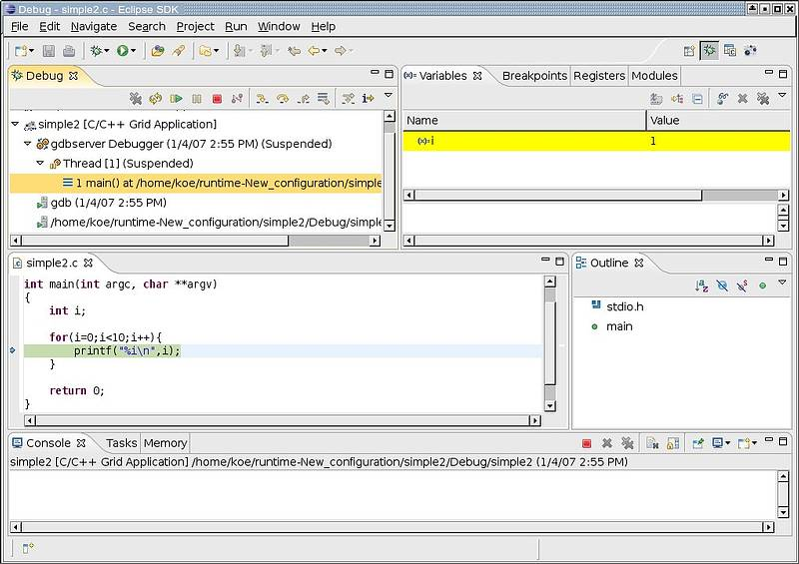
Screenshots III
Remote interactive Grid debugging
  don’t look different from local debugging

Slide 12
Outlook
g-Eclipse is based on the Eclipse eco system
  and will provide the Grid Eco system for Grids
g-Eclipse is able to provide interactive support for Grid infrastructure
  including remote instruments
    from your lab to Mars rover
Interactive support needs “portals” without the limitations of the HTTP protocol
Visit us
  at OGF booth 2: Interactive Grids and Instruments
  at OGF demo booth 28: g-Eclipse – access the power of the Grid
  at our EGEE User Forum talk on Thursday
  visit our webpages:
    www.geclipse.eu and www.eclipse.org/geclipse

Slide 13

Eyecatcher
Visualisation on the Grid with GVid

