Slide 1




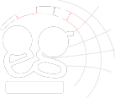


Visualization in Grid Environment
Dieter Kranzlmüller
kranzlmueller@gup.jku.at
GUP, Joh. Kepler Univ. Linz, Austria

Slide 2
Grids Today
Batch processing ⬄Throughput computing
3 simple steps of current grid applications:
Submit job to the grid
Receive results from the grid
Analyze results

Slide 3
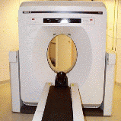
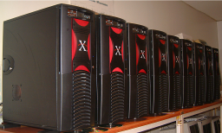
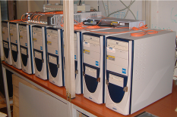
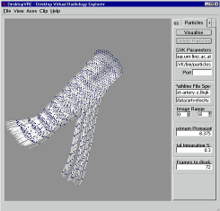
Example: Biomed Investigation
Remote
instrument
Grid resources
Scientific results

Slide 4
Remote Instrumentation Services in Grid Environment
Required services:
Connection to the remote instruments
Collaboration between multiple partners
Interactivity and remote steering
Integrated environments
&
Scientific visualization

Slide 5

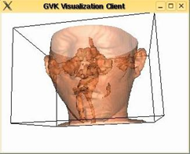
Video Streaming in the Grid
Worker
node
Grid
Visualization
Kernel
Worker
node
WORKING!
video
stream
inter-
action
video
stream
video
stream
Worker
node
glogin’
Client
glogin
GVid
Encode
interaction
interaction
on the Grid

Slide 6
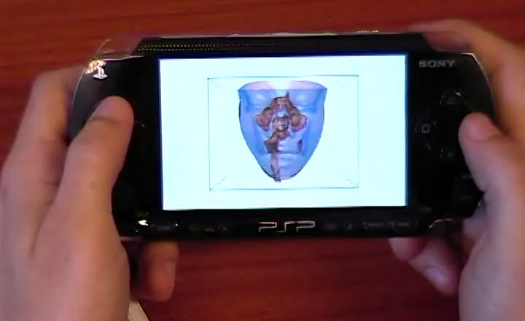

GVid Output on PSP

Slide 7
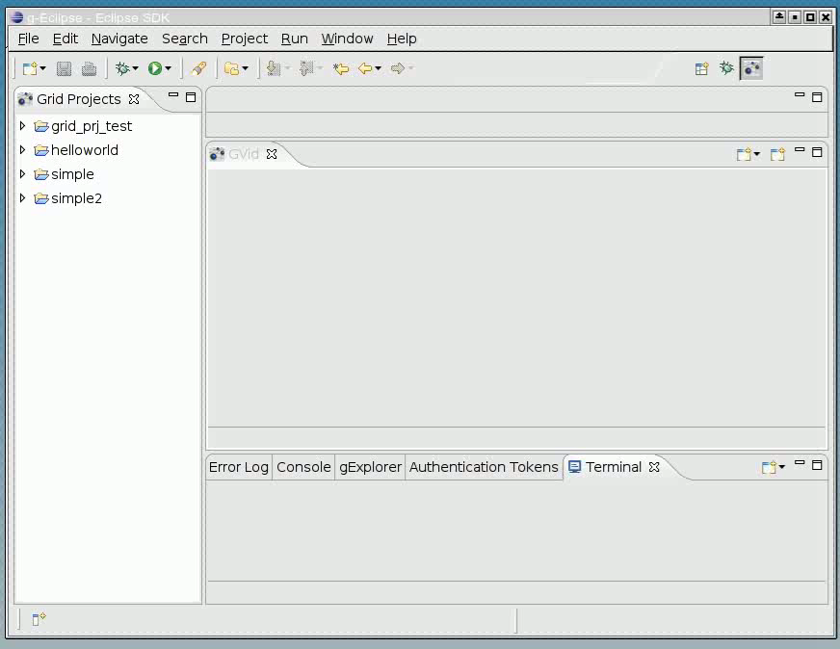
GVid Out in g-Eclipse

Slide 8
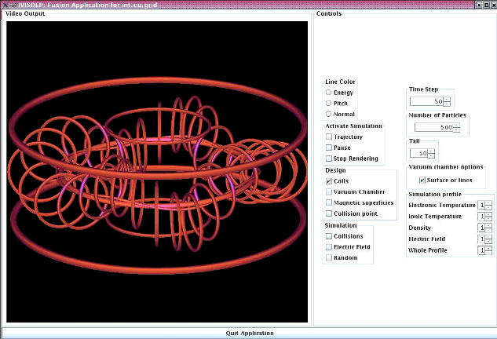
GVid Output in Migrating Desktop

Slide 9
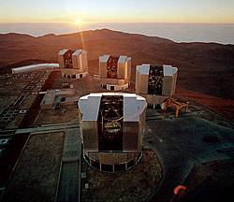
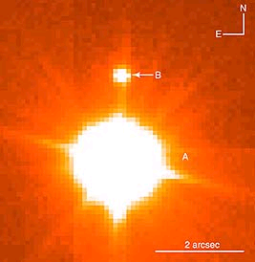
Video Streaming in the Grid
Grid
Visualization
Kernel
WORKING!
Worker
node
video
stream
inter-
action
video
stream
video
stream
Worker
node
glogin’
Client
glogin
GVid
Encode
interaction
interaction
on the Grid
Pictures: ESO VLT, Chile

Slide 10
Summary
Visualization (on the Grid)
… is needed for understanding the data
… connects to simulation and remote instruments
… provides interactive steering of visualization output and instruments
GVid … Video Streaming solution for the Grid
Fast, lightweight, adaptive, interactive, …

Slide 11
Team
Dieter Kranzlmüller,
Martin Polak, Thomas Köckerbauer,
Paul Heinzlreiter, Herbert Rosmanith,
Hans-Peter Baumgartner, Peter Praxmarer,
Andreas Wasserbauer, Gerhard Kurka,
Jens Volkert
http://www.gup.jku.at/gvid
http://www.gup.jku.at/glogin

