Slide 1

Medical Grid
Bonita Hung
2005/5/13

Slide 2
NCHC
  Medical Grid
  Asthma Grid
  SARS Grid
  Lung Cancer Gird
  Chronic Obstructive Pulmonary Disease Grid (COPD)
注意！
←每頁右下角之簡報主題 請至母片修改。

Slide 3

Asthma Grid
Movie

Slide 4
~Asthma Grid~
Objectives
Providing an easy and convenient way for doctors and patients to keep asthma under control
Reduce Taiwan’s asthma-related death rate
Educate patients on how to live with asthma
Provide monitoring services to individual patients
Assist physicians in making accurate asthma diagnosis
Establishment of a medical records archive for improving the health of Taiwan’s asthma patients

Slide 5

~Asthma Grid~ hospital process flow

Slide 6
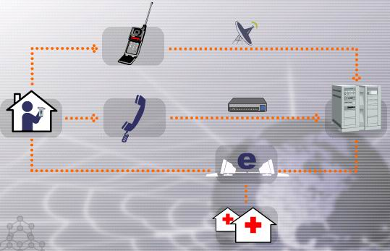
~Asthma Grid~
Patients at Home

Slide 7
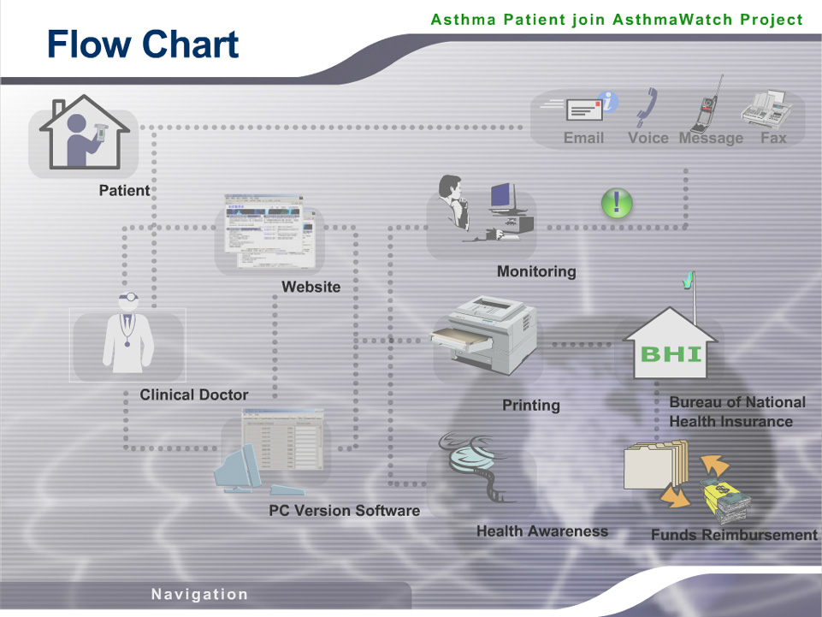
~Asthma Grid ~
Monitoring Service

Slide 8
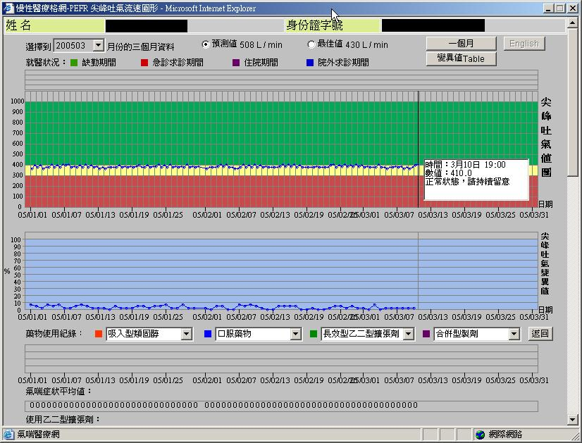
~Asthma Grid~
Platform

Slide 9

Asthma Grid
Medical Center / Area Hospital
Documented diagnosis
Treat complicated cases
Set therapeutic plan
Regular assessment (per 6M)t
Asthma Grid
Data
Patient Profile
GP
Regular follow up and treatment
Monitor asthma severity
Provide education program
Treatment on demand
Per 3-6 months

Slide 10
~Asthma Grid~
Physician
Monitor
Patients
Internet
Education
Nurses
Recording
Assessment
The Public
NCHC
Storage & Analysis

Slide 11
~Asthma Grid~
Collaborators
GlaxoSmithKline
AstraZeneca
MSD
Cheng Gung Memorial Hospital Center
National Taiwan Hospital Center

Slide 12
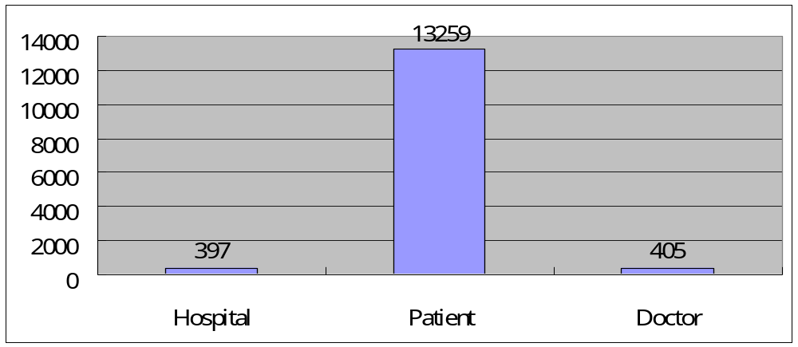
~Asthma Grid~
Impact
Over 400 physicians involved nationally
Over 13,000 patients participating nationally

Slide 13
Before Asthma Grid
Outpatient follow-up
First stage
Acute
exacerbation
86.5%
13.5%
Second stage
No acute symptoms
65.5%
34.5%
Third stage
Change in medication dosage
42%
58%
Forth stage
Self-control
87.5%
12.5%
Loss of follow-up in
outpatients

Slide 14
After Asthma grid
Outpatient follow-up
First stage
Acute exacerbation
95.0%
5%
Secondary stage
84.5%
No acute symptoms
Third Stage
15.5%
64%
Change in medication dosage
36%
Forth stage
43.5%
Self-control
56.5%
Loss of follow up in
outpatients

Slide 15
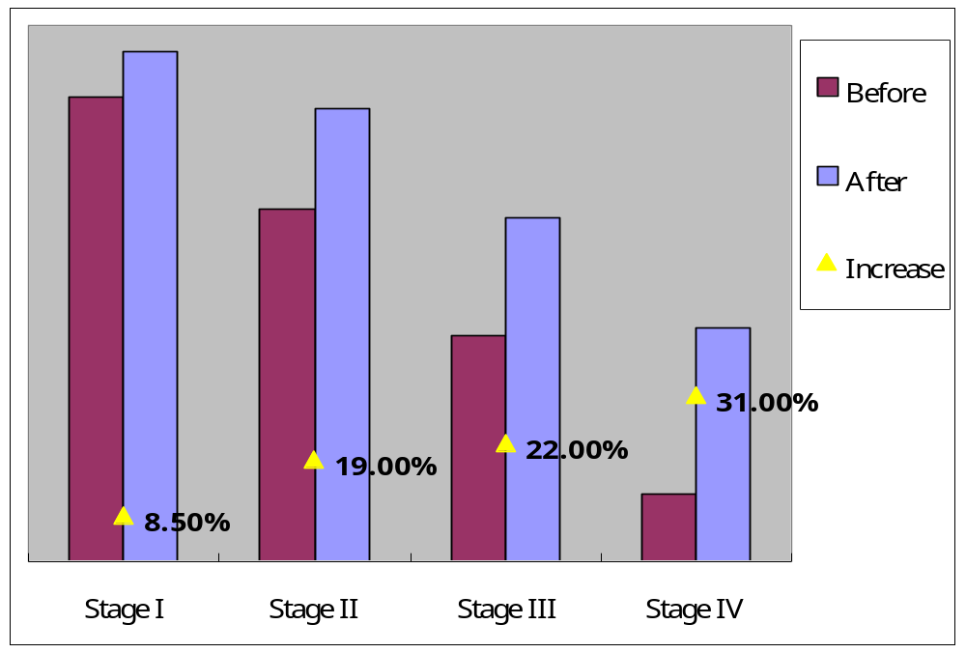
~Asthma Grid~
Impact

Slide 16
NCHC
~Thank you~
Bonita Hung

