Slide 1
Thoughts on
Network Modeling
Freek Dijkstra
Universiteit van Amsterdam, Netherlands
Notes:
XML vs RDF

Slide 2
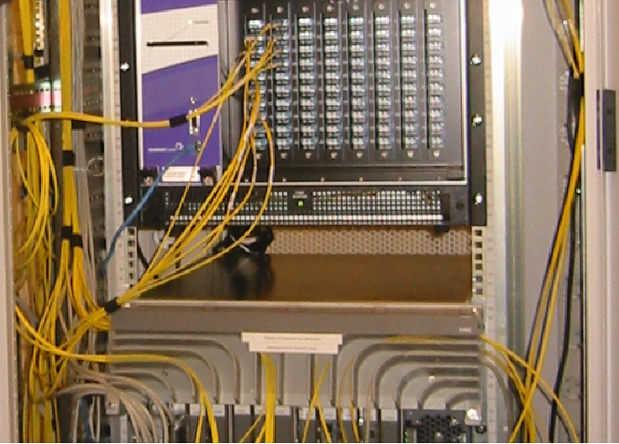
Model versus Syntax
Network Elements
Functional Elements
Syntax
<ndl:Device rdf:about="#Force10">
<ndl:hasInterface rdf:resource=
"#Force10:te6/0"/>
</ndl:Device>
<ndl:Interface rdf:about="#Force10:te6/0">
<rdfs:label>te6/0</rdfs:label>
<ndl:capacity>1.25E9</ndl:capacity>
<ndlconf:multiplex>
<ndlcap:adaptation rdf:resource=
"#Tagged-Ethernet-in-Ethernet"/>
<ndlconf:serverPropertyValue
rdf:resource="#MTU-1500byte"/>
</ndlconf:multiplex>
<ndlconf:hasChannel>
<ndlconf:Channel rdf:about=
"#Force10:te6/0:vlan4">
<ndleth:hasVlan>4</ndleth:hasVlan>
<ndlconf:switchedTo rdf:resource=
"#Force10:gi5/1:vlan7"/>
</ndlconf:Channel>
</ndlconf:hasChannel>
</ndl:Interface>
Information Model
Data Model
Notes:
Information Model / Data Model: RFC 3444

Slide 3
Existing Models
Information Models:
Graph Theory
ITU-T G.805 (functional elements)
Originally for network connections, but extended to describe networks
Data Models:
GMPLS: switching based on labels
CIM: describe access networks
asset management

Slide 4
Layer schema based on G.805
IP layer
Ethernet layer
SONET layer
UTP
layer
fiber
layer
Ethernet/
SONET switch
Ethernet/
SONET switch
Ethernet/
SONET switch
End host
SONET switch
End host

Slide 5
Describe All Layers?
P802.3ae
LLC
MAC Control
MAC
10 GigE Reconsiliation Sublayer (RS)
XGXS
XGMII
XGXS
XGXS
XAUI
XGXS
XGMII
PCS
PCS
WIS
PMA
PMA
PMD
PMD
Medium
Medium

Slide 6
Or Only Possible Incompatibilities?
Ethernet
LAN PHY
WAN PHY
Medium
Medium

Slide 7
Why Multi-layer NDL?
Target applications:
  Visualization
  Path finding
  (find incompatibilities. E.g. conflicting wavelengths, different adaptation, incompatible MTU sizes)
  Fault isolation
  (required network connection description)
The last two items require multi-layer network descriptions.

Slide 8
Multi-Layer NDL
Layer schema is used to describe technologies
(thus does not describe technologies itself)
Flexible
(can describe technologies in multiple ways)
Non-goals:
Packet networks (MAC, IP): describes those as large broadcast networks (not true for IP)
Physical properties: very limited concept of regeneration
But: can be included with other schemas (that’s the strength of RDF)
Notes:
Flexible: Incompatibilities change over time

Slide 9
Technologies
Test cases for the layer schema:
IP layer
Ethernet (MAC + LAN/VLAN layers)
ATM (AAL5/VCI + VPI (NNI/UNI) + cell layers)
SONET/SDH (15 (!) layers as RFC 4606)
WDM (Lambda + Fiber layers)
Copper (UTP) layer
Bundle layer (multiple fibers in a single duct)
And even: PPP, MPLS, L2TP, 802 Wireless

Slide 10
Applications in Development
Configuration of devices
Path Walk (given an end-point, find the destination)
Fault Isolation
Path Finding (must be a combination of topology, technology constraints, policy and scheduling/reservation)
http://ndl.uva.netherlight.nl/

