Slide 1
Grid High-Performance
Networking Research Group
Optical Network Infrastructure for Grid
Dimitra Simeonidou (ed.), Reza Nejabati (ed.), Bill St. Arnaud, Micah Beck, Peter Clark, Doan B. Hoang, David Hutchison, Gigi Karmous-Edwards, Tal Lavian, Jason Leigh, Joe Mambretti, Volker Sander, John Strand, Franco Travostino

Slide 2
Optical Network Draft
Optical network draft focuses on deployment of phonic network infrastructure for Grid applications
Motivation:
  Predictions for deployment of data-intensive Grid applications that will require transfers of Terabytes or even Petabytes of data
  These applications will require a high bandwidth network environment where bandwidth will be allocated on demand or by user/application driven scheduled reservation
This draft aims:
  To provide a comprehensive overview on solutions in optical technologies
  To list the particular demand and constraints of Grid infrastructures and applications
  To provide indicators for new functions that bridge identified gaps → New WGs

Slide 3
Optical Network Draft
The final version will aim to cover the following topics:
  Necessity of optical technologies/ networks to support Grid applications
  Main characteristics/operation of the optical Grid network
  Overview of available solutions, technology and research areas including state of the art (without promoting any particular solution)
  Integration issues with existing Grid & photonic network technologies, control, signalling and higher layer protocols

Slide 4
Current Structure of the Optical Network Draft
Grid applications and their requirements for high speed, high bandwidth infrastructure
Photonic Network topology for Grid
  State the demand for user-empowered light-path creation
Optical switching technology and transport format considerations for Grid
  Comprehensive overview
Optical switching nodes for photonic Grid
  State particular demands caused by Grids (Multicasting support)
Optical network control and signalling
  State of the art in Standardisation
Grid User Network Interface (GUNI)
  Overview on new functionality
Optical Networks as Grid service environment
  Light-Pathes as a first class service
QoS for the Grid optical transport
  Capabilities potentially requested by Grid applications and end-to-end issues
Security Considerations
  Strength with respect to security (isolation)

Slide 5
Topics for Further Consideration:
Grid applications
Current situation in the draft:
    Mainly for data-intensive and/or long-lived applications
    Today’s applications with large BW requirements (i.e. high energy physic centres, radio-telescopes) belong to well defined communities of users and destinations with typically long lived persistent relationships
    Application scenarios such as high bandwidth interactive applications, data visualisation applications, application that require bandwidth to reduce latency have been mentioned
New issues for further considerations:
    What will be the role for optical network in future Grid applications (i.e. short-lived applications, large number of anonymous and relatively small users)?
    It will be useful to discuss an example of possible Grid applications contributing large (or increasing?) number of anonymous users (not only small numbers and dedicated VOs) - this will be important in order to support the case for dynamic optical networking

Slide 6
Topics for Further Consideration:
Transport Format and Switching Technology
Current situation in the draft:
  Wavelength switching
  Hybrid IP router/wavelength switching
  Optical burst switching
New issues for further considerations:
  We need a trade off statement between OBS and OWS for representative Grid applications and network scenarios. During GGF10 it was commented (by Jon Crowcroft) that the trade off must also consider transport protocols

Slide 7
Topics for Further Consideration:
Control Plane and Signalling
Current situation in the draft:
  OBGP in conjunction with the existing GMPLS standards
    A shared optical "cloud" with rapid switching of lambdas between users
    A fixed optical point to point (partial) mesh between users with slow "automatic fiber patch panel" switching (OBGP)New issues for further considerations
  Control plane and signalling consider mainly (circuit) switching paradigm
New issues for further considerations:
  This part will merge with the GUNI section to avoid possible confusion on terminology

Slide 8
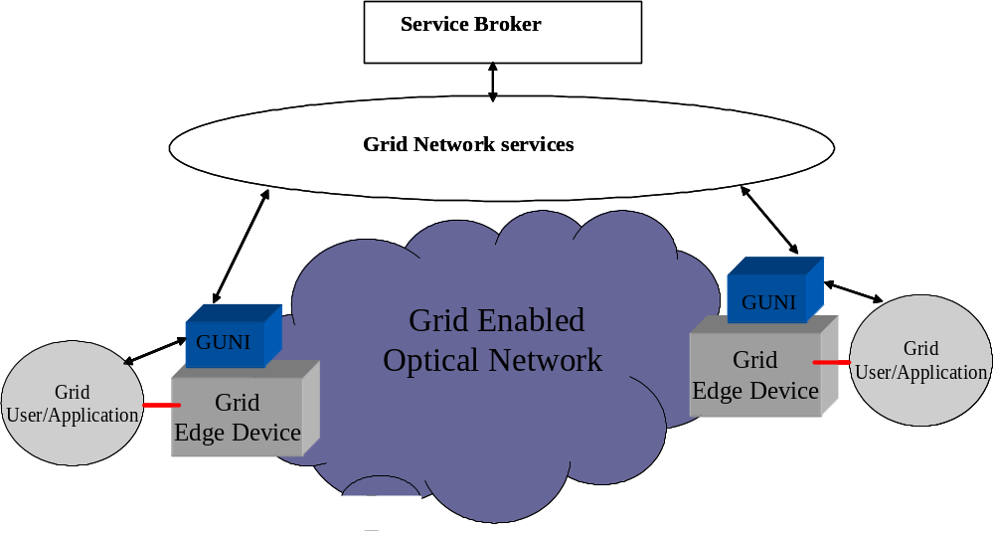
Topics for Further Consideration:
Grid User Network Interface (GUNI)
Current situation in the draft:
  GUNI mainly a complimentary to OIF UNI
    Indirect service invocation scenario
    Overlay model control plane
New issues for further considerations:
  What will be the GUNI role and functionality In case of
    Direct service invocation scenario
    Peer model for control plane
  The GUNI with the above complementary can be well fitted under control plane and signalling section
    The GUNI define signalling mechanism and its requirement between Grid user and network
    There are direct relations between GUNI and control plane architecture

Slide 9
Topics for Further Consideration:
Optical Network as Grid Service
Current situation in the draft:
  GRAM for optical resource management
  GARA for advance optical resource reservation
  WS-agreement for optical resource scheduling
New issues for further considerations:
  Application-driven definition of optical service abstractions
    Useful collections which match application paradigms and needs
  How abstraction for encapsulating optical network resources can accommodate AAA and related policy issues across multiple domains
  Optical bandwidth and optical NEs can be considered as two different types of services
    Optical bandwidth can be managed by bandwidth on demand server based on the AAA,GARA and WS-agreement
    Optical NEs (switches, ports) can be intelligent and considered as other Grid resources
QoS for the Grid optical network can be well merged with the Grid network services

Slide 10
Next Step:
All Photonic Grid Networking Scenario II
New section in the draft: Photonic Grid Networking Service schemas:
  Grid networking scenario based on wavelength switching (OWS)
  Grid networking scenario based on optical burst switching (OBS)
  Grid networking scenario based on hybrid OBS/OWS
  Self-organised Grid networking scenario based on OBS
Networking scenarios must be differentiated in the draft for each category based on the :
  Job submission phase
  Resource request and allocation phase
  Return process/path for sending back results

Slide 11
Some thoughts …
Service Level Agreements will likely be modelled by WS-Agreement
  Methods for service providers to advertise the capabilities of their services
  Forms a base for high-level scheduling and workflow services
Potential Solution: Grid resource Network interface (GRNI) to perform interoperable procedures between Grid resources (resource managers) and optical network
What will be functionalities and role of an interface between Grid resources (processing/storage) and optical network ?
Is it necessary to distinguish such interfaces?
How is the relation to GUNI

Slide 12
Further Suggestions?
e-mail: ghpn-wg@gridforum.org

