Slide 1
Grid Education and Training Workshop
Work in Progress and Future Collaboration
Malcolm Atkinson & David Fergusson
GGF16 in Athens
14th February 2006
OGSA is trademark of GGF

Slide 2
GGF Intellectual Property Policy
All statements related to the activities of the GGF and addressed to the GGF are subject to all provisions of Appendix B of GFD-C.1, which grants to the GGF and its participants certain licenses and rights in such statements. Such statements include verbal statements in GGF meetings, as well as written and electronic communications made at any time or place, which are addressed to any GGF working group or portion thereof,
Where the GFSG knows of rights, or claimed rights, the GGF secretariat shall attempt to obtain from the claimant of such rights, a written assurance that upon approval by the GFSG of the relevant GGF document(s), any party will be able to obtain the right to implement, use and distribute the technology or works when implementing, using or distributing technology based upon the specific specification(s) under openly specified, reasonable, non-discriminatory terms. The working group or research group proposing the use of the technology with respect to which the proprietary rights are claimed may assist the GGF secretariat in this effort. The results of this procedure shall not affect advancement of document, except that the GFSG may defer approval where a delay may facilitate the obtaining of such assurances. The results will, however, be recorded by the GGF Secretariat, and made available. The GFSG may also direct that a summary of the results be included in any GFD published containing the specification.

Slide 3
Workshop Goals
Share information and ideas about existing education and training for Grid Computing
Investigate whether people would be willing to continue working together to:
  Develop and share best practice
  Develop and share educational and training material
  Develop and share t-Infrastructure
  Develop agreed policies for access to training resources
  Develop shared eLearning resources
  Develop co-scheduling and cross-accreditation of courses
If the answer is “yes”, develop a charter and form a R/WG

Slide 4
Agenda: First Session
Welcome and Introductions David Fergusson
Globus Training Ian Foster
ICEAGE Malcolm Atkinson
EPIC Leslie Southern
Grid Ed. for minority groups Geoffrey Fox
Summer Schools All
MSc Programmes All
Discussion

Slide 5
Agenda: Second Session
Welcome & Introductions Malcolm Atkinson
EGEE Training Experience David Fergusson
T-Infrastructure tba
European Grid Training Rosa Badia
UK training David Fergusson
Discussion & possible R/WG Charter

Slide 6
Introduction to ICEAGE
Malcolm Atkinson & David Fergusson
Global Grid Forum, Athens
14th February 2006

Slide 7
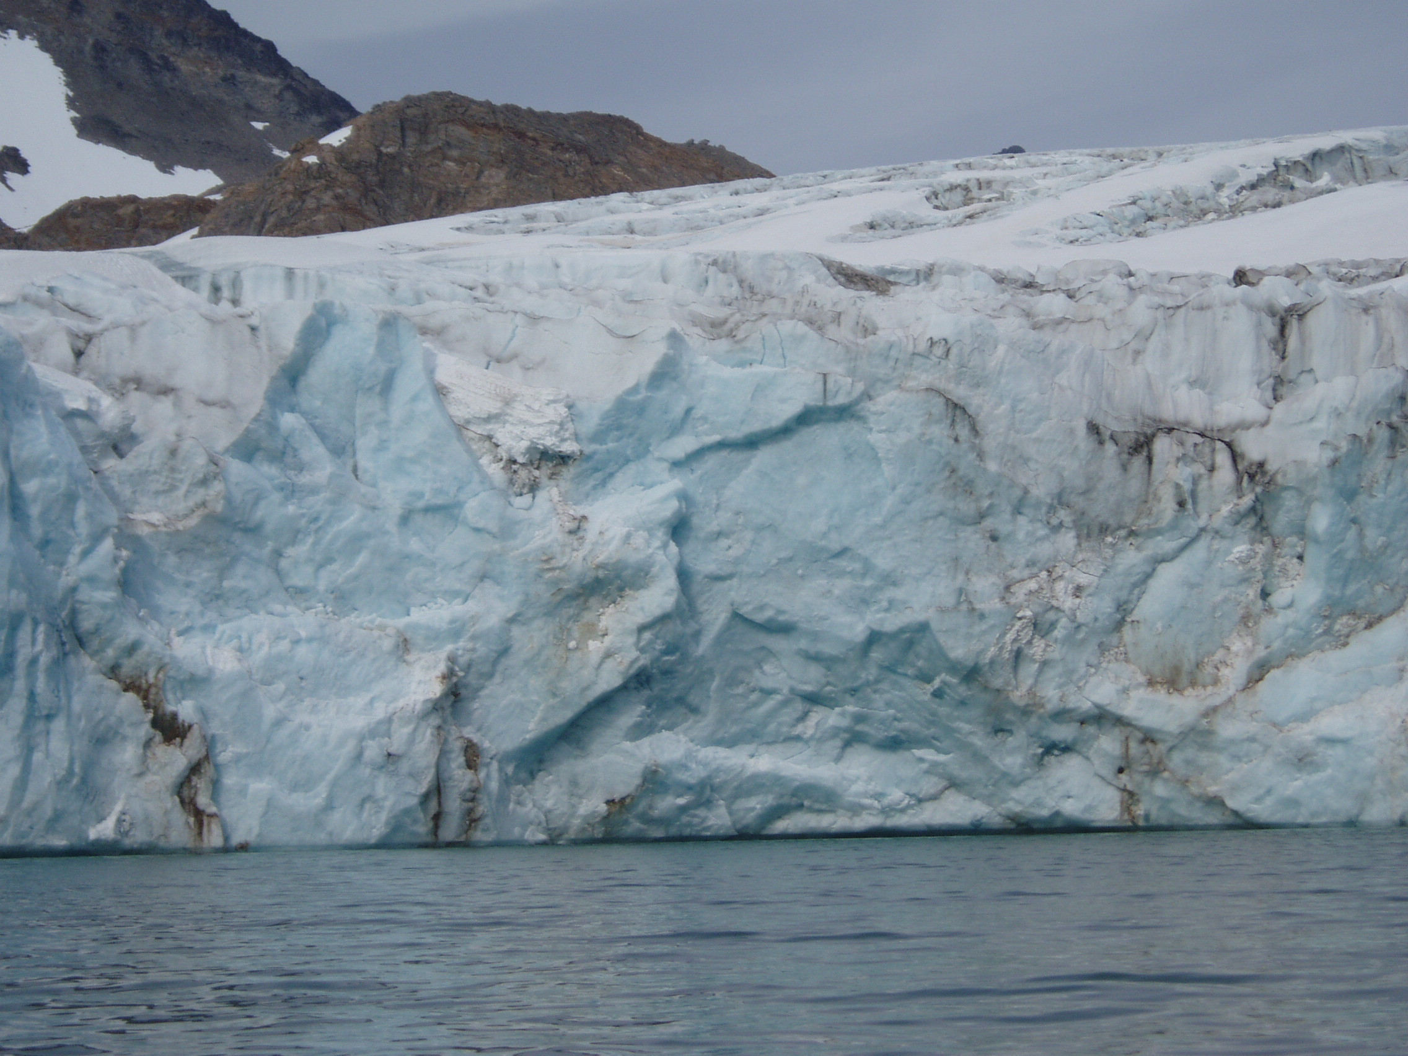
Overview
Mission
Partners
Activities
Plans
Summary
€1.2 million
2 years
Start
1st March
2006
Photographer: Kathy Humphry

Slide 8
Mission & Goals
Mission
Stimulate and support advances in grid education throughout Europe
Goals
  Achieve rapid growth in effective advanced grid education
    Enabling society to make best use of e-Infrastructure
  Make best use of worldwide capacity for advanced grid education
  Deliver a stimulating programme of educational events
    Including international summer schools
  Broaden engagement in an advanced grid education
    both geographically and across disciplines

Slide 9
Vive la Difference
Training
  Targeted
  Immediate goals
  Specific skills
  Building a workforce
Education
  Pervasive
  Long term and sustained
  Generic conceptual models
  Developing a culture
Both are needed
Strengthens
Organisation
Invests
Services & Applications
Training
Develop
Skilled Workers
Prepares
Enriches
Society
Invests
Innovation
Education
Create
Graduates
Prepares

Slide 10
Partners
Edinburgh – National e-Science Centre
  Malcolm Atkinson & David Fergusson
Universita’ degli Studi di Catania
  Roberto Barbera & Antonella Di Stefano
SPACI
  Southern Partnership for Advanced Computational Infrastructures
  Almerico Murli
CERN
  Erwin Laure
Kungliga Tekniska Högskolan, Stockholm
  Lennart Johnsson & Per Öster
SZTAKI – Budapest
  Magyar Tudományos Akadémia Számítástechnikai és Automatizálási Kutató Intézet
  Peter Kacsuk & Norbert Podhorszki

Slide 11
Activities
Forum
  Edinburgh
  International panel of experts to develop curricula, policies & strategies for increasing and improving Grid Education
Support, Outreach, Induction & Training services
  Edinburgh
  Attracting & Training the Educators
  Persuading Universities to adopt Grid Computing Curricula
  E-Learning, repository & course scheduling & announcement
Summer Schools
  KTH
T-Infrastructure
  Catania
Coordination & Management
  Edinburgh

Slide 12
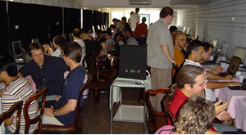
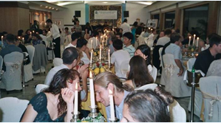
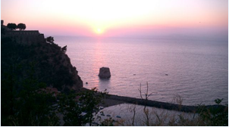
Summer Schools
GGF ISSGC’04 Vico Equense Italy
GGF International Summer Schools in Grid Computing
  ISSGC’03
  ISSGC’04
  ISSGC’05
Planned
  GGF ISSGC’06 Ischia, Italy
  9th – 23rd July
  IGGFSSGC’07 Scandinavia
  ISSGC’08 Hungary
Specialist Summer Schools
  Physics courses
    GridKa Summer Schools
    PPARC Summer Schools
    CERN Summer Schools
  Earth Sciences
    …
  Biomedical sciences
    …
  Software Engineering for Grids
    …

Slide 13
Plans
Raise Education & Training in National & EU agenda
  e-IRG meeting: 13 & 14th December 2005, London
  e-IRG meeting: 10 & 11th April 2006, Linz, Austria
ICEAGE project starts
  1st March 2006
  Duration 2 years
  Plan to generate National & EU follow up projects
Education workshop at GGF17
  7th to 12th May 2006, Tokyo
International Summer School in Grid Computing ‘06
  9th to 23rd July 2006, Ischia, Italy
  Contribute: Lectures, Students & Sponsorship please
First meeting of the Forum
  15th to 17th July 2006, Ischia, Italy

Slide 14
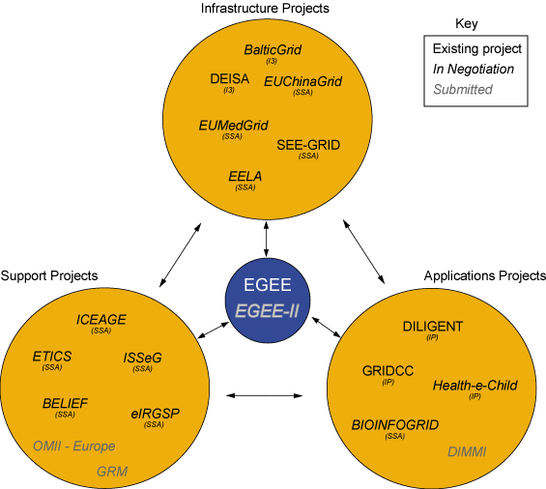
Thank you to EGEE

Slide 15
Summary
Grid Computing has huge potential
To realise this potential
  We must engage many more people
  We must enable and engage their creativity
Requires investment in Training & Education
  Pooling ideas and resources essential
Should be a core part of GGF work
A Working Group should start work now
If you think training is expensive,
try ignorance
Roy Crock, Founder of M^{c}Donalds

Slide 16

Questions
&
Comments
please
Photographer: Kathy Humphry

Slide 17
Grid Education and Training Workshop
Work in Progress and Future Collaboration
Second Session
Malcolm Atkinson & David Fergusson
GGF16 in Athens
14th February 2006
OGSA is trademark of GGF

Slide 18
GGF Intellectual Property Policy
All statements related to the activities of the GGF and addressed to the GGF are subject to all provisions of Appendix B of GFD-C.1, which grants to the GGF and its participants certain licenses and rights in such statements. Such statements include verbal statements in GGF meetings, as well as written and electronic communications made at any time or place, which are addressed to any GGF working group or portion thereof,
Where the GFSG knows of rights, or claimed rights, the GGF secretariat shall attempt to obtain from the claimant of such rights, a written assurance that upon approval by the GFSG of the relevant GGF document(s), any party will be able to obtain the right to implement, use and distribute the technology or works when implementing, using or distributing technology based upon the specific specification(s) under openly specified, reasonable, non-discriminatory terms. The working group or research group proposing the use of the technology with respect to which the proprietary rights are claimed may assist the GGF secretariat in this effort. The results of this procedure shall not affect advancement of document, except that the GFSG may defer approval where a delay may facilitate the obtaining of such assurances. The results will, however, be recorded by the GGF Secretariat, and made available. The GFSG may also direct that a summary of the results be included in any GFD published containing the specification.

Slide 19
Workshop Goals
Share information and ideas about existing education and training for Grid Computing
Investigate whether people would be willing to continue working together to:
  Develop and share best practice
  Develop and share educational and training material
  Develop and share t-Infrastructure
  Develop agreed policies for access to training resources
  Develop shared eLearning resources
  Develop co-scheduling and cross-accreditation of courses
If the answer is “yes”, develop a charter and form a R/WG

Slide 20
Agenda: Second Session
Welcome & Introductions Malcolm Atkinson
EGEE Training Experience David Fergusson
T-Infrastructure tba
European Grid Training Rosa Badia
UK training David Fergusson
Discussion & possible R/WG Charter

Slide 21
New people Introduce themselves
Name
Affiliation
Interest in Grid Education or Training
Experience as a Trainee (optional)
Experience as a Trainer (optional)

Slide 22
T-Infrastructure
What is it?
  Computational & Data facilities
  Example data, Software & Scenarios for Learning
    Examples cleared from ethical, IPR & privacy concerns
  Globally accessible portals
  Learning support
Why is it special?
  Light weight security
  Educator-managed policy, schedules and facilities
  Emulation of current, future and student-created Grids
  Commitment to responsive systems
  Safe to “break” infrastructure

Slide 23
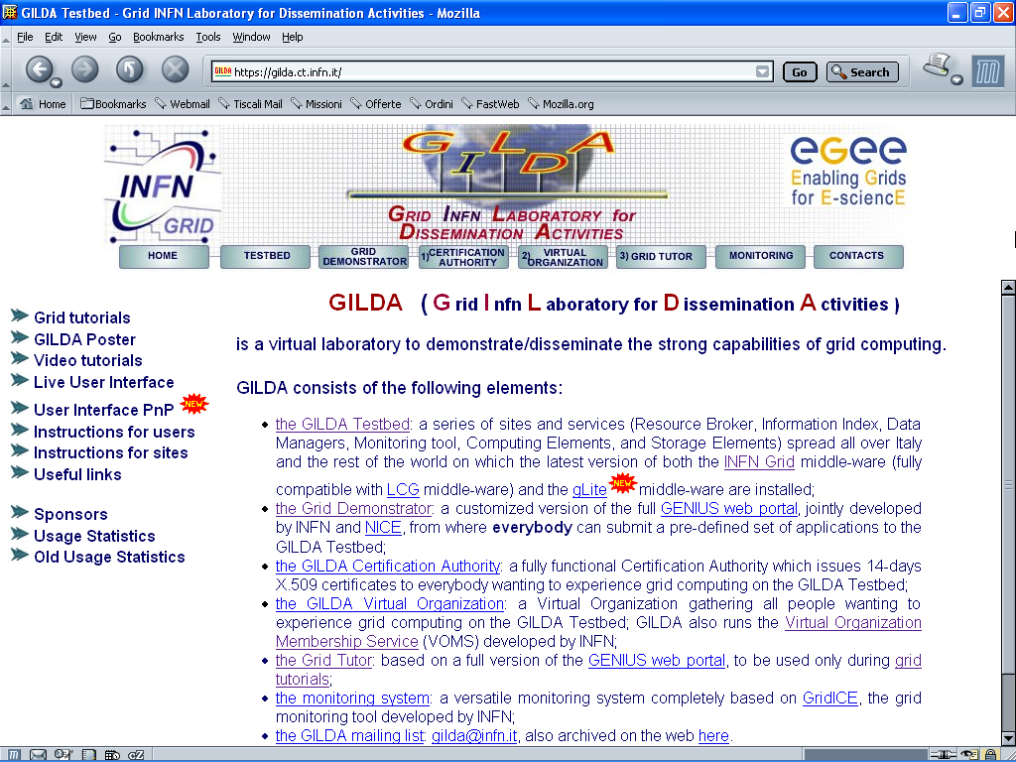
The GILDA t-Infrastructure
(https://gilda.ct.infn.it)
Catania
Leader:
Roberto
Barbera
Leading:
t-Infra-
structure
activity

Slide 24
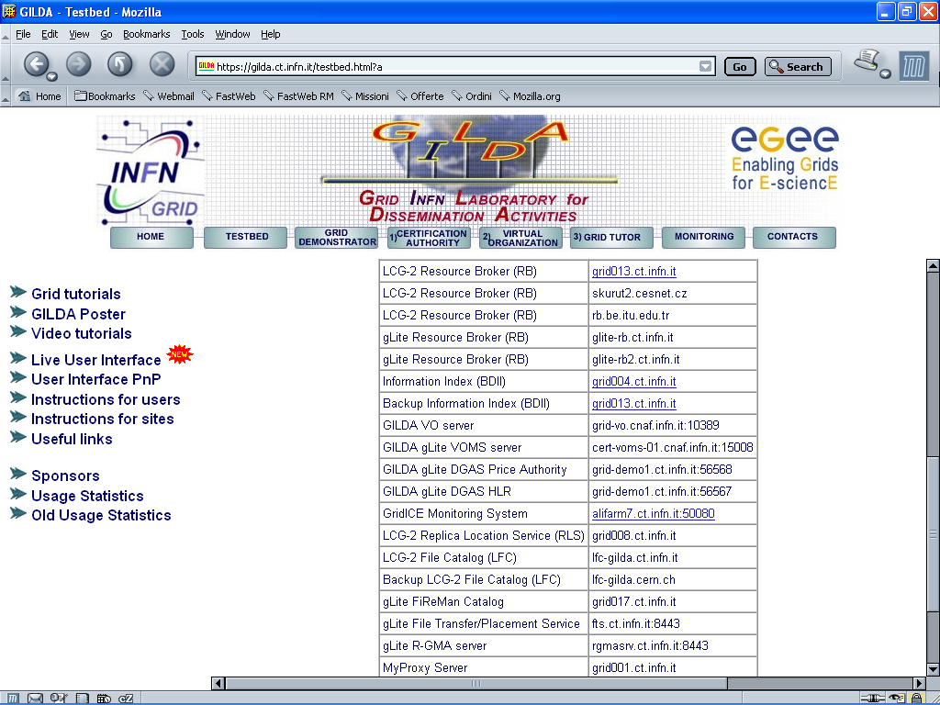
All gLite services are available on GILDA !
gLite Services

Slide 25
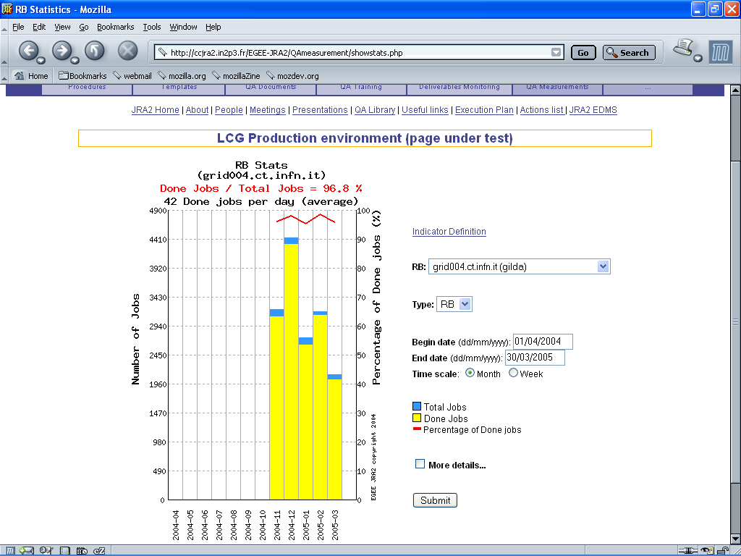
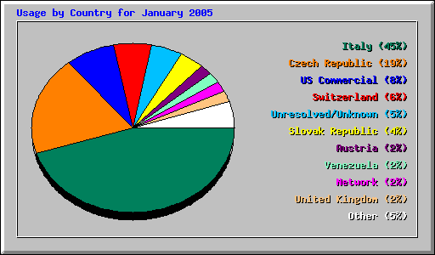
GILDA summary numbers
15 sites in 3 continents
> 2600 certificates issued, >15% renewed at least once
> 75 tutorials and demos performed in 15 months
> 50 jobs/day on the average
Job success rate above 80%
> 1,000,000 hits (> 47,000 visits) on (of) the web site from 10’s of different countries
> 0.6 TB of videos and UI’s
downloaded from the web site

Slide 26
T-Infrastructure & Summer School in EGEE CE Region
Peter Kacsuk
EGEE Summer School CE Region 2005 http://egee.hu/grid05
EGEE CE t-infrastructure:
  VOCE
http://egee.cesnet.cz/en/voce/
  P-GRADE portal
http://www.lpds.sztaki.hu/pgportal/
http://n42.hpcc.sztaki.hu:8080/gridsphere/gridsphere

Slide 27

Open Discussion
&
WG and/or RG Charter?

Slide 28
Suggested headings for Charter
Officers:
  Co-chairs
    Volunteers?
  Secretary
    Volunteers?
Scope
Goals
Milestones
Plan

Slide 29
Scope
Education & Training for Grid-based Computing
  Grids underpinning application disciplines
  Grid engineering, production & management
  Computer Science for Grids
Expected Education Target Communities
  Universities & Colleges
  Schools (later?)
  Industry
  Experts & Practitioners
What people want versus what people need
What society needs versus what people want

Slide 30
Goals 1
To understand and Report Current Work & Investment
To increase the value of Investment in Education & Training
  Developing shared best practice
    Curricula, Education & Training methods
  Establish and maintain shared resources
    Education and Training materials repositories
    Education & Training e-Learning Portals
    Education & Training t-Infrastructure
  Coordinate schedules and announcements
    Pooling information about courses, planning and teachers

Slide 31
Goals 2
Develop and Present Information Documents
  Covering the above goals
Identify where standards are needed
Develop and Nurture Standards proposals as needed, e.g. to enable sharing and student mobility
  Policy for sharing training resources
  Policy, procedures and standards for Course QA
  Policy, procedures & protocol for cross-course recognition

Slide 32
Milestones
Collated report on current work in Grid Education & Training by GGF18

Slide 33
Plan
Meet at GGF17 to:
  Assemble and critique information about current work
  Draft outline of first information document
  Allocate responsibilities
  Produce plan for next two documents
Meet at GGF18 to:
  Collate and polish content of Report on Current work ready for public review
  Start work on policy and standards documents
    e.g. to agree a framework for international repositories of shared educational and training material (NB links with digital library standards)
Meet at GGF19 to:
  Complete draft of standard for sharing training material

Slide 34
More Tomorrow
Education Community Group BoF
  Grid for Learning
Pierluigi Ritrovato
1:30 to 3:00pm
Naoussa

Slide 35
Reserve Slides

Slide 36
Take home story
Under FP5, FP6 & FP7 there is significant investment in creating & delivering e-Infrastructure
  EU & Member States
The resulting e-Infrastructure is
  Extremely powerful
  It will be pervasive & dependable
  It will be multi-purpose, then general purpose
E-Infrastructure has huge potential
  To transform the way we work
  Research, Design, Diagnosis, Decisions, Education, Business
  All Disciplines
  All walks of life
  All member states
It could significantly improve wealth & well-being
  Of large numbers of EU citizens
But it will not unless we invest heavily in Education & Training
Today only a tiny few cognoscenti use it

Slide 37
Why Education & Training work
Education
  The teachers & learners are already engaged
  They can assimilate ideas in their subjects
  The provide a creative milieu
    New ways of using e-Infrastructure
    New ways of doing their discipline
    New exemplars & teaching material
  They carry the message to their communities
    Conferences, journals & “the pub”
    Employers, colleagues & society
Training
  Employers, managers & trainees see immediate gain
  Delivered skills are immediately deployed
  The trained transfer skills to their colleagues
  The trained become trainers and educators

Slide 38
What do we need?
More people training
  For all roles
  Strategists & leaders
  Users
  Designers
  Application developers
  Operations
Existing trainers well informed about
e-Infrastructure
  Expertise matches target role
All trainers well supported
All trainees well supported
More people educating
  For all disciplines
  Earth sciences
  Life sciences
  Social Sciences
  Humanities
  Economics
  …
Existing educators well-motivated to bring
e-Science into their curricula
Educators well-informed
Educators well-supported
Learners well-supported

Slide 39
How can we get it? 1
More people training
  Attract & motivate trainers
  Special qualities needed
    enthusiasm, communication skills, technical skills, creativity
  Funds for more training staff
  Recognition and accreditation
  Engage the existing training organisations
Develop pool of training experts
  For roles
  For subject disciplines and application contexts
  For modes of delivery
  For national and societal contexts
Share expertise – draw on the pool of experts

Slide 40
How can we get it? 2
Trainers well informed
  Train the trainers
  Accredit the trainers
  Supply and share training material
Trainers well supported
  Good supporting “club” to share thoughts, experiences & problems
  Repository of training material
    Curricula
    Presentations
    Tutorial pages
    Hands-on exercises – courseware & example accessible data
  T-Infrastructure – platforms for exercises
  Cooperative scheduling
  Evaluation and feedback

Slide 41
How can we get it? 3
Trainees well supported
  Easy access to information about courses and trainers
  Good supporting “club” to share thoughts, experiences & problems
  Easy access to self-paced learning
    Federation of e-Learning portals
    Rich collection of well-structured e-Learning content
  Tutorial pages
  Readable documentation & experience stories
  Access to t-Infrastructure to run hands-on exercises
  Access to facilities to do next steps in transferring skills
  Summer schools
Can we share their provided environment?
Can we provide mobile & ubiquitous access for learners with modest hurdles?

Slide 42
How can we get it? 4
More people educating
  Stimulate interest in Universities (and Schools?)
    University leadership + front-line educators
  Outreach talks, information sources, visits, talks
  Stimulate interest in Ministries of Education
  They should fund stimulation activities for curriculum change
Existing educators well-motivated to bring
e-Science into their curricula
  Good supporting “club” to share thoughts, experiences & problems
  Work to develop curricula & success stories
    In many disciplines
  Develop this in their discipline’s meetings & forum
  Summer schools

Slide 43
How can we get it? 5
Educators well-informed
  All training topics above for educators
  Summer schools
Educators well-supported
  Shared materials, t-Infrastructure, …, as above
  Tuned for education
Learners well-supported
  High-quality material & educators
  New experiences – multi-discipline work, multi-site teams, multi-national collaboration – in their discipline
  Self-paced e-Learning facilities
  T-Infrastructure – accessable and responsive
  Good supporting “club” to share thoughts, experiences & problems
  Summer schools

