Slide 1

Tribal Colleges & Universities
and
Grid Computing
Global Grid Forum
Chicago, IL
June 28, 2005

Slide 2
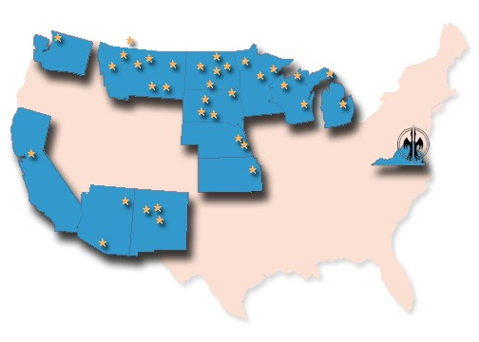
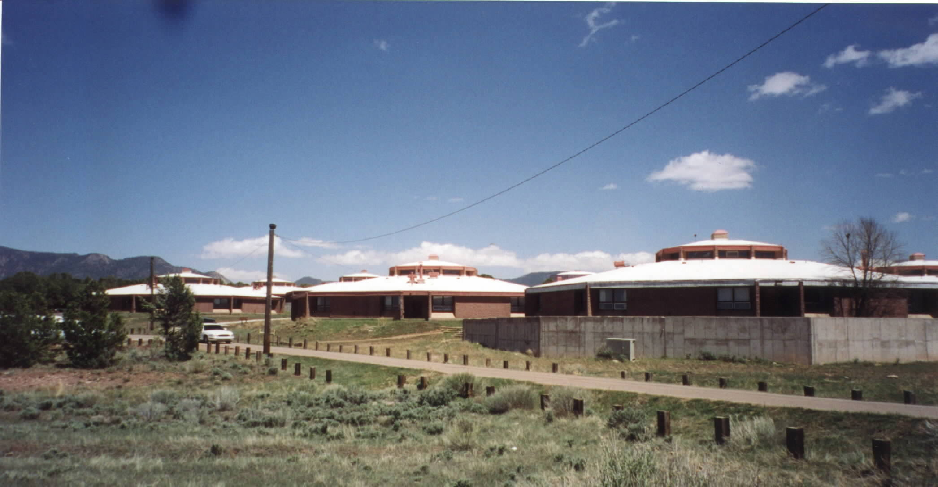
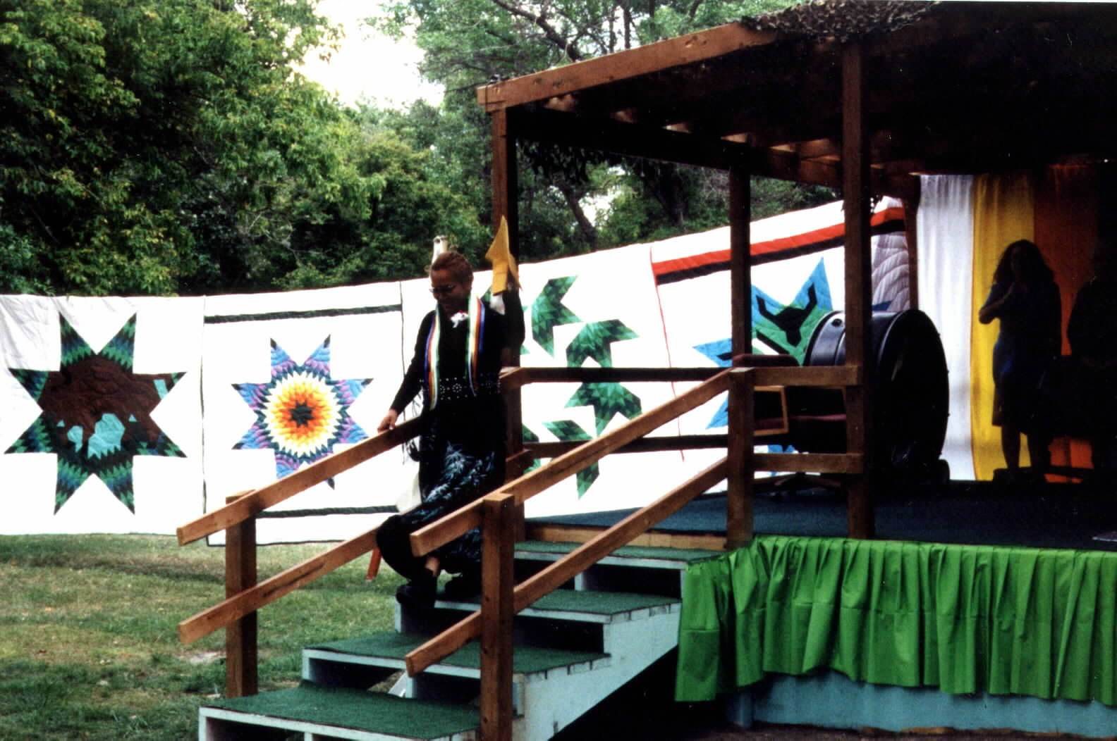
35 Tribal Colleges & Universities
Tribal Colleges are Young,
Geographically Isolated, and Poor
Notes:
And this philosophy has been very successful:
Over the past 30 years, tribal colleges have proliferated throughout Indian Country: providing higher education opportunities to some of the most rural and poverty stricken parts of this country. (In fact, three of the five poorest counties in America are home to tribal colleges…)
Tribal Colleges are located in the Great Lakes, the upper Northwest, and California, and they are expanding in all regions, including Alaska.

Slide 3
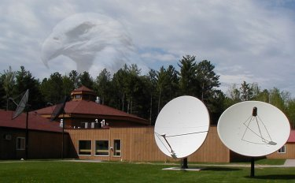

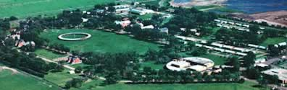
TCUs
Are Leading American Indian Reservation
Communities
With Innovative & Cost-
Effective Use of Technologies

Slide 4
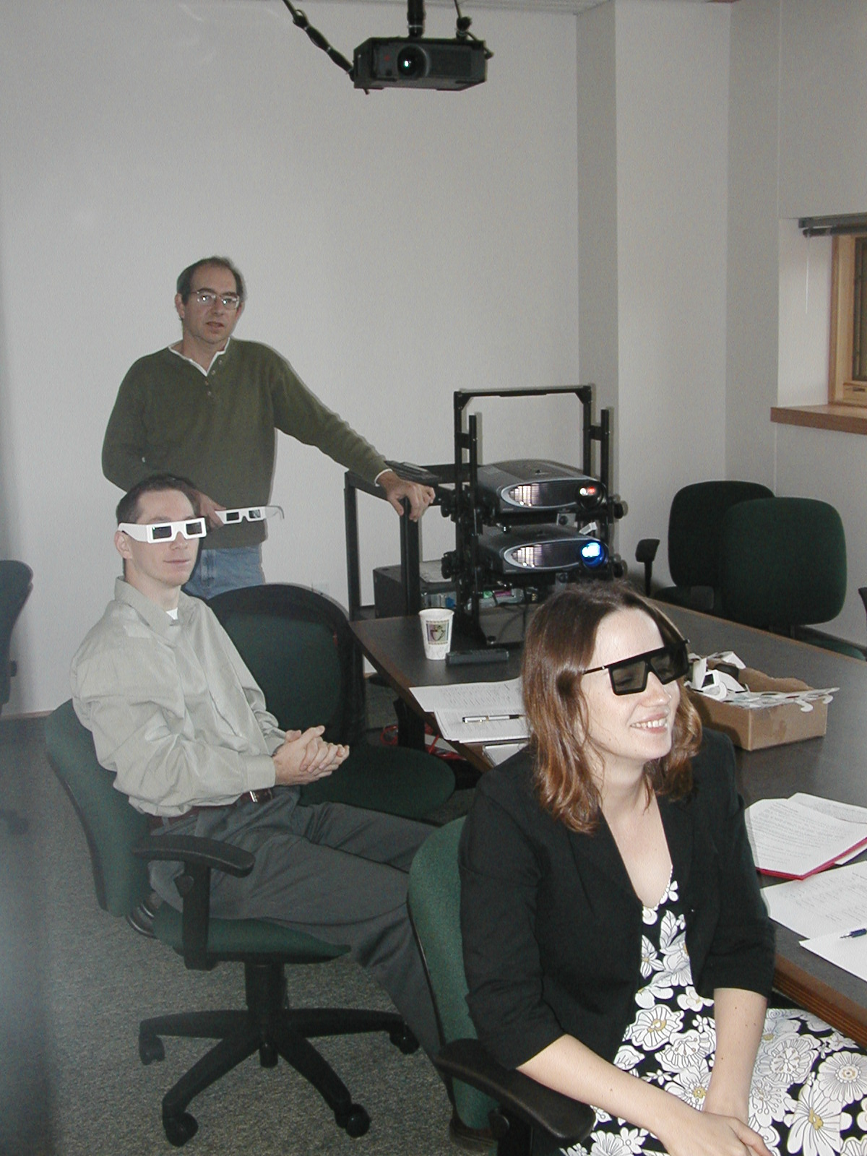
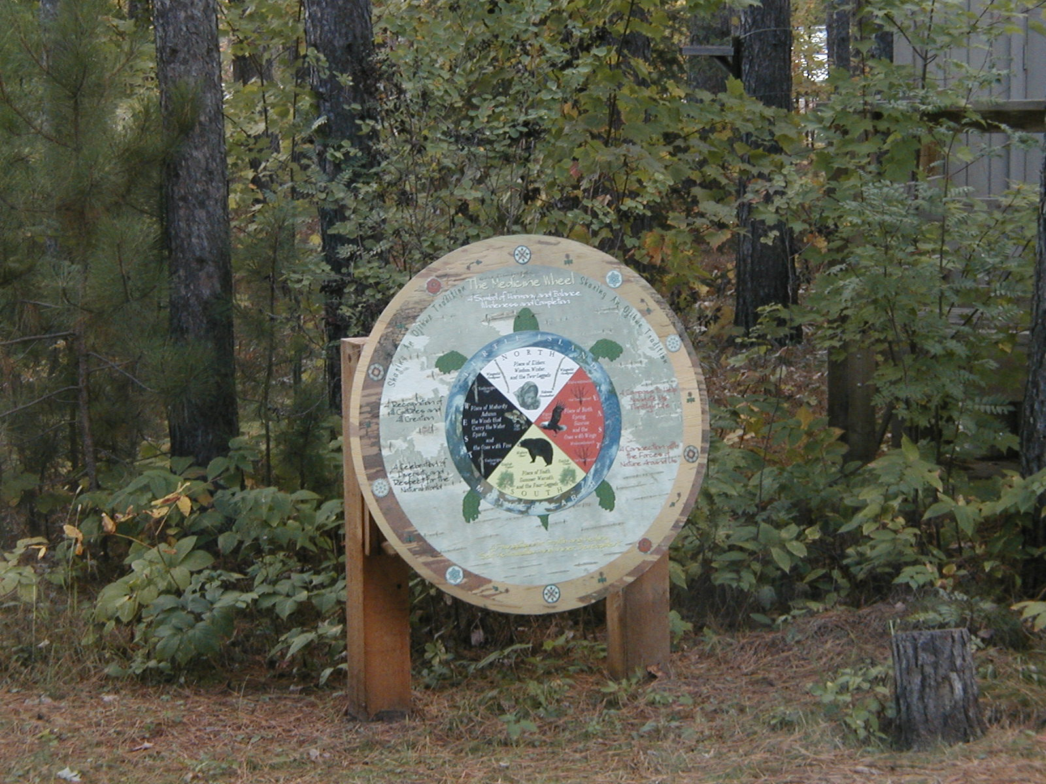
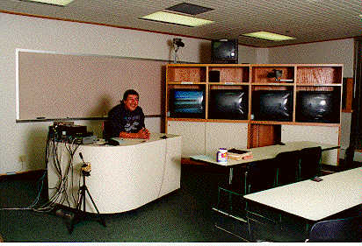
Through a multi-year, coordinated, & collaborative effort,
Many TCUs have developed
state-of-the-art IT
capabilities that are culturally responsive

Slide 5

THE GOAL:
To build a framework of strategic partnerships, resources, & tools that will help TCUs and their communities create locally based economic and social opportunities through information and communication technologies and services
Notes:
The goal is not to GIVE something to the colleges or our people. It is to build a framework….

Slide 6
8 Key Strategy Areas:
Goals & Actions
Crafting the
Framework
Resource
Development
Education
And
Human Resources
Leadership
And
Coordination
Policy
Infra-
Structure
Community
And
Culture
Partnerships
Research
And
Development

Slide 7
TCU Challenges
Resources -- TCUs-most poorly funded IHE
Technology infrastructure improving, but maintenance difficult without funding
Limited instructional resources
Many research programs not part of larger tribal or regional development/planning process
Lack of coordination among stakeholders/partners

Slide 8
How can Grid Computing
Help the Tribal Colleges?
Access to
  National research infrastructure
  Educational services on demand (just in time)
  Data Resources
  New communication and collaboration models
New Initiative Development: Innovation Brokering
Help coordinate multiple programs/initiatives
Grid Computing workforce opportunities
Notes:
TECH ADVISORY COMMITTEE:
Purposes:
-- National Framework of Partnerships, Resources, Opportunities
-- Current & Evolving Technologies and Strategies
Membership: Size: 15-20
-- TCU -- IHE/R&D
-- P Sector -- Fed Policy/Programs
-- Pre-K/12

Slide 9
Getting there:
Education and Training
Provide grid services learning opportunities within the Tribal College community
Establish grid developer’s practitioner community
Build multiple linkages with GGF community
Develop awareness: Grid Computing Project (Indiana University)
Notes:
TECH ADVISORY COMMITTEE:
Purposes:
-- National Framework of Partnerships, Resources, Opportunities
-- Current & Evolving Technologies and Strategies
Membership: Size: 15-20
-- TCU -- IHE/R&D
-- P Sector -- Fed Policy/Programs
-- Pre-K/12

Slide 10
Locally-relevant
Research
Environmental sciences
Biomedicine
Agriculture
Language preservation
Social sciences
Notes:
RESEARCH AND DEVELOPMENT

Slide 11
Participatory Design:
Building Tribal Grids
Users identify design and development priorities: strategic planning with/larger stakeholder group
Tribal participants fully involved in development process
Implementation, design, and development one continuous process
Build dynamic partner network
Notes:
TECH ADVISORY COMMITTEE:
Purposes:
-- National Framework of Partnerships, Resources, Opportunities
-- Current & Evolving Technologies and Strategies
Membership: Size: 15-20
-- TCU -- IHE/R&D
-- P Sector -- Fed Policy/Programs
-- Pre-K/12

Slide 12
Reasons to Partner with TCUs
Working laboratory for multi-cultural multi-ethnic Grids
Tribal/indigenous perspective within the general Grid problem-solving space
TCUs/MSIs major untapped national resource
Participate in dynamic partner network
Notes:
TECH ADVISORY COMMITTEE:
Purposes:
-- National Framework of Partnerships, Resources, Opportunities
-- Current & Evolving Technologies and Strategies
Membership: Size: 15-20
-- TCU -- IHE/R&D
-- P Sector -- Fed Policy/Programs
-- Pre-K/12

Slide 13
Some First Steps:
Tribal College Distributed Grid Curriculum
Digital Repatriation: the Indigenous Knowledge Management System
The MSI Cyberinfrastructure Institute
Notes:
CULTURE AND COMMUNITY

Slide 14
Thoughts on Next Steps
Growing the Social Grid
  Create distributed problem-solving environment
  Strengthen culture of cooperation between TCUs and potential partners
  Explore scalable Pilot Projects
  Conduct Tribal College Grid planning forum
  Identify new partners for current initiatives
  Coordinate multiple initiatives and leverage resources

Slide 15
Carrie Billy
AIHEC Deputy Director
703.838.0400 x107
cbilly@aihec.org
Al Kuslikis
STEM Program Development
703.838.0400 x104
akuslikis@aihec.org

