Slide 1

Use case of NMR spectrometry in Virtual Laboratory
Marcin Płóciennik
Poznan Supercomputing and Networking Center
OGF23, Barcelona, Spain, June 3rd, 2008

Slide 2
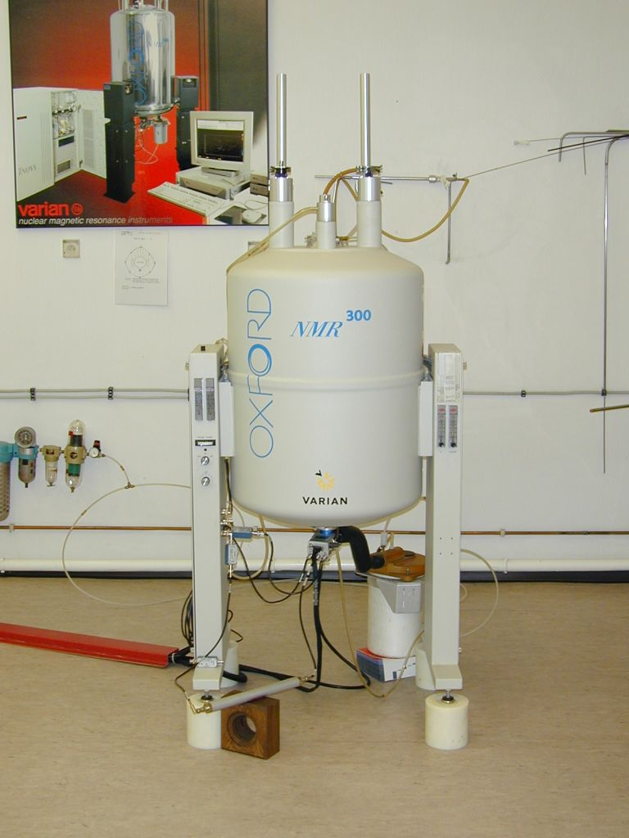
Example - NMR
Nuclear Magnetic Resonance (NMR) Spectroscopy

Slide 3
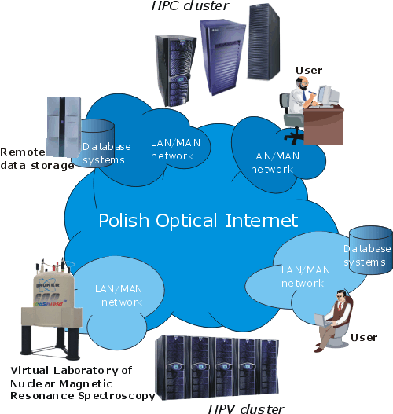
Virtual Laboratory (VLab) – R&D
Framework for virtual laboratories
Definition of dynamic measurement scenarios
All accessible remote facilities treated as simple resources
in the Grid infrastructure
Human factor and interactivity –
important issues to be taken into
account
Done in co-operation with Silicon Graphics, supported by the Polish Ministry of Science and Higher Education

Slide 4
VLab NMR use case
NMR experiment contains 3 main following stages:
a scientist prepares a sample and/or input data (e.g. parameters) which will be measured/ computed,
she/he uses laboratory devices to achieve data which is then processed by a specialized software,
Processing can include the visualization stage if it is needed to assess the results.

Slide 5
Use case (1)
Actors
  Primary
    Scientist
  Secondary
    NMR spectrometer operator
    Maintenance engineers / technicians

Slide 6
Use case (2)
Scope
  RII (instrument, network, computing, storage)
Stakeholders
  Scientist
  Equipment operator

Slide 7
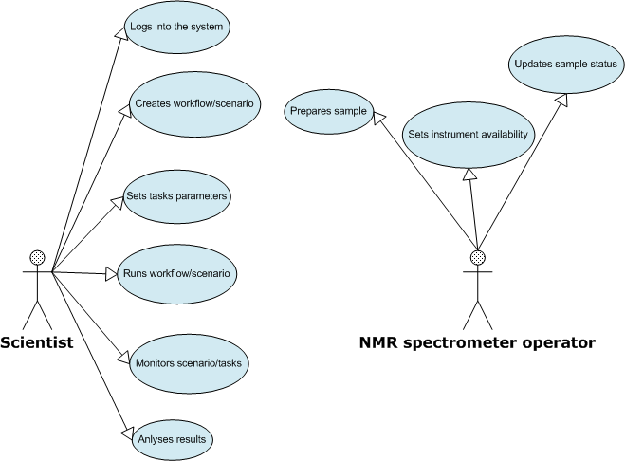
Use case diagram

Slide 8
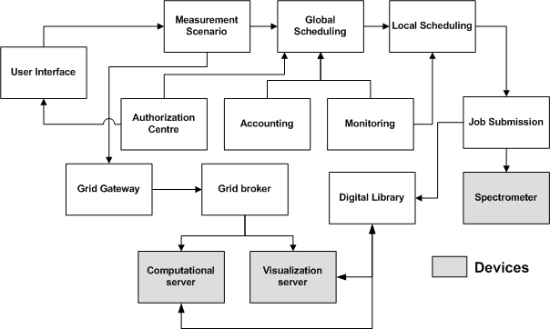
Module diagram

Slide 9
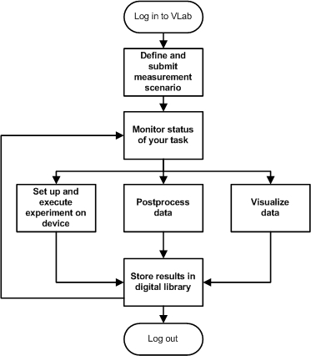
Float chart

Slide 10
Examples of functional requirements (1)
DISPLAYING THE DEVICE USER INTERFACE
ACTOR | End user
CONDITION | Device ready for experiment, task confirmed by device operator
INPUT | sample
OUTPUT | User interface to the device allowing the user to perform experiment from a remote location
SIDE EFFECT
INTERACTIVE POST PROCESSING OF ACQUIRED DATA
ACTOR | End user
CONDITION | User has read rights to the data files
INPUT | Visualization of input data, with all parameters necessary for performing data analysis and evaluation
OUTPUT | Graphical representation of data, modified according to parameters changes in real time
SIDE EFFECT

Slide 11
Examples of functional requirements (2)
SUBMITTING INTERACTIVE JOBS TO NMR SPECTROMETER
ACTOR | End user
CONDITION | Device is available for a given user, input data validated and within operational limits
INPUT | Experiment information: sample id (required for sample identification) sample form (solid, liquid etc.) sample formula sample properties (toxic, radioactive etc) additional sample information type of required NMR probe, required temperature range, nucleus type, pulse sequence experiment time (estimated) required start time device selection criteria (priorities, deadline, required precision) – if more than one device is available for experiment
OUTPUT | Information on when the task was scheduled, what (if any) device has been selected
SIDE EFFECT | Device queue updated with a new task, according to defined queue parameters and scheduling criteria

Slide 12
Examples - GUI

Slide 13
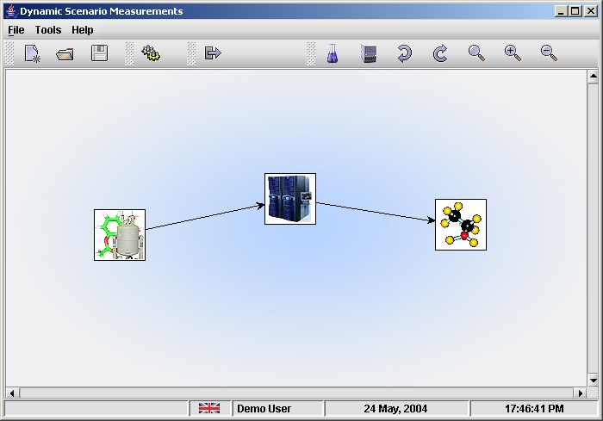
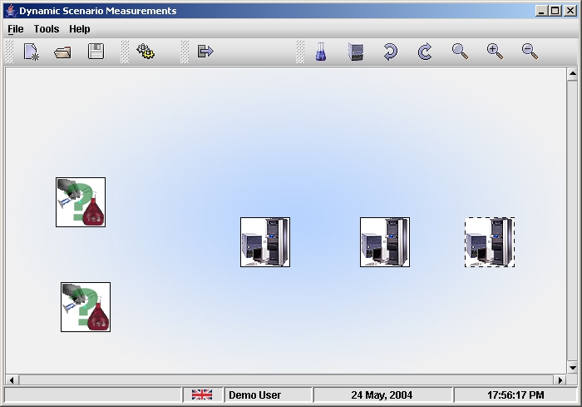
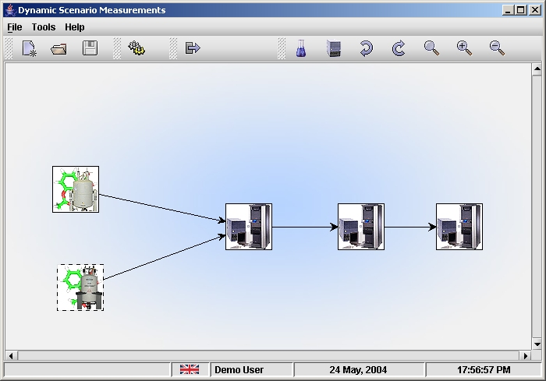
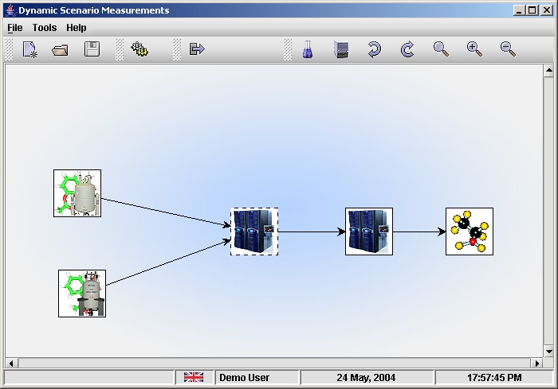
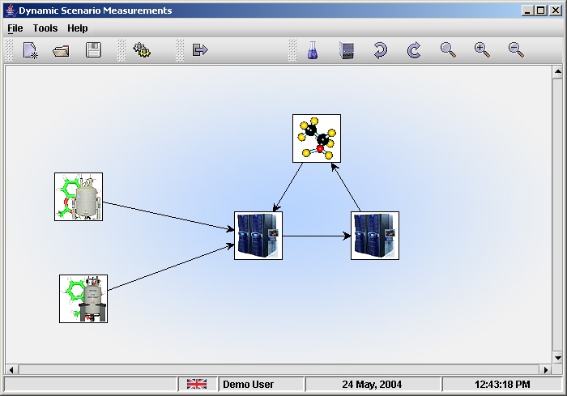

Slide 14
