Slide 1

Introducing EC-GIN:
Europe-China Grid InterNetworking
Europe-China Grid InterNetworking
European Sixth Framework STREP FP6-2006-IST-045256
Sven Hessler
Institute of Computer Science, NSG team
University of Innsbruck, Austria
sven.hessler@uibk.ac.at

Slide 2
What is EC-GIN about?
Original Internet technology
Enriched with customised
network mechanisms
Bringing the Grid to its full potential !
Today‘s Grid applications
EC-GIN
EC-GIN enabled
Grid applications
Applications with special
network properties and
requirements
Driving a racing car
on a public road
Traditional Internet applications
(web browser, ftp, ..)
Real-time multimedia applications (VoIP, video conference, ..)

Slide 3









Project facts
STREP in FP6 Call 6, total funding: € 2.2 M
Start date: 1 November 2006; duration: 3 years
Consortium: 11 partners
  7 European partners
    Universität Innsbruck, UIBK, Austria (coordinator)
    University of Zürich, UniZH, Switzerland
    Institut National de Recherche en Informatique et Automatique, INRIA, France
    Lancaster University, ULANC, U.K.
    Justinmind, JIM, Spain
    EXIS IT, Greece
    University of Surrey, UniS, U.K.
  4 Chinese partners
    Beijing University of Posts and Telecommunications, BUPT
    Institute of Software, Chinese Academy of Sciences, ISCAS
    China Telecommunication Technology Labs, CTTL
    China Mobile Group Design Institute Co., Ltd, CMDI

Slide 4
Objectives
“The EC-GIN project, based on a number of properties that make Grids unique from the network perspective, aims at developing a tailored network technology in dedicated support of Grid applications. These technical solutions will be supplemented with a secure and incentive-based Grid Services network traffic management system, which will balance the conflicting performance demand and the economic use of resources in the network and within the Grid.”
Enhancement of communication capabilities of Grid applications
Realistic long-distance demonstrator case
Economic Grid service / network traffic management
“Snowball effect” in European and Chinese research community

Slide 5
Research Challenges
  How to model Grid traffic?
    Much is known about web traffic (e.g. self-similarity) - but the Grid is different!
  How to simulate a Grid-network?
    Necessary for checking various environment conditions
    May require traffic model (above)
    Currently, Grid-Sim / Net-Sim are two separate worlds
    (different goals, assumptions, tools, people)
  How to specify network requirements?
    Explicit or implicit, guaranteed or “elastic“, various possible levels of granularity
  How to align network and Grid economics?
    Grid service model, charging model for grid services, and network model for such Grid services
    Network Mgmt mechanisms in support of those areas in an integrated fashion

Slide 6
Key technology advancements
  Faster Grid: network mechanisms based on Grid peculiarities
    Take special properties into account
      Example: Grid scheduler’s ability to specify future traffic occurrences
      (e.g., for sending a message which tells routers about future traffic)
    Satisfy special requirements
      Example: prediction of file transfer delay
  Economic Grid traffic management and security
    Securely balance conflicting demand of performance and economic use of resources
      Example: A4C enhancements and security, application of network management methods
    Incentive-driven use-based pricing
      Example: Grid services and pricing models for events/short-lived connections

Slide 7
Expected Results & Impact
Network level analysis of Grid applications
  Increased Grid knowledge in network community
ns-2 code for Grid network simulation
  Fostering EC-GIN related research
Grid-specific network enhancements
  Snowball effect in research community
Economic Grid traffic management and security mechanisms
  Reinforcing commercial use of Grids
Customised GINTONIC implementations
  Performance improvement of partner Grids

Slide 8
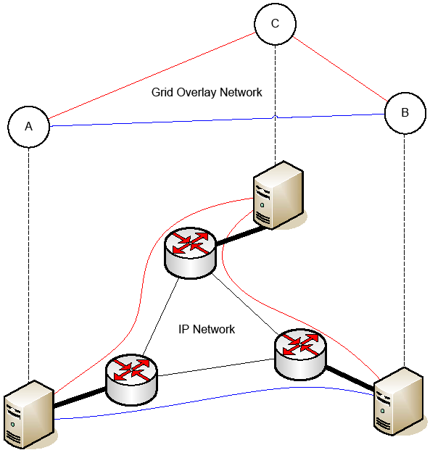
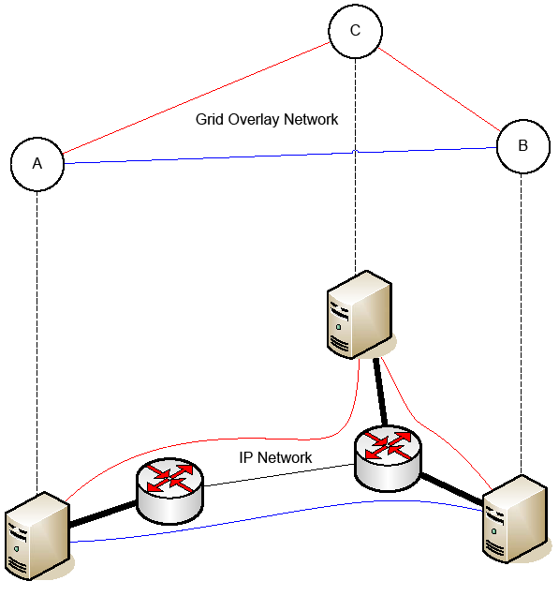
Example Scenario: Large File Transfer
Multipath file transfer
(A→B + A→C→B) beneficial
Multipath file transfer not beneficial
due to shared bottleneck
Also consider: B wants to send to A; obtains prediction; does not know that
C sends to A at the same time → prediction is wrong in right diagram

Slide 9
Large File Transfer Scenario: Questions
When does use of multiple paths make sense?
  To increase overall throughput
How could this functionality be exposed?
  As a transport service?
What constraints can be considered?
  To allow the delivery of a certain level of QoS
How could large file transfer be authenticated and authorized?
  By intermediate nodes?

Slide 10
Current activities
Defining architecture:
  Design API
    Key element for collaboration with XtreemOS
  Decide how to handle “peer awareness“
  (node discovery, topology mapping, ..)
    Necessary for tackling “large file transfer“ and “prediction“ scenarios
Questions raised for API:
  What are the network requirements of Grid apps?
  What is special about Grid network traffic?
Our approach: questionnaire
  Your help is required!

Slide 11
Current activities /2
GridNets conference, 17-19 October 2007, Lyon
http://www.gridnets.org
  Goals
    Bring the networking and Grid communities together
    Show that there is more to Grid-Networking than optical signaling
    Convince others to join EC-GIN in its effort
  Successful workshops (together with BroadNets) 2004-2006
    Now for the first time stand-alone conference
    IEEE + ACM sponsorship, ACM proceedings
    2 Satellite workshops (MetroGrid, Utility Computing)
  EC-GIN members involved in several org. roles
    So we need YOU to submit papers!

Slide 12

Thanks for your attention!
More information: http://www.ec-gin.eu

