Slide 1
ESnet’s Use of OpenFlow To Facilitate Science Data Mobility
Chin Guok
Inder Monga, and Eric Pouyoul
OGF 36 OpenFlow Workshop
Chicago, Il
Oct 8, 2012

Slide 2

Disclaimer

Slide 3
Pros and Cons of OpenFlow in the WAN
Separation of Control and Data Plane
Reduces costs | Requires infrastructure support for control plane
Simplifies operations | Control / data plane failure scenarios must be investigated for resiliency
Direct Access to Forwarding Table
Provides high degree of flexibility and customization | Access control to modify forwarding table is critical, concurrent access may require locks
Facilitates programmability of the network (e.g. Software Defined Networking*), and formalizes the notion of a Network OS | Reliant on third-party applications for routing functions (e.g. BGP, IGP, route / packet filtering, etc)
*NB: SDN concept has been deployed in R&E networks via dynamic circuit provisioning (e.g. IDC, NSI)

Slide 4
OpenFlow in the WAN
Augmenting edge services*
Facilitates moving of flows from one service (e.g. best-effort routed) to another (e.g. bandwidth guaranteed switched)
Leveraged for monitoring / security functions
IDS (e.g. black-holing DoS traffic)
CALEA compliance (e.g. mirroring traffic)
Service virtualization
Hides under-lying topology and exposes an Openflow interface for user manipulation of substrate
Facilitates recursive partitioning of substrates
Potential to dynamically support high layer constructs (e.g. anycast/manycast/multicast)

Slide 5
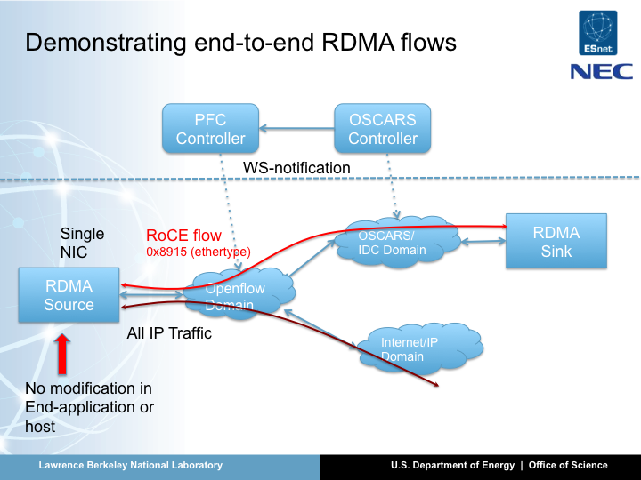
Journey with OpenFlow/SDN Joint Techs Summer 2011, Fairbanks, Alaska
Key Features
Flexible selection of service paths
Programmatic traffic engineering
High granularity of flow separation

Slide 6
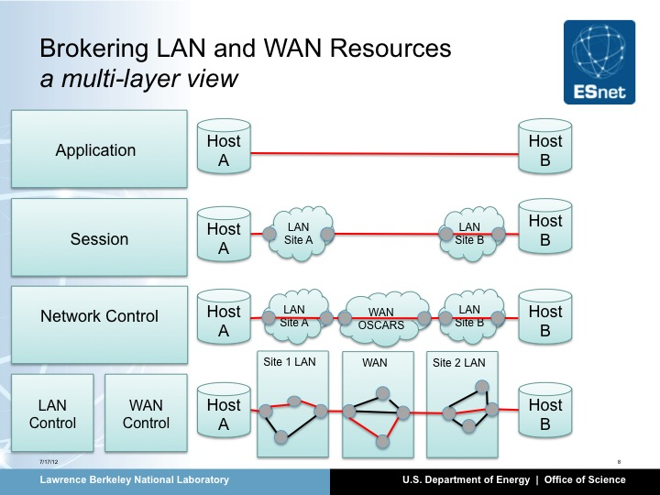
Journey with OpenFlow/SDN Inaugural Open Network Summit, 2011, Stanford and SuperComputing 2011, Seattle
Key Features
ECSEL*: Network Control End-site to End-site IDC
Leveraging OpenFlow’s topology capabilities to dynamically learn of new connections
Coordination and orchestration of end-to-end connections at various layers
*NB: ECSEL is a modified version of OSCARS supporting end site to end site negotiation of WAN resources, and on the fly LAN provisioning using OpenFlow

Slide 7
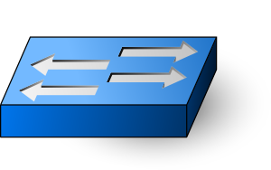
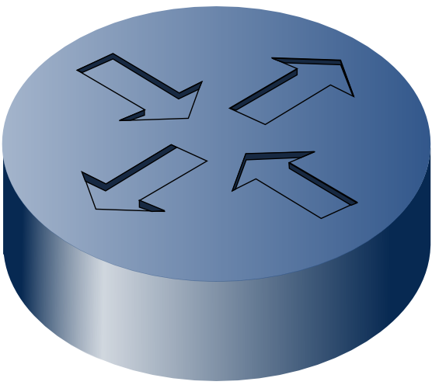
OneSwitch*: Abstracting the topology. Giving control to the application
Key Features
Virtualizes a WAN substrate/slice as a single switch
Allows for recursive abstraction of slices
Exposes programmatic OpenFlow interface to user
Target as SC12 demonstration
Virtual OpenFlow Switch
Application
Controller
*NB: This effort is funded as a DOE ASCR research project
Notes:
***Explain – One Switch and how it hides the physical topology
Virtual Switch makes it possible to view the entire ESnet as a single switch , with each of the
edge Openflow switches being represented as switch ports. With this abstraction ,
the application controller just has to send flow mod to Virtual Switch telling it to forward the
packet from one switch port to another. Simple , is nt it !!!

Slide 8
Implementing the ScienceDMZ Design Pattern
Simple application of OF
OF Switch: fine grained mapping of science flows to guaranteed bandwidth circuits
Dynamic
Application/Policy driven
Automated VLAN translation
OF Controller: manage WAN resources (virtual circuits, bandwidth etc.)
Site administrative resource allocation
Site-WAN, Site-Site policies enforced
WAN
OSCARS
virtual circuits
(L2 VLANs)
Border Router
OF Switch
OF
Controller
DTNs

Slide 9
Additional Thoughts
With the distinct separation of control and data plan functions, resiliency is a vital consideration when deploying OpenFlow in the WAN
Google leverages the distributed computing model and pre-computes failure scenarios to recover from failures
Having control plane functions done out-of-skin by 3rd party software (i.e. different from network device vendor), requires appropriate support models to be in place
Google develops and supports (in-house) the OpenFlow deployment in it’s internal WAN backbone
OpenFlow formalizes the concept of the Network OS by defining network device primitives (i.e south-bound interface to devices), the Network OS north-bound is yet to be determined and must be carefully considered
There are several potential candidates for the north-bound interface, e.g. OGF NSI, NOX programmatic interface, OpenStack Quantum, etc

Slide 10

Questions?

