Slide 1
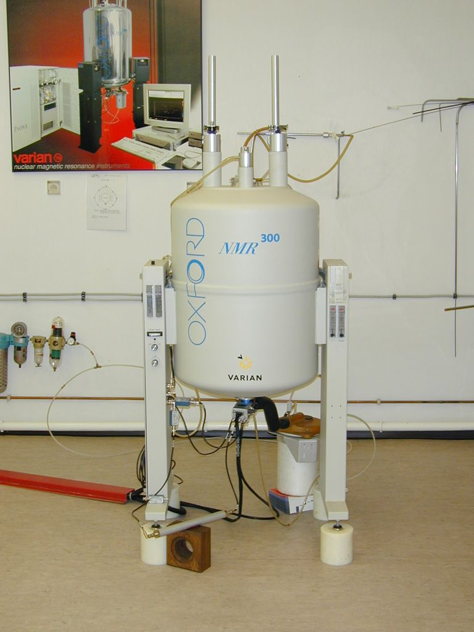
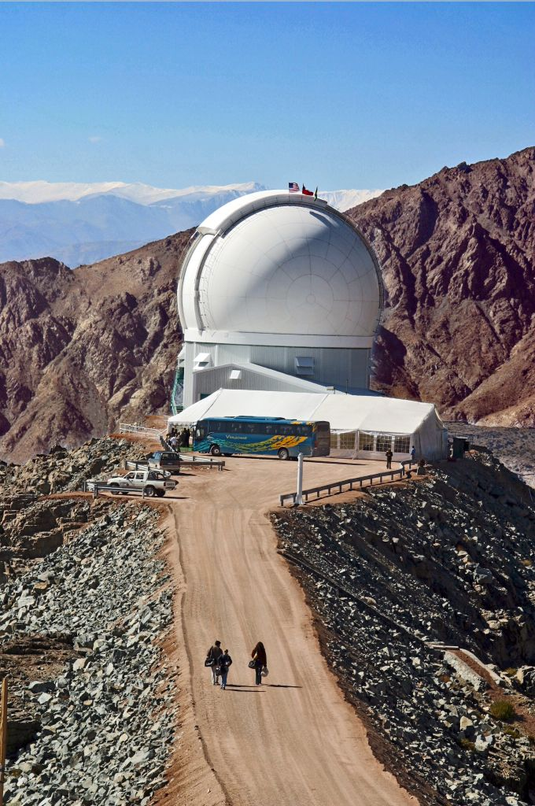
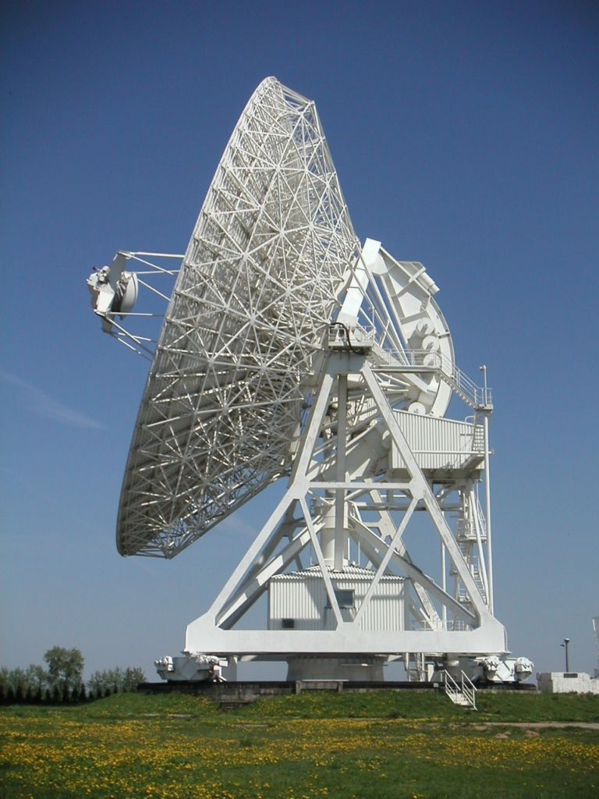

Remote Instrumentation in Grid Environment
Introduction
Marcin Płóciennik
marcinp@man.poznan.pl
OGF21, Seattle, 15-19.10. 2007

Slide 2
Session schedule
Current state & plans
Presentations
  Ocean Observing System Instrument Network Infrastructure, Observatory Middleware Framework (OMF), and Ocean Observing Initiative Network for Ocean Research, Interaction and Application (NORIA) projects – Duane Edgington
  Service Oriented Architectures for Remote Instrumentation – Michael Sutter
  RINGrid: Evaluation of Remote Instrumentation Infrastructures -
  Thomas Prokosch
  Grid enabled Remote Instrumentation with Distributed Control and Computation - Roberto Pugliese
Disscussion
(related Monday presentation: Real-time Web 2.0: Evolution of Middleware for Grid based Instruments and Sensors, by Donald F. (Rick) McMullen from Pervasive Technology Labs at Indiana University)

Slide 3
Research Group main goal
The main purpose of this research group is to bring together various existing approaches in defining remote access interfaces to sophisticated laboratory equipment, as well as to come up with use cases that can dictate the requirements for integrating scientific instruments with the Grid.

Slide 4
Group history
Very successful BoF in Manchester
  Initial projects involved in BoF:
    RINGrid, int.eu.grid, GRIDCC, g-Eclipse, DEGREE, Edutain@Grid, BalticGrid, VLab
  46 participants
Creation, of mailing list, engaging next projects, work on charter
Group has been accepted at the end of September 07

Slide 5
Currently involved representatives
GRIDCC (http://www.gridcc.org),
RinGRID (http://www.ringrid.eu),
int.eu.grid (http://www.interactive-grid.eu),
g-Eclipse(http://www.geclipse.org),
BalticGrid (http://www.balticgrid.eu),
AstroGrid-D(http://www.gac-grid.de),
DEGREE (http://www.eu-degree.eu),
Edutain@Grid (http://www.edutaingrid.eu),
VLab(http://vlab.psnc.pl),
MMRA -Minnesota Microprobe Remote Access (http://probelab.geo.umn.edu/remote.html),
AUGERACCESS(http://www.augeraccess.net),
ARCHER (http://archer.edu.au), Looking (http://lookingtosea.ucsd.edu),
CYCLOPS(http://www.cyclops-project.eu/Default.aspx?id_menu=7) ,
NICTA Open SensorWeb Architecture(http://nicta.com.au/research/projects/nicta_open_sensorweb_architecture),
SENSOR(http://www.mbari.org/rd/projects/2007/observatories/900026_sensors_07.html), Cyberinfrastructure for Ocean Observatories in the US (the NSF ORION OOI Cyberinfrastructure)
CIMA

Slide 6
Current state - technical issues
Mailing list: risge@lists.man.poznan.pl
  Over 60 members
  We have to change the address of list to: risge-rg@ogf.org !!!
    Will be done automatically
  Address:
GridForge project webspace
  12 members currently
  Please register & use it
  Short abstract/links/contacts for each project/research should be provided on wiki
  Address: http://forge.ogf.org/sf/projects/risge-rg
Logo & templates??

Slide 7
Plans - open points
Following the charter:
  bring together people involved in the field of remote instrumentation to document experiences,
    We should involve more researchers/projects from US, Asia
  identify best practices
    Collect use cases, requirements
  develop informational documents which can be fed to the Working Groups researching the area of digital contracts (Service Level Agreements) and guarantees on the Grid
  Make workshop??
  Long term - Create working group??

Slide 8
Next meetings
OGF22 – plans?
  Proposition – discuss on collected use-cases, their classification
INGRID conference???
OGF23 - ??
OGF24 - ??

Slide 9
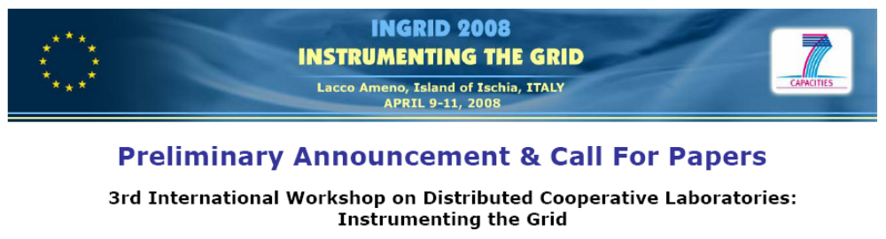
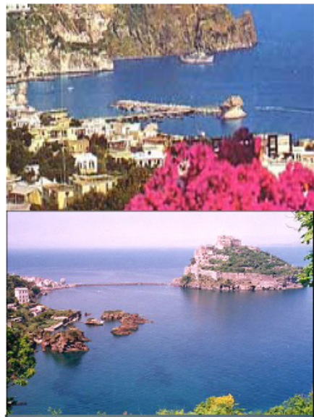
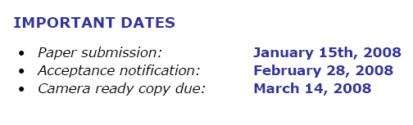
Invitation - INGRID 2008

