Slide 1

RISGE Use Cases
Remote Operations and Online Processing
Author: Roberto Pugliese (Sincrotrone Trieste S.C.p.A.)
Mail: roberto.pugliese@elettra.trieste.it

Slide 2

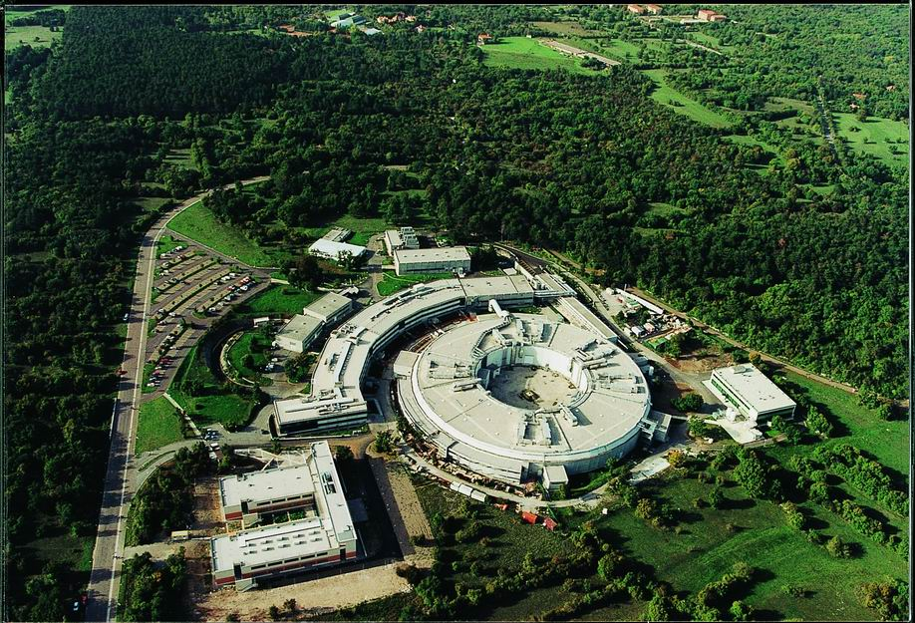
What is ELETTRA?

Slide 3
Online Processing in Experimental Science
Summary
  Experimental stations in facilities like Synchrotrons and Free Electron Lasers produce huge quantities of data. These data need to be analyzed on-line, which requires considerable computing power and often teamwork.
Customers
  The potential customers are the beamline scientist and experimental scientist working at these research laboratories, the users of the laboratory beamlines, remote collaborators.

Slide 4
Online processing application
Define workflows
Collective behavior
Controls beamline
instrumentation
Deploys software
Controls detector
developer
scientist
collaborate
Defines data
Collection strategy
Performs off-line
processing
Start/stop
Data collection
Runs workflows,
scripts
Monitors on-line
processing
Monitors workflows,
scripts
Access and visualizes
data
user
user

Slide 5
SAXS
VCR
Workflow description
User defines the data collection
strategy and starts the online
processing
At each acquisition the image is
stored
The fit2d application is executed
on the acquired image
The result is stored back on the
storage element
The user visualizes the acquired
and the processed image
1
5
IE
SE
4
CE
2
3

Slide 6
SYRMEP
Workflow description
The user controls the beamline
and the detector and defines the
data collection strategy
Each image is stored
The interactive tomographic
application is started
When the user request a slice
the back-propagation is performed
and result stored
The user controls the application
The user visualizes the results
Off line processing involves
only storage and computing
Tomographic 3D and stereo
visualisation involves again
storage and computing elements
VCR
5
1
6
IE
IE
SE
4
CE
SE
CE
2
3

Slide 7
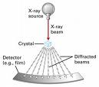

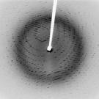

XRD

Slide 8
XRD
Workflow description (strategy)
User controls the instrumentation
defines the data collection
strategy and starts the online
processing
At each acquisition the image is
stored (3 images)
The mosflm index application
is executed on the acquired
images
The results are compared and
in case mosflm strategy is run
The result is the perfect strategy
which can be set on the instrument
VCR
5
1
IE
IE
4
SE
CE
SE
CE
2
3

Slide 9
XRD (cont.)
Workflow description (online)
User controls starts the online
processing
At each acquisition the image is
stored (180 images)
The mosflm index application
is executed on the acquired
images
Then scala is applied to the results
Starting from the hkl produced and
from a pdb hypothesis phaser is
executed producing a map
Coot is used to visualize the map
VCR
1
6
IE
IE
4
SE
5
CE
SE
CE
2
3

Slide 10
XRD (cont.)
Workflow description (offline)
User defines a sequence
Sequence is matched against
SWISSPROT
hkl and sequences are matched
against PDB
The result is passed to phaser
Ccp4 refmac is applied
Results are stored
Coot is used to visualize the map
VCR
7
1
DE1
DE2
4
5
3
SE
CE
SE
CE
2
6

Slide 11
Online Processing in Experimental Science
Functional requirements
  The described workflows should be fully supported
Non-functional requirements
  An appropriate AAA-mechanism is required
  Adequate quality of service and performance on the whole pipeline from instrument control, to data acquisition, transfer to storage resources, fast computation and data transfer back to storage and visualization to the end user.
  Interactivity is also required both at when interacting with instruments and during job execution and finally when visualizing the results.
Related work, Experience in the field, Use case situation analysis, References
  See www.gridcc.org now www.dorii.eu

Slide 12
Remote Operations of Experimental Facilities
Summary
  Operators of the experimental setup and remote experts through a Virtual Control Room collaboratively operate the experimental setup both in a routine and in a troubleshooting scenario
Customers
  The potential customers are operators of the experimental facility and the remote experts, which are scientist (e.g. machine physicists for an accelerator) and experimental scientist working at these research laboratories.

Slide 13
Remote Operations
Define workflows
Collective behavior
Controls equipment
instrumentation
Deploys software
Monitor equipment
instrumentation
developer
collaborate
Defines operations
parameters
developer
Define parameters of
Simulations
Start/stop
Operations
Workflows
Run simulation
workflows,scripts
Monitors
Operations
Workflows
Access and visualize
simulation data
Access and visualizes
Historical data
scientist
operator

Slide 14
Remote Operations
Workflow description (network)
User controls actuators
Gyroscopes acquire data which is
stored
User starts simulation
The simulated data is stored
Acquired and simulated data
is compared
Results and stored data is
visualized by the end users
VCR
1
6
IE
IE
4
SE
CE
2
CE
5
3

Slide 15

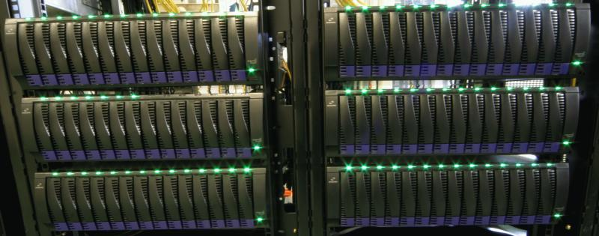
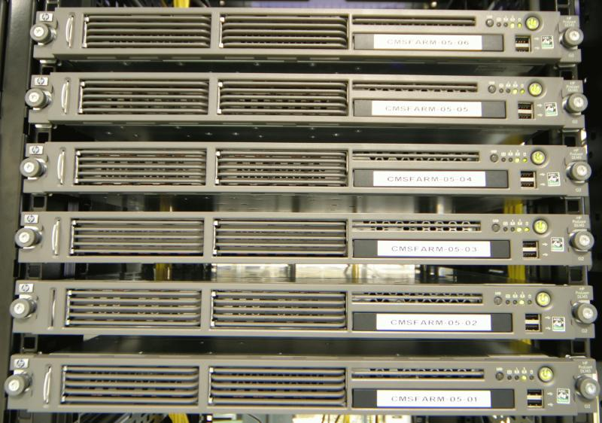
Remote Operations
IM
Accelerator
I E
IM
Position
Monitors
IM
Correctors
Remote Experts
GridCC
SE
CE
Operator

Slide 16
Remote Operations
VCR
ELETTRA IE
Positions
Accelerator
Correctors
SE
SE
CE

Slide 17
Remote Operations of Experimental Facilities
Functional requirements
  The described workflows should be fully supported
Non-functional requirements
  An appropriate AAA-mechanism is required.
  Remote operations requires adequate quality of service and performance on the whole pipeline from instrument control, to data acquisition, transfer to storage resources, fast computation and data transfer back to storage and instruments.
  The feedback via Grid to perform orbit correction is a typical example where real time response is needed.
  Interactivity is also required when interacting with instruments.
Related work, Experience in the field, Use case situation analysis, References
  See www.gridcc.org now www.dorii.eu

Slide 18
LEGO robot exploration demo
Define workflows
Collective behavior
Controls robots
Deploys software
Acquire robot data
(camera, …)
developer
scientist
collaborate
Defines exploration
strategy
Performs off-line
Processing of acquired
exploration data
Start/stop
exploration
Monitors
exploration
Runs workflows,
scripts
Monitors workflows,
scripts
Access and visualizes
Exploration data
user
user

Slide 19
LEGO robot exploration demo
Workflow description
The user controls the robots and
starts the exploration
Each acquired data is stored
and streamed to the VCR
The exploration data processing
occurs
The processed data is stored
and streamed to the VCE
The user visualizes the
processed data results
VCR
2
1
6
IE
IE
SE
4
CE
SE
CE
2
3

