Slide 1
GÉANT BoD Service Roadmap
Tangui Coulouarn, DeIC
OGF NSI WG meeting, 15 January 2013
Oxford

Slide 2
Agenda
Service components and objectives
Some of our commitments & KPIs
Footprint and usage of the BoD service
AAI and monitoring: areas of interest for the NSI WG?
Not in scope:
Details of our NSI implementation except timeline ( see Radek’s presentation)

Slide 3
BoD as a Service
Possibility to create P2P L2 circuits with guaranteed bandwidth dynamically
User-controlled through web-GUI or own application
Multi-domain
Components:
Software (mostly AutoBAHN & cNIS)
Support, troubleshooting, trouble-shooting
Monitoring
AAI
User outreach and PR
Cost-sharing model, AUP

Slide 4
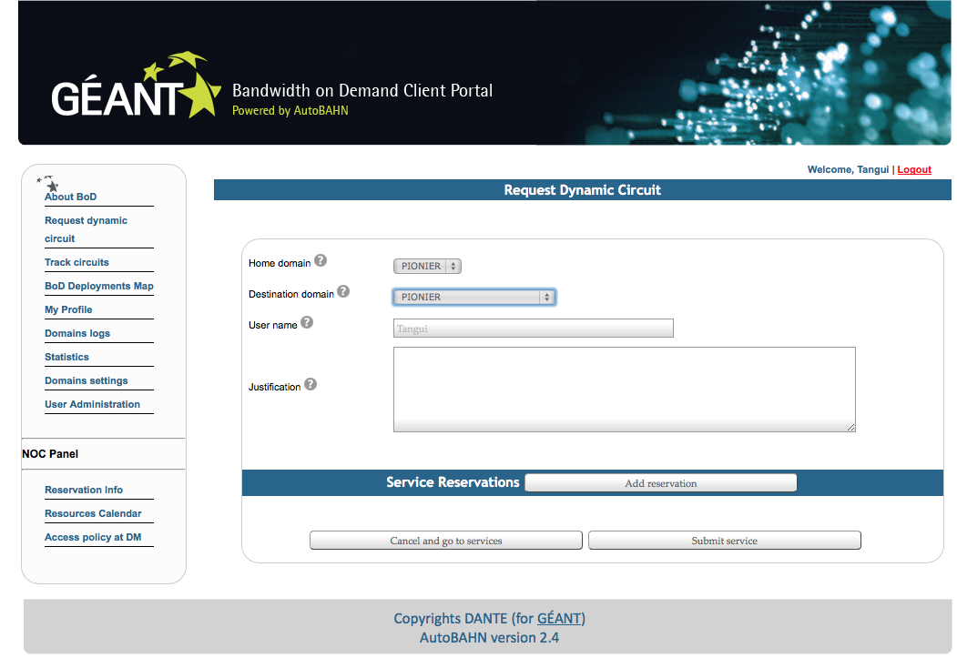
BoD in GN3+
BoD in production since GN3
Collectively defined by participating
providers
Several goals, milestones and KPIs
for this service defined with the EC
Usage:
Number of users
Number of circuits
Footprint:
Number of NRENs
Number of end-points
Monitoring
NSI CS implementation
Etc.

Slide 5
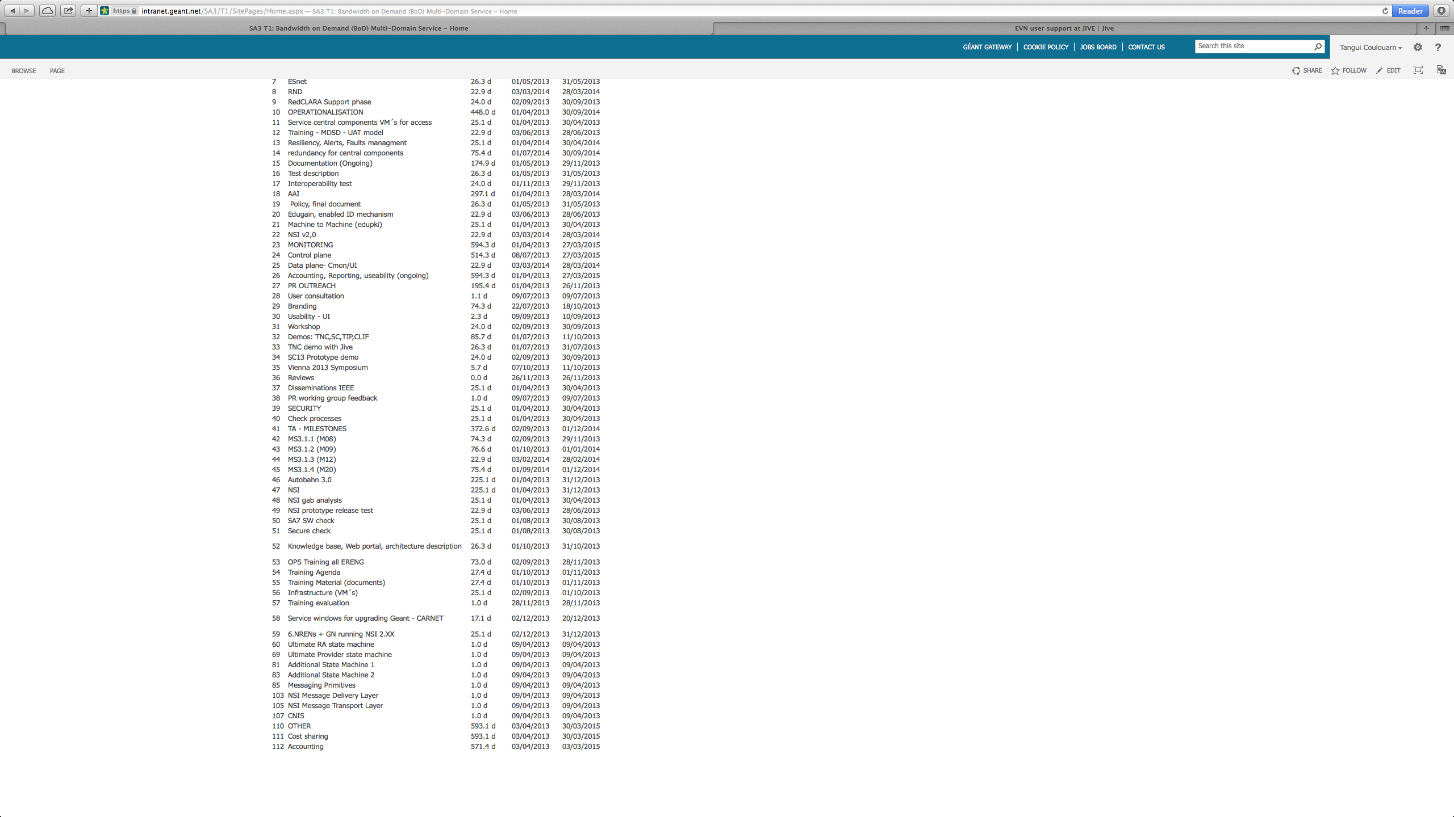
Work-plan on the service largely pre-constrained

Slide 6
(Revised) timeline for NSI implementation
Alpha release: End of January
Based on NSI v2 final revision (r116)
Internal and interoperability testing
Beta release: Middle of February
Testing by NRENs
Production release: Middle of March
Frequent updates will be difficult by then due to the NRENs installed base
Further upgrades should mostly be backwards interoperable

Slide 7
Test procedure
Unit and integration testing
Internal validation/system testing
Interoperability testing
Plans for testing with OpenNSA following alpha release

Slide 8
Risks / Pending issues
Later wsdl revisions will cause delay even if changes are small
Topology definition and exchange not standardized
STP semantics as detailed in Radek’s presentation

Slide 9

Footprint
GÉANT, GRNet, Pionier, HEAnet, JANET,
NORDUnet, DeIC, CARnet, SURFnet
- committed since GN3
- different stages (testbeds, production)
FUNET since August 2013; DFN currently
Testing
ESNet/Internet2 (IDCP)
Since August 2013
But down for a number of weeks
Circuits for users in NRENs with BoD:
iMinds in Belnet
eMusic project involving GARR and
CESNET
Notes:
NSI opens perspective

Slide 10
Use of BoD 1. The known users (esp. Here)
LHCONE/CERN.
Pilot
Concretely, big overlap with this group as well as GLIF, etc. known here
Radio-astronomy (NEXPReS, JIVE, etc.)
Network experts: Bonfire, Mantychore, XIFI, FIRE, Fed4Fire…
Notes:
end-points in Europe (Bristol, Edinburgh, i2Cat, Greece), and in the US: GENI and in Australia. Possibility to use static link to Australia.

Slide 11
Use of BoD 2. Emerging users
Bioinformatics (ELIXIR).
High energy physics: e.g. Denmark with SLAC, IPP, ILL.
Recent meetings with small groups are encouraging
Attempts outside “hard” science: eMusic

Slide 12
Use of BoD 3. Challenges
Last mile
Asymmetry of the interest and capacity between end-points
Lead time

Slide 13
Monitoring: an area for OGF collaboration?
Control plane:
Several solutions using Nagios / Icinga
Slow to deploy in the different NRENs
Data plane: circuit usage
cMON D with different scenarios:
SNMP traps sent to local agent
SNMP traps sent to central agent
SNMP polls
Pilot with GÉANT, HEAnet and GRnet running before end of Q1 2014
Production by end of Q2 2014
Integration with PerfSONAR UI
Notes:
4 methods with Nagios: ping checks, SOAP, NSCA, NRPE

Slide 14
AAI: collaboration within the OGF?
First approach consisted in defining policy and then deployment
It seems that the way to be followed is going to be implementation first on minimal policies

Slide 15
Thank you!

