Slide 1
SAGA- C++ Reference Implementation
  Hartmut Kaiser
  hkaiser@cct.lsu.edu, CCT, LSU Baton Rouge
  Thilo Kielmann, Andre Merzky
  kielmann@cs.vu.nl, andre@merzky.net, VU Amsterdam

Slide 2
Overall Architecture
Application
SAGA API
Bound at link time
Packages (Proxies)
SAGA Engine
File/Dir
Stream
SAGA CPI
Bound at runtime
Adaptors
File/Dir
Stream

Slide 3
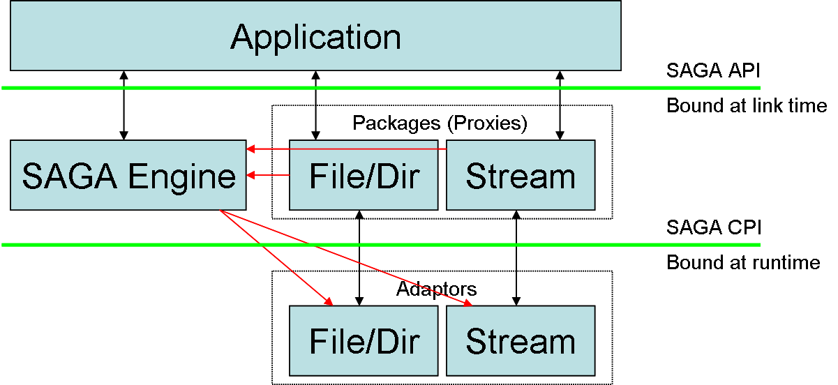
Overall Architecture
Application binds to SAGA engine and packages at link time
Adaptors are loaded at runtime by the engine
Adaptors get selected based on CPI group and preferences
Packages get connected to adaptors on call by call basis

Slide 4
Overall Architecture
Modular structure
  SAGA engine is usable with different API implementations
    Plan: implement SAGA V1 packages and GAT compatibility layer
  Applications can load different package sets on demand
  Extensible: user specific packages are possible

Slide 5
Asynchronous API
SAGA API is asynchronous by design
  We decided to implement every API function in 3 different ways:
    Synchronous
    Asynchronous
    Task based (same as asynchronous, but not started)
  But on CPI level we expose only 2:
    Synchronous
    Task based

Slide 6
Asynchronous API
Packages
  Implement the corresponding binding
  Emulate missing CPI functions
    Adaptor may implement only one, synchronous or asynchronous CPI functions
    Adaptor may implement asynchronous function solely based on his own synchronous implementation by letting the engine to wrap it in a task
  Run task if asynchronous operation is required

Slide 7
Asynchronous API
API directory::get_url()
  string s = get_url();
    Returns result directly
  task t = get_url<saga::Sync>(s);
    Returns finished task
    Returns result indirectly
  task t = get_url<saga::Async>(s);
    Returns running task
    Returns result indirectly
  task t = get_url<saga::Task>(s);
    Returns pending task
    Returns result indirectly

