Slide 1
ws-VLAM Workflow Management System a Re-factoring of VLAM
  Dmitry Vasyunin
  Adianto Wibisono
  Adam Belloum

Slide 2
Outline
VLAM Redesign and Refactoring
New Workflow Engine
New Workflow Composer
Additional Tools
New Modules/Components

Slide 3
A few Acronyms …
Grid middleware Acronyms
  GT4:Golbus Toolkit 4 (www.globus.org)
  GRAM: Globus Resource Allocation Manager
  GSI: Grid Security Infrastructure
Web service Acronyms
  WSRF: Web service Reference Framework (http://www.globus.org/wsrf/)
  WS: Web service
  WSDL: Web service Description Language
  SOAP: Simple Object Access Protocol
VL-e (http://www.vl-e.nl) Acronyms
  VLAM: Virtual Laboratory Amsterdam
  RTSM: Run Time System Manager
  PoC: Proof of concept environment (http://poc.vl-e.nl/)
  SPX.Y: VL-e reseach Sub-program
Other Acronyms
  VNC: Virtual Network Computing (http://www.realvnc.com/what.html)
  R: Statistical programming Framework (http://www.r-project.org/)

Slide 4
VLAM Redesign and Re-factoring: ws-VLAM
Goals
  Create a WMS which adopt a Service Oriented Paradigm
  And Complies with PoC requirements
Approach
  Redesign Workflow Engine (RTSM)
    Designed as a service based engine, use WSRF/GT4
    Refactoring: separate RTSM from the workflow composer (GUI)
  Redesign Workflow Composer (GUI)
    Thin client,
    Refactoring: separated from database and RTSM engine
  Simple repository for VLE Modules
    Substituting the previous database access
    Implemented also as GT4 services.

Slide 5
ws-VLAM Engine characteristics
Implemented as GT4 based/WSRF service
Uses GT4 standard delegation service for security
Uses GSI enabled, private VNC for Graphical modules
Provides notifications for monitoring the execution

Slide 6
ws-VLAM Engine: architecture
Service host(s) and compute element(s)
GT4 Java Container
Job functions
GRAM
services
RTSM
Factory
pre-ws-GRAM
Client
RTSM
Instance
Worker
nodes
Delegate
Delegation
service
Workflow
components

Slide 7
Sequence-diagram
WS-vlam
Client
GT4 Delegation
Service
RTSM Factory
GT4
GRAM
RTSM
Instance
1. Create: delegation credential
Get the delegation credential EPR
2. Submit workflow execution plan
3. Create: RTSM instance
Get the RTSM instance EPR
4. Create: RTSM instance
5. subscribe: to notification events
Get the notification events

Slide 8
Workflow components with graphical output
Border node
GSI enabled
connection
Proxy
Port forwarding
Client
Worker node
vnc server
Workflow
Components
With graphical output
Note: The connection to the workflow components from a remote client
can cause some problem, because of the restriction of the VL-e PoC. We
assume at least that the Globus port range will be available.
Otherwise another solution has to be found for the PoC. This feature
can be turned off, the PoC release R2 if no proper solution is found.

Slide 9
Step1: Create Delegated Credential
PoC at Sara
RTSM
Factory.
VLAM
Client
Create delegated credential resource
Credential EPR returned
EPR
GRAM
proxy
Delegation
Initialize user proxy cert.
Credential
RP
GT4 Service Container
Worker nodes
EPR: End Point Reference

Slide 10
Step2: instantiates the workflow components and Create a RTSM instance
PoC at Sara
Contact GRAM to instantiates the workflow components
RTSM
Factory.
VLAM
Client
EPR
GRAM instantiates the workflow components
Request the creation RTSM instance
Pass delegated credential EPR
GRAM
RTSM
Instance
RTSM instance EPR returned
Delegation
Access delegated credential resource
Credential
RP
GT4 Service Container
Worker nodes
Workflow
components
Workflow
components

Slide 11
Step3: monitors the application workflow
PoC at Sara
RTSM instance subscribes for notification events from GRAM and Workflow components
RTSM
Factory.
VLAM
Client
Notification
events
GRAM
RTSM
Instance
GRAM and Workflow components generate events
Delegation
Credential
RP
Contact RTSM instance and subscribe for notification events
Worker nodes
GT4 Service Container
Workflow
components
Workflow
components

Slide 12
New Workflow Composer
Allows the graphical composition of the application workflow
  Generates the XML description of the workflow
  submits the description of the workflow using SOAP protocol to the workflow engine
Retrieves the description of workflow components from Repository Services
Allows attach and detach to/from workflow engine in the case of long running workflows
Monitors the workflow execution using WSRF-notifications
Supports hierarchical data typing.
Supports hierarchical workflow composition (creates composite workflow components).
Based on JGraph library http://www.jgraph.org

Slide 13
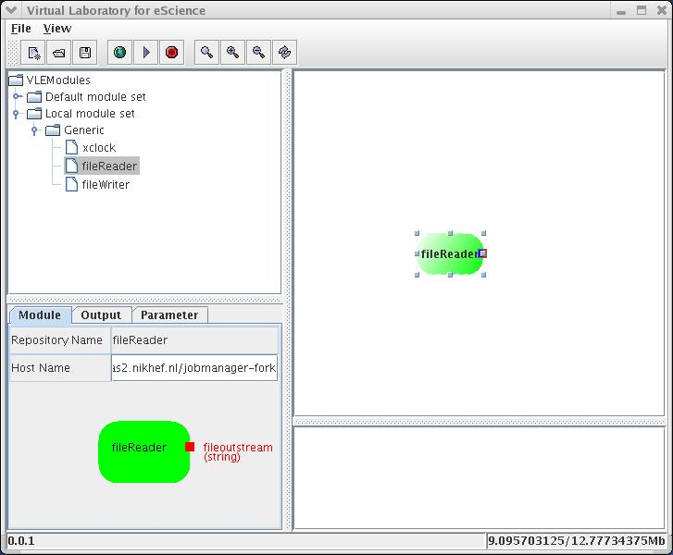
New VLAM GUI
Workflow
Components palette
Composition panel
Monitoring consol
Property panel

Slide 14
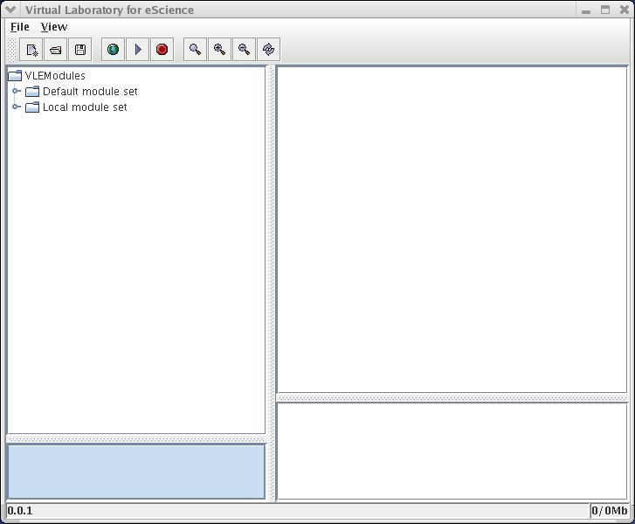
GUI features: The menu bar
Menu bar items (from left to right)
  Create new GUI
  Load saved workflow descriptions
  Save workflows
    Running workflow will be saved with the associated End Point Reference (EPR).
  Stop:
    Terminates the execution of a running workflow
  Zoom in/out
  Layout

Slide 15
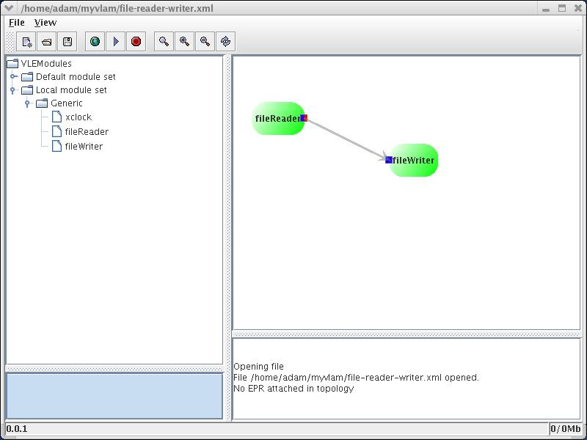
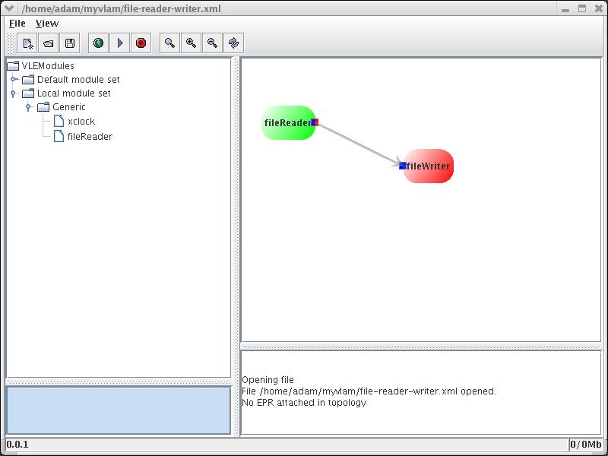
GUI features: detects missing components
When opening an application workflow the GUI checks if components are still available (local or in the shared repository
If a component is missing the GUI displays it in red
  the workflow cannot be executed

Slide 16
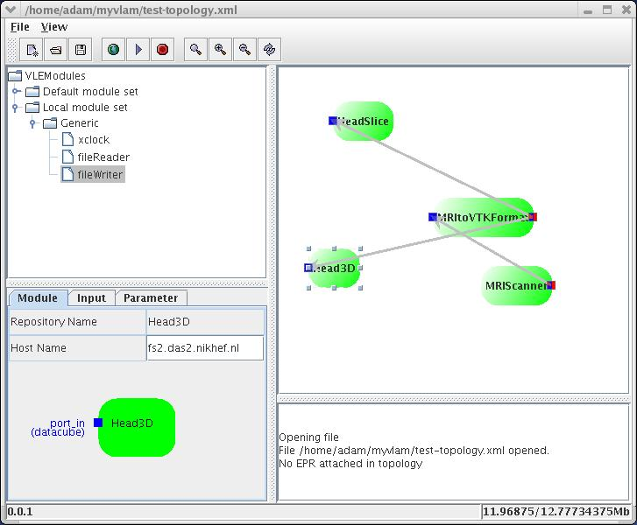
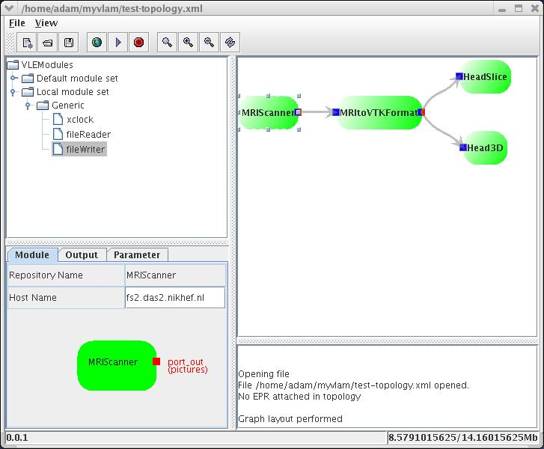
GUI features: Layout support
For complex workflows there a layout support which helps the end-users reorganizing his workflow components by a click on the layout button
The user can create modify the connections layout by creating intermediate graphical points (press Shift+left mouse button)

Slide 17
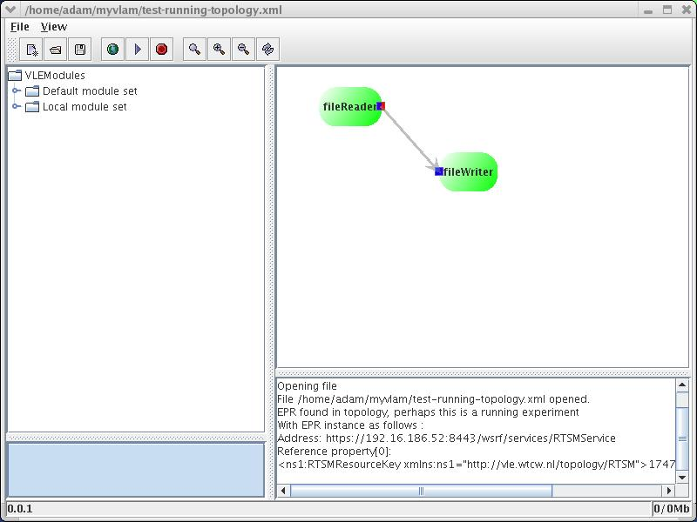
GUI features: attach and detach
For long running workflows, users can detach (close) the ws-VLAM client
Note:
  Before closing the ws-VLAM GUI the user has to save the running workflows
Later on the user can attach to the running workflows by just loading the saved workflow
Note:
  After loading the running workflow you can stop it (use the stop button in the main menu bar) and restart a new execution

Slide 18
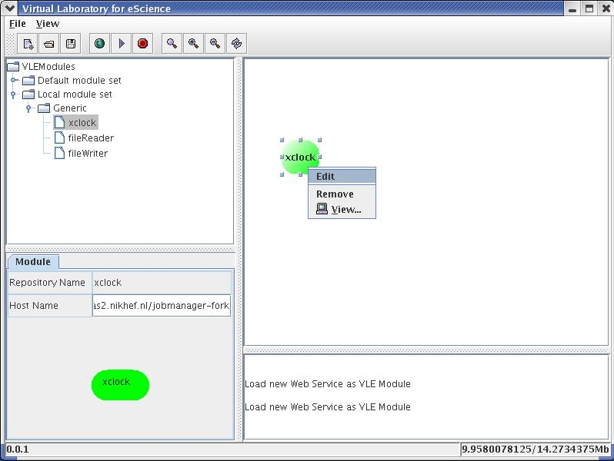
GUI features: attach to graphical output of a workflow component
To attach to the graphical output of a running workflow component:
  Select the workflow component, click on right mouse button, and select the View… menu item

Slide 19
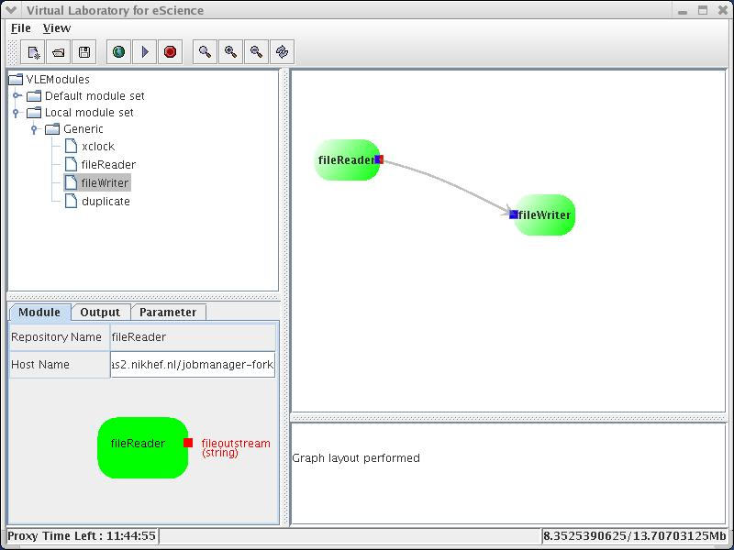
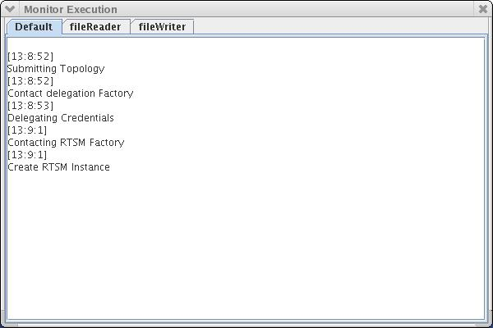
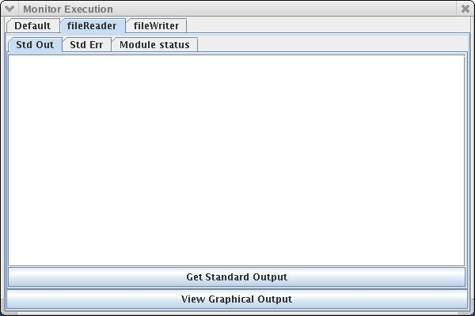
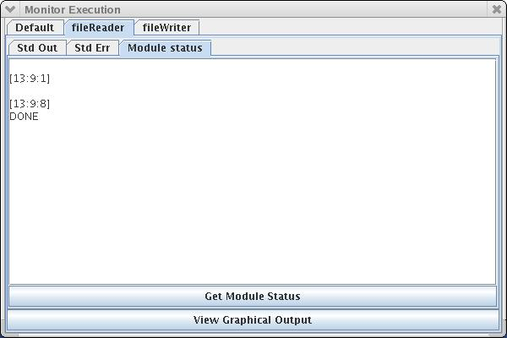
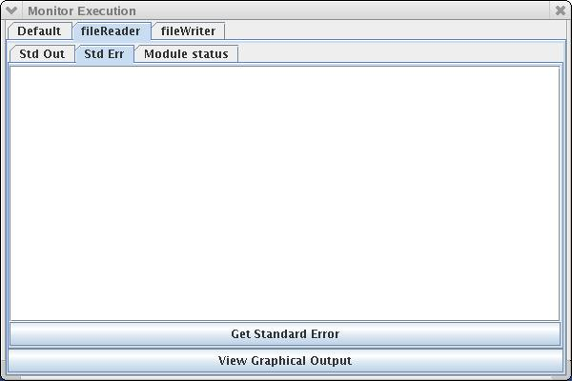
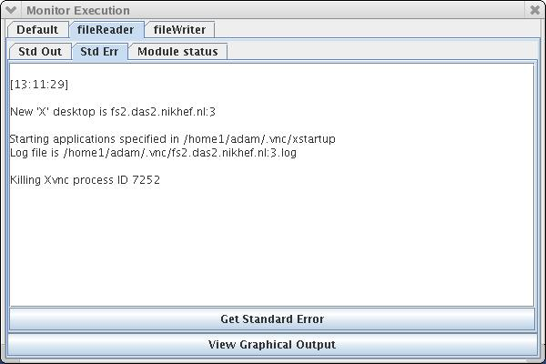
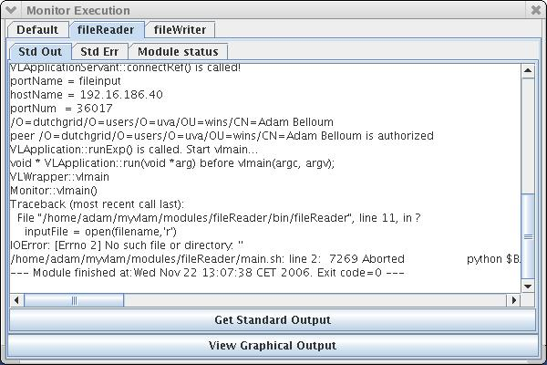
GUI features: Monitoring functions
When the user runs the experiment a monitoring window appears:
  The window has a tab for each workflow component to monitor the activity per component
  And Default tab which monitors the execution of the whole workflow
workflow components monitoring tabs are composed of 3 tabs:
    Std Out,
    Std Err,
    Module Status.
  By default the client subscribe only to the Module status event
  If the user is interested in some events he has to use the Get button at the bottom of each tab

Slide 20
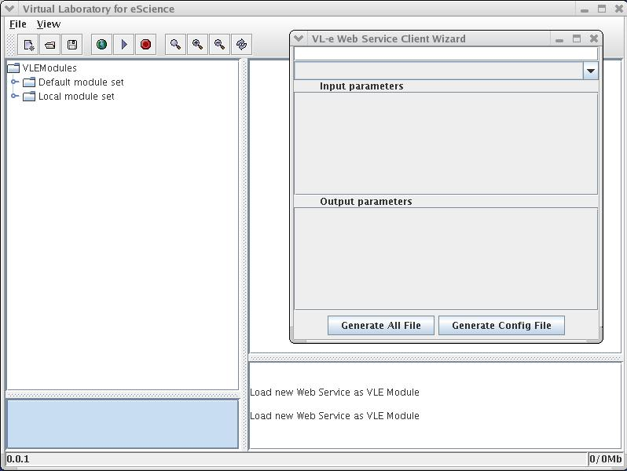
Additional Tools: web services harvester
Converting web services into workflow components
The user has to specify the URI to the WSDL of the web service

Slide 21

GUI features: composite modules
(Under development)
An application workflow can be saved one workflow component
Note:
  The users has to define the inputs, outputs ports and the parameters that should be exposed as inputs, outputs, and parameters of the composite module.
Still Under Testing and debugging

Slide 22
Additional Tools: R module generator
(Under development)
Convert annotated R script as ws-VLAM modules
The R script developer has to annotate his R scripts on before hand:
Still Under Testing and debugging

Slide 23
Additional Tools: Scan workflow component repository (Under development)
Scan workflow component repository
Still Under Testing and debugging

Slide 24
New workflow Components
(Under development)
The workflow components developed the last year, can be still used and will be deployed on the shared workflow component repository on the rapid prototyping environment
  Ridge-O-Grammar modules from (SP 1.5)
  Kansk Toolbox from (SP 1.4)
  AID web services (SP 2.2)
  Virtual file system Web service (SP 2.4)
  Generic workflow components (SP 2.5)
    File Reader/Writer,
    universal File Reader/Writer (SRB/GFTP/...)
    Demos: MRIscanner, Histogram, Floatingball
We will contact other SPs to integrate their components
    Legacy code, or fully integrated code (java, C++, Python)

Slide 25
Current deployment & validation
Current tests are performed on the rapid prototyping environment
  RTSM Service and Repository service are deployed on ds2a.das2.nikhef.nl
  ws-VLAM Client (3 MB) can be used only on ds2.das2.nikhef (because GT4 is only available on this node)
  ws-VLAM client can also be used a host where Poc R1 is installed
Tests will be performed on the validation environment for PoC R2

Slide 26
Planned tasks
Access to the ws-vlam engine from Taverna
  This will be developed in the context of a use case together with SP1.5
Access to the ws-vlam engine from Kepler
Parameter sharing among workflow components
Job farming
Support for more than one job submission mechanisms (GT4-GRAM, Direct, GAT)
Fault tolerance
Control flow
Data provenance
Semantic Service discovery

