Slide 1

RDF(S) Querying Specification
Use Cases, Specification Overview and Discussion Issues
Isao Kojima
AIST
Japan

Slide 2

OGF IPR Policies Apply
“I acknowledge that participation in this meeting is subject to the OGF Intellectual Property Policy.”
Intellectual Property Notices Note Well: All statements related to the activities of the OGF and addressed to the OGF are subject to all provisions of Appendix B of GFD-C.1, which grants to the OGF and its participants certain licenses and rights in such statements. Such statements include verbal statements in OGF meetings, as well as written and electronic communications made at any time or place, which are addressed to:
    the OGF plenary session,
    any OGF working group or portion thereof,
    the OGF Board of Directors, the GFSG, or any member thereof on behalf of the OGF,
    the ADCOM, or any member thereof on behalf of the ADCOM,
    any OGF mailing list, including any group list, or any other list functioning under OGF auspices,
    the OGF Editor or the document authoring and review process
Statements made outside of a OGF meeting, mailing list or other function, that are clearly not intended to be input to an OGF activity, group or function, are not subject to these provisions.
Excerpt from Appendix B of GFD-C.1: ”Where the OGF knows of rights, or claimed rights, the OGF secretariat shall attempt to obtain from the claimant of such rights, a written assurance that upon approval by the GFSG of the relevant OGF document(s), any party will be able to obtain the right to implement, use and distribute the technology or works when implementing, using or distributing technology based upon the specific specification(s) under openly specified, reasonable, non-discriminatory terms. The working group or research group proposing the use of the technology with respect to which the proprietary rights are claimed may assist the OGF secretariat in this effort. The results of this procedure shall not affect advancement of document, except that the GFSG may defer approval where a delay may facilitate the obtaining of such assurances. The results will, however, be recorded by the OGF Secretariat, and made available. The GFSG may also direct that a summary of the results be included in any GFD published containing the specification.”
OGF Intellectual Property Policies are adapted from the IETF Intellectual Property Policies that support the Internet Standards Process.
Notes:
This is OGF IPR Policy statements

Slide 3
Summary
Motivational Example
  Including SPARQL introduction
Strawman Document Specification Introduction
  Approach
  Resource Definition
  Query Interface
  Indirect Access Interface
Use Case
Issues
  Technical Issues
  Other Issues

Slide 4
Motivational Example
& SPARQL Introduction
WS-DAI RDF(S) Querying

Slide 5

Grid Resource Discovery Using Ontology
in our Semantic-MDS(S-MDS) prototype
GLUE
RPｓ
(Ganglia & TORQUE)
dbgrid
pentium
gneo
DG
Intel
cluster
GTRC
isa
itanium
aobe
Search computers
Where CPU type=SUN
And
belongs GTRC
ES
gt
isa
athlon
mdcc1d1
CPU
isa
ID
AMD
mdcc2d2
isa
FG
BIRC
AIST
opteron
mdcc3d3
SG
master
isa
isa
gtrc
super
SUN
genome
mdca1b1
CBRC
MF
Ultra
mdca2b2
BS
Resource Ontology
mdca3b3
VO? Ontology

Slide 6
Requirements
Ontology Handling Functions
  Computing resources, VOs, ,,,,
  Written in RDF-based representation
  Stored into some Repositories/Databases
Request is given by a Query
  RDF based Query Language = SPARQL
Need for RDF-based Ontology/Query Interface

Slide 7
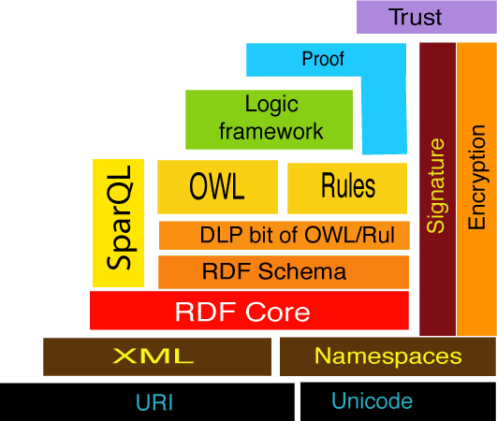
RDF (Resource Description Framework)
Common metadata/knowledge description in Semantic Web Applications
Number of RDF data is increasing
=> Support by the database technology/specs will be important
Statement:
“creator of “http://gtrc.aist.go.jp/~a.matono/ is matono”
http://gtrc.aist.go.jp/~a.matono
creator
matono
subject
predicate
object
DAIS
Next
<?xml version="1.0"?>
<rdf:RDF xmlns:rdf="http://www.w3.org/1999/02/22-rdf-syntax-ns#"
xmlns:dc="http://dublincore.org/2001/08/14/dces#">
<rdf:Description about="http://gtrc.aist.go.jp/~a.matono">
<dc:creator>matono</dc:creator>
</rdf:Description>
</rdf:RDF>
DAIS
NOW
XML-based Format
Layer Cake of the Semantic Web

Slide 8
W3C SPARQL
SQL-like Query Language for RDF graphs
  Query:
  PREFIX dc: <http://purl.org/dc/elements/1.1/>
  SELECT ?title
  WHERE { ?x dc:title ?title FILTER regex(?title, "SPARQL") }
  Data:
  @prefix dc: <http://purl.org/dc/elements/1.1/> .
  @prefix : <http://example.org/book/> .
  @prefix ns: <http://example.org/ns#> .
  :book1 dc:title "SPARQL Tutorial" .
  :book1 ns:price 42 .
  :book2 dc:title "The Semantic Web" .
  :book2 ns:price 23 .
  Query Result:
  title"SPARQL Tutorial“
Graph=a set of triples
Triple=(subject,predicate,object)

Slide 9
RPｓ
(Ganglia & TORQUE)
Grid Resource Discovery
using Ontology
GLUE
hasSemantics
dbgrid
pentium
Processor
gneo
DG
Intel
hasProcessor
MainMemory
cluster
GTRC
aobe
isa
itanium
hasMainMemory
ES
gt
Search Computers
Where CPU type=SUN
And
belongs GTRC
OS
isa
athlon
hasOS
mdcc1d1
CPU
isa
Architecture
ID
AMD
mdcc2d2
isa
FG
BIRC
AIST
opteron
mdcc3d3
FileSystem
SG
master
isa
isa
hasNetAdaptor
gtrc
super
NetAdaptor
SUN
genome
hasLoad
mdca1b1
MF
CBRC
Load
Ultra
mdca2b2
BS
Resource Ontology
mdca3b3
VO? Ontology

Slide 10
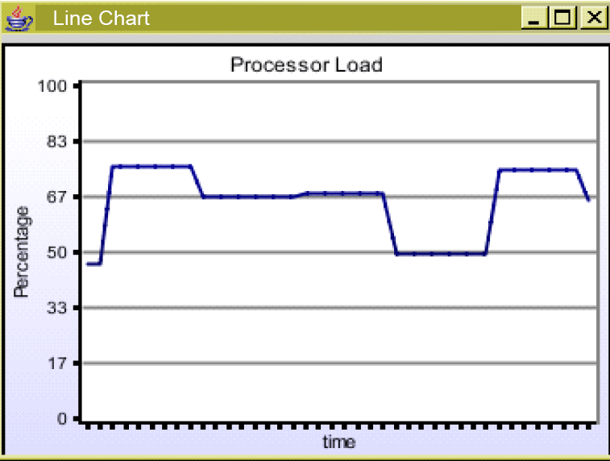
SPARQL Query (with reasoning)
hasSemantics
Processor
CPU
SELECT ?hostName, ?procLoadVal, ?ramVal
WHERE ｛
?host, glue:hasProcessorLoad, ?procLoad.
?procLoad, glue:hasProcLoad-1, ?load1.
?load1, semds:value, ?procLoadVal.
?host, glue:hasMainMemory, ?mainMemory.
?mainMemory, glue:hasRAMAvailable, ?ramAvai.
?ramAvai, semds:value, ?ramVal.
?host, glue:hasProcessor, ?proc.
?proc, semds:hasSemantics, ?procType.
?procType, rdf:type, cpu:Sun.
?host, semds:hasSemantics, ?se,
?se, rdf:type, org:GTRC｝
hasProcessor
MainMemory
Processor Load
（from GLUE)
hasMainMemory
OS
hasOS
Available RAM
（from GLUE)
Architecture
Resource
Ontology
FileSystem
AIST
hasNetAdaptor
VO? Ontology
NetAdaptor
hasLoad
Demo of our Semantic MDS(S-MDS)
which supports Continual Query
Load

Slide 11
Querying Specification Overview
WS-DAI RDF(S) Querying

Slide 12
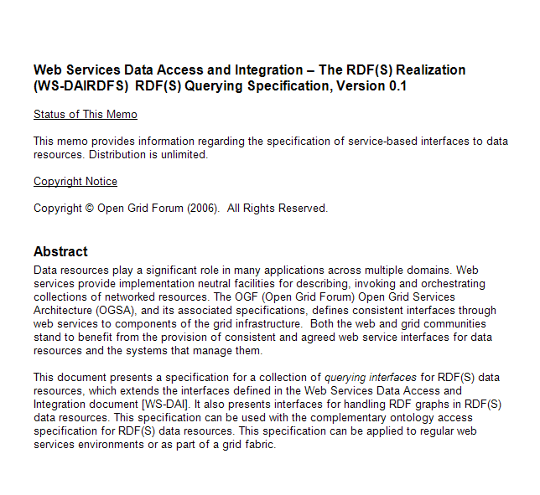
WS-DAI RDF(S) Querying
Feature:
  Focus on Instances, Not Schema.
    RDF Graph (Triples)
  Focus on Query Language, Not API.
    W3C SPARQL
Design Principle:
Minimum extension to the existing W3C standards.
  Supports W3C standards
    W3C SPARQL
    W3C SPARQL result XML format (and RDF/XML,)
    W3C SPARQL protocol for RDF (as possible)
  Supports WS-DAI core model.
    Direct and Indirect Access
  Supports Some Useful Functions
    Graph operations (including some update functions)

Slide 13
Functions Summary
 | WS-DAIR | WS-DAIX | WS-DAI-RDF(S) Querying | Note
Representation | Tables & Data Types | XML & XML Schema | RDF & RDFS
Data/Database | Table & Tuples | Collections & Docs. | Collection & Graphs | Repository? No Collection hierarchy
(Schema Handling?) | SQL | XML：:CollectionAccess | RDFS::CollectionAccess | Only for Graphs
Query Language | SQL | XPath,XQuery | W3C SPARQL
Result Set | RowSet | XML Sequence | W3C SPARQL Query Results XML Format & RDF/XML | Will Provide 2 interfaces
Update | SQL | XUpdate |  | No Update

Slide 14
Table of Contents (1)
Introduction
Notational Conventions
Terminology
  3.1 RDF(S) Data Resource
  3.2 RDF(S) Interfaces
4 RDF(S) Collection
  4.1 Static RDF(S) Collection Description
    4.1.1 RDFSCollection
    4.1.2 NumberOfGraphs
  4.2 Configurable RDF(S) Collection Description
  4.3 Example of RDFSCollectionPropertyDocument
4.4 RDFSCollectionAccess
  4.4.1 RDFSCollectionAccess::GetCollectionPropertyDocument
  4.4.2 RDFSCollectionAccess::AddGraphs
  4.4.3 RDFSCollectionAccess::GetGraphs
  4.4.4 RDFSCollectionAccess::RemoveGraphs
4.5 RDFSCollectionFactory
  4.5.1 RDFSCollectionFactory::GraphSelectionFactory
RDF(S)
Data Resource
Graph
Operations

Slide 15
Table of Contents (2)
5 SPARQL
  5.1 Static SPARQL Description
5.5 SPARQLAccess
  5.5.1 SPARQLAccess::GetSPARQLPropertyDocument
  5.5.2 SPARQLAccess::SPARQLExecute
5.6 SPARQLFactory
  5.6.1 SPARQLFactory::SPARQLExecuteFactory
6 SPARQLItemsSet
  6.1 Static SPARQLItemsSet Description
  6.1.1 NumberOfItemts
6.5 SPARQLResultsSetAccess
  6.5.1 SPARQLResultsSetAccess::GetSPARQLItemsSetPropertyDocument
  6.5.2 SPARQLResultsSetAccess::GetResults
6.6 SPARQLTriplesSetAccess
  6.6.1 SPARQLTriplesSetAccess::GetSPARQLItemsSetPropertyDocument
  6.6.2 SPARQLTriplesSetAccess::GetTriples
SPARQL
Access
Description of
Query Results
ResultsSet
Access
Triples
Access

Slide 16
  WSDLs
    See Appendixes of the document

Slide 17
RDF(S) Collection,Graphs
WS-DAI RDF(S) Querying

Slide 18
Data Resource for Querying
SPARQL requires Graph
Graph is (based on W3C definition)
  A set of Triples
  Identified by URI
RDF DataSet is defined in SPARQL specification
RDF DataSet is
  A set of Graphs including;
    One (or many?) default graph
    Zero or more NAMED graphs
Requirements
  Data resource = A set of Graphs (at least)
  No need to handle schema explicitly(form Querying viewpoint)
  No need to have hierarchical structure(at now)
  PREFIX foaf: <http://xmlns.com/foaf/0.1/>
  SELECT ?name
  FROM <http://example.org/foaf/aliceFoaf>
  WHERE { ?x foaf:name ?name }
Graph URI

Slide 19
Graph & Collection
(Definition of Collection is an issue)
Data Resource=RDFSCollection = TopLevelCollection of WS-DAIX
  No Hierachical Structure
  Holds a set of Graphs (=RDF DataSet)
  Each graph is uniquely identifed within the resource
Descriptions (PropertyDoc provides this info)
  Graph：string name which uniquely identifies an RDF graph
  NumberOfGraphs: number of graphs

Slide 20
Graph Operations (issue)
Basic Graph Operations is supported
AddGraphs
RemoveGraphs
GetGraphs
Not standard at all, but the definition is similar with Document operations of WS-DAIX
  Seems to be useful to support
GetPropertyDocument(to get a list of graphs)
GraphSelectionFactory

Slide 21
SPARQL Interface
WS-DAI RDF(S) Querying

Slide 22
SPARQL Interface
Consumer
SPARQLExecute(DataResourceAbstractName,
DatasetFormatURI
SPARQLQueryRequest)
RDF(S) Data Access Service
SPARQLAccess
SPARQLExecuteResponse(
Dataset)
Input:
  DataResourceAbstractName
  DatasetFormatURI
  SPARQLQueryRequest
Output:
  Dataset
SPARQL Description
  ExternalGraphAccess

Slide 23
DatasetFormat for SPARQL
SPARQL returns different kind of data as a result of a query.
SELECT: returns a set of data (variable bindings)
ASK : returns boolean (true/false, Match or Not)
CONSTRUCT: returns an RDF graph <rdf>……</rdf>
DESCRIBE: returns an RDF graph
For patterns 1 and 2
SPARQL Query Results XML Format is defined at W3C
  Candidate Recommendation(6 April 2006)
  WS-DAI RDF(S) Querying support this.
For patterns 3 and 4,
Use one of RDF format (like RDF/XML,or N3?)
The target format is specified within the DatasetMap parameter

Slide 24
SPARQL QueryRequest
Adopt the Same Request Pattern with W3C SPARQL Protocol
  (candidate recommendation 06 April 2006)
http://www.w3.org/2005/09/sparql-protocol-types/#quey-request
<xsd:element name="query-request">
<xsd:complexType>
<xsd:sequence>
<xsd:element minOccurs="1" maxOccurs="1" name="query" type="xs:string ">
  <xsd:annotation>
  <xsd:documentation>query is an xsd:string constrained by the language definition,
  http://www.w3.org/TR/rdf-sparql-query/#grammar, as "a sequence of characters in the
  language defined by the [SPARQL] grammar, starting with the Query production“
  </xsd:documentation>
  <xsd:annotation>
  </xsd:element>
  <xsd:element minOccurs="0" maxOccurs="unbounded" name="default-graph-uri" type="xsd:anyURI" />
  <xsd:element minOccurs="0" maxOccurs="unbounded" name="named-graph-uri" type="xsd:anyURI" /> </xsd:sequence>
  </xsd:complexType>
  </xsd:element＞
Query String
Graph URIs

Slide 25
Description:External Graph Access
Q1:PREFIX bio: <http://bio.example/schema/#>
SELECT ?valence
FROM <http://another.example/protein-db.rdf>
WHERE { ?x bio:protein ?valence }
ORDER BY ?valence
Query Service which supports
external access
Error handlings
Etc.
Client
http://www.example.org/sparql
http://another.example/
Issue: Do we need to have this kind of Flag explicitly?

Slide 26
Query Result Access
WS-DAI RDF(S) Querying

Slide 27
ResultsSet Access Example
Similar structure with WS-DAIR,DAIX
Consumer
RDFS
Data Access Service
SPARQLExecuteFactory (
DataResourceAbstractName,
PortTypeQName,
ConfigurationDocument,
SPARQLQueryRequest )
SPARQLAccess
Description
SPARQLFactory
Reference to SPARQL Query Results
SPARQLItemsSet
Data Access Service
SPARQLItemsSetDescription
GetResults(StartPosition,
ResultCounts )
SPARQLResultsSetAccess
Results

Slide 28
Access Interfaces for
SPARQL Query Results
SPARQL returns
  A set of triples(=graph) for Construct/Describe
  A set of bindings for Select
  Similar structure with Rowset and XMLSequence of WS-DAIR/X
Difference
  2 types of data format => 2 Interfaces
  One Data Description (ItemsSet)
Common Data Description
SPARQLItemsSet (for generic query results)
  Number of Items(Number of bindings or Number of Triples)
Access Interfaces (This is an issue whether we should have two)
ResultsSet Interface for Select/Ask(SPARQL/XML Format)
  Get one(or many) binding from a result Set
TriplesSet Interface for Construct/Describe(RDF Format)
  Get one(or many) Triple from a result graph

Slide 29
SPARQL ResultsSet Access
RDFS Data Service
Consumer
SPARQLItemsSet
Description
GetResults( DataResourceAbstractName
DatasetFormatURI,
StartPosition,
ResultCount)
SPARQLResultsSetAccess
GetResultsResponse(Dataset)
<?xml version="1.0"?>
<sparql xmlns="http://www.w3.org/2005/sparql-results#">
<head> ….</head>
<results ordered="false" distinct="false">
  <result>
    <binding name="x"> ... </binding>
    <binding name="hpage"> ... </binding>
  </result> ..
  <result>
    <binding name="x"> ... </binding>
    <binding name="hpage"> ... </binding>
  </result>
</results>
</sparql>
Startposition
&
ResultCount

Slide 30
SPARQL TripleSetsAccess
Same Structure
Get triple(s) from the graph
RDFS Data Service
Consumer
SPARQLItemsSet
Description
GetTriples( DataResourceAbstractName
DatasetFormatURI,
StartPosition,
ResultCount)
SPARQLTriplesSetAccess
GetTriplesResponse(Dataset)
Notes:
.

Slide 31
Use Case Example
WS-DAI RDF(S) Querying
Notes:
Use case example

Slide 32
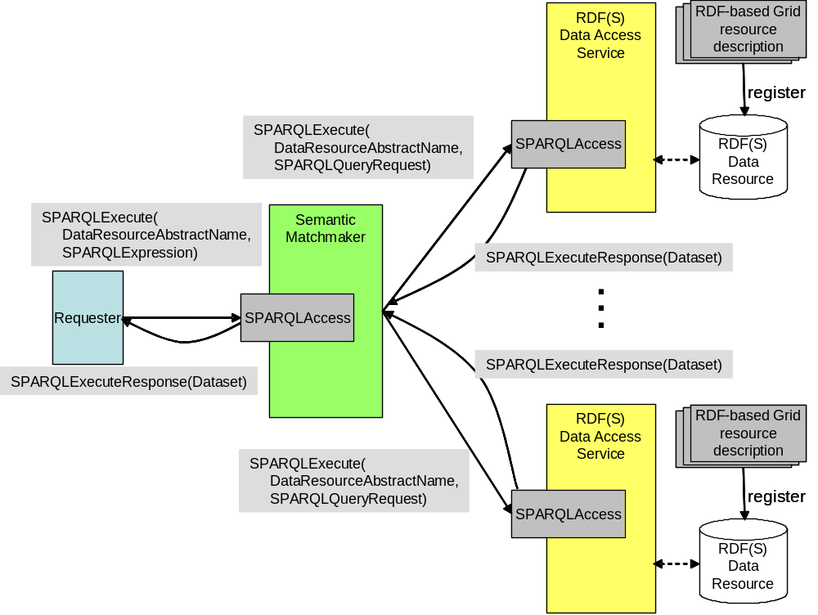
Use Case Example
Semantic matchmaking using SPARQL
Plan to include some
use cases into the strawman (issue)
Not suitable for spec doc but useful for the discussion

Slide 33
Issues
WS-DAI RDF(S) Querying

Slide 34
Document Status and ToDos
Document on the forge
Next Version:
Reflect the Discussion of this Session
Working Items
Fix some errors
Issues section (Appendix?) will be added.
  (result of the last telcon-> some of them will be presented later)
Some example usecases to show our motivation will be added. (Appendix?)
(All Use cases will be added to the motivational documents)
Some enhancements might be added
  Based on the feedbacks from OGSA-DAI-RDF in development

Slide 35
Issues(1)
Harmonize with Ontology Spec
Repository = Graph?
  ○ A set of triples
  × The word “Graph” is used corresponding W3C standards
  × Graph should be identified with URI.
      W3C spec requirement
    Repository is not?
      EPR?
Other Terms?
Single Namespace?
Functional Overlap?
Many issues to do,,,,

Slide 36
Issues(2)
Out of Scope of current Querying Spec.
No Update Language
  No standard Update language for RDF now
No Schema (only Graphs)
  Will be supported by Ontology spec.
No Reasoning Functions
  Out of the scope of the language

Slide 37
Issues (3) Inside the Query Spec.
2 types of interface for one itemsSet
  Should we merge into one?
External resource flag is introduced.
  Is this really useful for us?
Graph operations are introduced.
  Only for graphs, Not for triples
  Includes Update functions
Graph must be identified with URI.
  W3C spec requirements and is it OK?
    EPR?WSA?

Slide 38
Issues(4) W3C standards
We must support these standards as possible
SPARQL
  No direct relationship at now.
SPARQL result set XML
  WS-DAI supports this as a standard data format.
SPARQL protocol for RDF
  To be upward compatible
  Might cause some mismatch
    Errors, Return format,,,,

Slide 39
Other Issue : Enlarge the Community
Need to have more authors/contributors.
  Announced DAIS-WG and Semantic Grid RG
  Current response is not so good.
  Still need to advertise this activity.
  To? How?
Appeal to wider audience
Application within the Grid
  Grid Information Management/Resource Discovery Scenario
W3C DAWG?
  How?

Slide 40
Discussions?

Slide 41
Memo

