Slide 1

WS-DAI RDF(S) Realization
OGF20 DAIS Working Group

Slide 2

OGF IPR Policies Apply
“I acknowledge that participation in this meeting is subject to the OGF Intellectual Property Policy.”
Intellectual Property Notices Note Well: All statements related to the activities of the OGF and addressed to the OGF are subject to all provisions of Appendix B of GFD-C.1, which grants to the OGF and its participants certain licenses and rights in such statements. Such statements include verbal statements in OGF meetings, as well as written and electronic communications made at any time or place, which are addressed to:
    the OGF plenary session,
    any OGF working group or portion thereof,
    the OGF Board of Directors, the GFSG, or any member thereof on behalf of the OGF,
    the ADCOM, or any member thereof on behalf of the ADCOM,
    any OGF mailing list, including any group list, or any other list functioning under OGF auspices,
    the OGF Editor or the document authoring and review process
Statements made outside of a OGF meeting, mailing list or other function, that are clearly not intended to be input to an OGF activity, group or function, are not subject to these provisions.
Excerpt from Appendix B of GFD-C.1: ”Where the OGF knows of rights, or claimed rights, the OGF secretariat shall attempt to obtain from the claimant of such rights, a written assurance that upon approval by the GFSG of the relevant OGF document(s), any party will be able to obtain the right to implement, use and distribute the technology or works when implementing, using or distributing technology based upon the specific specification(s) under openly specified, reasonable, non-discriminatory terms. The working group or research group proposing the use of the technology with respect to which the proprietary rights are claimed may assist the OGF secretariat in this effort. The results of this procedure shall not affect advancement of document, except that the GFSG may defer approval where a delay may facilitate the obtaining of such assurances. The results will, however, be recorded by the OGF Secretariat, and made available. The GFSG may also direct that a summary of the results be included in any GFD published containing the specification.”
OGF Intellectual Property Policies are adapted from the IETF Intellectual Property Policies that support the Internet Standards Process.

Slide 3
Agenda
WS-DAI-RDF(S) Introduction (Isao)
Specification Introduction, Updates and Issues
  WS-DAI RDF(S) Querying Specification
  (Said and Isao)
  WS-DAI RDF(S) Ontology Access Specification (Oscar)
  Glossary of Terms （Oscar)
Discussion

Slide 4
WS-DAI RDF(S) Introduction
DAIS Working Group
Isao Kojima
Grid Technology Research Center
AIST
Japan

Slide 5
WS-DAI RDF(S) proposal
Sets general pattern for realisations
WS-DAI
Extensions for specific kinds of data resource
Possible Future Realisations
WS-DAIR
WS-DAIX
WS-DAI-RDF(S)
Relational
SQL
XML
XQuery/XPath
SPARQL,
Ontology Ops

Slide 6
Motivation: Semantic Web and Grid Computing (for other motivations, please read the motivational document)
Grid Computing: Beyond XML
Grid Applications and Infrastructure will use Semantic Web technology
    Ontology, Inference/Reasoning, etc
Example: Semantically enhanced Grid Resource Discovery
      (presented later in this session)
  Use of Ontology and Inference for discovering/monitoring grid resources
    Resource description format: not XML, but RDF
    Resource discovery language: not Xpath, but SPARQL
  Semantic Web technology is mainly based on RDF-based format
    RDF, RDF Schema, OWL,OWL-S, SPARQL,,,,,
  Current Grid standard is mostly based on XML-based format.
    XMLSchema, Xpath, XQuery etc.
Grid Infrastructure should support RDF-based format
  If you want to use semantic web technology within grid applications

Slide 7
Motivation: Semantic Web and Grid Computing
Semantic Web : Need to achieve Scalability
Semantic Web applications and Tools should achieve Scalability as application grows.
Example: Large scale Distributed RDF data for ubiquitous ID tag
      （also presented later in this session)
  Each ID tag is associated with various semantic information described with RDF
  Number of RDF data is huge and created in the distributed environment
    Distributed RDF databases
    Terabyte scale of RDF storage
For large scale semantic/RDF applications,
Grid-based scalable & distributed RDF storage is necessary.

Slide 8
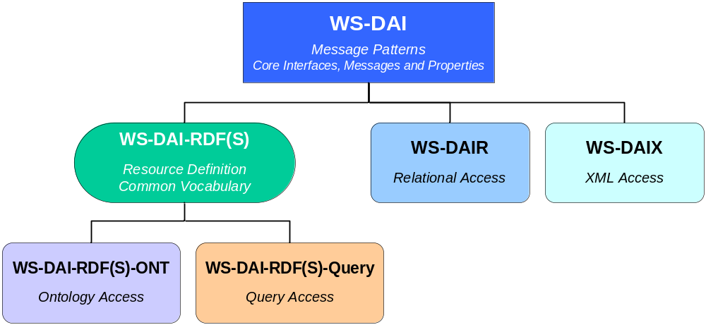
WS-DAI-RDF(S) Standard Structure
What is all about?
  Providing an access mechanism to RDF(S) data resources
New WS-DAI realization for RDF(S) databases
    which will consist of 2 complementary specifications
  RDF(S) Ontology Access
    Ontological Primitives based on RDF(S) model(as Class)
  RDF(S) Querying
    Query Language(SPARQL) for Instances
Alternative, but not exclusive!
Use either or both
according to your needs

Slide 9
DAIS for RDF: History
2006.02: GGF16 at Athens
  DAIS for RDF BOF: Share the Motivation
2006.05: GGF17 at Tokyo
  Charter Discussion
  Focus on RDF and RDF Schema (RDF(S))
  Scope/Roadmap/Deliverables
2006.06: RDF F2F at Edinburgh
  Decide to make an informational document
    Motivational Document : Structure Discussion
2006.09: GGF18 at Washington
  Motivational Doc Presented
2007.02：OGF19 at Chapel Hill, NC
  2 initial Specification Documents Presented

Slide 10
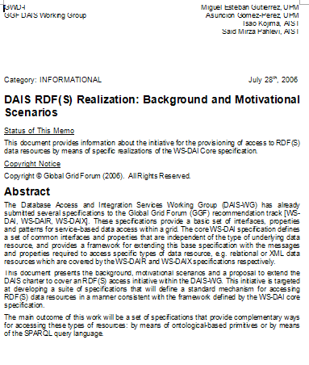
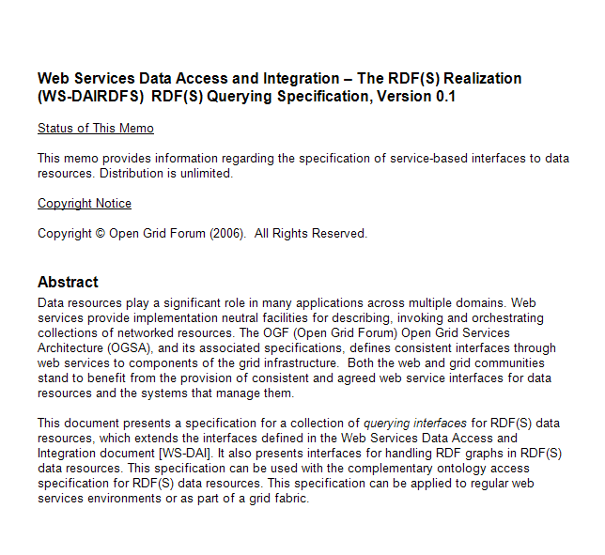
Current Documents
3 documents are on the forge
Background & Motivational Scenarios
Initial Specs for
Querying
Ontology
Please download and have a look

Slide 11
Progress after OGF19
Progress after OGF19 is not large
  Revised version is not on the forge
Periodical Telcons
  Document Process Discussion
    Need of “Common Glossary of Terminology”
      To read both specifications
      -> Will be discussed later
    Need to have more “Use Cases”
      To enhance motivational doc.
      -> Some will be presented later.
  How to increase the awareness of the activity
    To get more Comments, Feedbacks, Interests, Use Cases, Volunteers, etc.,,
Specification Docs updates
    -> Will be discussed here

Slide 12
Document Issues
Background & Scenario Document
  More Use Cases wanted
    Grid based application for RDF databases
    RDF Query & Ontology processing
Specification Documents
  Ontology: Still needs to be improved.
        WSDL seems to be stable
  Querying: Almost stable with WSDL (from AIST point of view)
Any contributions are welcome
  Comments, Functional Requirements and Feedbacks to the Documents

Slide 13
WS-DAI RDF(S) Querying
DAIS Working Group
Said Mirza Pahlevi & Isao Kojima
Grid Technology Research Center
AIST
Japan

Slide 14
Outline
Motivation & Aim of this presentation
  Document Status & Update
Document Specification Introduction
Current Use Cases
Issues

Slide 15
Motivation & Document Status
WS-DAI RDF(S) Querying

Slide 16
Motivation
Why do we need the query specification?
  There are many Semantic Grid projects
    The projects handle a large amount of RDF data
    The need to access and integrate the data in a standard grid-based interface with some QUERY LANGUAGE.
Why not only W3C SPARQL specifications?
  Query language, results XML Format & protocol
  No grid specific functions
    No factory access pattern
    No stateful Web service concept
    RDF data collection management
Extend the DAIS spec. by incorporating some parts of the SPARQL specifications

Slide 17
SPARQL as a Query Language
WS-DAIX
standard query language
XQuery
WS-DAIR
standard query language
SQL
WS-DAI-RDF
“standard” query language
SPARQL
W3C working draft
More than 20 query engine implementations
  (http://esw.w3.org/topic/SparqlImplementations)

Slide 18
WS-DAI RDF(S) Querying
(No change from GGF19)
Feature:
  Focus to Instances, Not Schema.
    RDF Graph (Triples)
  Focus to Query Language, Not API.
    W3C SPARQL
Design Principle:
Minimum extension /modification
to the existing W3C standards and WS-DAI core
  Supports W3C standards
    W3C SPARQL
    W3C SPARQL result XML format (and RDF/XML,)
    W3C SPARQL protocol for RDF (as possible)
  Supports WS-DAI core model.
    Direct and Indirect Access
  Supports Some Useful Functions
    Graph operations (including some update functions)

Slide 19
Table of Contents (1)
(No change from OGF19)
Introduction
Notational Conventions
Terminology
  3.1 RDF(S) Data Resource
  3.2 RDF(S) Interfaces
4 RDF(S) Collection
  4.1 Static RDF(S) Collection Description
    4.1.1 RDFSCollection
    4.1.2 NumberOfGraphs
  4.2 Configurable RDF(S) Collection Description
  4.3 Example of RDFSCollectionPropertyDocument
4.4 RDFSCollectionAccess
  4.4.1 RDFSCollectionAccess::GetCollectionPropertyDocument
  4.4.2 RDFSCollectionAccess::AddGraphs
  4.4.3 RDFSCollectionAccess::GetGraphs
  4.4.4 RDFSCollectionAccess::RemoveGraphs
4.5 RDFSCollectionFactory
  4.5.1 RDFSCollectionFactory::GraphSelectionFactory
RDF(S)
Data Resource
Graph
Operations

Slide 20
Table of Contents (2)
(No change from GGF19)
5 SPARQL
  5.1 Static SPARQL Description
5.5 SPARQLAccess
  5.5.1 SPARQLAccess::GetSPARQLPropertyDocument
  5.5.2 SPARQLAccess::SPARQLExecute
5.6 SPARQLFactory
  5.6.1 SPARQLFactory::SPARQLExecuteFactory
6 SPARQLItemsSet
  6.1 Static SPARQLItemsSet Description
  6.1.1 NumberOfItemts
6.5 SPARQLResultsSetAccess
  6.5.1 SPARQLResultsSetAccess::GetSPARQLItemsSetPropertyDocument
  6.5.2 SPARQLResultsSetAccess::GetResults
6.6 SPARQLTriplesSetAccess
  6.6.1 SPARQLTriplesSetAccess::GetSPARQLItemsSetPropertyDocument
  6.6.2 SPARQLTriplesSetAccess::GetTriples
SPARQL
Access
Description of
Query Results
ResultsSet
Access
Triples
Access

Slide 21
  WSDLs
    Presented in the Appendix of the doc.
    Almost stable as an initial version

Slide 22
Document Status Update
Only one major change from OGF19
GraphName(string) -> GraphNameURI(URI) (type change)
  This will be discussed in the “Issues” section
However, we could not get so many feedbacks and comments.
  Alt least the doc skeleton structure seems to be OK from AIST point of view.
  We think we need to have as many feedbacks to this initial spec.
Working Item: We will attach the another Appendix sections including
  Use Cases Section
  Issues Section
  These sections are not included in the final specification document, however, we think it will be useful to appeal to a wider audiences.
    as advised at Telcon

Slide 23
Querying Specification Overview
WS-DAI RDF(S) Querying
Basically, the spec is unchanged from OGF19

Slide 24
RDF(S) Data Resource for Querying
(Definition of Collection is an issue)
Data Resource=RDFSCollection = TopLevelCollection of WS-DAIX
  No Hierachical Structure
  Holds a set of Graphs (=RDF DataSet)
  Each graph is uniquely identifed by URI
SPARQL requires Graph
Graph is (based on W3C definition)
  IA set of Triples
  Identified by URI
RDF DataSet is defined in SPARQL specification
RDF DataSet is
  A set of Graphs including;
    One (or many?) default graph
    Zero or more NAMED graphs
  PREFIX foaf: <http://xmlns.com/foaf/0.1/>
  SELECT ?name
  FROM <http://example.org/foaf/aliceFoaf>
  WHERE { ?x foaf:name ?name }
GraphName
URI

Slide 25
Graph Operations (issue)
Basic Graph Operations is supported
AddGraphs
RemoveGraphs
GetGraphs
Not standard at all, but these definitions are similar with Document operations of WS-DAIX
  Seems to be useful to support
GetPropertyDocument(to get a list of graphs)
GraphSelectionFactory

Slide 26
SPARQL Interface
Same Pattern with WS-DAIR(SQL) and DAIX(Xpath/XQuery)
Consumer
SPARQLExecute(DataResourceAbstractName,
DatasetFormatURI
SPARQLQueryRequest)
RDF(S) Data Access Service
SPARQLAccess
SPARQLExecuteResponse(
Dataset)
Input:
  DataResourceAbstractName
  DatasetFormatURI
  SPARQLQueryRequest
Output:
  Dataset with
    W3C SPARQL QueryResult Format, or
    RDF Format
SPARQL Description
  ExternalGraphAccess

Slide 27
Indirect Access
Similar structure with WS-DAIR,DAIX
Consumer
RDFS
Data Access Service
SPARQLExecuteFactory (
DataResourceAbstractName,
PortTypeQName,
ConfigurationDocument,
SPARQLQueryRequest )
SPARQLAccess
Description
SPARQLFactory
Reference to SPARQL Query Results
SPARQLItemsSet
Data Access Service
SPARQLItemsSetDescription
GetResults(StartPosition,
ResultCounts )
SPARQLResultsSetAccess
Results

Slide 28
Difference with WS-DAIR,DAIX
SPARQL returns
  A set of triples(=graph) for Construct/Describe
  A set of bindings for Select
  Similar structure with Rowset and XMLSequence of WS-DAIR/X
Difference
  2 types of data format => 2 Interfaces
  One Data Description (ItemsSet)
Common Data Description
SPARQLItemsSet (for generic query results)
  Number of Items(Number of bindings or Number of Triples)
Access Interfaces (This is an issue whether we should have two)
ResultsSet Interface for Select/Ask(SPARQL/XML Format)
  Get one(or many) binding(s) from a result Set
TriplesSet Interface for Construct/Describe(RDF Format)
  Get one(or many) Triple(s) from a result graph

Slide 29
SPARQL ResultsSet Access
RDFS Data Service
Consumer
SPARQLItemsSet
Description
GetResults( DataResourceAbstractName
DatasetFormatURI,
StartPosition,
ResultCount)
SPARQLResultsSetAccess
GetResultsResponse(Dataset)
<?xml version="1.0"?>
<sparql xmlns="http://www.w3.org/2005/sparql-results#">
<head> ….</head>
<results ordered="false" distinct="false">
  <result>
    <binding name="x"> ... </binding>
    <binding name="hpage"> ... </binding>
  </result> ..
  <result>
    <binding name="x"> ... </binding>
    <binding name="hpage"> ... </binding>
  </result>
</results>
</sparql>
Startposition
&
ResultCount

Slide 30
SPARQL TripleSetsAccess
Same Structure
Get triple(s) from the graph
RDFS Data Service
Consumer
SPARQLItemsSet
Description
GetTriples( DataResourceAbstractName
DatasetFormatURI,
StartPosition,
ResultCount)
SPARQLTriplesSetAccess
GetTriplesResponse(Dataset)

Slide 31
Use Case Examples
WS-DAI RDF(S) Querying

Slide 32
Outline
Semantic matchmaking of Grid resources
RDF data snapshot
Large scale distributed RDF storage
Federated SPARQL query processing

Slide 33
Semantic Matchmaking of Grid Resources

Slide 34
Grid Resource Matching
Motivation:
  Works describing Grid resources/services using RDF/OWL
    S-MDS, Said et al., OMM, Tangmunarunkit et al.
  The need for accessing various RDF-based resource descriptions and matching resources
Goal:
  Semantic Grid resource matching using SPARQL

Slide 35
S-MDS
Provides a mechanism to map a resource property (RP) into ontology and to aggregate and maintain the mapping results
mapping
RDF
data
WS
RP
RDF
data
WS
RDF
DB
RP
…
RDF
data
WS
RP

Slide 36

Data Grid Cluster
(Ganglia, Torque & Gram)
GRAM RP Mapping
<Host Name="dbgrid.x.x" UniqueID="dbgrid.x.x">
<Processor CacheL1="0" CacheL1D="0" CacheL1I="0"
CacheL2="0" ClockSpeed="3001" InstructionSet="x86"/>
<MainMemory RAMAvailable="19" RAMSize="1484"
VirtualAvailable="332" VirtualSize="2041"/>
<OperatingSystem Name="Linux"
Release="2.6.0-test5_2smp"/>
<Architecture SMPSize="2"/>
<FileSystem AvailableSpace="65511" Name="entire"
ReadOnly="false" Root="/" Size="82459"/>
<NetworkAdapter IPAddress="163.220.2.54"
InboundIP="true" MTU="0" Name="dbgrid.hpcc.jp"
OutboundIP="true"/>
<ProcessorLoad Last15Min="10" Last1Min="6"
Last5Min="8"/>
</Host>
dbgrid
pentium
<processor> Element Mapping
gneo
DG
Intel
<host> Element Mapping
cluster
GTRC
aobe
isa
itanium
ES
gtrc1
isa
athlon
mdcc1d1
isa
ID
CPU
AMD
mdcc2d2
isa
FG
BIRC
AIST
opteron
mdcc3d3
SG
master
isa
isa
gtrc2
super
genome
Sun
mdca1b1
MF
CBRC
Ultra
mdca2b2
BS
CPU Ontology
AIST Ontology
mdca3b3
GRAM Resource Property

Slide 37
Grid Resource Matching
RDF
DB
RDF(S) Data Access Service
Response
SPARQLAccess
SPARQLExecute()
.
.
.
Matchmaker/
Client
RDF(S) Data Access Service
SPARQLExecute()
Result ordering
Set-matching
Resource monitoring
SPARQLAccess
Response
RDF
DB

Slide 38
RDF Data Snapshot

Slide 39
RDF Data Snapshot
Motivation:
  Dynamic RDF data
    Processor load and available memory
    Road traffic and weather information
  The need to obtain a data snapshot of a certain time point
Goal:
  Providing an RDF data snapshot

Slide 40
RDF Data Snapshot
RDF
DB
RDF(S)
Data Access Service
EPR
SPARQLFactory
SPARQLExecuteFactory()
RDF graph
(set of triples)
Consumer
GetTriples()
SPARQLTripleSetAccess
Response
SPARQLResponse
Data Access Service

Slide 41
Large Scale Distributed RDF Storage

Slide 42

Large Scale Distributed RDF Storage
dc:creator
A farm
rdf:type
Motivation
  Ucode: Ubiquitous Code
    Has 128 bit code for identifying ubiquitous object
    Uses in RFID tag applications
    Has RDF as the information model (DC, FOAF etc.)
  A huge distributed RDF data
  SPARQL for UCode resolution
Goal
  Provide a scalable distributed RDF storage that supports SPARQL
geo:spacialThing
tomato
B Shop

Slide 43




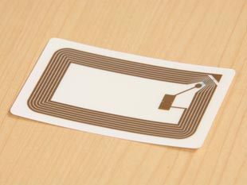





Large Scale Distributed RDF Storage
RDA: RDF(S) Data Access
SPARQL
Distributed
Processing
The Grid
ucode
RDF-DB
ucode
RDF-DB
RFID
RDA
RDA
ucode
RDF-DB
ucode
RDF-DB
RDA
RDA
RFID
RFID
RFID
RFID
RFID
RFID

Slide 44
Federated SPARQL Query Processing

Slide 45
Federated SPARQL Query Processing
Motivation
  RDF data is created in bottom-up manner
    Distributed RDF repositories
  Managed by an RDF software/tool that supports SPARQL (e.g., Jena, Sesame, and Boca)
    Heterogeneous Platform
  Data in different repositories may be relevant to each other
    FOAF
Goal
  Enabling SPARQL query over distributed RDF repositories that joins the RDF data

Slide 46
Federated SPARQL Query Processing
WS-DAI
RDF(S)-Query
SPARQLExecute()
SPARQLExecute()
WS-DAI-RDF(S)-Query
Jena
SPARQLExecuteResponse
SPARQLExecute
Response(Dataset)
SPARQL Compiler ,
Scheduler & Optimizer
SPARQLExecute()
AddGraph()
AddGraph()
SPARQL
Execute()
SPARQL
Execute
Response
SPARQLExecuteResponse
WS-DAI
RDF(S)-Query
WS-DAI-RDF(S)-Query
Sesame
Temporary RDF Repository for
Distributed Query Processing

Slide 47
Appendix

Slide 48
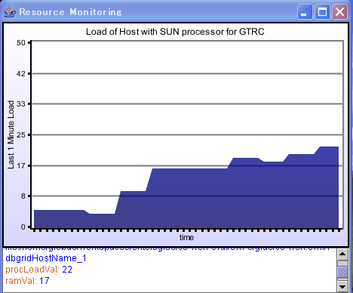

Monitoring Client
Data Grid Cluster (Ganglia & TORQUE)
dbgrid
GRAM
GT4
p09cmp000
Register
&
Update
p09cmp001
gt3
SMP
p09cmp002
Register
&
Update
p09cmp003
p09cmp004
SMR
Jena
inference
engine
p09cmp005
gtrc
SPARQL
p09cmp006
p09cmp007
m00cmp109
Client

Slide 49
Issues
WS-DAI-RDF(S) Querying

Slide 50
Issues(1)
Harmonize with Ontology Spec
Terminology
  We should unify the terminology list to read both specs.
  Initial “Glossary of Terms” is just given by UPM.
    This covers most of the terms used for the specs.
    Should be put on the forge after adding some terms.(will be discussed later)
Correspondence of Terms between 2 specs.
  Most of the terms used within 2 specs seems to have no overlap
  since these specs cover separate point of views.
  (Ont) Repository Resource ?=? (Query) Collection = Set of Graphs with URI
Single Namespace?
Functional Overlap?

Slide 51
Issues(2) (these are the same with OGF19)
Out of Scope of the current Querying Spec.
No Update Language
  No standard Update language for RDF now
No Schema Support (only Graphs and Triples)
  Will be supported by Ontology spec.
No Reasoning Functions
  Out of the scope of the language

Slide 52
Issues (3) (these are the same with OGF19)
Inside the Query Spec.
Two types of interface for one itemsSet is defined
  Depends on the Result format
    RDF/XML: TriplesSet
    SPARQL/XML: ResultsSet
External resource flag is introduced.
        (please see the document if you interested)
  Is this really useful?
Graph operations are introduced.
  Only for graphs, Not for triples
  Includes Update functions

Slide 53
GraphName->GraphNameURI
(which is different from OGF19 version)
Most Important Issue in this Spec
Current: GraphName(string type)
  Graph Identity = EPR with GraphName
W3C Standards:
  Graph Identity=URI
Change: (GraphName => GraphnameURI)
  Graph Identity = EPR with GraphNameURI
Note:
  EPR must cope with URI
  Uniqueness of the GraphNameURI must be supported.
    (These will be the responsibility of the implementation)
  String name alias is not defined. (currently)

Slide 54
Issues(4) W3C standards
(They are the same with OGF19)
We must support these standards as possible
SPARQL
  No direct relationship at now.
SPARQL result set XML
  WS-DAI supports this as a standard data format.
SPARQL protocol for RDF
  To be upward compatible
  Might cause some mismatch
    Errors, Return format,,,,

Slide 55
Other Issue : Enlarge the Community
Need to have more authors/contributors.
  Announced DAIS-WG and Semantic Grid RG
  Current response is not so good.
  Still need to advertise this activity.
  To? How?
Appeal to wider audience
  After the release of the Next version of the Docment
W3C DAWG

